Slide 1
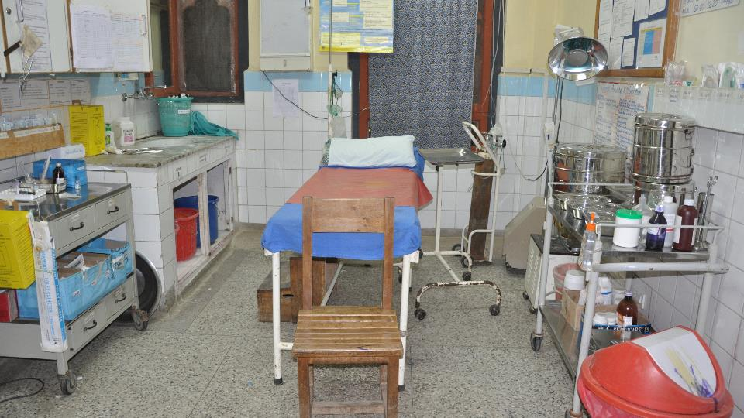
WASH in health care facilities for preventing COVID-19
Session 4 (28 April 2020):
Environmental cleaning

Slide 2

Introduction to environmental cleaning during COVID-19 outbreak
MARIA CLARA PADOVEZE, RN, MsC, PhD
IPC Expert – WHO Technical Officer
IPC Technical and Clinical Hub, WHO
Thanks for Alice Simniceanu, MPH, CIC, IPC Consultant

Slide 3
Goals of Infection Prevention and Control
Protecting yourself
Protecting your family & community
Protecting your patients
WHO2015 Safe & Quality Health Services Package
Notes:
Proper adherence to standard infection prevention and control practices can help to protect you, as the health care worker, your patients and ultimately, your family and community,

Slide 4
What is a coronavirus?
Coronaviruses (CoV) are a large family of viruses that cause a wide range of illness from the common cold to more severe diseases
  i.e., Middle East Respiratory Syndrome [MERS] and Severe Acute Respiratory Syndrome [SARS]
The novel coronavirus (SARS-CoV-2) is a new strain that has not been previously identified in humans.

Slide 5
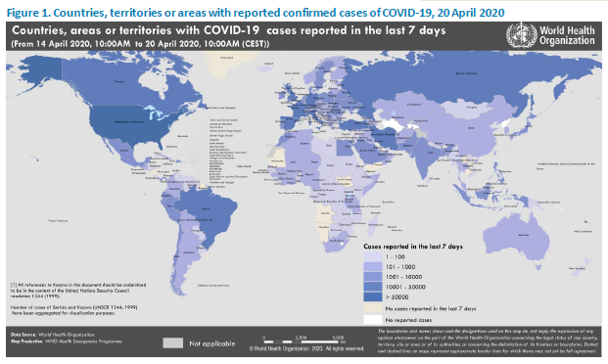
Countries affected (19-04-2020)
https://www.who.int/emergencies/diseases/novel-coronavirus-2019/situation-reports/

Slide 6
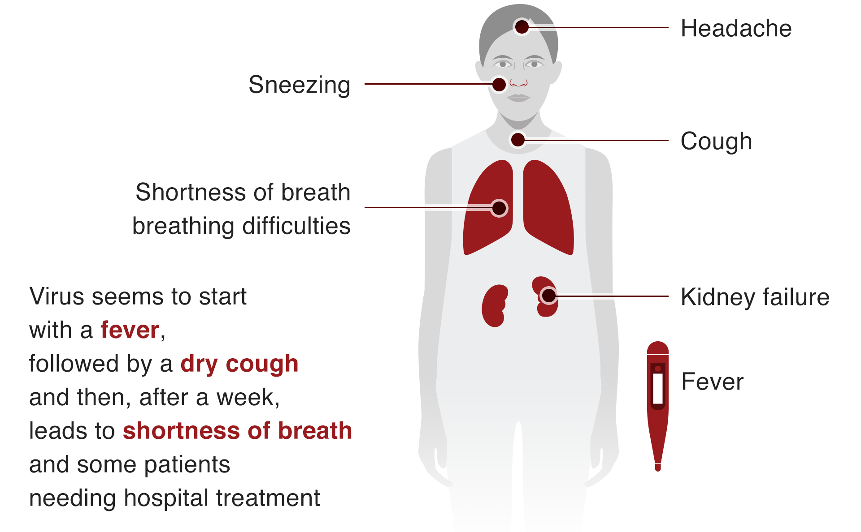
COVID-19 signs and symptoms
Illness seems to start
Notes:
Source: WHO https://www.bbc.com/news/world-51235105

Slide 7
Mode of transmission:
Droplet:
Respiratory droplets are generated when an infected person coughs or sneezes. Any person who is in close contact (within 1 m) with someone who has respiratory symptoms (coughing, sneezing) is at risk of being exposed to potentially infective respiratory droplets.
Contact:
Droplets may also land on surfaces where the virus could remain viable; thus, the immediate environment of an infected individual can serve as a source of transmission (contact transmission).

Slide 8
Aerosol Generating Procedures

Slide 9
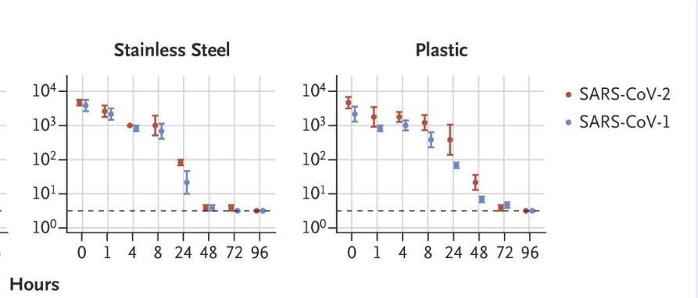
What do we know about environmental survival?
Many clinically important healthcare pathogens can survive on surfaces for days to possibly months
Laboratory-based studies (see table):
  Actual survival based on temperature, humidity, surface type and other factors
SARS-CoV-2 (laboratory studies):
  2-7 days (wood 2 days; plastic and stainless steel 7 days) (Chin et al, 2020)
  ~ 4 days (plastic and stainless steel) (van Doremalen et al, 2020)
(Dancer, 2014 adapted from Kramer, 2006)
(van Doremalen et al, 2020)

Slide 10
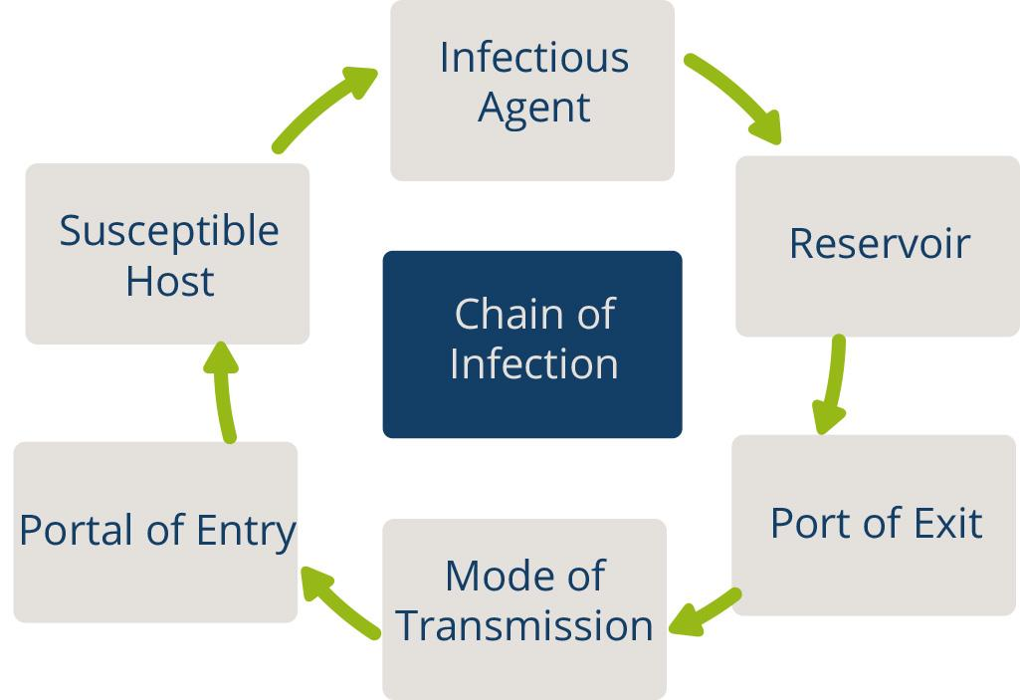
Chain of Transmission
For an infection to spread, all links must be connected
Breaking any one link, will stop disease transmission!
Notes:
An infection occurs when a microorganism enters the body, increases in number, and damages tissues in the body. The diagram represents the chain of infection. For any infection to spread, all steps in the chain must occur. The key to stopping the spread of infection is to break at least one link within the chain.

Slide 11
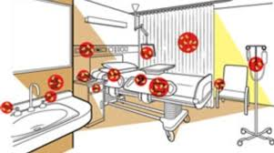
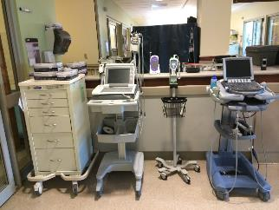
Environmental cleaning in health care
Cleaning and disinfection (when needed based on risk) of environmental surfaces and non-critical patient care equipment
Environmental surfaces include:
  Tables, chairs, floors, walls, bedrails, light switches
Non-critical patient care equipment means:
  Comes into contact with intact skin only (not mucous membranes, for example)
  Examples in a clinical setting: IV poles, blood pressure monitors, stethoscopes, mobile computers and workstations, incubators, wheelchairs
Emphasis is always on surfaces that are frequently touched by HCWs and/or patients “high-touch surfaces”

Slide 12
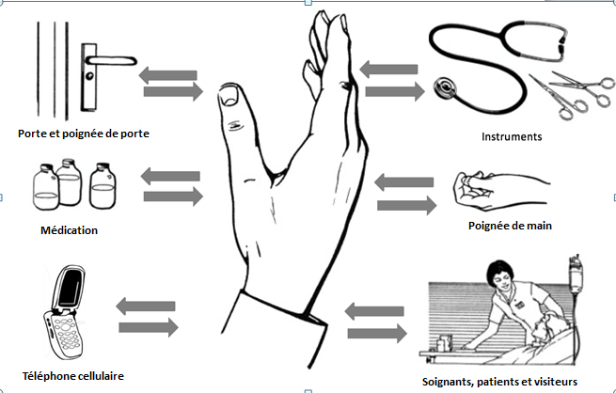
Hand Hygiene
Best way to prevent the spread of germs in the health care setting and community
Our hands are our main tool for work as health care workers- and they are the key link in the chain of transmission
Door handles
Instruments
Medication
Cellphones
Caregivers
Notes:
Why is hand hygiene important? Studies have shown that the best way to prevent the spread of germs (micro-organisms) in health care settings and in your community is through good hand hygiene practices.
Up to 30% of health care infections are preventable, many through proper hand hygiene.
Good hand hygiene protects you, your patients and your co- workers

Slide 13
Key messages for environmental cleaning in context of COVID-19
SARS-CoV-2 can survive on environment surfaces for days, but environmental survival is low compared to many other important pathogens
Environmental cleaning is important to mitigate the spread of COVID-19 (contact transmission route)
Environmental cleaning using existing best practice methods and strategies is effective against SARS-CoV-2
SARS-CoV-2 is susceptible to standard environmental cleaning and disinfection methods (enveloped virus)

Slide 14
Latest guidance on environmental cleaning in health care facilities during COVID-19 outbreak
MOLLY PATRICK, M.Eng
Environmental Engineer
International Infection Control Program
US Centers for Disease Control and Prevention

Slide 15
Key messages for environmental cleaning in context of COVID-19
SARS-CoV-2 can survive on environment surfaces for days, but environmental survival is low compared to many other important pathogens
Environmental cleaning is important to mitigate the spread of COVID-19 (contact transmission route)
Environmental cleaning using existing best practice methods and strategies is effective against SARS-CoV-2
SARS-CoV-2 is susceptible to standard environmental cleaning and disinfection methods (enveloped virus)

Slide 16
Key documents for environmental cleaning in health care
WHO 2020 Technical guidance on IPC / WASH for COVID-19
Notes:
These three documents have informed many of the environmental cleaning indicators within WASH FIT (current and upcoming 2.0 version).
Check out the technical guidance website for a specific guidance document on environmental cleaning and disinfection to be published by the end of April!

Slide 17
Environmental cleaning is one of the Standard Precautions for IPC
Environmental cleaning requires a multi-modal approach
For all types of healthcare facilities, best practices for cleaning programs should include:
  Organizational structures
  Staffing and training
  Policies and standardized procedures
  Supporting infrastructure and supplies
  Monitoring, feedback and audit
These elements are needed for all types of facilities
These are relevant no matter whether cleaning is provided by in-house services or contracted
Refer to CDC/ICAN Guidance for more information: https://www.cdc.gov/hai/prevent/resource-limited/index.html
Notes:
Multi-modal approach = multiple methods or strategies
For IPC practices, it’s important to use multiple strategies to ensure successful implementation
These five main elements cover the basic strategies that will help ensure that cleaning programs are implemented according to best practices – note that WASH FIT includes some of these indicators and the new version will include at least one indicator within all five of these areas

Slide 18
Best Practices for Environmental Cleaning Programs
1
Organizational structures
  Administrative/leadership support:
    Designated facility-based manager or focal person
    Validation of cleaning policy
    Annual budget
  Communication and integration of cleaning program:
    Multisectoral planning committee
    Routine meetings with key stakeholders
  Management and supervisory structures:
    Cleaning program organizational chart
    On-site supervisors
The focal point and on-site cleaning supervisors are key management personnel
Notes:
Who are the key stakeholders that should meet regularly?
Cleaning program manager
IPC or hygiene committee
Ward in-charge from each department
Contracting company rep (if applicable)
All of these should meet monthly if possible!

Slide 19
Best Practices for Environmental Cleaning Programs
2
Training best practices:
  Participatory
  Practical (hands-on)
  Appropriate literacy level
  Repeated annually (refresher)
  Conducted prior to staff working on their own
  Led by experienced trainers
Staffing and training
  Formal staffing:
    Job descriptions, performance standards
    Adequate staffing levels
  Formal training:
    Introduction to IPC
    Practice and review
    Workplace safety
Without a structured training program, cleaning staff put themselves and others at risk

Slide 20
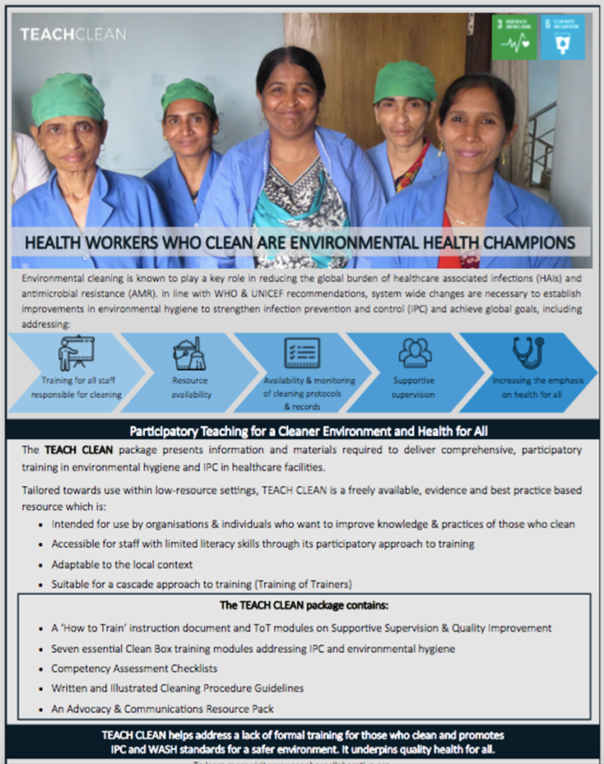
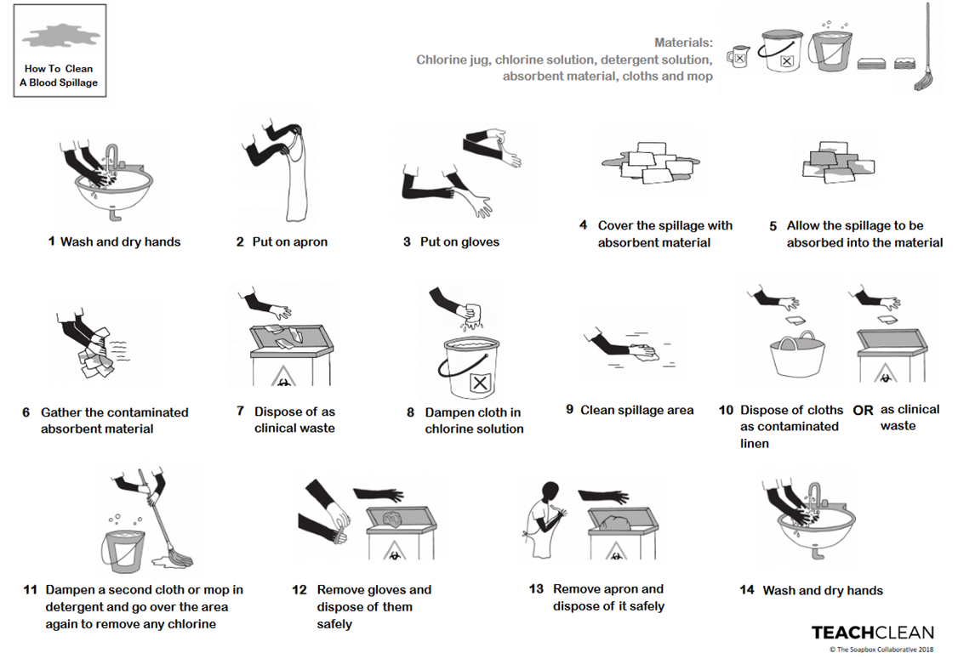
Lessons Learned from Implementation
TEACH-CLEAN Training Package: provides information & tools to deliver comprehensive participatory training in basic IPC & environmental hygiene to all staff who clean in healthcare facilities in LMICs.
Experiences from implementation in Gambia, India, Myanmar &Tanzania:
Participatory approach greatly appreciated
Important to consider including in training, healthcare professionals who clean &/or supervise cleaners –>helps improve mutual respect
Scheduling training can be challenging as must fit around cleaning rotas
High turn-over of cleaners, so need for repeat training
Important training is matched by regular availability of equipment & supplies
Post-training supportive supervision is key, including reminders using illustrated guidelines
TEACH CLEAN was created by The Soapbox Collaborative & the London School of Hygiene & Tropical Medicine. For free copy, visit: https://www.lshtm.ac.uk/research/centres/march-centre/soapbox-collaborative/teach-clean

Slide 21
Best Practices for Environmental Cleaning Programs
3
Policies and standardized procedures
  Facility cleaning policy
    Reporting lines and responsibilities
    Cleaning schedules
    Training requirements
    Monitoring requirement
    Approved cleaning products, supplies and equipment
  Standard operating procedures (SOPs) and job aids
    Step-by-step process for performing cleaning in each patient care area
    Should include all of the products, supplies and equipment required (including cleaning staff PPE)
    SOPs and job aids also needed for preparing cleaning and disinfectant products, reprocessing non-critical equipment

Slide 22
What are the recommended cleaning schedules in the context of COVID-19?
Patient area | Frequency | Person / staff responsible | Products/Supplies | Additional guidance
Triage area | At least twice daily | Environmental cleaning (EC) staff | Cleaning solution (neutral detergent and water); Disinfectant (alcohol, chlorine-based, other as approved*) * See next slide Freshly made solutions, cloths, and mops for each cleaning session. Discard/reprocess supplies after each cleaning session. Dedicated supplies for inpatient isolation areas. PPE: gowns and/or impermeable aprons, rubber gloves, medical mask, and eye protection (preferably face shield). | Focus on high-touch surfaces, then floors (last)
Inpatient rooms / cohort – occupied | At least twice daily; three times daily if possible (high-touch surfaces) | EC staff OR clinical staff if possible |  | Focuses on high-touch surfaces, starting with shared/common surfaces, then move to each patient bed; use new cloth for each bed if possible
Inpatient rooms – unoccupied (terminal clean) | Upon discharge/ transfer | EC staff |  | Low-touch surfaces, high-touch surfaces, floors (in that order); waste and linens removed, bed thoroughly cleaned and disinfected
Outpatient / Ambulatory Care rooms | After each patient visit and at least once daily terminal clean | Clinical staff (after each patient); Terminal clean (EC staff) |  | High touch surfaces to be disinfected after each patient visit; terminal clean as above (end of day)
Hallways / Corridors | At least twice daily | EC staff |  | High-touch surfaces (e.g., railings)
Patient toilets | Private (at least twice daily); Shared (at least three times daily) | EC staff |  | High-touch surfaces, including door handles, light switches, counters, faucets, then sink bowls, then toilets and finally floor (in that order)
Notes:
See this table within the new guidance document to be published here - https://www.who.int/emergencies/diseases/novel-coronavirus-2019/technical-guidance/infection-prevention-and-control

Slide 23
Best practices for cleaning procedures
Priority!
Immediately attend to any body fluid spills prior to starting routine cleaning
1. Proceed from cleaner to dirtier:
  Clean high-touch surfaces outside the patient zone before high-touch surfaces inside the patient zone
  Clean patient beds before patient toilets
  Clean low-touch surfaces before high-touch surfaces (terminal clean)
  Clean general patient areas before isolation areas
Example of a cleaning strategy from cleaner to dirtier areas

Slide 24
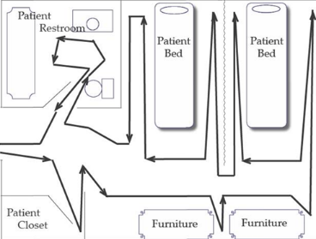
Best practices for cleaning procedures
2. Proceed from high to low (top to bottom):
  Clean bed rails before bed legs
  Clean environmental surfaces before floors
3. Proceed in a methodical, systematic manner:
  Left to right
  Clockwise or counterclockwise
Example of surface cleaning, moving in a systematic manner around the patient care area

Slide 25
Best Practices for Environmental Cleaning Programs
4
Supporting infrastructure and supplies
  Designated space at facility
    Environmental cleaning services area
    Decontamination / sluice area
  Water and wastewater services
    Adequate water supply and wastewater management!
  Approved cleaning products, supplies and equipment
  Procurement and supply management systems
    Avoid stock-out of cleaning supplies and equipment
    Furniture and patient equipment that can be cleaned

Slide 26
General definitions
Cleaning: the physical removal of foreign material (e.g., dust, soil) and organic material (e.g., blood, secretions, excretions, microorganisms). Cleaning physically removes rather than kills microorganisms. It is achieved with water, detergents, and using ‘mechanical action’ (e.g., friction, scrubbing). Cleaning is always the first step in environmental cleaning.
Disinfection: a chemical process for inactivating microorganisms (with the exception of bacterial spores) on inanimate objects. Disinfection occurs after the cleaning process.
      Low-level disinfection: inactivates most vegetative bacteria, some fungi, and some viruses, but does not kill more hardy viruses (e.g. non-enveloped), bacterial genus (e.g. mycobacteria), or bacterial spores
      Mid-level disinfection: kills inactivate vegetative bacteria, including mycobacteria, most viruses, and most fungi, but might not kill bacterial spores
      High-level disinfection: kills all microorganisms, with the exception of small numbers of bacterial spores (not used for environmental cleaning, used for invasive device reprocessing)

Slide 27
Cleaning and disinfectant products for environmental cleaning
Cleaning products: liquids, powders, sprays, or granules that remove organic material (e.g., dirt, body fluids) from surfaces and suspend grease or oil. Can include liquid soap, enzymatic cleaners, and detergents.
  For most surface cleaning procedures: neutral detergent (pH 6-8), easily soluble in warm and cold water is best
Disinfectants: Chemical compounds that inactivate (i.e., kill) pathogens and other microbes. Disinfectants are applied only to inanimate objects. All organic material and soil must be removed by a cleaning product before application of disinfectants.
    For most surface disinfection procedures: low-level disinfectants are used (mid-level disinfectants are often required)
    Some products combine a cleaner with a disinfectant (combined detergent-disinfectants)
    There are some situations where separate cleaning and disinfectant products are required

Slide 28
Microbial disinfectant hierarchy – intrinsic resistance
High-level disinfection
Most resistant
Mycobacteria (e.g., M. tuberculosis)
Small non-enveloped viruses (e.g., norovirus, polio)
Fungi (e.g., Candida spp)
Vegetative bacteria
Enveloped viruses (e.g., HIV, HSV, Flu, COVID-19)
Bacterial spores (e.g., C. difficile)
Most susceptible
Gram-negative bacteria (e.g., Pseudomonas spp, E. coli, Acinetobacter)
Gram-positive bacteria (e.g., MRSA)
Large non-enveloped viruses (e.g., rotavirus)
Mid-level disinfection
Low-level
Notes:
https://www.cdc.gov/infectioncontrol/guidelines/environmental/background/services.html
microorganisms can usually be grouped according to their innate resistance to a spectrum of physical or chemical germicidal agents
Mycobacteria is more resistant to chemical germicides than ordinary vegetative bacteria, fungi, and medium to small viruses (with or without lipid envelopes). Because mycobacteria have the highest intrinsic level of resistance among the vegetative bacteria, viruses, and fungi, any germicide with a tuberculocidal claim on the label (i.e., an intermediate-level disinfectant) is considered capable of inactivating a broad spectrum of pathogens, including much less resistant organisms such the bloodborne pathogens (e.g., hepatitis B virus [HBV], hepatitis C virus [HCV], and HIV). It is this broad spectrum capability, rather than the product’s specific potency against mycobacteria, that is the basis for protocols and OSHA regulations indicating the appropriateness of using tuberculocidal chemicals for surface disinfection.
Other claims (e.g., “fungicidal,” “pseudomonicidal,” and “virucidal”) may appear on labels of environmental surface germicides, but the designations of “tuberculocidal hospital disinfectant” and “hospital disinfectant” correlate directly to Spaulding’s assessment of mid-level disinfectants and low-level disinfectants, respectively

Slide 29
Microbial disinfectant hierarchy – spectrum of activity
Most resistant
Mycobacteria (M. tuberculosis (USA), M. terrae, M. avium (EU) )
Small non-enveloped viruses (norovirus, adenovirus, polio (EU))
Fungi (Aspergillus, Candida spp)
Vegetative bacteria (S. aureus, P. aeruginosa, +)
Enveloped viruses (HIV, HSV, Flu, COVID-19)
Bacterial spores (C. difficile)
Most susceptible
Fungal spores
Yeasts
Sporicidal
Tuberculocidal or mycobactericidal
Virucidal
Fungicidal or Yeasticidal
Bactericidal
Specific claims for relevant organisms

Slide 30
Microbial disinfectant hierarchy – role of test organisms
Most resistant
Mycobacteria (M. tuberculosis (USA), M. terrae, M. avium (EU) )
Small non-enveloped viruses (norovirus, adenovirus, polio (EU))
Fungi (Aspergillus, Candida spp)
Vegetative bacteria (S. aureus, P. aeruginosa, + )
Enveloped viruses (clinically relevant organisms)
Bacterial spores (C. difficile)
Most susceptible
Fungal spores
Yeasts
Test organisms are used to make a claim regarding the spectrum of activity
They should be representative of the class of microbes in the hierarchy (e.g., P. aeruginosa or S. aureus for all vegetative bacteria)
Should generally have following characteristics:
  Microbiologically well characterized
  A clinically important human pathogen or a validated surrogate for a human pathogen
  Standardized stock strains available from commercial sources
Test organisms are sector specific (e.g., food industry, health care) and also vary by country/geography
Notes:
The standards and regulatory framework for disinfectants vary by country/region
They can be based on sector/application (e.g., food industry, healthcare)
They can be based on spectrum of activity (e.g., virucidal, bactericidal)

Slide 31
Disinfectants
Active ingredient(s) | Spectrum of activity | Level of disinfection
Quaternary ammonium compounds (e.g., alkyl dimethyl benzyl ammonium chloride) (0.1-1%) *newer formulations dimethyl ammonium bromide | Bactericidal Fungicidal | Low-level
Chlorine-releasing agents (e.g., sodium or calcium hypochlorite, sodium dichloroisocyanurate (NaDCC)) at 500ppm | Bactericidal Fungicidal
Alcohols (60-80%) (e.g., isopropyl alcohol, ethyl alcohol/ethanol) *Ethyl alcohol doesn’t inactive poliovirus or HAV, but does adenovirus, enterovirus, rhinovirus | Bactericidal Fungicidal Virucidal* Mycobactericidal | Mid-level
Chlorine-releasing agents (e.g., sodium or calcium hypochlorite, NaDCC) at ≥1,000ppm | Bactericidal Fungicidal Virucidal Mycobactericidal
Improved hydrogen peroxide (e.g., 0.5% enhanced action formulation hydrogen peroxide, 3% hydrogen peroxide) | Bactericidal Fungicidal Virucidal Mycobactericidal
Hypochlorite at 5,000ppm; Hydrogen peroxide at 4-5% | Bactericidal Fungicidal Virucidal Mycobactericidal Sporicidal | Sporicidal
Note:
alcohols, chlorine and chlorine compounds, standard and improved hydrogen peroxide, phenolics, iodophors, peracetic acid, and quaternary ammonium compounds.
Table includes the most common disinfectants used for env cleaning in HCFs.
  Iodophors are sometimes used as disinfectants, but more so used as antiseptics
  Phenolics are not used so much any more due to health effects (newborns)
Most important to look at:
Active ingredient(s)
Label claim (spectrum of activity, test organisms)
Remember the disinfectant hierarchy!
Notes:
https://www.cdc.gov/infectioncontrol/guidelines/disinfection/disinfection-methods/chemical.html
Note the susceptibility of microbes may vary by specific disinfectants – for example alcohols can inactivate mycobacteria but not some viruses. Therefore there are specific label claims for clinically relevant organisms that may differ from these broad classes of low- and mid-level disinfection.
povidone-iodine most common form of iodophors. iodophors demonstrate that iodophors are bactericidal, mycobactericidal, and virucidal but may require prolonged contact times to kill certain fungi and bacterial spores.
Peracetic acid, or peroxyacetic acid, will inactivate gram-positive and gram-negative bacteria, fungi, and yeasts in less than 5 minutes at less than 100 ppm. In the presence of organic matter, 200 to 500 ppm is required. For viruses the dosage range is wide (12 to 2250 ppm), with poliovirus inactivated in yeast extract in 15 minutes with 1500 to 2250 ppm.
Two phenol derivatives commonly found as constituents of hospital disinfectants are ortho-phenylphenol and ortho-benzyl-para-chlorophenol. Many phenolic germicides are EPA registered as disinfectants for use on environmental surfaces (e.g., bedside tables, bedrails, laboratory surfaces) and noncritical medical devices. The use of phenolics in nurseries has been questioned because of the occurrence of hyperbilirubinemia in infants placed in bassinets in which phenolic detergents were used.
Some of the chemical names of quaternary ammonium compounds used in healthcare are alkyl dimethyl benzyl ammonium chloride, alkyl didecyl dimethyl ammonium chloride, and dialkyl dimethyl ammonium chloride. The newer quaternary ammonium compounds (i.e., fourth generation), referred to as twin-chain or dialkyl quaternaries (e.g. didecyl dimethyl ammonium bromide and dioctyl dimethyl ammonium bromide.

Slide 32
Microbial disinfectant hierarchy – intrinsic resistance
High-level disinfection
Most resistant
Mycobacteria (e.g., M. tuberculosis)
Small non-enveloped viruses (e.g., norovirus, polio)
Fungi (e.g., Candida spp)
Vegetative bacteria
Enveloped viruses (e.g., HIV, HSV, Flu, COVID-19)
Bacterial spores (e.g., C. difficile)
Most susceptible
Gram-negative bacteria (e.g., Pseudomonas spp, E. coli, Acinetobacter)
Gram-positive bacteria (e.g., MRSA)
Large non-enveloped viruses (e.g., rotavirus)
Mid-level disinfection
Low-level

Slide 33
What are the disinfectants we should use in healthcare facilities in the context of COVID-19?
Disinfection of environmental surfaces in healthcare facilities should consider not only SARS-CoV-2, but also other clinically important healthcare pathogens
  hospitalized patients at increased risk of other infections due to underlying medical conditions and invasive procedures
The following disinfectants and defined concentrations can be used on environmental surfaces to achieve a >3 log reduction of human coronavirus (Kampf, 2020), and they are also proven to be effective against other clinically relevant pathogens in the healthcare settings (contact time ≥1 minute):
  Ethanol ≥70%
  Hydrogen peroxide 0.5%
  Hypochlorite from 0.1% (1,000 ppm)
Other disinfectants can be used, provided they have demonstrated action against other human coronaviruses or harder to kill organisms (e.g., non-enveloped viruses) for the health care settings, according to the local authorities or regulatory bodies (use manufacturer recommended contact time).
Use 5,000ppm on hardy pathogens when facility has history with hardy pathogens (C. auris, C. difficile)
Use 5,000pm for large blood and body fluid spills

Slide 34
Summary of guidance
Implementing environmental cleaning according to best practices requires multiple strategies and strong organizational/leadership support
Staff who perform cleaning functions should always be trained and should be given support through monitoring and feedback
Environmental cleaning schedules and protocols should be developed for all patient areas based on risk-level
Environmental cleaning requires a standardized process, always apply the best practices for cleaning techniques (clean to dirty, high to low, systematic order)
Cleaning products and disinfectants should be carefully selected and managed at the facility level

Slide 35
Key messages for environmental cleaning in context of COVID-19
COVID-19 can survive on environment surfaces for days, but environmental survival is low compared to many other important pathogens
Environmental cleaning is important to mitigate the spread of COVID-19 (contact transmission route)
Environmental cleaning using existing best practice methods and strategies is effective against COVID-19
COVID-19 is susceptible to standard environmental cleaning and disinfection methods (enveloped virus)

Slide 36
References
CDC and ICAN (2019) Best Practices for Environmental Cleaning in Healthcare Facilities in Resource-Limited Settings. Atlanta, GA: US Department of Health and Human Services, CDC; 2019. Available at: Environmental Cleaning in Resource-Limited Settings | HAI | CDC
WHO (2019) Implementation manual to prevent and control the spread of carbapenem-resistant organisms at the national and health care facility level WHO 2019: Implementation manual to prevent and control the spread of carbapenem-resistant organisms at the national and health care facility level [PDF – 98 pages]
WHO (2020) Technical guidance on IPC / WASH for COVID-19.
WHO (2008) Essential environmental health standards in health care. https://www.who.int/water_sanitation_health/publications/ehs_hc/en/
LHSTM (2019). TEACH CLEAN. Available from: https://www.lshtm.ac.uk/research/centres/march-centre/soapbox-collaborative/teach-clean

Slide 37

Thank you for participating in the
WHO global annual hand hygiene campaign
SAVE LIVES: Clean Your Hands
NURSES AND MIDWIVES
Clean care
is in your hands!
Learn more at:
https://www.who.int/infection-prevention/campaigns/clean-hands/5may2020/en/

Slide 38


Some slides in this presentation were from:
Infection Prevention and Control (IPC) for COVID-19 Virus
Access free online courses on COVID-19
in your national language!
Italiano
فارسی
日本語
Português
Türk
српски језик
Bahasa Indonesia
Tiếng Việt
हिन्दी, हिंदी
OpenWHO.org

Slide 39
Today’s agenda
Introduction & overview (WHO WASH)
Introduction to environmental cleaning during COVID-19 outbreak (Maria Clara Padoveze, WHO IPC; 10 minutes)
Latest guidance on environmental cleaning in health care facilities during the COVID-19 outbreak (Molly Patrick, CDC) – 25 minutes
Perspective from African continent – (Professor Folasade T Ogunsola; University of Lagos, Nigeria and Chair, Infection Control Africa Network; 5 minutes)
UNICEF WASH – 5 minutes
Questions and answers (chat box)

Slide 40
Supplementary slides
The following slides are supplementary to the main slide deck.
They provide a summary of additional environmental cleaning best practices but are considered beyond the scope of a short webinar.

Slide 41
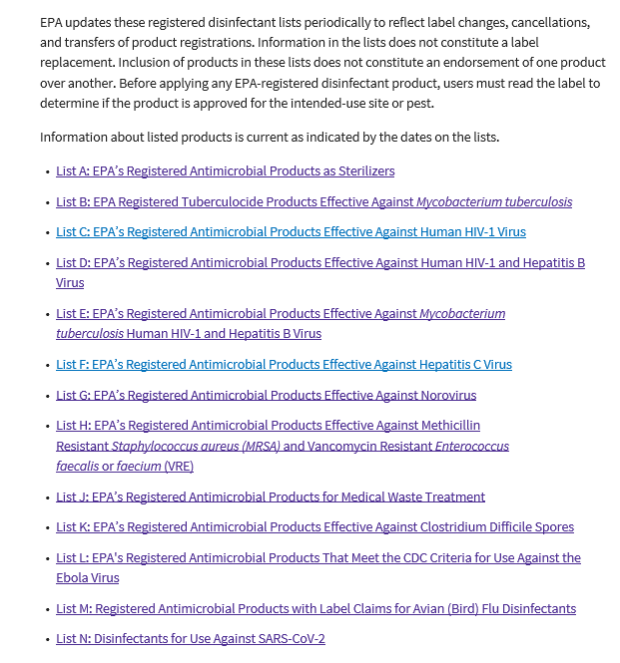
Healthcare disinfectants (US)
All of these are ‘hospital disinfectants’ → meaning have been tested against test organisms for ‘bactericidal’ claim and are equivalent with ‘low-level disinfection’
These lists delineate additional clinically important pathogens
Those included in List N include disinfectants that:
  Have demonstrated efficacy against another human coronavirus similar to SARS-CoV-2
  Have been tested against a harder-to-kill virus than SARS-CoV-2 (non-enveloped virus)
https://www.epa.gov/pesticide-registration/selected-epa-registered-disinfectants
Notes:
https://www.epa.gov/pesticide-registration/selected-epa-registered-disinfectants

Slide 42
Hypochlorite-based disinfectants
Always wear PPE when preparing and using chlorine-based solutions
Store in a covered, plastic container away from direct sunlight
Test concentration every day (test strips) or make new solution every day
NEVER mix chlorine solutions with any other cleaning products
Notes:
This graphic will be available soon from: https://www.cdc.gov/coronavirus/2019-ncov/hcp/non-us-settings/index.html
Also see instructions for making a 5,000ppm chlorine-based solution for disinfecting blood and body fluid spills or when there is a very hardy organism (e.g., spore-forming such as C. difficile) :
https://www.cdc.gov/vhf/ebola/pdf/cleaning-handwashing-5percent-liquid-bleach.pdf
https://www.cdc.gov/vhf/ebola/pdf/cleaning-hand-washing-with-chlorine-powder.pdf

Slide 43

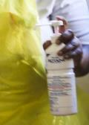
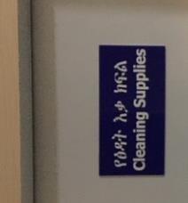
Best practices
A master list of facility-approved products should be developed in the facility policy, as well as approved suppliers
The number of approved products should be minimized to:
  Simplify the environmental cleaning process
  Simplify training requirements for staff
  Reduce potential for errors in preparation and use
Products should be stored to prevent exposure and degradation
Other factors to consider
Contingency planning
Supply-chain
Ease of use & preparation
Safety
Environmental disposal

Slide 44
Preparing solutions
Prepare solutions in dedicated environmental cleaning services area
Provide training and simple instructions for preparing solutions
  Pictorial job aids (e.g., posters) helpful if possible
Provide any required PPE needed for preparing solutions according to the product SDS
If feasible, use an automatic dispensing system to prepare solutions (calibrated regularly)
  If preparing manually, use standardized containers for measuring
If feasible, use test strips to confirm correct concentrations

Slide 45
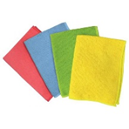
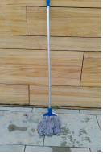
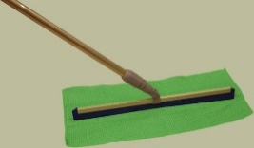
Environmental Cleaning Supplies and Equipment
Surface cleaning: cloths can be cotton or microfiber
  Different colored cloths should be stocked to allow color-coding (e.g.,
    one color for cleaning and one color for disinfection steps
    one color for toilets, one color for general patient areas, one color for isolation areas
Floor cleaning: mop heads or floors cloths can be used (cotton or microfiber)
  Two or three-buckets needed, depending on need for floor disinfection
  Always use wet floor sign!

Slide 46
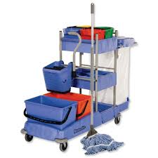
Environmental Cleaning Supplies and Equipment
Cleaning carts should be stocked with sufficient quantities so that cleaning tasks can be completed without having to return to the storage area
Separate clean and soiled items (e.g., cleaning cloths)
Use color-coded cloths or buckets if possible
Never put personal items, food or beverages on the cart
Clean and disinfect cart at the end of the day
Never leave unattended, store in the dedicated EVS area

Slide 47

Personal Protective Equipment (PPE) for Cleaning
Hand hygiene action should always be applied, including after PPE removal
Type of cleaning task | Required personal protective equipment for cleaning staff
Routine cleaning (standard precautions) | None (unless spills or contamination risk—see below)
Terminal cleaning (standard precautions) | Reusable rubber gloves
Blood and body fluid spills and high contamination risk areas (e.g., cleaning bed of an incontinent patient, labor and delivery wards) | Gown and/or plastic apron Reusable rubber gloves Face shield or face mask and goggles (if splash risk or large spill)
Droplet precautions (routine and terminal cleaning) | Gown and/or plastic apron Reusable rubber gloves Face shield or face mask and goggles
Contact precautions (routine and terminal cleaning) | Gown and/or plastic apron Reusable rubber gloves
Airborne precautions (routine and terminal cleaning) | Respirator (N95 or FPP2), fit tested Reusable rubber gloves
Preparation of disinfectant products and solutions | According to specifications in SDS (manufacturer instructions) If SDS not available, then: Chemical-resistant gloves (e.g., nitrile) Gown and/or apron Face shield or face mask and goggles
Cleaning staff PPE for COVID-19

Slide 48
Environmental cleaning services area should:
be easily accessible in relation to the areas it serves (i.e., easily accessible throughout the facility)
be appropriately sized to the amount of materials, equipment, and chemicals stored in the room/area
have printed copies of the SDS for all environmental cleaning products, manufacturer’s instructions, and job aids for preparation of cleaning and disinfectant solutions
never contain personal clothing or grooming supplies, food or beverages (there should be a separate area for cleaning staff to store these items)
have safe chemical storage and access
have locks fitted to all doors to restrict access only to cleaning staff
be free from clutter
have washable surfaces (floors, walls, shelves)
be well-ventilated and illuminated (lighting or window access)
be labeled with a biohazard sign on the door
have an appropriate water supply (hot and cold water access, if feasible)
have a utility sink/floor drain for safe disposal of used solutions
be designed so that, whenever possible, buckets can be emptied into utility sink/floor drains without lifting them or creating splashes
have a dedicated handwashing sink, used only for handwashing
have access to an eyewash station
have appropriate PPE available
have enough space to keep reprocessing (dirty areas) separate from storage areas for cleaned equipment

Slide 49
Best practices:
Surface cleaning
Use fresh cleaning cloths to start
Change cleaning cloths when no longer saturated
Change cleaning cloths between each patient zone (in high-risk areas)
Make sure you have enough cleaning cloths to finish the cleaning session
Never double-dip!
(From Soapbox, 2018 “TEACH CLEAN”)

Slide 50
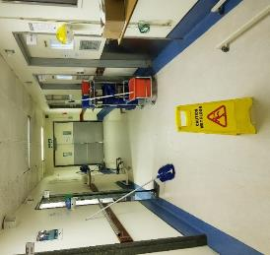
Best practices:
Floor cleaning
Display wet-floor sign
Immerse mop in bucket with cleaning solution and wring out
Mop in a figure eight, overlapping stroke, turn the mop head regularly (e.g., every 5-6 strokes)
After cleaning a small area (e.g., 3m x 3m), immerse mop in bucket with rinse water and wring out
Repeat from step 2

Slide 51

What do staffing needs depend on?
Based on:
# of inpatient beds
Types of services (e.g., high-risk areas)
Bed occupancy levels
Type of cleaning (e.g., routine vs terminal)
And should take into account:
Reasonable shift length
Regular breaks
Contingencies (e.g., outbreaks or other emergencies)
No single-best practice method for determining staffing needs, but consider using:
Workload software
Comparisons with other facilities
Empirical calculations at facility level
Notes:
How are staffing levels calculated at the facilities you work with/in?

Slide 52

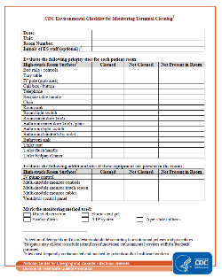
Monitoring & feedback
  Routine monitoring
    Use objective (e.g., ATP system) over subjective methods (visual assessment of cleanliness)
    Use both direct (e.g., performance observation) and indirect methods (e.g., marking with fluorescent gel)
  Direct feedback
    Timely feedback to staff
    Used for coaching, inform training needs
    Also monthly reporting, summary, trends
For assessing: | Use these methods:
Cleaning practice | Performance observation Visual assessment Fluorescent markers
Cleanliness | ATP system (residual bioburden) Environmental cultures (agar plate, swab)

