Slide 1
© WaterAid
ARABELLA HAYTER, WHO
haytera@who.int
Prince Madihol Conference, 2020
Transforming health service quality through improved water, sanitation & hygiene:
from Resolution to Revolution

Slide 2
“QUALITY”: an empty promise without basic services
8.6 million deaths per year in 137 LMICs are due to inadequate access to quality care.
Of these, 3.6 million are people who did not access the health system.
Whereas, 5.0 million people who sought care but received poor quality care.
https://www.thelancet.com/pdfs/journals/langlo/PIIS2214-109X(17)30101-8.pdf

Slide 3
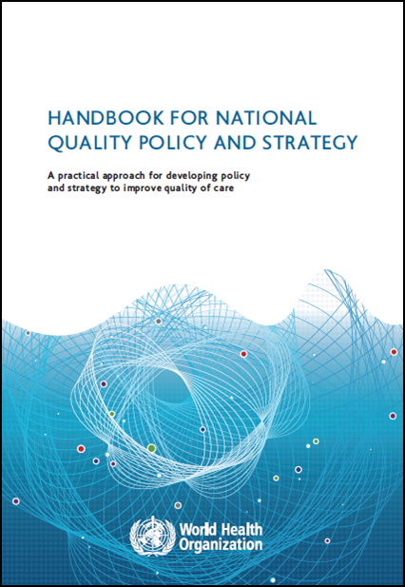
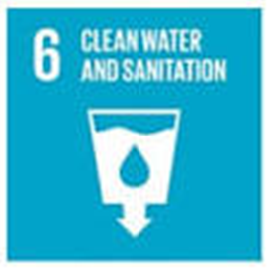
Quality care, WASH & IPC
Recap on the dimensions of quality care:
1. Timely
2. Efficient
3. Equitable
4. Integrated
5. Effective
6. Safe
7. People-centered
Lack of WASH in health care means care is less effective, less safe & harmful
WASH supports & strengthens IPC to prevent: i) the spread of infection, ii) the overuse/unnecessary use of antibiotics & iii) outbreaks
WASH – a fundamental building block
Notes:
Lets bring this to life by focusing on a topic of interest today – the prevention and control of infection (IPC) and how WASH plays such an important role in supporting efforts to stop preventable infection in health care as part of overall efforts to improve the quality and safety of health care.
A quick recap on what is meant by quality health care.
Quality health care us timely, it’s efficient, equitable and integrated - delivered in a seamless way for people who access it.
With respect to WASH – one way of looking at this is that a lack of WASH in health care means care is less effective, less safe & harmful.
And if we think specifically about IPC - WASH supports & strengthens IPC to prevent: i) the spread of infection, ii) the overuse/unnecessary use of antibiotics & iii) outbreaks.
As we heard in the video – WASH is a building block for the delivery of quality health care for people.

Slide 4
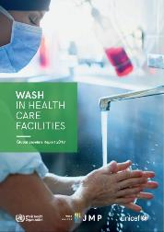
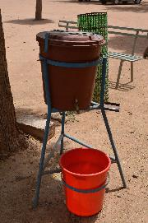
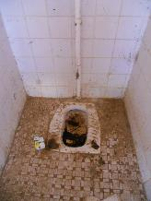
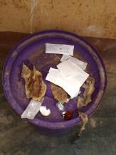
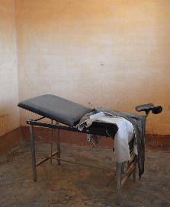
WASH remains shockingly inadequate
WHO/UNICEF, 2019 Global Baseline Report
1 in 4 lack basic water
1 in 5 have no sanitation
42% lack hand hygiene at point of care
40% lack systems to segregate waste
Find your country’s data:
www.washdata.org/healthcare
“Do not call it a health care facility if there is no WASH”

Slide 5
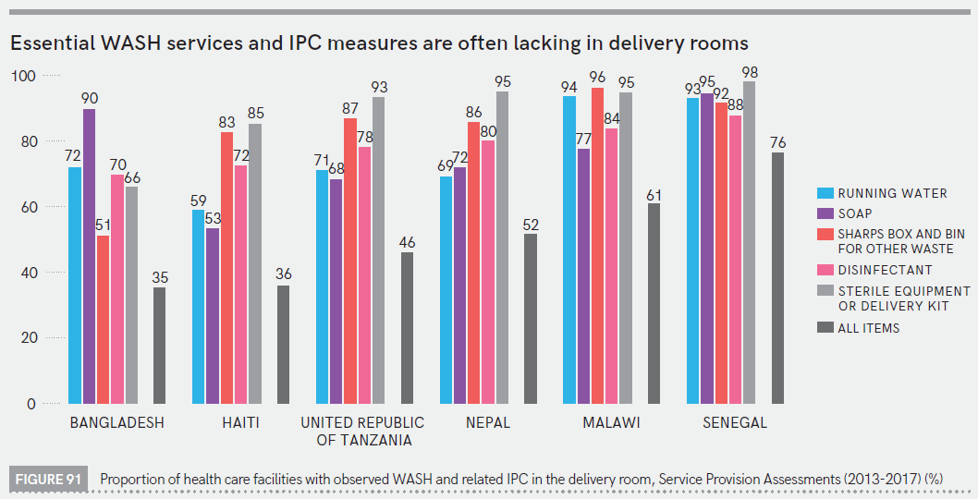
Only half of delivery rooms in 6 countries have all basic WASH and infection prevention and control supplies

Slide 6
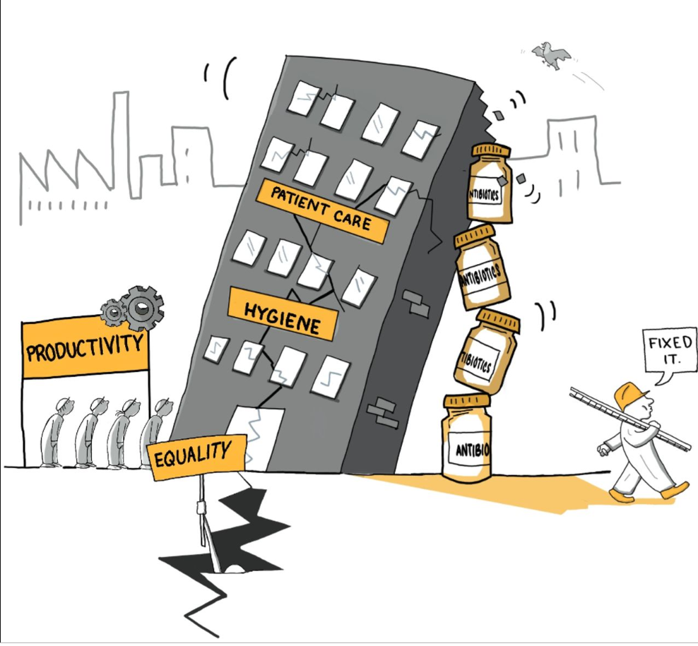
Antibiotics a quick fix for poor WASH in fractured health systems?
From: Willis and Chandler, 2019. Quick Fix for care, productivity, hygiene and inequality: reframing the entrenched problem of antibiotic overuse. BMJ Global Health.

Slide 7
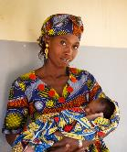
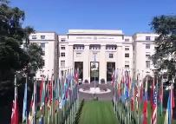
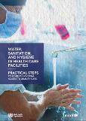
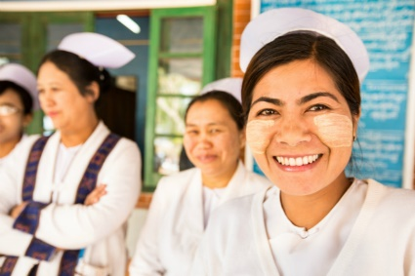
2020: the movement is growing
Ongoing
Advocacy, technical support to countries, documenting what works
72nd World Health Assembly (WHA) approves a Resolution
WASH in HCF recognized by WHO as urgent health challenge of decade
Event on progress and investments at World Health Assembly
Every user has quality care and universal WASH
Global baseline and guidance form basis for strategic action
2020: Year of Nurse and Midwife #YNOM
April 2019
May
2019
2020
January 2020
May
2020
2030

Slide 8
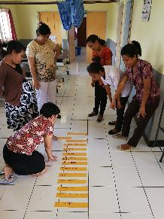
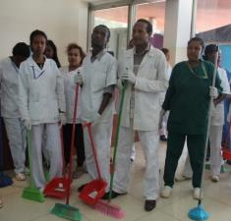
Practical steps for improving and sustaining services: a distillation of “what works” in 30+ countries
WASH FIT improvements, Indonesia
Empowering cleaners in Ethiopia.

Slide 9
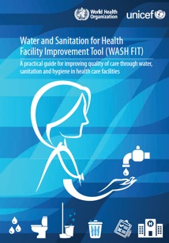
Spotlight on WASH FIT: a practical tool for improving quality of care
QI methodology
Implemented in >25 countries
Assessment and risk prioritization
4 core areas: water, sanitation and waste, hygiene and management
2020 update: climate resilience, gender & inclusivity, emergencies
Training slides and mobile app visit: www.washinhcf.org; www.washfit.org.

Slide 10
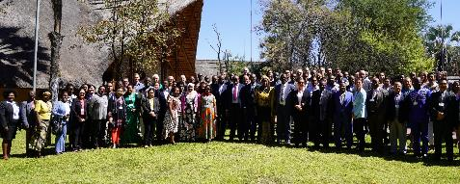
Join the Revolution!
LEARN: Visit www.washinhcf.org for practical tools, case studies, news and stories.
CONNECT: Join the community @wash_for_health
COMMIT: Support country commitments and/or encourage others to commit at www.washinhcf.org/commitments
IMPROVE: Identify health entry points; work on one or more practical actions; implement & document.

