Slide 2
HAND HYGIENE
WASH FIT technical module
Add date & location
Notes:
Introduce yourself if you have not already, and make sure you insert the date and location to the slide before you start

Slide 3



Learning objectives
By the end of the session, participants will:
Understand how WASH supports the five golden rules for hand hygiene
Understand and describe the importance of using a multimodal improvement strategy and where WASH fits within this
Describe the importance of health workers and managers being trained and reminded on the right moments and technique for hand hygiene
State how WASH FIT indicators overall support infection prevention and control (IPC) and hand hygiene efforts to stop the spread of health care associated infections and antimicrobial resistance, including the infrastructure/resources necessary to support hand hygiene improvement
Group
work
Icons to look out for
All group discussion
Notes:
READ SLIDE
NOTE FOR TRAINER: you can make sure participants are clear on the outline of this module and what they will learn.
SAY:
the symbols here are ones you will se throughout the module to indicate activities
we will now watch a short (less than 2 mins) video to introduce the main terminology and concepts that will be covered during the session, n relation to a hand hygiene improvement approach
NOTE FOR TRAINER:
This video is upbeat and energizing and intended to secure participants attention from the start!
The video will start automatically on the click of the slide – you should hear a drum beat and then words and images will start to appear on the screen.

Slide 4

Video
WHO YouTube channel Applying the WHO multimodal strategy for successful infection prevention improvements in health care https://www.youtube.com/watch?v=pcKBIltlE3c
Notes:
PLAY VIDEO

Slide 5
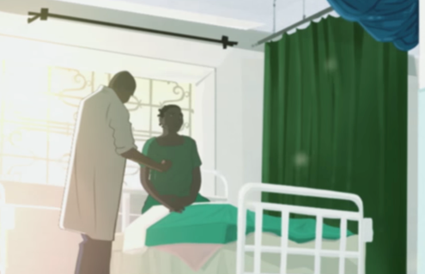
During care delivery, the hands of health workers are contaminated by potentially harmful microbes (also referred to as germs), from different sources
Some of these may be capable of causing and contributing to outbreaks & some may be resistant to antibiotics
Hand hygiene stops the spread of these microbes – it protects patients and staff
Achieving hand hygiene at the right times is still a challenge everywhere
Water, sanitation, a clean environment & waste management are important to support hand hygiene improvement
Image source: WHO video: Health care without avoidable infections - peoples' lives depend on it https://youtu.be/K-2XWtEjfl8
Notes:
READ SLIDE
SAY:
Hands can be contaminated by touching people, i.e. patients, and the environment and then germs can transfer from hands to enter vulnerable people during different health care procedures/interventions
Microbes can become resistant to antibiotics due to antibioitic misuse & overuse and the problem of resistance varies between health care settings and countries (this module does not cover the topic of antibiotic resistance, but it is a global challenge)
WHO guidelines on infection prevention and control and hand hygiene which summarize infrastructure, behavioural and practice issues that if not applied contribute to the problem of avoidable infections in health care. You can read more on the evidence in the WHO Guidelines (listed at the end of this module),
The link at the bottom of the slide is a short video (participants should be encouraged to watch in their own time and may find it useful to show to others to demonstrate the problem of health care associated (nosocomial) infections)

Slide 6

Warm up question
Fact: every human sheds dead skin scales/flakes every day and these can contain living germs (some of which may be harmful to some people).
Question: How many skin scales/flakes do you think the average person sheds each day?
  100
  1,000
  1,000,000
Notes:
READ SLIDE
SAY: think for a moment about the answer and shout out what you think
NOTE FOR TRAINER: this question is concerned with engaging the participants in the module through using a powerful, relevant piece of information

Slide 7

Answer
The average person sheds around 1 million skin flakes each day (that’s about equal to the population of Bhutan and Barbados combined!)
Microbes live on peoples’ intact skin (& other places too)
Because health workers touch patients they can contaminate their hands with 1000s of germs during day to day activities (Helping patients move, taking the patient's pulse, blood pressure, or oral temperature, touching patients’ immediate surroundings)
Some germs can survive on hands for 2 minutes, some for up to an hour
Some germs can survive in the environment for long periods
This module does not focus specifically on viruses that spread in the air
Source: Pittet D et al. Evidence-based model for hand transmission during patient care and the role of improved practices. Lancet Infectious Diseases, 2006, 6:641–652
Notes:
READ SLIDE
SAY:
the reference at the bottom of the screen is available if you want to read more
NOTE FOR TRAINER:
If there are questions on airborne microbes, such as coronavirus, take a note of this and explain this will be returned to another time - this module focuses on stopping spread via hands and an approach to hand hygiene improvement
SAY: this module is on microbes spread by “touch” via hands. It is concerned with a) the importance of achieving hand hygiene action at the right times to prevent the spread of these microbes in health care & b) encouraging participants to appreciate the importance of WASH in enabling hand hygiene at the right moment

Slide 8
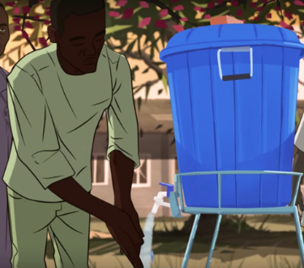

What do we know about the problem and solution? (i.e. data to drive improvement)
Health care-associated infections
Surgical site infections
Preventing infections
10%
50%
70%
1 in 10 patients get an infection while receiving care
More than 50% of surgical site infections can be antibiotic-resistant
Effective IPC reduces health care-associated infections by up to 70%
Problem: ‘…even in resource-rich settings, hand hygiene compliance can be as low as 0%, with levels most frequently below 40%’
Solution: effective hand hygiene improvement strategies can prevent up to 50% of avoidable infections in health care and generate economic savings.
Q. Are you aware of the health care-associated infection and hand hygiene rates in your country?
Notes:
READ SLIDE
SAY:
This slide summarises the problem and burden on health care
With reference to the problem – recent WHO global surveys show that many countries continue to score low in relation to a range of hand hygiene improvement efforts - the reference list will provide more information on the problem of infection in health care
We will find out more about what is required to influence hand hygiene behaviour as we go through the main part of this session which is about an approach to improving hand hygiene & also how WASH fits into this approach
SAY:
Please take a moment to think and then share any information you have on your own national or local hand hygiene rates - shouting examples to the whole group
NOTE FOR TRAINER - additional information if needed to explain at this point, depending on the audience:
Reminder of the relevant WASH data (2021):
One third of health care facilities do not have what is needed to clean hands where care is provided; one in four facilities lack basic water services and one in 10 have no sanitation services.
1.8 billion people use facilities lack basic water services
Across the world’s 47 least-developed countries, the problem is even greater: half of health care facilities lack basic water services. Furthermore, the extent of the problem remains hidden because major gaps in data persist, especially on environmental cleaning
A clean environment goes hand in hand with effective hand hygiene – environmental cleaning reduces the burden of germs in the environment and therefore reduces the risks of health workers contaminating their hands from the environment
A key message is that both WASH surveys and IPC and Hand Hygiene assessments provide data to drive improvement

Slide 9
The five golden rules for hand hygiene
1
Hand hygiene must be performed at the point-of-care*
(right time)
During care delivery, there are five moments when it is essential to perform hand hygiene
2
Hand rubbing with an alcohol-based formulation, if available, makes hand hygiene possible at the point of care, is faster, more effective and better tolerated
3
4
Hand washing with soap and water is necessary when hands are visibly soiled
(right technique)
The appropriate technique and time taken to clean hands is also important
5
Notes:
READ SLIDE
SAY:
this session will now focus on what WHO describe as the five golden rules for hand hygiene.
These rules focus on
The right times for hand hygiene, so that you can understand how key moments fit within the flow of activities that happen in a range of health care settings, and
The right technique.
For the first two rules to be met they require essential WASH services in the facility

Slide 10
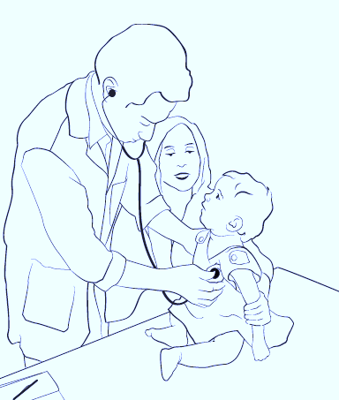
“Point of care” – a definition
1
The place where three elements occur together:
  the health worker
  the patient
  care or treatment involving touch
Hand hygiene infrastructures and products (e.g. alcohol-based handrub if available, water, soap, sinks) should be in place & easily accessible at the point of care to enable health workers to clean their hands at the right moments
1. Health worker
3. Care or treatment involving touching the patient
“Can I clean my hands easily to keep this child safe?”
2. Patient
Notes:
READ THE SLIDE
SAY:
The point of care helps to explains “when” hand hygiene should occur to keep people safe – i.e. it is about understanding that the right time for hand hygiene matters
The phrase point of care is important, e.g. in WASH FIT you will see this mentioned
Understanding the point of care helps to make sense of the need for a supportive and enabling infrastructure for hand hygiene – as the physician in the image asks “can I easily clean my hands to keep this child safe?” If a health worker has to leave a patient and walk a considerable distance to a hand hygiene station this reduces the likelihood of them cleaning their hands.
Performing hand hygiene at the point of care, immediately where health workers touch patients is critical, to protect those most vulnerable

Slide 11
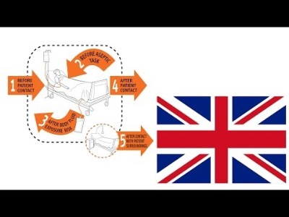
Video on hand hygiene moments (indications)
https://www.youtube.com/watch?v=sa1iFq2YuUE
Notes:
SAY:
We will now watch a short video to help understand hand hygiene in healthcare including where it should occur in the flow of work of a health worker and therefore highlighting the most important times for hand decontamination to protect patient and health workers.
Copy paste the URL into a browser and show from 2m44s to 6m16s to help participants visually understand the patient zone and moments for HH - if you have time you may want to show more.

Slide 12
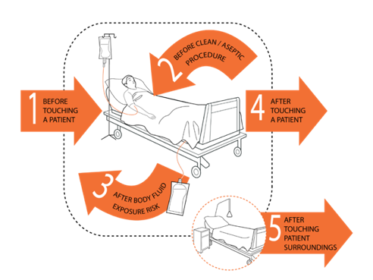
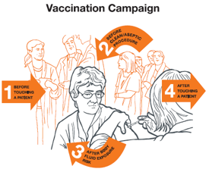
5 Moments – right time
2
Benefits of using 5 Moments approach
Simplifies - when to do hand hygiene in a range of settings
Logically - integrates hand hygiene action into the workflow of busy health workers
Easy - to remember
Encourages - a consistent approach for training, monitoring and reminders
Applicable - in any care setting
Notes:
READ SLIDE
SAY:
This builds on what has been seen about the importance of hand hygiene at the point of care as described in the video.
The simplicity of the Five Moments images/pictures is that it is:
Is a powerful training tool
It can be used as a poster or reminder on the wall
It is based on the evidence of microbe transmission and risk of spread of microbes in a real world setting
It highlights the critical times when hand hygiene action will prevent infection
The 5 moments is a universally used approach and the evidence on its role in infection prevention is well established
Applying hand hygiene at the right times helps address water issues/availability (see the WASH FIT water module for more information)
To fully understand the 5 Moments there are other WHO documents and training slides that explain how it works in detail

Slide 13
Example of the right time
2
The doctor is in his office and the patient enters the room.
The patient and doctor sit down and talk to each other while the doctor goes through the patient’s record.
The doctor asks the patient to lie down on the couch.
Visit to a family practitioner/ general practitioner’s office
The doctor performs the physical examination by listening to the patient’s heart and chest, checks the patient’s tendon reflexes with a hammer, and measures the blood pressure.
1
At the end of the physical examination, the doctor helps the person to get up.
4
The doctor walks back to his desk, makes notes on a computer, and writes a prescription.
The patient sits down again and they discuss his condition.
The patient leaves and the next patient enters the room.
Think about how the Five Moments might be integrated into real life workflow examples in the facilities where WASH FIT is being implemented
Notes:
READ SLIDE
SAY:
Here we see an example of a workflow scenario: a visit to a family practitioner/general practitioner’s office
This further illustrates how the 5 Moments apply in a sequence of care, commonly experienced in a general practice/family practice setting.
The numbers in the orange circle represent the moment for hand hygiene according to the Five Moment
1) the moment is: before touching a patient and 4) the moment is: after touching a patient (Be sure to read these words out to help explain hand hygiene within the example workflow scenario given)
Think about how the Five Moments might be integrated into real life workflow examples that you can think of from the facilities where WASH FIT is being implemented. An example could be attending to a pregnant woman during an antenatal check – think about all the actions and interactions that occur part in a detailed step by step way through the woman's journey and how many times she might be touched by a health worker (this aims to stimulate participants to think about different scenarios and then consider at which moments hand hygiene will be required). Shout out any examples if you wish before we move on
There is a document in the references that is available if people want to learn more about these scenarios (WHO Hand hygiene in outpatient and home-based care and long-term care facilities: a guide to the application of the WHO multimodal hand hygiene improvement strategy and the “My 5 moments for hand hygiene” approach).
NOTE FOR TRAINER:
EXPLAIN THIS SLIDE, DEPENDING ON THE AUDIENCE AND YOUR CONFIDENCE IN EXPLAINING THE SCENARIO

Slide 14

5 Moments – right technique
4
3
5
Alcohol based handrub: 20–30 seconds
Water, soap and clean towels: 40–60 seconds
Notes:
SAY
Considering WHO’s 5 golden rules for hand hygiene, this is a reminder that the technique of handrubbing and handwashing is also an important part of ensuring hand hygiene action is effective.
On its own, understanding and practicing how to clean hands will not ensure the safety of both patients and health workers.
This is because the “when” is key.
Performing hand hygiene at the right time and using the correct technique is what keeps people safe.

Slide 15






The WHO multimodal improvement strategy
Q. What do you think the 5 symbols comprising the multimodal improvement strategy represent?
multi
modal:
many
methods
2 minute exercise
Notes:
READ SLIDE
SAY:
The evidence tells us that to improve hand hygiene behaviours in health care requires more than one approach or method.
WHO describe this as a multimodal improvement strategy – an evidence based approach for improving hand hygiene and other infection prevention actions, which has 5 elements
NOTES FOR TRAINER:
If the multimodal video was played at the start of the session, SAY: ”think back to the first video we watched – what do each of these symbols represent?” Take one minute to wok with the person next to you and be prepared to shout out some ideas and I will capture these on a flipchart.
If the video was not played, SAY: Take one minute to wok with the person next to you and be prepared to shout out some ideas of what you think these 5 symbols represent, and I will capture these on a flipchart.
These symbols provide a clue
NOTE FOR TRAINER
Write down the answers on flip chart.
In general the answers are (and these will be fully explained in the next slides)
Systems that enable hand hygiene at the point of care - that means the right infrastructure, resources and equipment in place
Training and education
Monitoring/auditing and feedback
Reminders and communications
A supportive culture in the facility
FINALLY SAY:
that this multimodal strategy is recommended by WHO in its evidence based hand hygiene guidance and has been tried and tested in many countries and settings. Improvement in hand hygiene is achievable using a combination of many, namely 5 things, as described, each of which can be adapted to the local situation. However, if you focus on just one thing this is known not to lead to improvement in hand hygiene. E.g. running training sessions every year is good, but will not change health worker behavior on its own - why not?

Slide 16

The multimodal improvement strategy explained
The infrastructure & resources available to perform hand hygiene, including water, sinks, alcohol handrub
People trained in why, when and how for hand hygiene
Checks in place to monitor whether it is being/can be performed at the right time & in the right way & timely feedback so that corrective action can be addressed
Reminding people to perform hand hygiene, at the right time and in the right way
A culture within a care facility that values hand hygiene, especially the support of managers and supervisors
Notes:
READ SLIDE
SAY:
Based on the previous slides and discussion it is clear that hand hygiene is a behavior that is influenced by many factors.
WASH plays an important role in enabling and supporting hand hygiene. WASH helps to build the right infrastructure and a clean safe environment that supports hand hygiene.
The multimodal strategy canalso be summarised in these five simple phrases, as mentioned in the video (if played):
Build it, Teach it, Check it, Sell it & Live it.

Slide 17
Read through the scenario in your handout & discuss the questions presented.
Group work - real life example
10 minute exercise
Notes:
READ THE SLIDE, REFER STUDENTS TO THE HANDOUT EXERCISE AND READ OUT THE INSTRUCTION FROM IT TO BE SURE EVERYONE IS CLEAR ON WHAT TO DO

Slide 18

Group work – feedback & discussion
X
Understanding of the multimodal improvement strategy supports behavior change & sustainable hand hygiene
X
Notes:
SAY:
Please read out the findings of your group discussion so that everyone can hear.
NOTES FOR TRAINER:
Prompts to use if needed, especially if the feedback is limited
What does this exercise tell us about training? About monitoring/auditing? About promoting hand hygiene (posters), about hand hygiene infrastructures? About the culture? What does this tell us about there being ‘no one single magic bullet to change hand hygiene behaviour??
When considering gaps in the current approach, here are some ideas to discuss:
In this facility, staff are currently being trained which is positive, but how frequent is this?
What is included in the training? Training must be provided on the why and the when and not just the how.
Likewise, use of posters in the workplace to remind staff about hand hygiene is a good thing but it is useful to consider posters that promote and reinforce the when, i.e. the moments when hand hygiene should occur. Are posters attractive to the audience? Are they changed regularly?
Audits (checks) are taking place but the senior managers do not seem to be interested in being involved, including not interested in the results.
This is indicative of a wider challenge here – the culture of the clinic does not seem to value hand hygiene. We will come back to this later in the session.
Lastly, have questions been asked about the availability of ’infrastructure/resources’ to support hand hygiene in the right places at the right time (alcohol handrub, soap, water, clean towels)?
If people are trained to clean their hands at the point of care but there is no way to do this, the overall health system is not supportive of hand hygiene and may not be dedicating budget to this! This has an impact on the staff but also the fears of patients and potential infection risks.

Slide 19
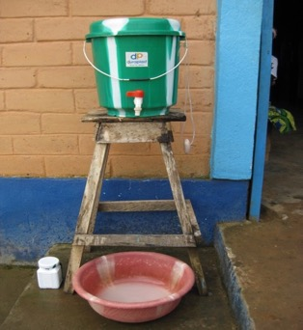
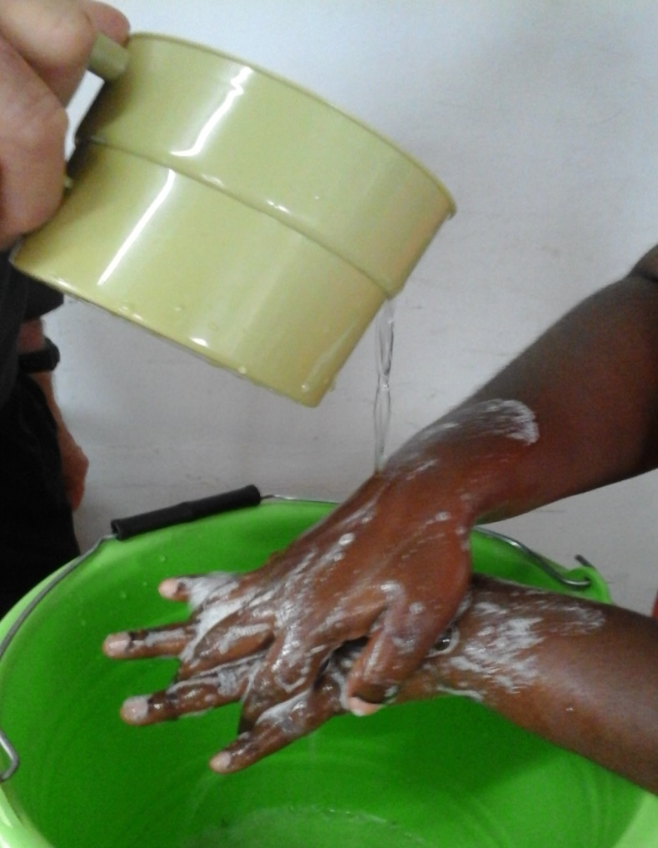
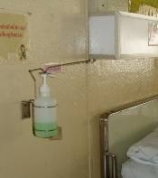
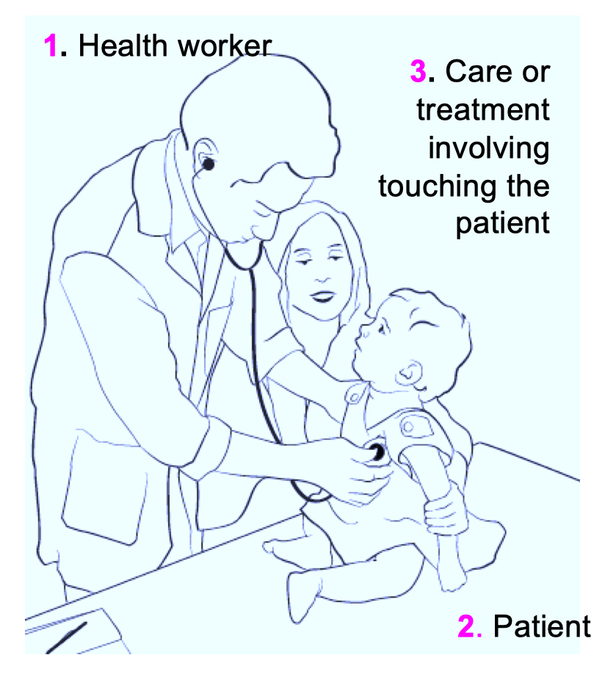
System change
System change/Build it & WASH FIT
Related WASH FIT indicators to be assessed*:
Functioning hand hygiene stations available at all points of care including the delivery room
Functioning hand hygiene stations available in all waiting areas and/or public areas and in the waste disposal area
There are functioning hand washing facilities within 5 metres of toilets
Budget is available to cover costs of cleaners and maintenance staff, IPC/WASH training, IPC/WASH consumables (e.g. soap, chlorine) and all activities listed in protocol above
*note: indicators for an available quality water supply, waste management and human resources are also related to achieving hand hygiene
Notes:
FIRST SAY (THEN READ THE SLIDE)
We will now focus on learning in more detail what each element of the multimodal improvement strategy means in practice and how it fits with WASH
We will drill down into each of the five elements of the multimodal strategy - there is no particular order to follow for each of the 5 elements, it depends on as assessment of the local situation and what is needed.
This slide explains how system change relates to WASH FIT.
These WASH FIT indicators focus on building the right infrastructure for hand hygiene which will support your improvement strategy alongside other actions.
Examples of how hand hygiene stations have been established where needed are available and you can read more in the WHO/UNICEF practical steps document and on the washinhcf.org web platform.
But remember, to truly influence patient and health worker safety, the infrastructure and resources must be reliably available at the point of care.

Slide 20
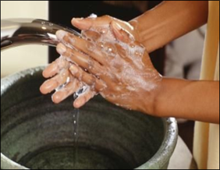
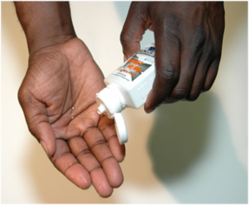
System change
System change/Build it – key takeaways
In the facility where WASH FIT is being implemented, ask the questions:
can staff clean their hands easily at each (and every) point of care as per the 5 Moments?
are the right managers and leaders engaged to ensure that system change to support hand hygiene can be achieved?
Remember:
Handwash with soap and water when hands are visibly dirty or following visible exposure to body fluids
Alcohol-based handrub is the gold standard for hand hygiene in all other situations
Notes:
READ SLIDE
SAY:
These questions are key for understanding the importance of “Build It” or system change (the terms are interchangeable, which ever works to help people understand).
Reflect for a moment, thinking about these questions and the relevence to your setting.
From a WASH perspective, system change improvement may be critical as action may not be possible without the right infrastrucutre and resources.
However, even where there are challenges in infrastructure – all of the other elements of the multimodal improvement strategy should still be considered to help understand everything needed for improvement.
NOTE FOR TRAINER:
if participants are more interested in climate issues that affect water remember this is covered in the module on water.

Slide 21
Training & education
Training & education/Teach it & WASH FIT
Related WASH FIT indicators to be assessed:
All new auxiliary staff, including waste handlers and those who clean, receive appropriate WASH and IPC training, tailored and appropriate to their job function (including hand hygiene)
Questions to ask yourself, to meet hand hygiene training and education standards:
Is someone dedicated to checking that current training and education programmes includes the correct, up-to-date hand hygiene recommendations?
Is there a possibility to carry out targeted training needs assessments?
https://www.who.int/infection-prevention/tools/hand-hygiene/workplace_reminders/en/
Notes:
READ SLIDE

Slide 22
Training & education
Training & education/Teach it – key takeaways
In the facility where WASH FIT is being implemented, ask the questions:
  Are up-to-date training package/materials available, with responsibilities allocated for delivery, as well as a rolling schedule?
  Are all health workers trained on the right moments and technique?
  Have knowledge and practice gaps been identified?
Notes:
READ SLIDE
SAY:
The key message is that when we think about training and education for hand hygiene improvement we should address the training materials, the human and other resources for delivering training and the focus of the training.
An important clarification is when hands should be washed with soap and water and when alcohol based handrub can be used. WHO recommendations state that hands can safely be cleaned by alcohol handrub at any time except when they are visibly soiled when they should be washed with soap and water and dried.

Slide 23

Monitoring & feedback
Monitoring and feedback/Check it & WASH FIT
Related WASH FIT indicators to be assessed:
Advanced: Hand hygiene compliance activities are undertaken at least annually
Advanced: Regular ward-based audits are undertaken to assess the availability of handrub, soap, single use towels and other hand hygiene resources (at least 3 monthly)
Q. What are some of the common challenges associated with monitoring hand hygiene compliance?
How might these challenges be overcome?
Are valid tools available for trained monitoring staff to use alongside templates for feedback to support improvement? If not, what would you do to overcome this?
Notes:
READ SLIDE
SAY:
Shout out some of the challenges you can think of (take just a few moments
NOTE FOR TRAINER:
Some of the common challenges to share are:
Securing support for audit from managers and leaders
Audit considered too time and resource consuming
A realistic monitoring schedule
Prompt participants to think of other challenges from their area
SAY:
Tell me whether you have any examples of solutions, of how they have successfully implemented hand hygiene audits.
If WASH FIT is being implemented, it is likely that there will be some general support for associated audits, but there will still be a need for regular communication on the value of the data that will be generated. Hand hygiene audit results feed into the general facility improvement plan.

Slide 24
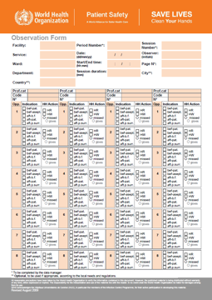
Monitoring & feedback
Monitoring and feedback/Check it – key takeaways
In the facility where WASH FIT is being implemented, ask the questions:
  Does the facility have dedicated trained staff to monitor hand hygiene resources and compliance among a range of health workers, including the use of valid tools and dedicated human resources with assigned responsibilities?
  Does the facility monitor hand hygiene perceptions and knowledge in a range of health workers?
  How is feedback given to support improvement? How will the facility know that an improvement has taken place (e.g. how regular is monitoring and feedback)
  Are all elements of the multimodal strategy monitored, available reminders, etc?
Notes:
READ SLIDE
SAY:
The form on the screen shows the WHO hand hygiene observation form. This is used to check compliance and provides feedback according to the Five Moments for hand hygiene.
Detailed instructions are available on the back of the WHO observation form if you chose to use this.
The instructions can be consulted during observations and people should be trained in how to undertake this detailed activity.
A WHO manual and comprehensive slide set exists on how to observe hand hygiene according to the five moments (if this is considered helpful and it is deemed a priority actions during your assessments).

Slide 25
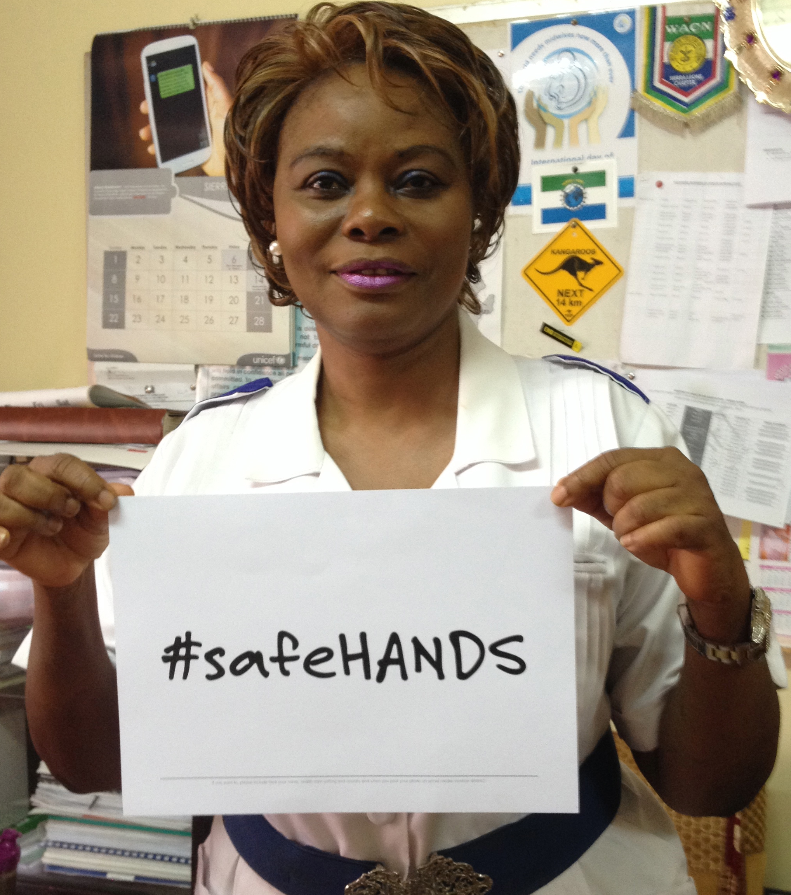
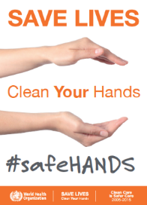
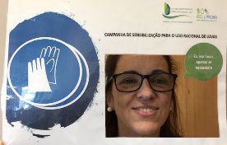
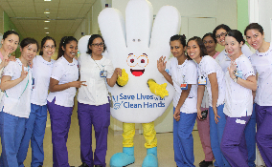
Reminders & communications
Reminders and communications/Sell it & WASH FIT
Related WASH FIT indicators to be assessed:
Essential: Hand hygiene promotion materials are displayed, clearly visible and understandable in all ward/treatment areas.
Remember:
Promotional materials don’t just mean posters.
If posters are used they require regular replenishment to have an impact.
Notes:
READ SLIDE
SAY:
Think of other ways hand hygiene promotion can take place to reach a health care facility, e.g. information leaflets, badges and stickers, social media including podcasts, local radio, conventional media e.g. newspapers, messages on t-shirts!
Campaigns are also ways to promote hand hygiene, both global and local campaigns – including radio campaigns, community campaigns etc. Some of the images here relate to WHO’s annual global hand hygiene in health care day that takes place each 5 May.

Slide 26
Reminders & communications
Reminders and communications/Sell it – key takeaways
In the facility where WASH FIT is being implemented, ask the questions:
What is the best way to publicize hand hygiene?
Do you engage health care staff/ others to help produce a range of reminders?
Do the posters and reminders used reinforce and promote the Five Moments related to the setting?
Are dedicated human resources and staff engaged during placement of materials?
Notes:
READ SLIDE

Slide 27

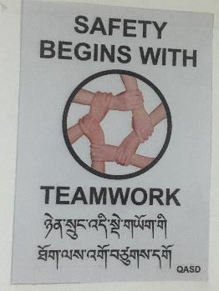
Safety climate/culture change
Safety climate/culture change/Live it & WASH FIT
Related WASH FIT indicators to be assessed:
Facility has a functional quality management/ quality improvement/IPC / WASH FIT team, with designated focal persons from IPC, WASH, etc.
Staff are regularly appraised on their performance with high performing staff recognized/ rewarded and those that do not perform well are supported to improve.
All auxiliary staff, including those who clean and waste handlers, have a clear, written job description, which outlines WASH and IPC responsibilities.
Rural HCF in Bhutan © Arabella Hayter, WHO
Notes:
READ SLIDE

Slide 28
Safety climate/culture change
Safety climate/culture change/Live it – key takeaways
In the facility where WASH FIT is being implemented, ask the questions:
  How do you make and maintain hand hygiene as a facility priority? Is it discussed at management level/with leaders?
  How are senior managers, champions and opinion leaders engaged and engaging others over time?
  Do all levels of staff, including senior managers and other leaders understand, role model and value the Five Moments for Hand Hygiene?
  Can role models that would have an influence on staff behaviours be identified and be made visible, e.g. a badge, during staff safety meetings/discussions?
  Are facility leaders and managers visibly demonstrating the value they place on hand hygiene in a number of ways?
Image source: What Women Want Global Findings – Image from White Ribbon Alliance (WhiteRibbonAlliance)
https://www.dropbox.com/sh/rcw1hn9dnqu1fpl/AAC0qON71SZULyRM3j_Xkd6da?dl=0
Notes:
READ SLIDE
SAY:
This element of the multimodal strategy addresses the importance of an institutional safety climate or culture for hand hygiene
The culture or safety climate of a health care facility is important for the delivery of safe, quality care – leaders and managers influence the culture/safety climate
Their commitment to hand hygiene and other safety initiatives is a big driver of success
If leaders and managers are not committed it is unlikely that hand hygiene will be valued, supported, funded or championed
How familiar are you with the idea of role models and champions – have they used this approach in relation to hand hygiene, IPC, WASH or any other initiative? (Ask people to shout out their examples)

Slide 29
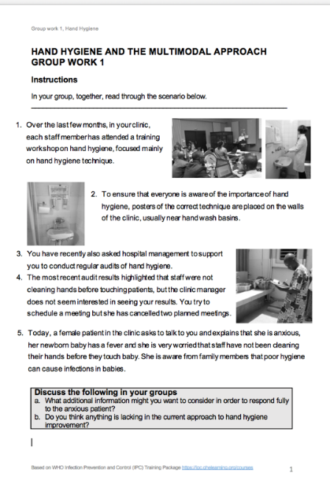
Safety climate/culture change
To achieve the right culture many things are required.
These will often depend on the local setting.
There is no one clear answer but leadership, in many forms, is known to be critical.
Human resources that facilitate quality health care delivery is also paramount.
Question: How might you better engage hospital or clinic managers in hand hygiene improvement?
5 minute exercise
Notes:
READ SLIDE
SAY:
For the next 5 minutes we will revisit the group work exercise you already read.
Return into your working groups and look again at the scenario.
A key challenge identified earlier was the lack of engagement of senior managers in hand hygiene improvement – it appears in this scenario that managers are not prioritizing hand hygiene.
Discuss some ideas on how managers might be engaged to take hand hygiene more seriously for a few minutes and be ready to feedback
NOTE FOR TRAINER - some ideas and prompts might include:
Persuading managers to participate in some audits and then be part of discussing results and ideas for improvement
Using the concerns of the female patient as a driver to engage managers and trying to secure their support to a) verbally support/promote the importance of hand hygiene to health-care workers b) authorise/mandate a hand hygiene improvement programme
The possibility of the senior manager verbally supporting/promoting the improvement at high-level organizational meetings
Exploring whether it is feasible to identify a Hand Hygiene Co-ordinator/project manager to direct a renewed hand hygiene initiative with manager approval and mandate
Discussing related funding in the broader context of WASH improvements
Messages from managers being planned leaders, which should be both visible/audible and updated regularly
Leaders seen to attend training and role model hand hygiene as per the Five Moments
Staff have WASH and IPC related responsibilities and are appraised, with high performing staff recognized & rewarded and those who do not perform managed according to the local culture
These and other ideas can be found in the WHO IPC Hand Hygiene Resources, Template Letter to Advocate Hand Hygiene to Managers (link in the reading list) and in the WASH FIT guide and assessment tool.

Slide 30
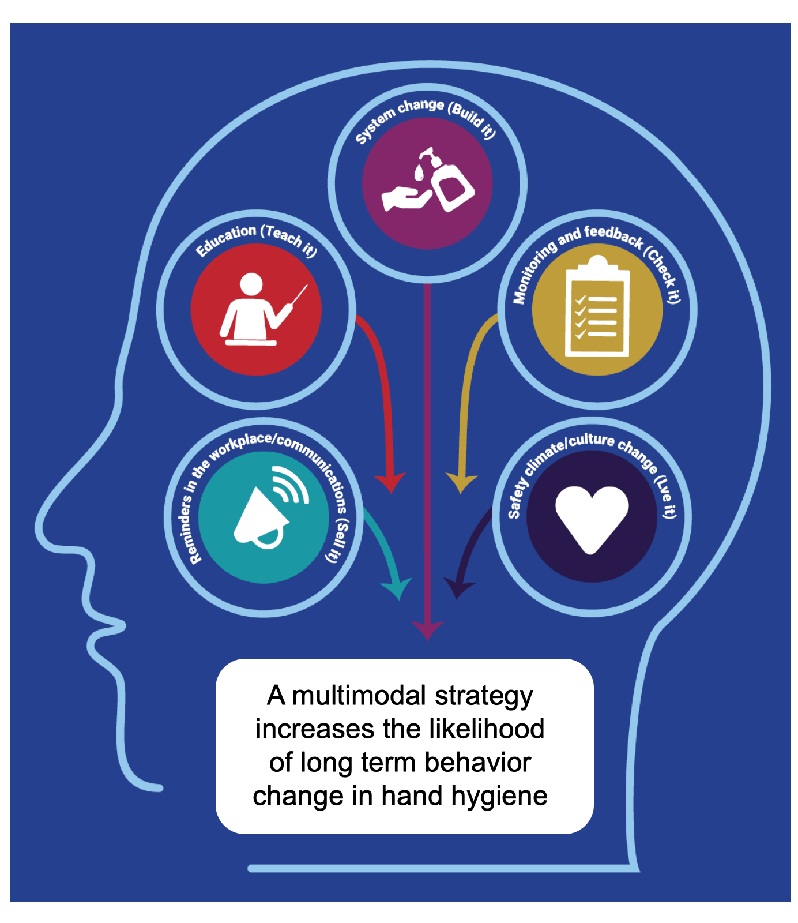
Hand hygiene and WASH take-aways
Without timely and effective hand hygiene, health for all (quality care) will not be realized.
An enabling environment (i.e. WASH) supports hand hygiene at the right times & in the right way.
Adopting & adapting a multimodal strategy will improve hand hygiene access and behaviours.
Hand hygiene can act as the ‘entrance door’ to wider IPC improvements and relevant WASH indicators.
Hand hygiene is a key performance indicator in reducing the burden of antimicrobial resistance, outbreaks and all avoidable health care associated infections.
Notes:
READ SLIDE
If required, SAY: this module does not specifically focus on COVID however, the information presented applies to all times and will support HH action when coronavirus or other organisms are present

Slide 31
Further reading/resources
All WHO Hand hygiene tools and resources:
  Implementation tools: https://www.who.int/teams/integrated-health-services/infection-prevention-control/hand-hygiene/tools-and-resources
  Training tools: https://www.who.int/teams/integrated-health-services/infection-prevention-control/hand-hygiene/training-tools
  Monitoring tools: https://www.who.int/teams/integrated-health-services/infection-prevention-control/hand-hygiene/monitoring-tools
  Resource considerations for investing in hand hygiene improvement in health care facilities: https://www.who.int/publications/i/item/9789240025882
New England Journal of Medicine hand hygiene video article:
  English: https://www.nejm.org/doi/full/10.1056/nejmvcm0903599
  Official UN languages plus other languages: https://www.who.int/campaigns/world-hand-hygiene-day
Hand Hygiene: A Handbook for Medical Professionals: https://www.wiley.com/en-gb/Hand+Hygiene:+A+Handbook+for+Medical+Professionals-p-9781118846865
OpenWHO Standard Precautions Hand Hygiene module: https://openwho.org/courses/IPC-HH-en

Slide 32
Further reading/resources
WHO Hand Hygiene Self Assessment Framework: https://cdn.who.int/media/docs/default-source/integrated-health-services-(ihs)/hand-hygiene/monitoring/hhsa-framework-october-2010.pdf?sfvrsn=41ba0450_6
Alcohol based hand rub:
  WHO (2010). Alcohol-based Handrub planning and costing tool. https://www.who.int/teams/integrated-health-services/infection-prevention-control/hand-hygiene/monitoring-tools
  WHO (2010). Guide to local production: WHO-recommended handrub formulations. https://www.who.int/publications/i/item/WHO-IER-PSP-2010.5
Five moments in a range of care settings:
  WHO (2012). Hand hygiene in outpatient and home-based care and long-term care facilities: a guide to the application of the WHO multimodal hand hygiene improvement strategy and the “My 5 moments for hand hygiene” approach. https://apps.who.int/iris/handle/10665/78060

Slide 33
Further reading/resources
Additional training materials:
WHO IPC Training Package (e-learning): Standard Precautions; Hand Hygiene & Standard Precautions; Environmental Cleaning: https://openwho.org/courses/IPC-HH-en
IPC (general):
  WHO (2019). Minimum Requirements for infection prevention and control (IPC) programmes https://apps.who.int/iris/handle/10665/330080
  WHO (2016). Guidelines on core components of infection prevention and control programmes at the national and acute health care facility level https://apps.who.int/iris/handle/10665/251730
  WHO (2021). Aide-memoire: respiratory and hand hygiene. In: Infection prevention and control: guidance to action tools. https://apps.who.int/iris/handle/10665/341418
WHO Antimicrobial resistance:
  WHO AMR pages: https://www.who.int/health-topics/antimicrobial-resistance

Slide 34
Questions?
Notes:
TRAINER NOTE:
Try to answer qus by reiterating points covered in the session
Refer back to relevant slides - repeat things that have been said, if necessary verbatim, from the slides
Use the resources highlighted in this session to additionally support you to answer questions (this will require pre reading)
If questions arise that are not related to the content of this module, tell participants that you will take note of them and can attempt to find answers to share with them at a later stage

