Slide 2
WASH FIT methodology
Core module
Add date & location
Notes:
Introduce yourself if you have not already, and make sure you insert the date and location to the slide before you start

Slide 3




Learning objectives
By the end of this session, you should:
Describe what WASH FIT is, where and how it is used and the expected impacts and outcomes
Understand the five phases of the WASH FIT cycle and how to carry them out
Understand how to adapt and use WASH FIT in a range of different settings
Describe the enabling factors and possible barriers for implementing WASH FIT successfully
Group
work
Link with a country
example
Icons to look out for
Links with climate
resilience
Links with GEDSI
Notes:
READ THE SLIDE

Slide 4

Icebreaker: “Just a minute”
Turn to the person next to you
Pick one person to speak. Explain to your partner, for one minute:
Why is having adequate WASH services in health care facilities important?
Try NOT to:
Hesitate (um…. er…. hmmm….)
Deviate (dont discuss anything other than the question)
Repeat yourself/words you have already used
If you hesitate, deviate or repeat, pass to the other person to try to talk to you about the question
3-5 mins
Notes:
READ THE SLIDE
NOTES FOR TRAINER:
This icebreaker can be used here or at a different time in the workshop depending on how the workshop is structured. This is based on a game featured on a radio show in the UK and is designed to be a fun way of thinking about WASH in health care!
If you think 60 seconds is too long – amend the time to 30 seconds.
You could also suggest different questions not related to the session topic, e.g. “Talk to your partner, for one minute about your favourite food/animal/plant: ” the aim to get people talking.
Once people have finished, SAY:
- Was that difficult? Could you get better at explaining this question to others? Did anyone give a really good answer?

Slide 5
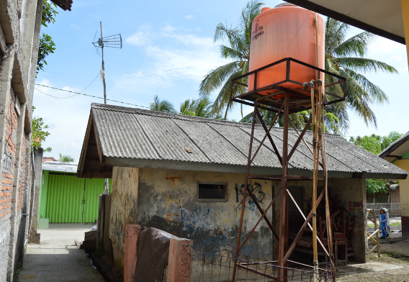
Part 1: Background
What is WASH FIT?
What resources are available to support you?
What is the purpose and scope of WASH FIT?
For those already familiar with WASH FIT, what is new in the 2nd edition?
Which parts of a facility does WASH FIT address?
How can WASH FIT support health initiatives?
Notes:
READ THE SLIDE
SAY:
this section of the training will address each of these six areas.

Slide 6
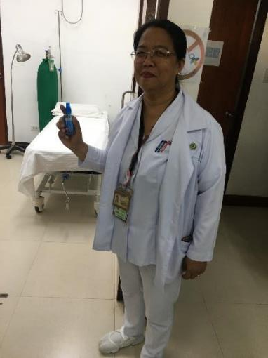
“Before starting WASH FIT, I thought the way WASH services were managed and the hygiene practices passed on to me by previous health workers from [the facility] were acceptable, and that nothing had to be changed or improved.
After setting up the team & conducting the assessment collectively we identified many items that need improving [such as de-clogging drains, increasing ventilation and staff training for waste management]. These are things we can do ourselves that benefit the staff and the clientele we are serving.
The time will come for me to be transferred to another facility, I can hand over the facility to the next health worker together with the WASH FIT plan, that he/she can use as the baseline for further improvement”.
Nurse from the Philippines, 2019.
Notes:
SAY:
take a few moments to read the slide, would anyone like to read this aloud to the rest of the group?
This quote illustrates perfectly the purpose and benefits of using WASH FIT.

Slide 7
What is WASH FIT?
A planning and implementation guide
A framework to be adapted
A tool that supports infection prevention and control
A stimulus for collaboration
WASH FIT covers:
Infrastructure
Behaviours
Operation and maintenance
Part 1: Background
Notes:
READ THE SLIDE
SAY:
A framework: to develop, monitor and continuously implement an improvement plan and prioritize specific WASH actions that are climate resilient, equitable and inclusive. Users are encouraged to use and adapt the framework to suit their needs. It can be used as it is or selected elements integrated into existing quality improvement programmes.
A planning and implementation guide: to be used as part of wider quality improvement efforts and to meet local, national and/or global standards,
A tool that supports IPC: precautions according to national guidelines/standard operating procedures (SOPs)
A stimulus for collaboration: and brings together all those who share responsibility for providing WASH service.
Ask participants: who are the kinds of people that share responsibility for providing WASH services?
Answer: Legislators/policymakers, district health officers, hospital administrators, water and sanitation engineers, climate and environmental specialists and users.

Slide 8
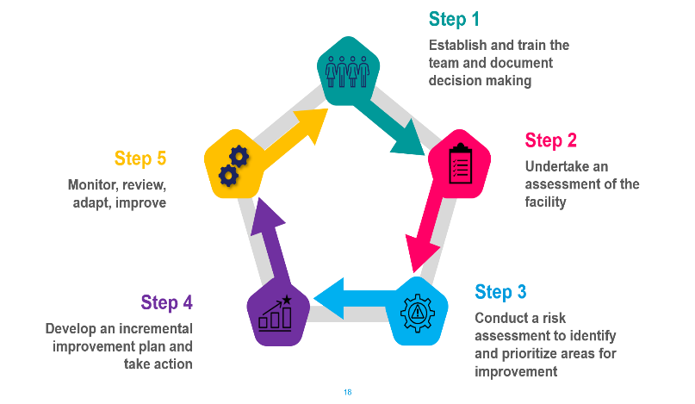
WASH FIT is not…
A tool just for assessing - it is about making improvements
A one-size fits all approach
A process that can be completed in a day
Notes:
READ THE SLIDE
SAY:
WASH FIT was initially designed for small (e.g. primary health care) facilities in resource constrained setting.
It has been used in bigger facilities (e.g. district hospitals and in some instances, larger national hospitals) but there are some limitations.
It works best in smaller facilities but can be adapted for bigger facilities. The basic 5-step methodology should remain the same, but the assessment form will need to be adapted to the national and local context (i.e. adding additional indicators to cover more complex settings such as requirements for major surgical and invasive procedures). This adaptation normally takes place at the national level by the Ministry of Health and WHO/UNICEF.
There are often requests to use WASH FIT for national estimates and country comparisons. Refer to the next slide for the differences between WASH FIT assessments and other survey formats using the JMP basic global indicators.
You can see the 5 steps of the cycle which we will focus on for much of this session – and this highlights the points made in the bullets.

Slide 9


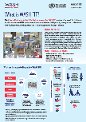
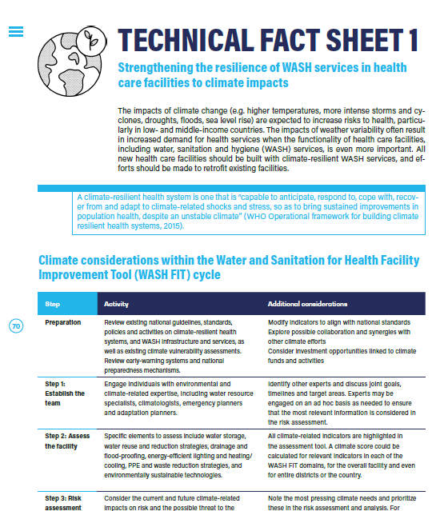



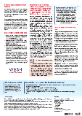
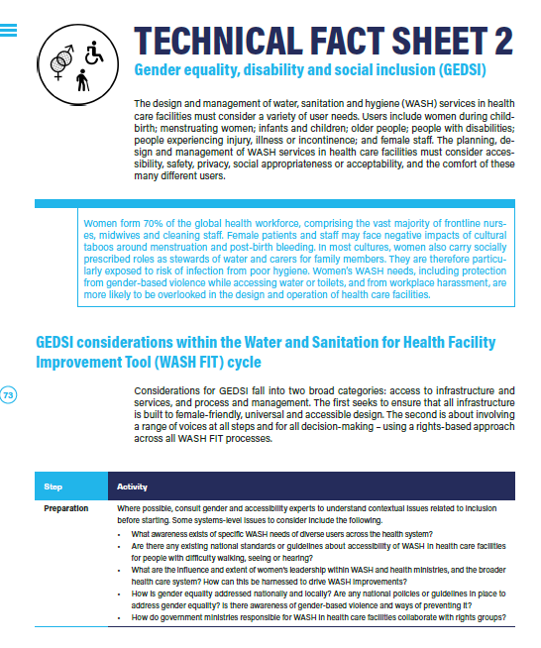


WASH FIT resources
WASH FIT helpdesk washinhcf@who.int
110 pages
50 minute read
WASH FIT 2nd ed. Practical Guide
READ THIS FIRST
Step by step guidance
What is WASH FIT?
Tools
Fact sheets
Manual for Trainers
WASH FIT portal
Short introduction to WASH FIT
Assessment, hazard & risk analysis tools (support development & implementation of improvement plan & ongoing monitoring)
5 factsheets
(within the WASH FIT Practical Guide)
All the materials for training in one place (slides, speaker notes, assessment & evaluation tools, sample agenda etc)
www.washinhcf.org/wash-fit
Country examples, case studies & opportunity to share experience
2 pages
5 minute read
5 minute read
3-5 pages each
5 minute reads
50 pages
30 minute read
Excel assessment tools
Sanitary assessment forms
Plan monitoring & feedback template
Electronic version on Kobo Toolbox
Notes:
SAY:
This shows the supporting resources that are available to learn more about WASH FIT, how to use it, where it has been used so far.

Slide 10
WASH FIT 2nd Edition
What’s new?
Guidance to adapt the tool for very rudimentary or temporary emergency facilities, larger facilities (e.g., regional or district hospitals) and those in middle-income settings where higher levels of services are sought
A greater focus on climate resilience and change mitigation strategies
Recognition of how to ensure WASH services prevent the spread of pathogens (including COVID-19) and antimicrobial resistance.
Updated assessment form including climate, gender and equity considerations and indicators for more advanced facilities and tertiary settings
Addresses additional WASH-related aspects of health care facilities, namely energy, vector control and occupational health
Notes:
READ THE SLIDE
SAY:
This slide is more relevant for audiences who are already familiar with the 1st edition of WASH FIT (2018).
Version 2.0 includes expanded technical content in training slides and fact sheets, a greater emphasis and streamlining of climate and gender considerations and a training manual. More details are provided in the following sections. And a new Q&A exists on the washinhcf.org platform to help you understand how to act on WASH FIT 2.0

Slide 11
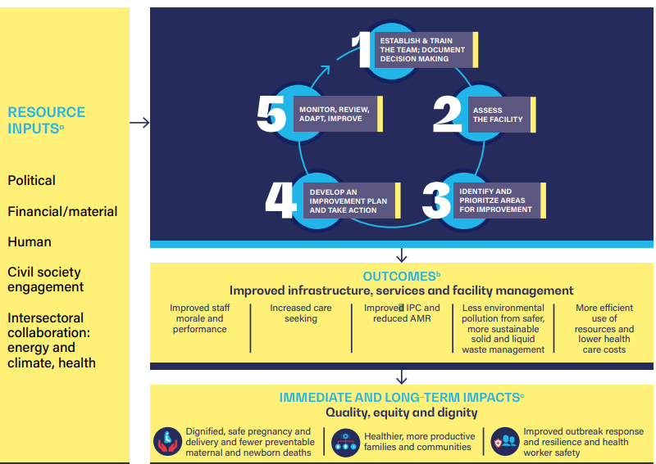
What is the purpose of WASH FIT?
Background
Notes:
SAY:
WASH FIT guides planning and implementation of WASH improvements as part of wider quality improvement (QI) efforts, and to meet local, national and global standards; supports the implementation of IPC standard and transmission-based precautions according to national guidelines and standard operating procedures (SOPs); and facilitates multisectoral actions by bringing together all those who share responsibility for providing WASH services, including legislators and policymakers, district health officers, hospital administrators, water and sanitation engineers, climate and environmental specialists, and users.
So the primary importance is for improving and sustaining WASH improvements in order to improve health-and health in the broadest sense, which includes but is not limited to infection prevention and control, it also relates to gender equity, human rights, compassion, care seeking, trust and uptake of health services.

Slide 12



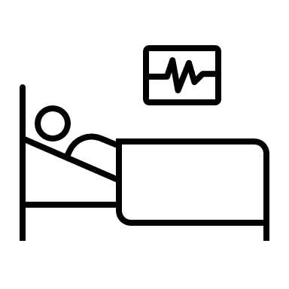
WASH FIT helps to improve all of these
Environmental sustainability & climate resilience
Outbreak response & resilience
Gender, equity, disability & social inclusion
Availability of basic services enables facilities to respond to emergencies & outbreaks
Strengthens resilience and sustainability of WASH and energy services
Planning, design and management of WASH services for accessibility, safety, privacy, social appropriateness & acceptability
Infection prevention & control
Quality of care
WASH is a core component and minimum requirement for IPC programmes
Also helps to reduce antimicrobial resistance
WASH preserves dignity, respect and provides a supportive environment
Healthier more productive communities
- Dignified, safe pregnancy & postpartum care
Notes:
SAY:
This is a recap of the content provided in module 1: Links with health - you may or may not have already undertaken this module.
READ THE SLIDE
SAY:
Immediate impacts from WASH FIT include:
Improved infection prevention and control, and antimicrobial resistance
More efficient use of resources and lower health care costs
Improved staff morale and performance
Dignified and safe pregnancy, delivery and postpartum care, improved health outcomes, lower maternal mortality rates
Improved newborn care and health outcomes, and lower neonatal mortality rates
Healthier, more productive families and communities
Improved outbreak response and resilience
GEDSI, climate resilience and IPC (hand hygiene) are also covered by the WASH FIT technical factsheets.
Assessment goes beyond just WASH (e.g. includes elements of IPC, climate resilience, GEDSI)
Indicators to systematically assess, monitor and track progress
Technical factsheets with suggested improvements
All improvements made through a climate lens

Slide 13
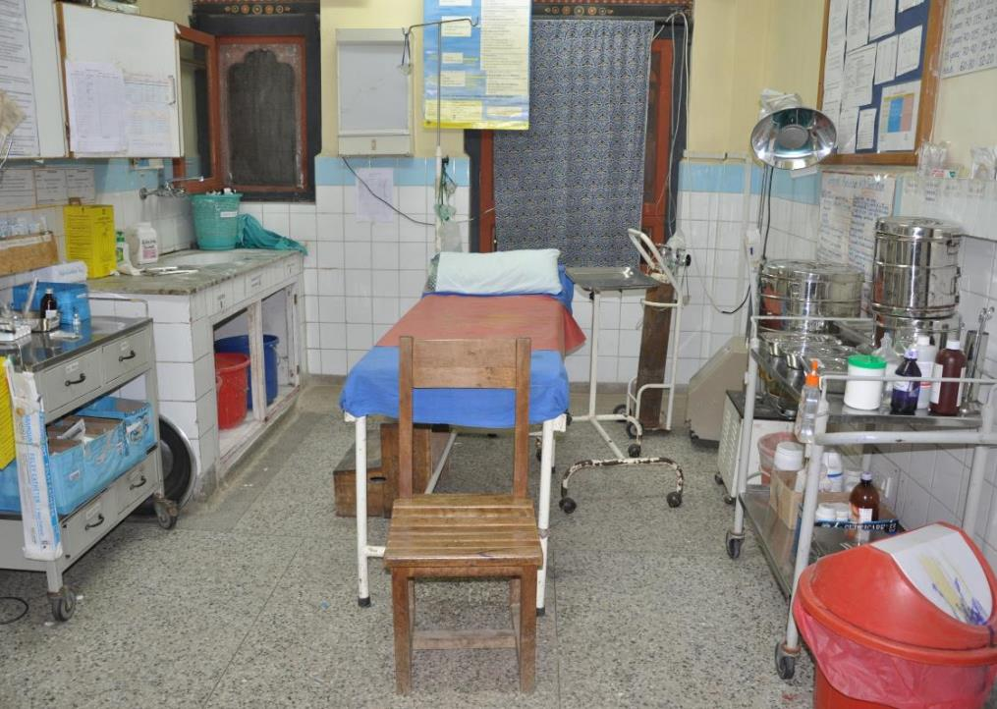

Which parts of a facility does WASH FIT address?
Add suggestions in the chat box/ flip chart.
Time 1-2 minutes.
5 mins
Notes:
NOTE FOR TRAINER:
Hand out the photographer to participants if you have prepared this, as well as post it notes
SAY:
Focus on this photograph, and in pairs
consider the main areas that would need to be improved in a health care facility (the next slide includes a list of these potential areas - you will talk through these in a moment with participants).
place post-it notes on the image where they consider risks could be or where they think risks could develop.
where might problems might arise, or where things could go wrong, from a WASH point of view?
After a few moments be prepared to feedback to everyone what you think/what you have written on the post it notes.

Slide 14


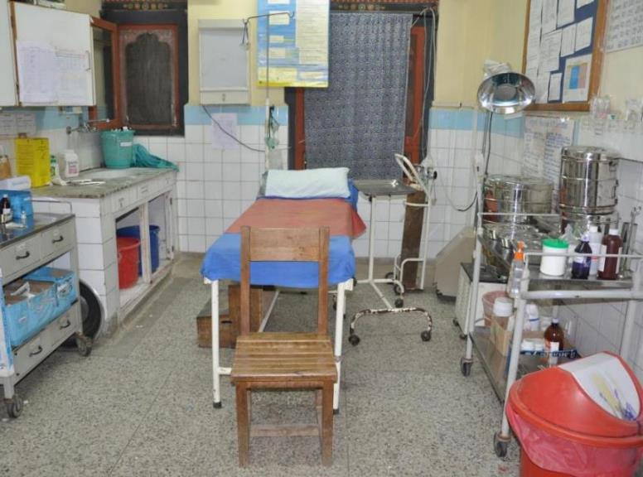







Seven WASH FIT “domains”
2. SANITATION
(toilets, treatment, wastewater)
1. WATER
(supply, storage, quality, conservation)
3. WASTE MANAGEMENT
(from generation to final disposal)
+ 2 cross-cutting themes
Climate
Gender equality, disability and social inclusion (GEDSI)
4. HAND HYGIENE
(infrastructure, compliance, training)
7. MANAGEMENT & WORKFORCE
(training, occupational health, protocols)
6. ENERGY & ENVIRONMENT
(lighting, pumping, heating, ventilation)
5. ENVIRONMENTAL CLEANING
(staff, protocols, equipment, training)
Notes:
NOTE FOR TRAINER:
Have a copy of the assessment in front of each participant to refer to if possible
SAY:
On this slide, we have superimposed the seven areas that can be seen in the photograph which relate to the seven domains of WASH FIT. Read out each domain from 1-7 and note the two cross-cutting themes (which cannot be seen in this photo). There are elements of these 2 themes throughout the other domains, for example disability-friendly access to toilets (sanitation) and water conservation strategies (water).
Questions in domains 1-5 align with the JMP core questions while 6 and 7 are outside of the scope of global monitoring and therefore not included in the JMP core questions.
Each domain includes indicators (between 5 and 17 per domain), and these are based on/aligned with the following global documents. A full list is provided in an optional reference slide at the end of the module:
Essential environmental health standards (2008)
JMP core questions (2018)
Sanitation guidelines (2018)
IPC core components
Climate guidance

Slide 15
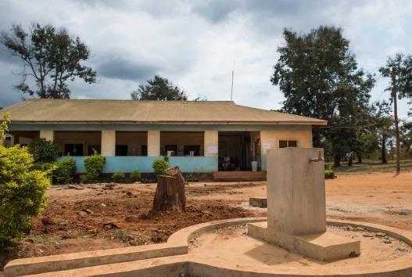
What problems have you experienced that are linked to WASH in health care facilities?
8-10 mins
Think about your own facility, district or country.
Where are the main gaps that you/staff/patients face across the 7 domains?
How would addressing these gaps improve health and the climate?
Notes:
SAY:
Work in pairs with the person sitting adjacent for 5 mins and be prepared to feedback to the whole group.
NOTE FOR TRAINER:
encourage discussion and affirmation e.g.in the feedback, if one persons shares that the main gap is XXX, ask the group whether this is common in their experience too? Keep a note of the problems they suggest and keep referring to these problems throughout the training. This will make subsequent exercises more relevant to the local setting.
problems may be very different for different sized facilities so if participants come from a range of settings, try to ask a range of people to share their ideas.
If conducting a national training, the question could be broadened to consider problems on a national level. “What are the most common problems facilities face across these 7 domains?”

Slide 16
Part 2: WASH FIT cycle
What are the five steps of the WASH FIT cycle?
What are the key outputs and tasks for each step?
What resources are available to help and how do you use them?
Notes:
SAY:
This part of the module will focus on three main areas - read these three areas out from the slide.
Part 2 is lengthy since it addresses in detail each of the five steps of the cycle.
If time is limited use only the first 5 slides which summarizes each of the steps rapidly.
For a more in depth understanding of the methodology associated with each step, the remaining slides probe into much more detail.
Breaks and pause points and reflections/Q&As should be built in after each of the steps. Give participants time to absorb the information and discuss amongst themselves what they have learnt, what questions they have outstanding.

Slide 17





WASH FIT improvement cycle
Step 1
Establish and train the team and document decisions
Step 2
Step 5
Undertake an assessment of the facility
Monitor, review, adapt, improve
Step 3
Step 4
Conduct a risk assessment to identify and prioritize areas for improvement
Develop an incremental improvement plan and take action
Notes:
SAY:
The WASH FIT improvement cycle consists of five phases which are undertaken at the facility.
The next 5 slides describe the main elements required for each phase. Each phase is then described in detail with group exercises to discuss elements in more depth. Trainers may wish to choose a smaller selection of slides to use, depending on how much time is available. Further information, beyond that included in the slides, can be found in the WASH FIT guide. Encourage participants to read the guide in detail to deepen their understanding.

Slide 18
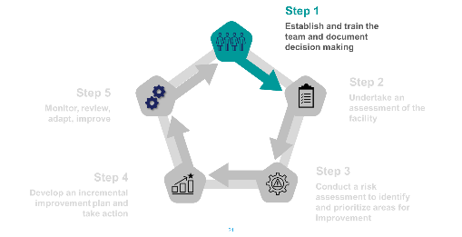
Step 1 summary
A team responsible for WASH FIT and quality improvement is established and trained
Team meets regularly and documents decision making
Team is the driving force behind all WASH FIT activities
Size and makeup of team will vary according to the size of facility – external expertise may be sought
Training the team is important.
Notes:
READ THE SLIDE

Slide 19
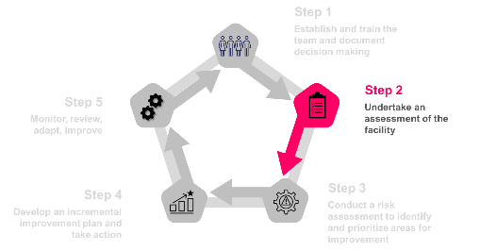
Step 2 summary
A comprehensive assessment of the facility is undertaken which informs all subsequent phases
A facility WASH FIT score is calculated to give an overall picture of performance
Assessment shows where gaps and problems exist
Results of assessment should be shared with relevant stakeholders
Assessment repeated after 6-12 months
Notes:
READ THE SLIDE

Slide 20
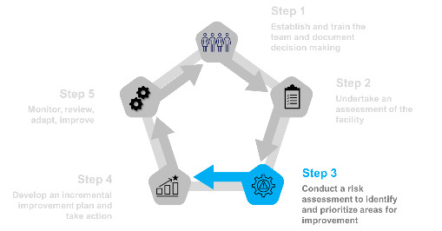
Step 3 summary
A risk score is assigned to all the problems identified in the assessment
Risks scores are based on 1) risk to facility users and the environment and 2) likelihood of occurrence
Total risk score is between 0-20.
Problems are ranked according to risk score (highest to lowest) to determine what needs to be addressed first
Climate change will affect present and future risk
Notes:
READ THE SLIDE

Slide 21
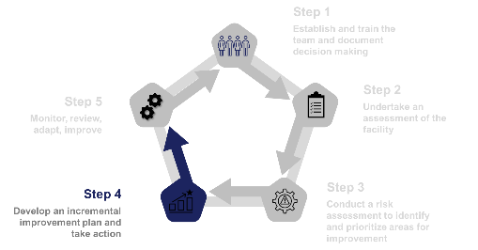
Step 4 summary
For each problem identified, team decides improvements needed to address risk
Prioritize quick win/low-cost solutions
Some problems require incremental improvements – break down improvements into short-term and long-term measures
Action plan is implemented in a timely manner
Improvements should be GEDSI and climate friendly
Notes:
READ THE SLDIE

Slide 22
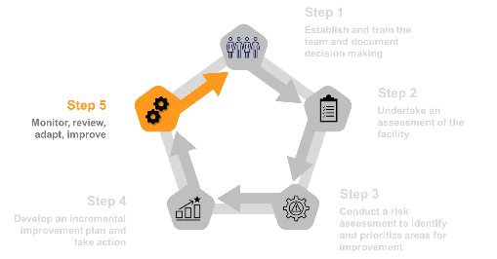
Step 5 summary
Regular and continuous monitoring of progress to troubleshoot problems
WASH FIT processes are modified review identifies problems
Daily and weekly spot-checks of the facility help to maintain progress and identify new problems arising
Data are shared with local and national level and partners
Notes:
READ THE SLIDE
SAY:
the rest of Part 2 goes into the detail of each of the phases.

Slide 23
Step 1
Step 1
Establish and train the team and document decisions
Step 2
Step 5
Undertake an assessment of the facility
Monitor, review, adapt, improve
Step 3
Step 4
Conduct a risk assessment to identify and prioritize areas for improvement
Develop an incremental improvement plan and take action

Slide 24
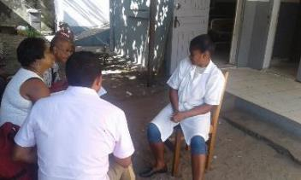

Step 1: Establish and train the team and document decisions
Outputs
A team responsible for WASH FIT and QI is established and trained, has a set of clear roles and responsibilities and meets regularly to assess make progress, prioritize tasks, and sustain progress
Documentation of team meetings and decisions (written reports, photos and videos)
Tasks
Identify and train a group of people (staff and community members) with the necessary expertise to form the WASH FIT team
Conduct regular meetings with these staff
Document results & decisions taken
Annual refresher training
Supporting tools
Simple form to record roles & responsibilities of team members
Record of team meetings
Training manual
Notes:
READ THE SLIDE
SAY:
QI = quality improvement
Tasks:
Train team members – this could be using the “official” WASH FIT training package or other locally adapted materials
The tasks for step 1 are a mixture of start-up tasks and ongoing activities. The team should also agree on the scope of WASH FIT (i.e. will it be applied to the whole facility or just a selected ward or department?)

Slide 25
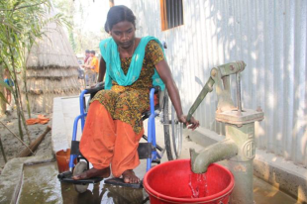
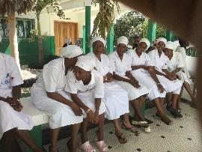
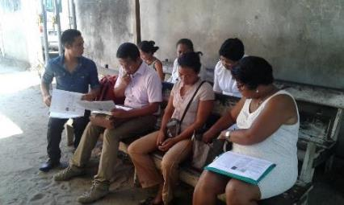
Who should be in the WASH FIT team?
What external expertise could be needed?
How might the team differ between a PHC and a district/national hospital?
© Shumon Ahmed/CDD
Notes:
SAY: how do you think the team will differ according to the size of the facility? What a team in a PHC would look like?
NOTE FOR TRAINER:
If time, you could have the participants should out answers very briefly
SAY:
- In larger facilities, there may already be an existing team or structure responsible for overall management of the facility, quality improvement, WASH or IPC (and cleaning).
- In smaller primary health care facilities, the team will be smaller, potentially only two or three people. These facilities, particularly in low-resource settings, often provide limited services and have few staff, with many responsibilities.
Number of members depends on size of facility
Inclusive and diverse
Clinical and non-clinical staff

Slide 26
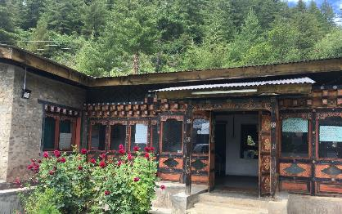
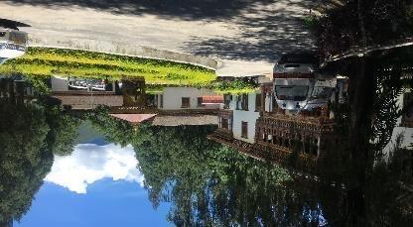
Group exercise: who is responsible for WASH FIT?
Rural primary health care centre
1 nurse, 1 health assistant
No births
3 hours drive from the capital
1
10 mins
Who should be responsible for WASH FIT activities?
What external expertise would you need to bring in?
What management structures or teams are already in place?
How could you integrate WASH FIT into these structures?
District hospital situated in a large town, 2 hours from the capital
100 beds, 10 deliveries per week, large town 2 hours from the capital
2
1
2
Notes:
SAY:
half of you please discuss scenario 1 and half discuss scenario 2 and answer the questions - be ready to feedback
LEADERSHIP IS KEY. A lot can be achieved with limited resources if there is a leader who is active and engaged.
NOTE FOR TRAINER:
Divide into small groups, tell them when you want to hear answers
The pictures are from 2 facilities in Bhutan. You may like to replace the photos with examples from your setting. If there are specific teams or structures (e.g. quality improvement teams are common) which are common in your setting, consider altering the questions too.
The next slide asks participants about common challenges that the team might face. You may wish to merge it with this slide if time is limited.

Slide 27
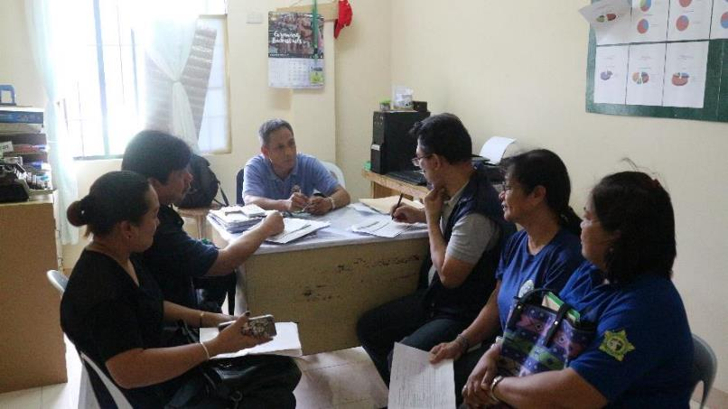
What challenges might the WASH FIT team face?
3 mins
Notes:
SAY:
- Work in pairs now to consider this question, be prepared to shout out some answers - in the next slide we will review some of these that we have gathered from different settings
NOTE FOR TRAINER:
Depending on how much time is available, you may wish to merge this exercise with the previous slide.

Slide 28
What challenges might the WASH FIT team face?
Technical capacity of team members
Engaging stakeholders & senior management
High workload – limited time for WASH FIT activities
Turnover of staff – need for retraining
Maintaining a consistent and effective communication between the WASH FIT team members
Ensuring all voices are heard – gender, ethnicity, age, clinical vs. non-clinical
Scheduling regular meetings of the WASH FIT team together and sustaining initiatives
Notes:
READ THE SLIDE

Slide 29
Example WASH FIT teams
Primary health care facility
District/national hospital
Facility manager, doctor or clinician Nurse or health assistant Community engineer or technician Community leader/focal point District health authority/district health officer (may not attend every WASH FIT meeting) | Member of senior management Nurse or other clinician IPC or IPC/WASH focal point Quality lead District health officer representative Engineer with WASH and energy skills (ideally with climate expertise) Health care waste technician and/or cleaner Community and/or patient groups Local authority representative
Notes:
READ THE SLIDE
SAY:
Examples of external people that may be involved:
Local government unit (LGU) / Local drinking water quality management committee / WASH Council or Task Force representative
Representative from Non-Governmental Organizations (NGOs) or Professional Organizations related to public health interest
Local WASH experts
Representative from water districts / water suppliers / water regulators

Slide 30
Making the team more GEDSI-friendly
Key principles
All team members have specific roles and responsibilities that are clearly defined at the start, written down and endorsed by senior management.
A leader is appointed to drive the process with full support from senior management
Team has diversity and gender balance and involves clinical and non-clinical or auxiliary staff
Community and local government representatives are involved and provide broader community context
The team reflects the diversity of the community & users with specific WASH requirements or constraints;
  members of disabled people’s organisations (DPOs)
  women’s groups and human rights activists
  civil society to speak up for marginalised and indigenous groups.
Notes:
READ THE SLIDE

Slide 31
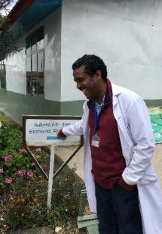
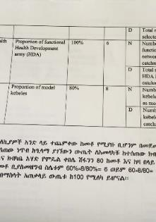
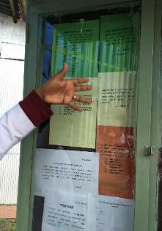
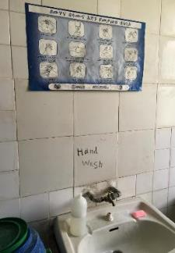
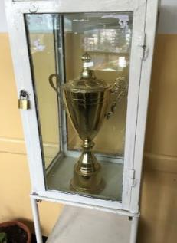
Leadership to drive change in Ethiopia
Committed leader created a culture of quality improvement
Staff incentivized with awards for good performance
A formally recognized quality management system includes WASH
Regular audits of WASH & IPC
Wards ranked according to WASH FIT score & shown at facility entrance
Hand hygiene activities
1
2
4
5
6
Notes:
READ THE SLIDE
SAY:
These pictures were taken in 2016 at a large district hospital which was part of the CASH initiative (Clean and Safe Hospitals). This was a large, national programme to improve quality of care through WASH and IPC. CASH included an audit tool which was made more comprehensive by including some of the WASH FIT indicators that were not previously covered by the programme.
Leadership and a culture that values WASH and demonstrates that value is a critical part of a multimodal strategy that drives behaviour change. You can learn more about the different elements of a multimodal behaviour change strategy in the hand hygiene module and in the technical factsheet on the multimodal strategy.
Consider reading the hand hygiene factsheet on washinhcf.org before attending the hand hygiene module training.

Slide 32
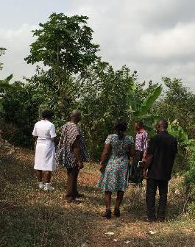
Community engagement in Ghana
In a rural PHC, a community committee:
Planned a cleaning campaign to improve health care waste management
Engaged a local engineer/technician who helped fixed blocked taps, mend windows and build a fence around the facility to prevent animals entering
Appeared on the local radio station asking community members to report problems they had encountered at the HCF
Members of the community committee inspect the waste pit with the IPC focal point to plan improvements
Notes:
READ THE SLDIE

Slide 33

Step 1
Establish and train the team and document decision making
Step 2
Step 5
Undertake an assessment of the facility
Monitor, review, adapt, improve
Step 3
Step 4
Conduct a risk assessment to identify and prioritize areas for improvement
Develop an incremental improvement plan and take action

Slide 34

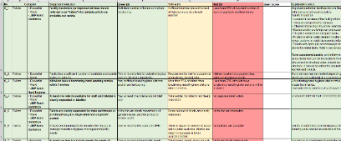
Step 2: Undertake an assessment of the facility
Outputs
An adapted version of the assessment form, tailored to the facility’s needs
Regularly completed assessment and records of previous assessments to compare progress
Tasks
Review and adapt the assessment form to the local or facility context
Regularly conduct an assessment of the facility to provide the basis for improvement planning
Supporting tools
Assessment form
  Excel
  Kobo (online version)
Notes:
READ THE SLIDE

Slide 35
Structure of assessment form
Available in Excel or Kobo Toolbox
> 90 indicators sorted in 7 domains
Not all indicators relevant for all facilities (PHC / hospitals; basic / advanced services)
Scored according to three levels:
Meets minimum standards (2/2) Maintenance needed to sustain score
Partially meets standards (1/2) Needs minor improvement
Does not meet standards (0/2) Needs major improvement
Example indicator Domain: health care waste | Meets standards: | Partially meets: | Does not meet:
Waste correctly segregated at all waste generation points | Yes (2) | Some sorting but not all correctly or not practiced throughout the facility (1) | Waste not correctly sorted at any waste generation points (0)
Notes:
READ THE SLDIE
SAY:
Kobo toolbox is an online platform. It allows quicker data collection. Refer to the module on use of Kobo toolbox. A recording of the module is available on the WASH in HCF YouTube channel.

Slide 36
Adapt the assessment tool
Align indicators with national standards
Change scoring criteria to make more achievable or more aspirational
Add missing indicators for other areas of interest and higher service levels
Reduce number of indicators for small facilities (remove those that are not relevant, e.g. in-patients, on-site waste treatment)
Focus on a specific WASH domain, e.g. water or health care waste or area within facility (e.g. maternity)
Use local terminology and translate to local language
Adaptation usually happens at national level by Ministry of Health - all partners should be mandated to use the same version
Refer to WASH FIT Guide: Annex 2 for further instructions
Notes:
READ THE SLIDE
SAY:
This is often done at the national level before the first training takes place.

Slide 37




Simplifying the assessment for smaller facilities
Country example: Mali
Target facilities: very small, PHCs in rural areas, extremely limited resources & capacity. Full set of indicators was found to be overwhelming
Reduced the number of indicators by half
Used locally drawn illustrations to show necessary improvements
Notes:
READ THE SLIDE

Slide 38
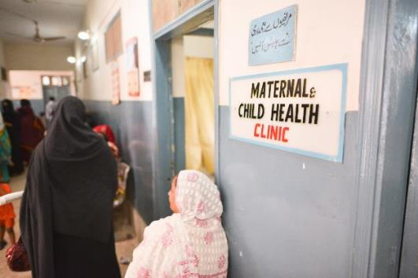
Hospitals & bigger facilities
Include more indicators
Start WASH FIT in one ward or department before assessing full facility
  → Chose department with obvious needs + motivated staff
Some indicators will need to be assessed multiple times (e.g. once per ward) & average given across indicator
  → Helps identify poor performing wards & allocate resources
Maternity services are often underserved – a good place to prioritize WASH FIT
Notes:
READ THE SLIDE
SAY:
Labour, delivery and neonatal departments are often the most underserved in a facility and are a good place to start WASH FIT b/c improvements can have a significant health impact.

Slide 39

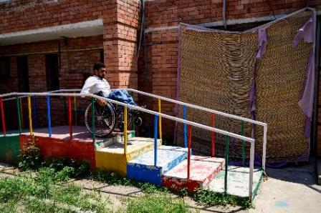
Assessing gender, equality and disability inclusion
Pay special attention to the delivery rooms, neonatal care unit and postnatal care rooms
Check for gender-specific facilities and infrastructure (e.g., toilets, MHM)
Check accessibility of services
Speak to healthcare workers and facility management to understand and challenge harmful attitudes and discrimination towards certain groups
Recognise that not all staff will feel comfortable highlighting problems due to power imbalances
(c) WHO/Sebastian Liste
Notes:
READ THE SLIDE
SAY:
MHM = menstrual hygiene management
Refer to the module on GEDSI which explores these issues in more detail.

Slide 40
Suggested cut offs
WASH FIT facility score
How to calculate the score?
Can be calculated for whole facility or by ward or domain
Track progress over time
Enables comparisons between facilities
Total score of all indicators assessed
Max possible score [no. of indicators assessed x 2]
> 75% Good Facility is doing well but continue making improvements to meet minimum standards
67-75% Average Additional efforts are needed and ongoing maintenance
< 67% Poor Major efforts and resources needed for improvements, poor quality of care
Notes:
SAY:
The score will help to get an overall picture of the facility. It is a crude score because all indicators are weighted the same (i.e. whether the facility has an improved water supply contributes the same as whether there is lighting in the latrines).
The score can be used to measure progress over time, however it is important to remember that the score may go up overall, while some important indicators go down during the same period.
What does the score mean?
The cut off points are just a suggestion; you may wish to use different criteria. This should be agreed at the national level or at the facility level by the WASH FIT team.

Slide 41
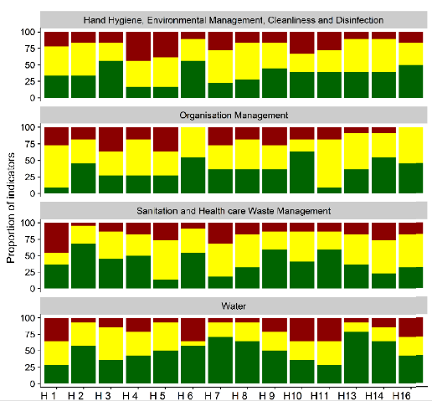
WASH FIT score and data visualization in Kenya
Comparison of 16 district hospitals in Kenya
% of indicators scoring 0, 1 or 2 across four domains
Highest scoring domain = water
Helpful for government/policy makers to compare facility performance
Drives interest and consistent performance for facility staff
Meets target
Partially meets target
Does not meet target
Notes:
SAY:
It is useful to show how facilities are doing. These graphs compare 16 district hospitals in Kenya. The same graph format could be used to show the same facility over time, or to compare different wards within a facility.
The best performing domain, across all hospitals, was water (bottom row, with the most green).
These 16 hospitals were part of a research project carried out by Oxford University, Wellcome and KEMRI using WASH FIT to assess and identify areas for improvement to address antimicrobial stewardship.

Slide 42
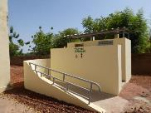
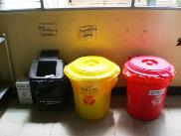
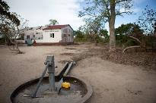
Group exercise: does this picture meet the standards?
5 mins
In groups, look at the photos on the next slide:
What indicators / standards are relevant?
What will you DO to get the information at this location?
What will you ASK to get information? WHO will you ask?
What challenges might be faced when trying to do the assessment?
See next slide for enlarged photos
Refer to the WASH FIT assessment tool for the full list of indicators.
Notes:
SAY:
We will now break into groups and you will review the photos and make comment - be ready to feedback your thoughts
What indicator and standards are relevant? It doesn’t matter if you don’t know the exact WASH FIT indicator. This is a general discussion to think about the types of information you’d be looking for during a WASH FIT assessment.
NOTES FOR TRAINER:
Each group should be given one picture to focus on and report back to the main group. They may then discuss other pictures if there is time.
Consider replacing the photos with other examples from the local area. The photos may also be replaced by a video tour of a facility or, where feasible, a real-life assessment.
It may be helpful to have the questions written on a flip chart so participants can refer back to them while looking at the photos on the next slide.

Slide 43
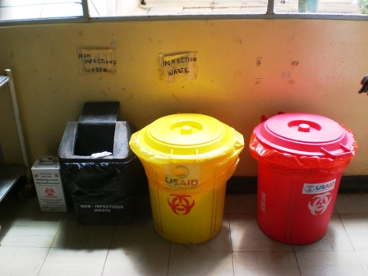


Bins for segregating waste at outpatient point of care
Onsite water supply
Women’s toilet block
Notes:
SAY:
You need to be as thorough as possible when doing an assessment.
What information would you need to find in each picture and how you should do it – observation, questions (if so, what type of questions), collect data?
The following list is not exhaustive.
Lift up the lids and look inside. Is waste correctly segregated? Are bins labelled? Are there posters with information on the wall? Who is responsible for emptying the bins? Are they full? Empty?
Ask the staff if the water is functioning, does it always function? Is water quality tested? Is there a protocol to take action if the water quality is poor? Is it affected by seasonality? Is there a backup supply? Consult the SI form to do a more detailed analysis.
Open the doors of the latrines and look inside. Don’t just trust what you see on the outside. Is there a hand washing station with water & soap? How is fecal waste managed? Is there onsite treatment? Is there a staff toilet? Is there provision for MHM?
Be thorough – even if you know the facility well, there may be things that are not as they appear and more probing and questions are needed!

Slide 44
Step 1
Establish and train the team and document decision making
Step 2
Step 5
Undertake an assessment of the facility
Monitor, review, adapt, improve
Step 3
Step 4
Conduct a risk assessment to identify and prioritize areas for improvement
Develop an incremental improvement plan and take action

Slide 45
Step 3: Conduct a risk assessment to identify and prioritize areas for improvement
Outputs
A list of problems and gaps identified during the facility assessment
An understanding of the risks associated with each of these problems, ranked according to the severity of these risks
A list of problems that are sorted in order of the priority needed to address them.
Tasks
Review the results of the assessment and identify all the indicators that do not meet the targets (across the facility, ward or domain), which constitute problems or gaps.
Determine the level of risk associated with each problem
Rank the problems according to their risk score to show which to prioritize for improvements
Supporting tools
Risk assessment
Notes:
READ THE SLIDE

Slide 46
Calculating risk
Category | Score | Description
Severity of consequences to facility users and environment | 0–3 = low severity | No major health effects are anticipated, and no urgent attention is required, but improvements are needed to reach standards and to improve quality of care.
 | 4–6 = medium severity | It is likely that there will be moderate negative health effects, discomfort from unsatisfactory services (e.g. unpleasant odours, unsatisfactory working conditions, potential for minor injuries), impact on staff morale and performance, or impact on the environment.
 | 7–10 = high severity | The problem is very likely to result in injuries, illness or infection in staff, patients and visitors, and an inability to provide essential services. It affects the dignity and safety of all facility users. There may be significant environmental contamination and impact on surrounding communities.
Likelihood of occurrence | 0–3 = likely to occur only rarely | The problem is likely to occur only rarely.
 | 4–6 = may occur half the time | The problem is somewhat likely to occur.
 | 7–10 = highly likely to occur | The problem is constant and ongoing and has a very high likelihood of occurring.
Notes:
READ THE SLIDE

Slide 47
Additional tips
Overall risk score
0–7 = low risk | Minimal harm to humans or the environment.
8–14 = medium risk | Some harm will occur to humans and/or the environment.
15–20 = high risk | Significant harm is likely to humans and/or the environment.
Excel tool will calculate total score automatically
Avoid tendency to categorize everything as “high risk”
Alternative risk assessment methods may be developed by team
Notes:
SAY:
So you have considered some typical problems that might arise. Thinking about the last picture, consider how you would assign a risk score to the problems that you saw. How serious is the risk to facility users? What is the threat to environmentally sustainability and climate resilience?
For each problem identified (i.e. each indicator which doesn’t meet standards) a risk score should be assigned using these 2 criteria.
Other criteria (scored 0-10) could be added and the total risk score adjusted accordingly
There is a tendency for people to automatically categorize every problem as “high risk ” as this will make it difficult to prioritize certain improvements over others. Rankings should be based on predefined criteria.
Think about how would you try to avoid this problem if you were doing a risk assessment?

Slide 48
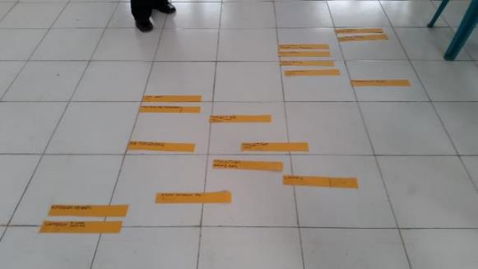
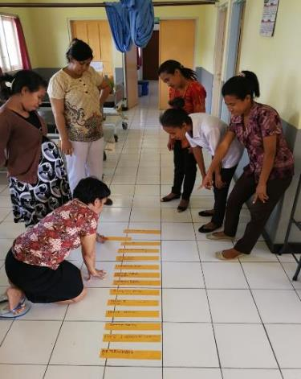
Alternative method used in Indonesia
Staff wrote a list of all problems identified on strips of paper
Staff ranked these according to risk/priority for addressing them
Staff decided their own criteria for ranking
Notes:
SAY:
This example is from a catholic hospital in West Timor. The team conducted an assessment, and wrote all the problems they identified (i.e. anywhere that an indicator scored 0 or 1), onto a piece of paper.
As a team, they decided which were the most important things that needed to be addressed.
Please give alternative suggestions from your work if you have them. Again, there is no right or wrong way to do this.

Slide 49

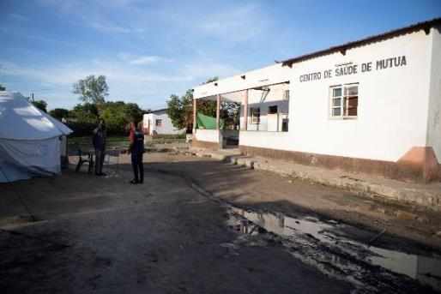
Don’t forget - climate change may affect the risk over time
New problems will arise in the future, each with their own risks
New risks may be linked to existing problems
When calculating the risk score, consider will the risk increase or decrease over time?
Photo: flooding at a HCF in Mozambique after cyclone Idai
Notes:
SAY:
Risk is not simply an assessment of what has occurred in the past but about envisioning what might occur in the future. The past can be a good guide to the future, but it is not a perfect one, particularly when new trends may emerge.
A simple approach to incorporate climate change in the risk assessment is to assess, on the basis of climate change scenarios, the likely change in the risk over time.

Slide 50
Prioritize items for action
Sort list of problems according to risk score: highest risk scores take priority for urgent action
  Problems can be further sorted by domain (e.g. all water-related problems) or by area in a facility (e.g. all out-patient department)
Lower risk scores should be addressed subsequently when resources become available
Some problems which have low risk scores may only require simple/low-cost improvements and can be done at the same time
Notes:
READ THE SLIDE
SAY:
Not everything can be addressed immediately as there will always be a limit to resources available. The risk score allows users to decide which to prioritize first.

Slide 51
How to prioritize according to level of risk
Risk | Immediacy | Action | Cost of inaction
LOW (0-7) | Address as resources become available Lowest priority but in reality, often easiest to address | May be addressed with no/low-cost actions | Inaction unlikely to result in cost implications
MEDIUM (8-14) | Action needed but less urgency than high risk problems | Take action to ensure risk does not get worse | Some cost savings by addressing problem
HIGH (15-20) | Urgent & immediate Takes priority | May require significant, time, expertise and resources to address | Serious cost implication from inaction
Notes:
READ THE SLIDE

Slide 52
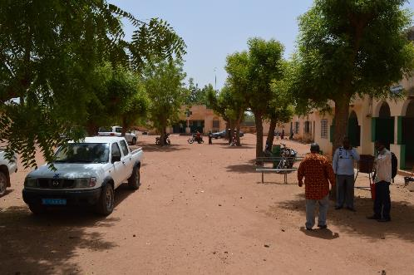
Group exercise: Conduct a risk assessment
At your facility, you have identified the following problems:
15 mins
No improved water supply on premises; water collected off-site; quantity is limited especially during dry season
No functioning waste treatment technology; autoclave is broken and has been for some time; all waste burned together in an open pit
Septic tank is not emptied regularly or functioning properly; fecal waste overflows during heavy rain
Lack of lighting in toilets; toilets are 30 metres away from consultation areas
Notes:
READ THE SLIDE
SAY:
You will now have time to work in groups for 10 mins to conduct this assessment and provide answers for the last 5 mins for our discussion
You have identified four major problems at the HCF (no doubt there are others too!).
Using the criteria presented on the previous slides, assign a risk score (out of 20) for each of the 4 problems (1-10 for severity of risk to users and 1-10 for likelihood of occurrence)
Which would you consider the highest risk and which the lowest? Why?
Which item would you address first? What kind of action would you need to take to address the problem? (Reminder that we will come on to the improvement plan in the next section but it’s good to start thinking about it now).
NOTE FOR TRAINER:
Questions for reflection:
Did participants consider the impact of climate change on future risk? Are there any risks that you think are likely to get worse (or better) over time?
Was it hard to assign a score? If so, why?
Would you use this method for risk assessment or would you use an alternative way?
Note, these examples are taken from the WASH FIT guide. You may wish to chose different examples which are more relevant to the local context.

Slide 53
Suggested answers
 | Severity of risk | Likelihood of occurrence | Total risk
No improved water supply on premises | 9 | 10 | 19
No functioning waste treatment technology | 8 | 10 | 18
Septic tank is not emptied regularly | 8 | 6 | 14
Lack of lighting in toilets | 4 | 3 | 7
Notes:
READ SLIDE TO CONCLUDE THE EXERCISE

Slide 54
Step 1
Establish and train the team and document decision making
Step 2
Step 5
Undertake an assessment of the facility
Monitor, review, adapt, improve
Step 3
Step 4
Conduct a risk assessment to identify and prioritize areas for improvement
Develop an incremental improvement plan and take action

Slide 55
Step 4: Develop an incremental improvement plan and take action
Outputs
An incremental improvement plan with a set of time-bound activities, agreed by the team with endorsement from senior management
Timely action on activities listed in the plan.
Tasks
Develop a detailed incremental improvement plan with a defined improvement aim and specific, time-limited activities, outlining what improvements will be made within a given time frame.
Identify measures that improve management of current climate risks and will help to manage long-term future risks and resilience.
Supporting tools
Improved plan (Excel)
Notes:
READ THE SLIDE
SAY:
Remember to implement the improvement plan in a timely manner, including ongoing operation and maintenance of infrastructure.

Slide 56
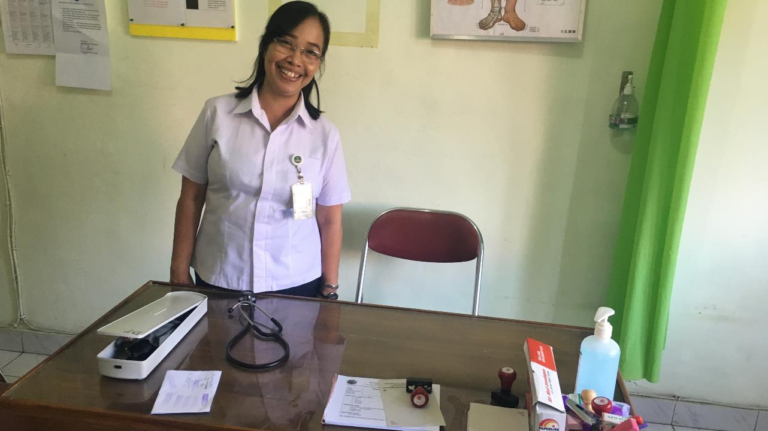
WASH FIT is about taking improvement action
…otherwise, it’d be called
WASH FAT: facility assessment tool!
Notes:
READ SLIDE

Slide 57


Step 4: Develop an improvement plan and take action
Based on step 4, you have prioritized where urgent action is needed
  Other items will be addressed later
What actions are required? (immediate & longer term)
Estimated budget (and source of funding)
What other resources are needed (e.g. technical, human)
Deadline for completion
Notes:
READ THE SLIDE
SAY:
Improvement planning should achieve step-wise, incremental improvement with a particular focus on the highest risks, so that limited resources can be used most effectively.
A stepwise approach to full implementation of an optimal solution is often needed due to resource constraints and/or budgetary planning cycles.
Such an approach should consider what can be done immediately to reduce the risk level given the available resources (often referred to as “quick wins”). Such measures may provide a small but immediate improvement in risk management, whilst longer-term improvement measures can be planned and delivered in parallel which ultimately will reduce the risk level to the desired and acceptable level.
It is recommended not to plan any activities beyond 6 months as these are likely to be forgotten. Focus on 1 month, 3 months, 6 months. Review again in 6 months (Step 5) and reassess what needs doing.

Slide 58


Suggested improvements
Building new infrastructure
Upgrading old infrastructure to make more climate resilient or GEDSI friendly
Reviewing protocols and SOPs
Staff training in new techniques or procedures
Improving management methods
Simple, low-cost improvements can have a big impact
But may require some imagination and creativity!
Notes:
READ THE SLIDE
SAY:
When thinking about improvements, consider:
How have neighbouring facilities responded to similar issues?
Are there local or national examples to learn from?
Does the facility need to bring in external expertise (e.g. an engineer) to help develop solutions and/or carry out the improvements?

Slide 59
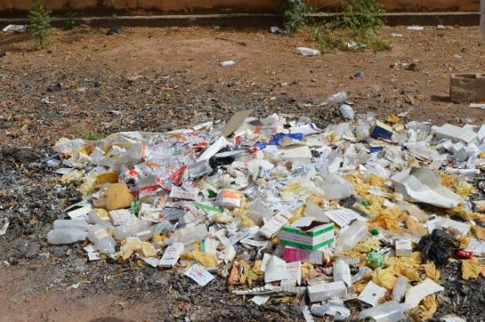
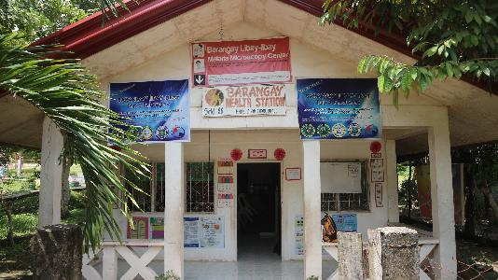
What incremental improvements would you suggest to address the waste problem?
You work in a primary health care facility in a small town
There is no waste segregation
No safe storage of waste
All waste is combined and burnt in an open pit in facility grounds
Autoclave existed once but it is long broken, and no one knows how to fix it
What environmentally sustainable improvements are there?
Notes:
SAY:
I want you to shout out answers. What are the immediate improvements (low cost), medium term and longer term/more expensive improvements that could be made?
Think about what risk score you gave to this in the previous exercise? How would that affect the improvement plan? (Is this considered a problem that requires immediate action? What is the cost of inaction?)

Slide 60
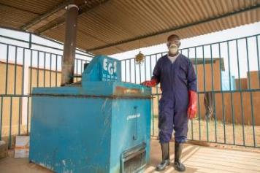
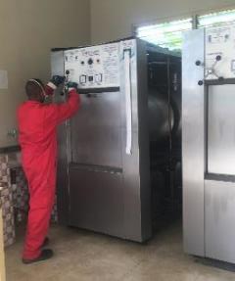
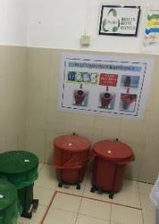
Incremental improvements for waste
Long term, most expensive
Training on waste segregation & rationale use of PPE
Reminders at points of care
Develop reverse logistics system:
Waste is regularly & safely transported to centralized plan with non-burn technology
Build lockable, covered storage areas
Build low-cost incinerator as interim solution
Medium term
Immediate improvements, minimal cost
Notes:
READ SLIDE

Slide 61
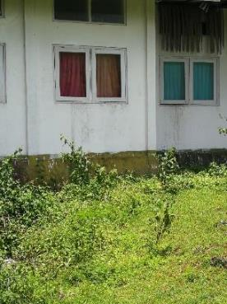
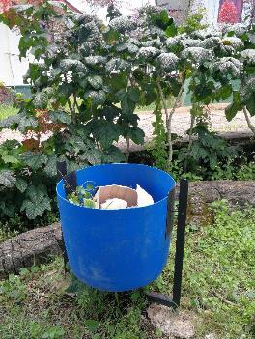

Waste improvements in Indonesia
After
Before
Waste outside nutrition clinic identified as a major problem
Cleaning campaign for 1 month
Bins installed for general waste in grounds
Clean surroundings, risk of infection and injury decreased
Notes:
READ THE SLIDE
SAY:
This facility in Indonesia is the same as the one showing the alternative risk prioritization method. One of the simple, low cost improvements identified was to tidy up waste at the facility.

Slide 62



Improvements in an extremely low-resource setting
Planting plants by HCF entrance
Clear signs demonstrating gender separation of latrines
Hand washing poster drawn by
head of HCF
Chad
Photos: Chad 2016, © WHO
Notes:
SAY:
These are examples from a rural primary health care facility with limited resources. They had limited capacity for the “big ticket items” so focused on small manageable things that they could do without external help.

Slide 63



Improvements in a lower-middle income setting
Sanitation facility adapted for patients with physical impairment
Water tanks with lid and tap accessible for patients
Hand washing posters
Tajikistan
Photos: Tajikistan 2019, © WHO
Notes:
SAY:
These are examples from a rural primary health care facility with limited resources. They had limited capacity for the “big ticket items” so focused on small manageable things that they could do without external help.

Slide 64





Technical factsheets provide example improvements
Strengthening climate resilience
Gender equality, disability and social inclusion (GEDSI)
Health care waste
Safe plumbing
Hand hygiene
Notes:
SAY:
The factsheets provide guidance for users wishing to focus improvements in a particular area. They include notes on how to adapt the process (e.g. what other expertise or staff are needed if you are focusing on climate?) as well as suggested interventions for making improvements.

Slide 65
Step 1
Establish and train the team and document decision making
Step 2
Step 5
Undertake an assessment of the facility
Monitor, review, adapt, improve
Step 3
Step 4
Conduct a risk assessment to identify and prioritize areas for improvement
Develop an incremental improvement plan and take action

Slide 66

Step 5: Monitor, review, adapt, improve
Outputs
Regular WASH FIT team meetings, senior management and relevant stakeholders to discuss the progress being made
An annual/ bi-annual review of progress with modifications to the WASH FIT methodology as needed
WASH FIT data shared across the facility, local and national level
Tasks
Regular and continuous monitoring of progress (weekly/monthly), including spot-checks to verify improvements are being made
Identify additional facilitation, training, coaching or supportive supervision to help appropriate health workers conduct measurement
Document / share best practices with all staff, facility leadership, other facilities and with local/district authorities and/or the national level, as appropriate
Supporting tools
No specific tools provided

Slide 67

Step 5: Monitor, review, adapt, improve
Every 6 months, conduct assessment and re-calculate the WASH FIT score
How has the facility score changed since the last assessment?
Which has improved?
  NB: the overall score may improve, but important indicators can still go down
Which domains (or indicators) are scoring less well and why?
Do you need to ask for external help? Is there particular expertise missing?
Is there capacity to address new areas of the facility?
Notes:
READ THE SLIDE
SAY:
Monitoring confirms progress towards reaching the targets of each domain
Build monitoring into staff job descriptions
Ensure there is a monitoring lead and that the health facility manager is engaged
Primary aim is to improve processes internally but sharing of results with district and other stakeholders is important for long-term change
Monitoring is not about blaming, but about recognizing improvements and addressing ongoing problems

Slide 68

Can you convince your colleagues of the benefits of WASH FIT?
ROLE PLAY
Person 1: You are the manager of the facility, and you must explain the WASH FIT methodology and the benefits of using it to your staff
Person 2 & 3: You are staff members at the facility. You have never heard of WASH FIT before and you do not understand the approach. You ask person 1 questions about WASH FIT to try and understand more.
10 mins
Notes:
SAY:
This exercise is designed to consolidate learning from the previous section. Who will come forward to play each role? You can use everything you have heard, learned already as your script!
NOTE FOR TRAINER:
If nobody is forthcoming with explanations, try probing or stimulating them e.g. a manager may focus on how cross cutting WASH FIT is to sell the benefits of WASH FIT.
For example:
It includes guidance to adapt the tool for use in additional settings including rudimentary or temporary emergency health care facilities, larger facilities (e.g., regional or district hospitals), and those in middle-income settings where higher levels of services are sought.
WASH FIT 2.0 has a greater focus on climate resilience and change mitigation strategies such as water conservation, waste reduction and low-carbon energy.
Through each of the five steps of WASH FIT from forming the team to continual improvements, specific guidance and examples are provided on how to ensure planning and decision making, assessments, infrastructure improvements and hygiene behaviours consider and include the needs of women, children, minorities, those with disabilities and other important but often overlooked stakeholders.
It addresses additional WASH-related aspects of health care facilities, namely energy, vector control and occupational health. And it provides links to other resources tools that can help with the whole WASH FIT process including training.

Slide 69

Part 3: Initial implementation to national roll out
What needs to happen outside of the facility (e.g. at national level) for WASH FIT to succeed?
What is the process from preparation and initial implementation to sustaining and scaling up?
Notes:
SAY:
what do you think needs to happens outside of the facility for WASH FIT to succeed? Shout out some answers
NOTE FOR TRAINER:
Answers are presented on the next slide followed by slides which explain each component in more detail. You may not have time to go into detail on these slides, and may want to select a few slides that are most relevant to the local context.

Slide 70


Factors for success
Tool adapted to national & local context
Political commitment and leadership
Training and capacity building (national & local level)
Sustainable financing & investment
Supportive supervision and mentorship
Data sharing to improve resource allocation
Human resources
Community participation
Notes:
READ THE SLIDE

Slide 71

Political commitment & leadership
Drives WASH FIT process and fosters ownership through existing health systems processes and people.
Ensures long-term success and regular financing, technical support & mentorship
Government adopts WASH FIT as the national tool to achieve standards → mandates partners to use a common approach to training, assessment, improvements and sharing data
Engage local, district or provincial authorities
In Lao PDR, by including the deputy director of the local health office in the WASH FIT team, who then advocated for greater investments, local government decided to provide extra funding for necessary improvements.
Notes:
READ THE SLIDE

Slide 72


Training and capacity building
Starts with national level sensitization → government & partners able to adapt framework to national context
MoH runs training of trainers
Trainers cascade training to facility
Conduct regular refresher trainings for facility staff as needed
Liberia’s Ministry of Health convened multi-stakeholder meetings to develop a national WASH and environmental health package which included use of WASH FIT. A national training package was developed and rolled-out to every district. District health teams were engaged to follow-up on WASH FIT processes and progress on key WASH indicators was reported back and analyzed at the national level.
Refer to WASH FIT training manual for
more information
Notes:
READ THE SLIDE
SAY:
Training starts with national level sensitization to familiarize government officials and partners to the process and provide them with the skills needed to adapt the tool to the national context. Following this, a training of trainers may be run by the Ministry of Health, with support from partners, commonly WHO and UNICEF and NGOs
The roster of trainers may then be responsible for cascading training from the national to district to facility level. Many facilities, particularly in rural areas, have high turnover of staff. Where this is common, contingency measures for training new staff should be in place to ensure a continuity of skills and knowledge.
Having a database of national trainers to continually build local capacity and support WASH FIT roll-out will be helpful.

Slide 73
Sustainable financing & investment
  Where should the money come from?
  Recurrent: from facility discretionary budget, municipality, district health or national budget
  Capital: larger costs, requiring multiple ministries and donors
Needed for training, infrastructure upgrades, O&M, hygiene training, supportive supervision
Start-up costs:
  Initial WASH FIT training
  Workshop or event to launch WASH FIT
  Printing of materials and dissemination
  Infrastructure upgrades
On-going:
  Operation and maintenance of infrastructure
  Hygiene or other training
  Consumables (e.g. spare parts, soap/handrub, chlorine for water treatment)
  Supportive supervision to facilities
Notes:
READ THE SLIDE

Slide 74


Examples of supportive supervision
Mali
Lao PDR
Regional health authorities organise periodic meetings with all facility management committees and mayors in their region.
Assessments and improvement plans are reviewed with support of a local implementing partner.
Learning about the process through success stories helps create a demand for WASH FIT in other health districts.
Regular visits to facilities found to be a crucial factor in maintaining progress
Notes:
READ THE SLIDE
SAY:
Supportive supervision can be done by district health (DH) management teams or integrated with existing monitoring efforts (quality, IPC, child & maternal health).
Responsible teams/organizations should conduct regular visits to WASH FIT facilities:
To troubleshoot issues
To Provide technical support
To Conduct learning sessions & exchange between facilities
Can be conducted remotely or in person
Should last at least a year (ideally longer, depending on budgetary constraints)

Slide 75

Sharing data
Electronic WASH FIT assessment available at www.washinhcf.org/wash-fit
Share data from WASH FIT assessments & other documentation with district health office and/or national level
Quarterly or biannually
Electronic tools (e.g. Kobo Toolbox) facilitate real time data sharing
Implementing partners have an obligation to share data with government
Photo: Submitting data to an online portal in the WHO Middle East Region
Notes:
READ THE SLIDE

Slide 76

Leadership creates a culture of quality
Leadership of senior management
  Ensures problems identified are acted on
  Supports WASH FIT team
  Creates a culture of quality
  Encourages dialogue, openness, accountability
One committed individual can make a huge difference
In Chad, facilities with leaders committed to the WASH FIT process made greater progress than those without.
Improvements in overall cleanliness of the facility and improvements in sanitation services and hand hygiene facilities were observed.
Notes:
READ THE SLIDE

Slide 77

Can you convince senior management why WASH is important?
ROLE PLAY
10 mins
Person 1: You have been to a WASH FIT training and return to your facility. You have to convince the facility manager of the important of WASH in HCF and why they should invest in WASH.
Person 2: You are the facility manager, and you think you have already got too much work to do. You are not interested in putting time and money into improving WASH.
Notes:
SAY:
This exercise is designed to consolidate learning from the previous section. Who will come forward to play each role? You can use everything you have heard, learned already as your script!
NOTE FOR TRAINER TO ASK AFTER ENACTMENT:
Person 1 - how did you feel?
What arguments did you both use?
Did you use persuasion? Evidence? Jokes?
What challenges do you think staff might find when they talk to management?

Slide 78

Community participation
Active involvement and engagement of community in project planning and decision making
Representation on WASH FIT team
  Community representative, local leader or influencer
Demand better services
Encourage community buy-in to the WASH FIT process and ultimately increase care seeking
In Mali, the community successfully demanded investment in improvement plans from the municipality during a public hearing of WASH FIT results

Slide 79

Does WASH FIT need to be changed in response to COVID-19?
Existing WHO guidance on the safe management of drinking-water, sanitation and health care waste along with hand hygiene recommendations all apply to COVID-19.
No additional or different measures are needed
Where rapid improvements are needed, focus on a subset of indicators
If possible, use electronic assessment to enable better sharing of data when there are movement restrictions
Notes:
READ THE SLIDE

Slide 80
Further reading
WHO (2008). Essential environmental health standards in health care. www.who.int/water_sanitation_health/publications/ehs_hc/en/.
WHO (2014). Safe management of wastes from health care activities. Second Edition. World Health Organization, Geneva. www.who.int/water_sanitation_health/publications/safe-management-of-wastes-from-healthcare-activities/en/
WHO (2017). Safe management of wastes from health care activities: a summary. World Health Organization, Geneva. www.who.int/water_sanitation_health/publications/safe-management-of-waste-summary/en/
WHO (2019). Overview of treatment technologies for infectious and sharp waste from health care facilities. www.who.int/water_sanitation_health/publications/technologies-for-the-treatment-of-infectious-and-sharp-waste/en/
WHO (2016). Standards for improving quality of maternal and newborn care in health facilities http://www.who.int/maternal_child_adolescent/documents/improving-maternal-newborn-care-quality/en/#
WHO (2016). Global guidelines on the prevention of surgical site infection http://www.who.int/gpsc/ssi-guidelines/en/
WHO SAVE LIVES: Clean Your Hands https://www.who.int/campaigns/world-hand-hygiene-day
Full list of relevant reading available at:
https://washinhcf.org/resource/summary-of-all-who-and-related-resources-on-wash-in-hcf/

Slide 81
Further reading: source documents for WASH FIT targets and indicators
WHO Essential environmental health standards in health care
WHO Guidelines for drinking-water quality (4th edition)
WHO Guidelines on sanitation and health
WHO Guidelines on core components of infection prevention and control programmes at the national and acute health care facility level
WHO Minimum requirements for infection prevention and control
WHO Guidelines on hand hygiene in health care
CDC Best Practices for Environmental Cleaning in Healthcare Facilities: in Resource-limited Settings
WHO Strengthening infection prevention and control in primary care facilities
WHO Safe management of wastes from health care activities and WHO Overview of technologies for the treatment of infectious and sharp waste from health care facilities
WHO Standards for improving quality of care for mothers and newborns in health care facilities
WHO Standards for improving quality of care for children and young adolescents in health facilities
WHO Guidance for climate-resilient and environmentally sustainable health care facilities
WHO Access to Modern Energy Services for Health Facilities in Resource-Constrained Settings. A Review of Status, Signi­ficance, Challenges and Measurement
Links to all documents can be found at:
https://washinhcf.org/resource/summary-of-all-who-and-related-resources-on-wash-in-hcf/
Notes:
This slide is included for background reference but does not need to presented/read out.

Slide 82
Supplementary slides
And further reading

Slide 83
Facility visit – conducting a WASH FIT assessment

Slide 84


WASH FIT portal
www.washinhcf.org/wash-fit
washinhcf@who.int

Slide 85

What are the aims of WASH FIT?
Replace this diagram with new version from document
Notes:
The ultimate aim of WASH FIT is to improve quality of care. It helps facility staff to understand the general situation in a facility, identify problems in a holistic way and prioritize where improvements are most needed.
Resources are limited in all health care facilities in all settings. This helps facilities to prioritize where to direct resources.
WASH FIT is particularly important during the COVID-19 pandemic. It helps facilities to improve the basic facilities and practices needed to effectively respond to COVID-19 as well as future outbreaks and pathogens, including cholera and Ebola.

Slide 86
WASH FIT is one example of a quality improvement tool
What is quality improvement?
An analysis of process and outcomes data and application of systematic efforts to improve performance
Involves everyone working to implement iterative, measurable changes to make health services more effective, safe and people-centred
Notes:
WASH FIT is one example of a QI methodology. Participants may be familiar with other QI tools (e.g. 5S, PDSA or Kaizen).
How is QI a part of WASH FIT? The approach consists of a continuous process of conducting assessments and spot checks, understanding how gaps in WASH infrastructure and practices may be affecting quality of care, designing an improvement plan to address these gaps and modifying the improvement plan based on ongoing monitoring and evaluation.
Mention that as part of the broader interventions package to improve quality health services, it may be more valuable to integrate WASH FIT including its indicators and processes rather than to implement WASH FIT separately.
References:
World Health Organization. Improving the quality of health services: tools and resources. Geneva: World Health Organization; 2019. https://apps.who.int/iris/bitstream/handle/10665/310944/9789241515085-eng.pdf
World Health Organization. Handbook for national quality policy and strategy. A practical approach for developing policy and strategy to improve quality of care. Geneva: World Health Organization; 2018. https://apps.who.int/iris/handle/10665/272357

Slide 87

What is the difference between WASH FIT and the JMP global core questions?
 | JMP global core indicators | WASH FIT
Purpose | Harmonized national level assessments and monitoring | Qualitative analysis and progressive improvement & action for which comparison between facilities / countries is less important
Suitable for national comparisons? | Yes, for comparisons within and between countries | Not recommended
Indicators | Five basic indicators: Water, sanitation, hand hygiene, health care waste and environmental cleaning (total 14 questions) | Five basic indicators + energy & environment and facility management. These additional indicators necessary for more comprehensive assessments (e.g. water quality, climate considerations) (total > 90 questions)
Question format | Yes / No Allows for coverage estimates to be calculated | Three-point scale (red/ yellow/green or 1/2/3) To inspire facilities to make incremental improvements
Notes:
Download the JMP global core questions document at https://www.who.int/publications/i/item/9789241514545

