Slide 2
CLIMATE RESILIENCE TECHNICAL MODULE
WASH FIT technical module
Add date & location
Notes:
Introduce yourself if you have not already, and make sure you insert the date and location to the slide before you start

Slide 3
Learning objectives
By the end of the session, participants will:
Understand climate change related definitions and how climate change impacts health
Differentiate betweem approaches that can be employed to combat the impacts of climate change
Be familiar with global guidance that relate to Climate Change and WASH, specifically for HCFs
Describe approaches to address climate change in health care facilities in relation to:
Water supply
Sanitation
Hygiene
Health care waste
Environmental cleaning
Icons to look out for
All group discussion
Notes:
SAY
In this session we will learn:
Key climate change related definitions and how climate change impacts health
what approaches can be employed to combat those impacts of climate change
key global guidance that relate to Climate Change and WASH, specifically for HCFs
In more detail we will review approaches to address climate change in HCFs in relation to:
Water supply
Sanitation
Hygiene
Health care waste
Environmental cleaning

Slide 4
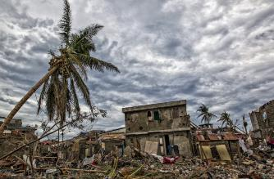
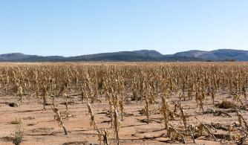
Key climate terminology
Weather: atmospheric condition at any given time or place
Climate: usually defined as the “average weather” over a period of time (usually 30 uyears)
Climate Hazard: event with potential to cause harm
Exposure: people, property or other elements in places or settings that could be adversely affected by hazards and that are thereby subject to potential losses.
Vulnerability: degree to which a system is susceptible to harm due to exposure to a perturbation or stress and the ability to cope, recover, or fundamentally adapt.
Risk: is the result of the interaction of physically defined hazards with the properties of the exposed systems (e.g. social vulnerability). Risk = (Hazard) x (Exposure) x (Vulnerability).
Notes:
SAY: here is some key terminology to be familiar with. READ THE SLIDE.
SAY:
Weather: Atmospheric condition at any given time or place. It is measured in terms of such things as wind, temperature, humidity, atmospheric pressure, cloudiness, and precipitation. In most places, weather can change from hour-to-hour, day-to-day, and season-to-season.
Climate: in a narrow sense is usually defined as the "average weather", or more rigorously, as the statistical description in terms of the mean and variability of relevant quantities over a period of time ranging from months to thousands or millions of years. The classical period is 30 years, as defined by the World Meteorological Organization (WMO).
Climate hazard: is a physically defined climate event with the potential to cause harm (such as heavy rainfall, drought, storm) or long-term change in climatic variables such as temperature and precipitation (APF 2005). A hazard maybe a transient, recurrent event with an identifiable onset and termination such as a storm, flood or drought, or a more permanent change such as a trend or transition from one climatic state to another.
Exposure. The term exposure can be defined as “people, property, systems, or other elements in places or settings that could be adversely affected by hazards and that are thereby subject to potential losses”.
Vulnerability: The degree to which a system unit is susceptible to harm due to exposure to a perturbation or stress and the ability (or lack thereof) of the exposure unit to cope, recover, or fundamentally adapt (become a new system or become extinct) (Kasperson et al., 2000.) It can also be considered as the underlying exposure to damaging shocks, perturbations or stresses, rather than the probability or projected incidence of those shocks themselves (APF 2005).
Risk: is the result of the interaction of physically defined hazards with the properties of the exposed systems — i.e., their sensitivity or social vulnerability. Risk can also be considered as the combination of an event, its likelihood, and its consequences — i.e., risk equals the probability of climate hazard multiplied by a given system's vulnerability (APF 2005).

Slide 5
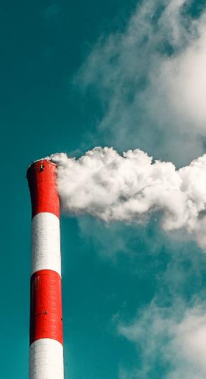
Definition of Climate Change
Climate change (CC) refers to “a change of climate that is attributed directly or indirectly to human activity that alters the composition of the global atmosphere and that is in addition to natural climate variability observed over comparable time periods” (UNFCCC)
Notes:
READ THE SLIDE
SAY:
There are different definitions of climate change that can be found among the literature. In the United Nations Framework Convention on Climate Change (UNFCCC),climate change refers to a change of climate that is attributed directly or indirectly to human activity that alters the composition of the global atmosphere and that is in addition to natural climate variability observed over comparable time periods.
For more information: https://unfccc.int/
It must be noted that the Intergovernmental Panel on Climate Change in their Fourth Assessment Report (2007) defined climate change as “a change in the state of the climate that can be identified (e.g. using statistical tests) by changes in the mean and/or the variability of its properties, and that persists for an extended period, typically decades or longer”. Thus the, IPCC refers to any change in climate over time, whether due to natural variability or as a result of human activity. https://www.ipcc.ch/report/ar4/syr/

Slide 6
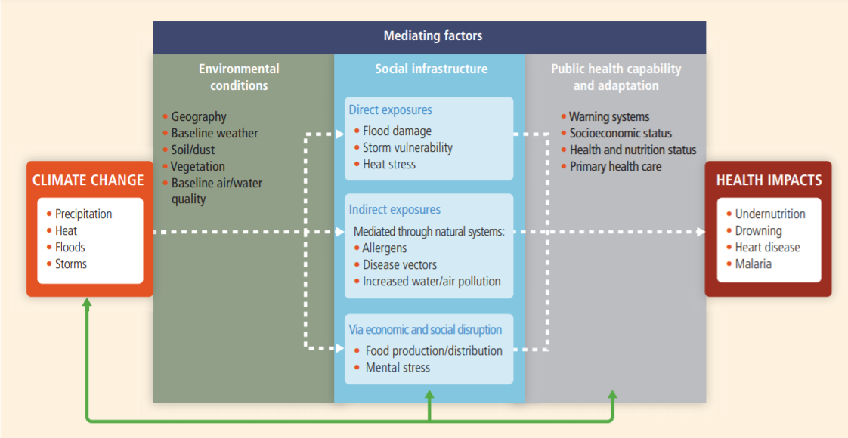
The Impacts of Climate Change on Health
Notes:
SAY:
This slide presents a conceptual diagram showing three primary exposure pathways by which climate change affects health: directly through weather variables such as heat and storms; indirectly through natural systems such as disease vectors; and pathways heavily mediated through human systems such as undernutrition.
The green box indicates the moderating influences of local environmental conditions on how climate change exposure pathways are manifest in a particular population.
The gray box indicates that the extent to which the three categories of exposure translate to actual health burden is moderated by such factors as background public health and socioeconomic conditions, and adaptation measures.
The green arrows at the bottom indicate that there may be feedback mechanisms, positive or negative, between societal infrastructure, public health, and adaptation measures and climate change itself.

Slide 7
Quick Quiz
2 mins
In addition to reducing water availability, increasing temperatures also affect the physical, chemical and biological properties of freshwater lakes and rivers. Epidemiological studies of climate and disease transmission show that many of the main infectious killer diseases affecting children are highly sensitive to climate changes. Which of the following statements is true?
a. An 8 per cent increase in E. coli- related diarrhoea is associated with a 4° C increase in temperature.
b. An 18 per cent increase in E. coli- related diarrhoea is associated with each 1° C increase in temperature.
c. An 8 per cent increase in E. coli- related diarrhoea is associated with each 1° C increase in temperature.
d. An 18 per cent increase in E. coli- related diarrhoea with a 3° C increase in temperature
Notes:
READ OUT the information at the top of the slide.
SAY:
consider which statement you understand to be correct
READ OUT each statement
NOTE TO TRAINER: pause for just one minute and ask the participants to shout out answers

Slide 8
Answer: c)
The results of the research suggests that increases in ambient temperature correspond to an elevated incidence of diarrheagenic E. coli and underscore the need to redouble efforts to prevent the transmission of these pathogens in the face of increasing global temperatures.
Rebecca Philipsborn, et. al. “Climatic Drivers of Diarrheagenic Escherichia coli Incidence: A Systematic Review and Meta-analysis”
.
Notes:
READ THE SLIDE
SAY:
Together, pathogenic E. coli and Shigella species are responsible for an estimated 583 500 deaths [3] and 44 million disability-adjusted life years per year [4] globally. The recently published Global Enteric Multicenter Study identified Shiga toxin–producing enterotoxigenic E. coli (ETEC) as one of the leading causes of moderate-to-severe diarrhea in 7 locations in Africa and Asia [2].
Key interpretation of the data:
-higher temperature can increase replication rates and survival of bacteria in the environment
-human exposure may be higher in warmer months
-increase pathogen loading from animals may be higher in warmer months
The full study can be downloaded here: https://www.ncbi.nlm.nih.gov/pmc/articles/PMC4907410/

Slide 9
Approaches to combat climate change
MITIGATION
ADAPTATION
Technological change and substitution that reduce resource inputs and emissions per unit of output.
Examples:
Renewable energy supply (e.g. hydropower, solar energy)
Reforestation
Waste minimization
Composting of organic waste
Adjustment in natural or human systems in response to actual or expected climatic stimuli or their effects, which moderates harm or exploits beneficial opportunities.
Examples:
Expanded rainwater harvesting
Water storage and conservation
Water reuse
Desalinization
Improved water efficiency
Notes:
READ THE SLIDE
SAY:
We understand now what climate change is and how impacts health. Let´s review now what are the main two different approaches to combat climate change: adaptation and mitigation.
Mitigation: the IPCC defines mitigation as “Technological change and substitution that reduce resource inputs and emissions per unit of output”, and indicates that although several social, economic and technological policies would produce an emission reduction, with respect to climate change, mitigation means implementing policies to reduce GHG emissions and enhance sinks. (Read the examples on the slide)
Adaptation: The Intergovernmental Panel on Climate Change (IPCC) defines adaptation as an “adjustment in natural or human systems in response to actual or expected climatic stimuli or their effects, which moderates harm or exploits beneficial opportunities.” The IPCC further distinguishes between the types of adaptation as follows: anticipatory vs. reactive, private vs. public, and autonomous vs. planned. (Read the examples on the slide)

Slide 10
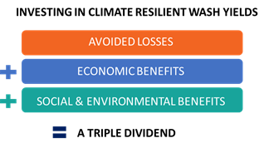
Addressing climate change impacts requires higher up-front costs but is cost-efficient
Climate resilience objectives for healthcare facilities:
Health systems and WASH infrastructure designed to be climate resilient (risk informed)
Health systems built and operated to lower carbon emissions and foster environmental sustainability
Notes:
READ THE SLIDE
SAY:
Climate resilience WASH objectives for health care facilities and systems are twofold. Firstly, health systems and the facilities and infrastructure within them need to be designed to become climate-resilient in response to climate hazards (ADAPTATION). Secondly, health care systems must be built and operated in a way that reduce their harmful impact on the environment and surrounding communities, lowering as much as possible greenhouse gases emissions. (MITIGATION).

Slide 11
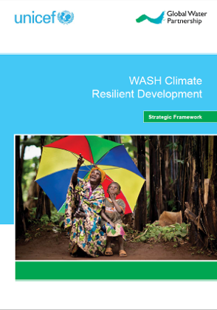
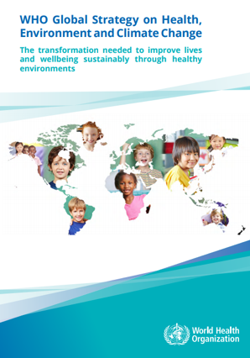
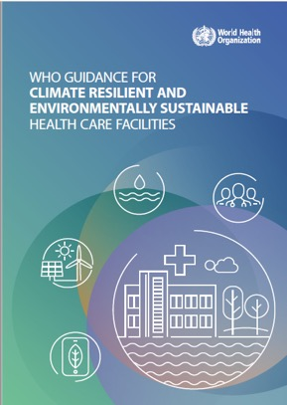
Three Global Frameworks
WHO Global Strategy on Health, Environment and Climate Change
Strategic Framework for WASH climate resilient Development
Framework for building climate resilient and environmentally sustainable health care facilities
Notes:
READ THE SLIDE
SAY:
With this understanding lets look over the next few slides at these 3 key frameworks that can help us address climate change in HCFs.

Slide 12
1. WHO Global Strategy on Health, Environment and Climate Change
Goal for healthcare settings
“all health care facilities and services are environmentally sustainable: using safely managed water and sanitation services and clean energy; sustainably managing their waste and procuring goods in a sustainable manner; are resilient to extreme weather events; and capable of protecting the health, safety and security of the health workforce”
WHO global strategy on health, environment and climate change (2019)
https://www.who.int/publications/i/item/9789240000377
Notes:
READ THE SLIDE
SAY:
First we have the WHO Global Strategy on Health, Environment and Climate Change. In relation to Health Care Facilities, the goal is to ensure: provision and sustainable management of essential environmental health services, including access to clean and reliable energy and safe water, sanitation and hygiene practices; resilience to extreme weather events and the effects of climate change; and protection of health care workers and the wider community, through chemical safety, infection control and waste management.
The strategy can be downloaded here: https://www.who.int/publications/i/item/9789240000377

Slide 13
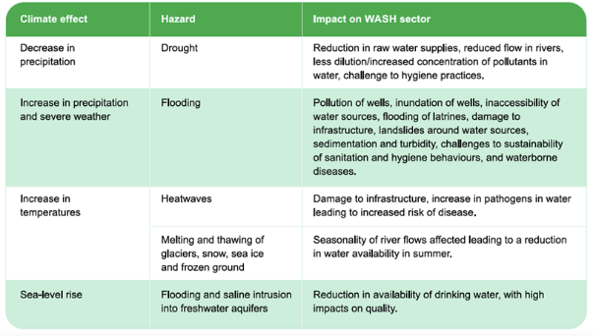
2. Strategic Framework for WASH climate resilient Development
https://www.unicef.org/wash/climate
Notes:
SAY:
The Strategic Framework for WASH Climate Resilience, was developed jointly by the Global Water Partnership (GWP) and UNICEF in 2014 and updated in 2017. The framework aims to provide the sector with a basic tool that is easy to follow and that can help bring coherence to existing but dispersed WASH climate resilient development programming. Its results framework proposes some approaches that can be tailored to health care facilities.
Read more about UNICEF’s work here: https://www.unicef.org/wash/climate

Slide 14
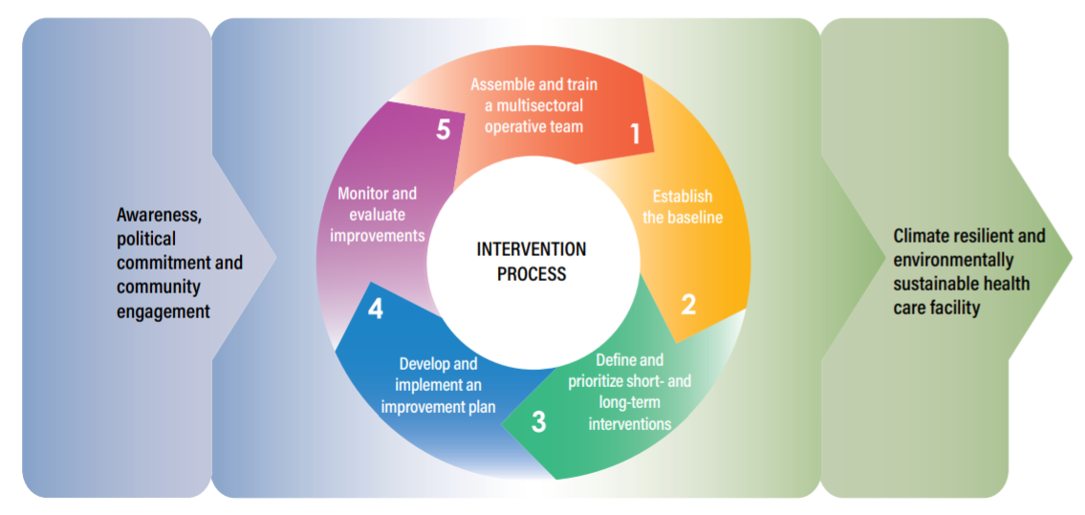
3. Framework for building climate resilient and environmentally sustainable health care facilities
Proposed process and steps for increasing climate resilience and environmental sustainability in health care facilities
https://www.who.int/publications/i/item/9789240012226
Notes:
SAY:
Finally, the Framework for building climate resilient and environmentally sustainable health care facilities aims to enhance the capacity of health care facilities to protect and improve the health of their target communities in an unstable and changing climate; and to empower health care facilities to be environmentally sustainable, by optimizing the use of resources and minimizing the release of waste into the environment.
In the figure we see 5 proposed steps for increasing climate resilience and environmental sustainability in health care facilities. (Read from the Slide).
The guidance can be found here: https://www.who.int/publications/i/item/9789240012226

Slide 15
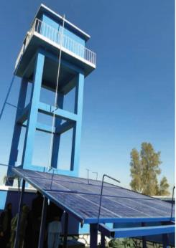
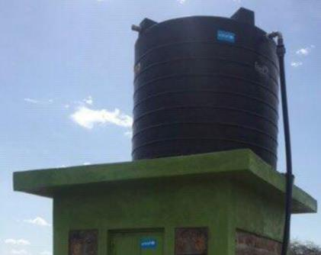
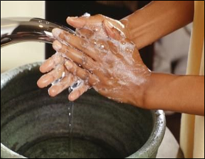
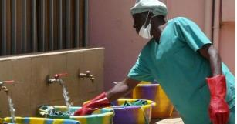
WATER
Climate Resilience
Technologies
Reliability
Low carbon
Efficiency, conservation and reuse
Efficiency and Reuse - related to hygiene
Notes:
SAY:
in the next section the focus will be on climate resilience and water, specifcially the 5 things listed on the screen – read them out.

Slide 16
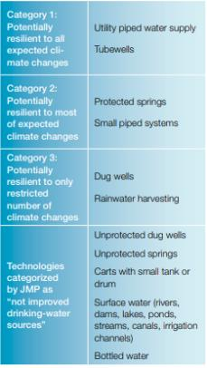
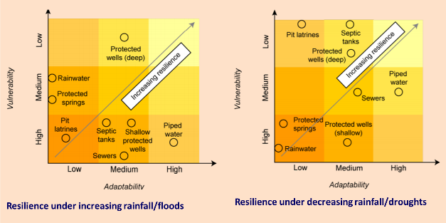
Consider climate resilience of water supply technologies
Source: WHO, 2009. Vision 2030: The resilience of water supply and sanitation in the face of climate change. https://www.who.int/water_sanitation_health/vision_2030_9789241598422.pdf?ua=1
Notes:
SAY:
Climate resilience needs to be embedded as part of WASH in HCFs, starting with the identification of climate risks in specific locations. Once the risks are understood, the water technologies (hardware) need to be climate resilient and to address specific climate risk identified.
In terms of water supply, springs, wells, rainwater harvesting from roofs are classified as least resilient. This is because of their vulnerability to contamination (especially during flood events or with rising groundwater levels), susceptibility to drought (limited storage) and/or the difficulty in preventing damage during floods. Springs and rainwater harvesting also offer little flexibility in terms of location. From an adaptation angle, climate change may also overwhelm the ability to deal with problems (e.g. flood damage) in situations where the quality and reliability of services is already poor.
There are water technological options available that are adapted for different climate risks. For example in a water scarce and drought prone area you might want to assess the use of taps with a press function (so water only runs for a few seconds).

Slide 17
Climate resilient water supplies – reliability
Ensuring water availability at the health care facilities at all times and climate scenarios
Sufficient water storage at the health care facility to buffer droughts periods
Alternative (back up) sources of water supply
Infrastructure needs to ready to withstand potential climate hazards (e.g. heavy rain, wind, floods, etc.)
Notes:
READ THE SLIDE
SAY:
Since water is an essential component of a HCF we need to make sure it will always be available, and this includes under all climate impacts and scenarios. Key considerations when dimensioning water supply for a new HCF, or when undertaking un upgrade of an existing one include:
Water storage at the HCF to buffer droughts periods (or failure of water supply system). It is necessary to design the water supply system with sufficient water storage capacity to have enough water during drought periods. This does not mean that a HCF should storage water for months but enough to be able to find a solution if, for example water supply relies on groundwater and aquifer levels drop during a drought period. In dry and hot areas, water storage should be covered to prevent water stored from evaporating. There are different technological options to allow for enough safe storing of drinking water.
Alternative (back up) sources of water supply need to be in place for the same reason as explained above. If the main source of water supply is groundwater, a back up system might be needed that could tap other sources of water, at least momentarily till a sustainable solution is in place. The principle of redundancy should always apply to water systems in a HCF (system to be dimensioned assessing scenario where main water source fails).
Climate resilient Water Safety Planning (WSP) helps addressing both points above. WHO has made available guidance for WSP in buildings.

Slide 18
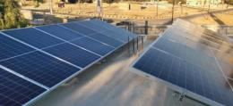
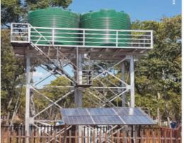
Climate resilient water supplies – low carbon
Solar systems: affordable, sustainable and climate smart
Long-term durability and low day-to-day running costs
Opportunity to reach higher levels of service and reliability
Reduced pressure on groundwater sources
Notes:
SAY:
Solar powered water systems are receiving growing attention as a means of scaling up affordable, sustainable and ‘climate smart’ services. To date, the majority of systems have been installed in rural communities, schools and health care facilities, replacing handpumps and motorized systems. Their key advantages, in addition to their zero emissions, include:
Long-term durability and low day-to-day running costs (unlike motorized systems); although the design and installation of systems can be technically demanding and higher up front costs (costs are decreasing however).
Solar powered water systems can offer HCFs not connected to a piped system the opportunity to step up the water ladder to reach higher levels of service, including increased reliability.
Reduced pressure on boreholes, and therefore less likelihood of failure, because solar powered systems typically pump and move water over an extended period of time. In addition, the tank storage included in system design can provide an important supply buffer (as mentioned in the previous slide). Taken together, these attributes may increase the overall resilience of the service in drying conditions or droughts.

Slide 19
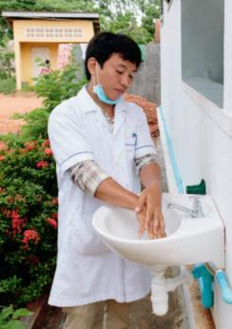
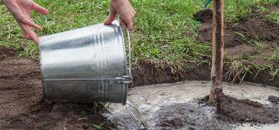
Climate resilient water supplies – Efficiency, conservation and reuse
Behavior change: water conservation and efficiency in health care facilities
Focusing on water conservation and efficiency in HCFs is becoming increasingly urgent due to the volume of water they require.
Examples include:
Low flow and self closing taps
Low flow and dry urinals
Sensitization of those who clean and those who use HCFs
Notes:
READ THE SLIDE
SAY:
Studies from the United States show how Health care facilities are the third-largest water consumers of all buildings in the country, and are responsible for 7 percent of water use among all commercial buildings. While this might not be exactly the same in low and middle income countries, focusing on water conservation and efficiency in HCFs is becoming increasingly urgent due to the volume of water they require.
Reducing water use is a sustainable approach, specially in water scarce areas and those prone to droughts. It can also lead to major savings in terms of lower water and sewer bills. In addition, many water conservation techniques can be directly linked to reduced energy consumption, resulting in even greater cost savings. Examples in a HCF include low flow and self closing taps, low flow and dry urinals, sensitization of cleaners and users for example for handwashing, etc.
In some cases water can be reused for gardening.

Slide 20
Water Conservation, Efficiency and Reuse - related to hygiene
In drought prone areas and those facing water scarcity, water efficiency and conservation (e.g. push tabs), and water reuse (e.g. for gardening) need to be observed.
Image source: https://www.who.int/news/item/01-01-2018-delivering-climate-resilient-water-and-sanitation-in-africa-and-asia
Notes:
SAY:
In drought prone areas and in locations facing water scarcity it is important to observe approaches such as increasing water efficiency (e.g. avoiding wasting water), water conservation (e.g. push tabs that allow for water to only flow a few seconds), and water reuse (e.g. for gardening) need to be considered.

Slide 21
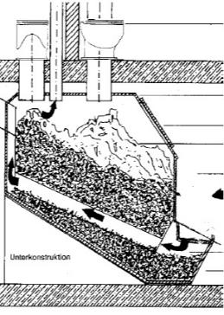
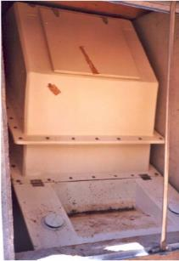
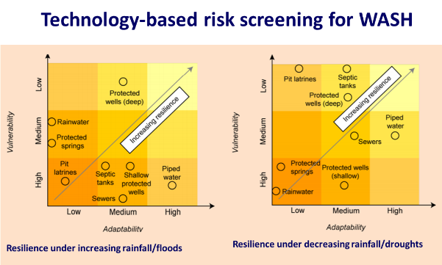
SANITATION
Climate Resilience
Examples of climate impact
Technologies
Low carbon sanitation
Notes:
SAY:
in the next section the focus will be on climate resilience and sanitation, specifically the 3 things listed on the screen – read them out.

Slide 22
Examples of climate impacts on sanitation
Climate change effect | Example impact on sanitation | Examples of associated health effects
More intense precipitation or inundation caused by sea-level rise | Flooding of on-site systems causing destruction of facilities, spillage, overflow and environmental contamination | Increased stress and potential exposure to violence and anxiety from lack of access to toilet facilities and reliance on open defecation Increased risks of water- and vector-borne diseases Increased exposure to faecal contamination
Long-term declines in rainfall and run‑off (leading to e.g. long-term drought etc.) | Declining water supply impeding function of water-reliant sanitation systems (e.g. flush toilets, sewerage); Increased demand for use of wastewater – especially in agriculture; shifting ground due to drying soils cracks or damages infrastructure | Increased risks of water- and vector-borne diseases (e.g. due to lack of water for flushing and cleaning resulting in poor sanitary conditions and poor hygiene, and changes in mosquito breeding) Increased open defecation and associated health risks Increase risk of water- and vector- borne diseases linked to untreated wastewater reuse
Higher temperatures (leading to e.g. warmer surface water and soil temperatures, heatwaves) | Malfunction, breakdown or inaccessibility of sanitation systems deterring safe sanitation behaviours (e.g. strong odours during heatwaves deterring use of latrines) | Health impacts resulting from unsafe use or non-use of sanitation systems (e.g. physical or mental health conditions)
Source: WHO, 2019. Discussion paper on sanitation, climate change and health. https://www.who.int/water_sanitation_health/sanitation-waste/sanitation/sanitation-and-climate-change20190813.pdf?ua=1
Notes:
READ THE SLIDE
SAY:
While the impacts of climate change on water supply seem more obvious, there are also negative impacts of climate change on the performance of sanitation systems and on sanitation newly acquired behaviors. (Read some examples from the slide).

Slide 23
Consider climate resilience of sanitation technologies
Resilience | Sanitation types
More resilient | Pit toilets Low flush on-site systems
Less resilient | High volume onsite systems Conventional sewerage Modified sewerage
Source: WHO, 2019. Discussion paper on sanitation, climate change and health. https://www.who.int/water_sanitation_health/sanitation-waste/sanitation/sanitation-and-climate-change20190813.pdf?ua=1
Notes:
SAY:
For sanitation, resilience is directly linked to whether water is part of the technology process (e.g. sewerage), or indirectly where the capacity of the environment to absorb or reduce the effect of wastes is affected. The resilience of simple on-site sanitation is closely linked to climate scenarios. In drying environments, the risk of pollution may decline as the distance between the base of pits and groundwater (and hence travel time for pathogens) increases.
Nonetheless, on-site sanitation may still be vulnerable to damage from short-term flood events. Where rainfall and/or flooding increases, risks may be significant, especially if groundwater tables rise, with serious public health implications. In contrast, both declining water availability and increased flooding will pose major risks to sewerage and septic systems relying on water, although their potential adaptability is higher, at least with utility backstopping.
There are sanitation options available that are adapted for different climate risks. For example in a water scarce and drought prone area you might want to assess the use of dry urinals for men, etc.

Slide 24
Low carbon sanitation in health care facilities – contributing to mitigate climate change
Where viable and appropriate consider:
Using human waste as fertilizer and soil conditioner (e.g. composting latrines)
Generating biogas from human waste for energy
Using renewable energy sources for pumping wastewater.
Notes:
SAY:
Were viable and appropriate, you can also consider how low carbon sanitation in HCFs can contribute to mitigate climate change. For example, using human waste as fertilizer and soil conditioner (e.g. composting latrines); Generating biogas from human waste for energy; and using renewable energy sources for pumping wastewater.

Slide 25
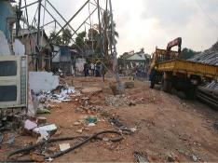
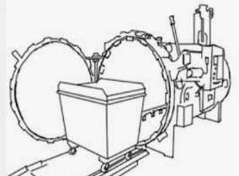
HEALTH CARE WASTE
Climate Resilience
Climate change impacts
Adapting to climate change
Mitigations
Sustainability
Notes:
SAY:
in the next section the focus will be on climate resilience and health care waste, specifically the 4 things listed on the screen – read them out.

Slide 26
Climate change impacts on health care waste management
Solid waste management can have exacerbating effects on the climate especially due to the emission of greenhouse gasses when transporting items.
Changes in hydrology and temperature can affect the stability of waste containment structures
Increased rainfall and flooding can affect waste containers and lead to spreading of contaminants (including hazardous).
Even if facility is not flooded but the surroundings are, there can be disruption of the waste management chain (e.g. flooding of road, railway affect waste collection and off-site treatment).
Low lying coastal facilities are at increasing risk from inundation.
Notes:
SAY:
Solid waste management can have exacerbating effects on the climate especially due to the emission of greenhouse gasses: Transporting health care waste in vehicles using fossil fuels, inadequate incineration, inappropriate incinerator technology, or the incineration of unsuitable materials results in GHG emissions and the release of pollutants into the air.
Also, changes in hydrology and temperature can affect the stability of waste containment structures (e.g. waste pits) within the health care facility, and increased rainfall and flooding can lead to inundation of the facility and affect waste containers with spreading of contaminants (including hazardous). So you need to consider this risk when planning and checking waste containers - placement and protection.
Even if a HCF facility is not flooded but the surroundings are, there can be disruption of the waste management chain (e.g. flooding of road, railway affect waste collection and off-site treatment), so extra containment capacity needs to be in place at the facility.

Slide 27
Adapting health care waste management to climate change
Sufficient containers and/or frequency of emptying planned and resourced in case demands on health care facilities increase
Pit/waste dump: In case of flooding, an alternative is in place including storing waste in elevated containers and/or transporting off-site
Waste pits are water tight to avoid flooding and are not over filled
Safe storage available for additional waste generated during climate-events and/or emergencies
Recovery Efforts after Dumpsite Collapse from Heavy Rains in Colombo, Sri Lanka
Notes:
READ THE SLIDE
SAY:
In this slide we see examples of how to adapt healthcare waste management to climate change (Read some examples from the slide).

Slide 28
Health care waste management contribution to mitigate climate change
Waste prevention and reduction: strategies are employed resulting in a reduction in the quantity of waste generated
Waste recycling: Non-hazardous waste is safely recycled
Phased out of incineration of medical waste: non-burn technologies are available to safely disinfect, neutralize or contain waste (e.g. autoclaves)
While incineration is phased out: Cardboard sharps/safety boxes are used in place of plastic boxes, to reduce harmful emissions when burned
Autoclave treatment of medial waste
Notes:
READ THE SLIDE
SAY:
There are also opportunities for mitigation as it relates to healthcare waste management. (Read some examples from the slide).
Note: Autoclaves are closed chambers that apply heat and sometimes pressure and steam, over a period of time to sterilize medical equipment. Autoclaves have been used for a century to sterilize medical instruments for re-use.

Slide 29
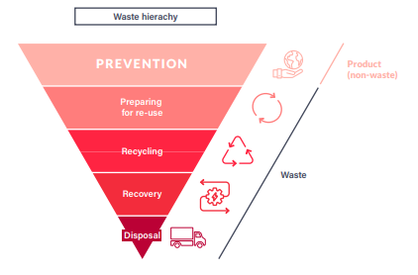
Environmental sustainability and health care waste management
There is a need to eliminate non-essential single use plastics in health facilities and select PPE materials that have more bio-based elements (e.g. hemp, bagasse, cellulosic fibers)
Invest in safe reusable PPE and/or recycling.
Plastic bottled water eliminated and invest in safe water systems and/or point of use water treatment
Equipment and supplies purchased give priority to environmentally friendly products (such as minimal and ecological packaging, reusable and recyclable products, avoiding hazardous chemicals and non-degradable plastics)
Notes:
READ THE SLIDE
SAY:
There is a role that each level can play-health worker, health facility/facilty manager, sub-national, national and global. Health care waste can no longer be ignored and it is possible to keep health workers and patients safe while also protecting the environment. Doing so will save costs and benefit both planetary and human health. Read more in the WHO Global Analysis of COVID-19 health care waste: https://www.who.int/publications/i/item/9789240039612

Slide 30
ENVIRONMENTAL CLEANING
Climate Resilience
Actions to improve sustainable cleaning
Notes:
SAY:
in the next section the focus will be on climate resilience and actions to improve sustainable cleaning

Slide 31
Actions to improve sustainable cleaning
Increase cleaning staff awareness of water conservation
Avoid running the tap continuously for cleaning (specially outdoors spaces). Fill a bucket with the amount of water you need and use only the water inside to clean.
Use cleaning products that are environmentally sustainable and clean thoroughly with soap and water (to reduce the need for overuse of disinfectant)
Check for and repair leaking taps
Cleaning the health facility is a great opportunity to check for anything in need of repair. When you turn on the tap to get water to clean, have a look at its function. If broken, report immediately and ensure it is fixed. A broken tap can waste a great amount of water in a short period of time.
Photo credit: WHO / Fid Thompson
Notes:
SAY:
Clean water is a critical element of cleaning but might be scarce. An approach that can be considered is to Increase cleaning staff awareness of water conservation. It is important they understand how to avoid running the tap continuously for cleaning, specially outdoor spaces, and also to check for leaking taps as cleaning the HCF is a great opportunity to check anything in need of repair.
While infection risks are of paramount importance in healthcare settings, many cleaning products and processes, whether conventional or "green," have little or no direct impact on infection. Facilities can immediately engage in green cleaning by first addressing resource-intensive practices and toxic or irritating chemicals that can clearly be replaced by preferable alternatives without impacting infection transmission. Some examples:
Replacing floor strippers and finishes that contain heavy metals and asthmagens
Substituting low-VOC (volatile organic compound) glass cleaners
Using 100% recycled content bathroom paper products
Employing carcinogen-free carpet cleaners
Introducing high-filtration vacuum cleaners
Using UV Light Disinfection rather than chemicals in select areas and where advised by infection prevention focal points/experts
None of these products or practices significantly impact infection transmission or infection prevention and all can improve worker safety and reduce environmental impacts.
You can also undertake the environmental cleaning module to learn about products and how these can be efficiently used to prevent environmental contamination

Slide 32
Key take-aways
Climate change might seem a distant challenge to a health facility but it does impact essential services
WASH services need to be planned according to local and identified risks. What works in one location might not work in a different context.
Water storage, conservation and efficiency are a must in water scarce contexts and those suffering from increasing incidence of droughts.
Health care facilities exposed to floods need to carefully ensure that sanitation does not pose a risk to water supply and the environment
Notes:
READ THE SLIDE

Slide 33
Questions?

Slide 34
Further reading
WHO (2020). global strategy on health, environment and climate change
https://apps.who.int/iris/handle/10665/331959
Global Water Partnership, UNICEF (2017). Strategic Framework for Climate Resilient WASH Development
https://www.gwp.org/en/WashClimateResilience/
WHO (2020). guidance for climate resilient and environmentally sustainable health care facilities
https://www.who.int/publications/i/item/9789240012226
WHO (2019). Discussion paper on sanitation, climate change and health. https://www.who.int/publications/m/item/climate-sanitation-and-health
WHO (2009). Vision 2030: The resilience of water supply and sanitation in the face of climate change.
https://apps.who.int/iris/handle/10665/70462
Climatic Drivers of Diarrheagenic Escherichia coli Incidence: A Systematic Review and Meta-analysis
https://www.ncbi.nlm.nih.gov/pmc/articles/PMC4907410/
More information on sustainable cleaning products and practices in health care. https://practicegreenhealth.org/topics/safer-chemicals/green-cleaning
WASTE

