Slide 2
Managing safe water supplies
WASH FIT technical module
Add date & location
Notes:
Introduce yourself if you have not already, and make sure you insert the date and location to the slide before you start

Slide 3
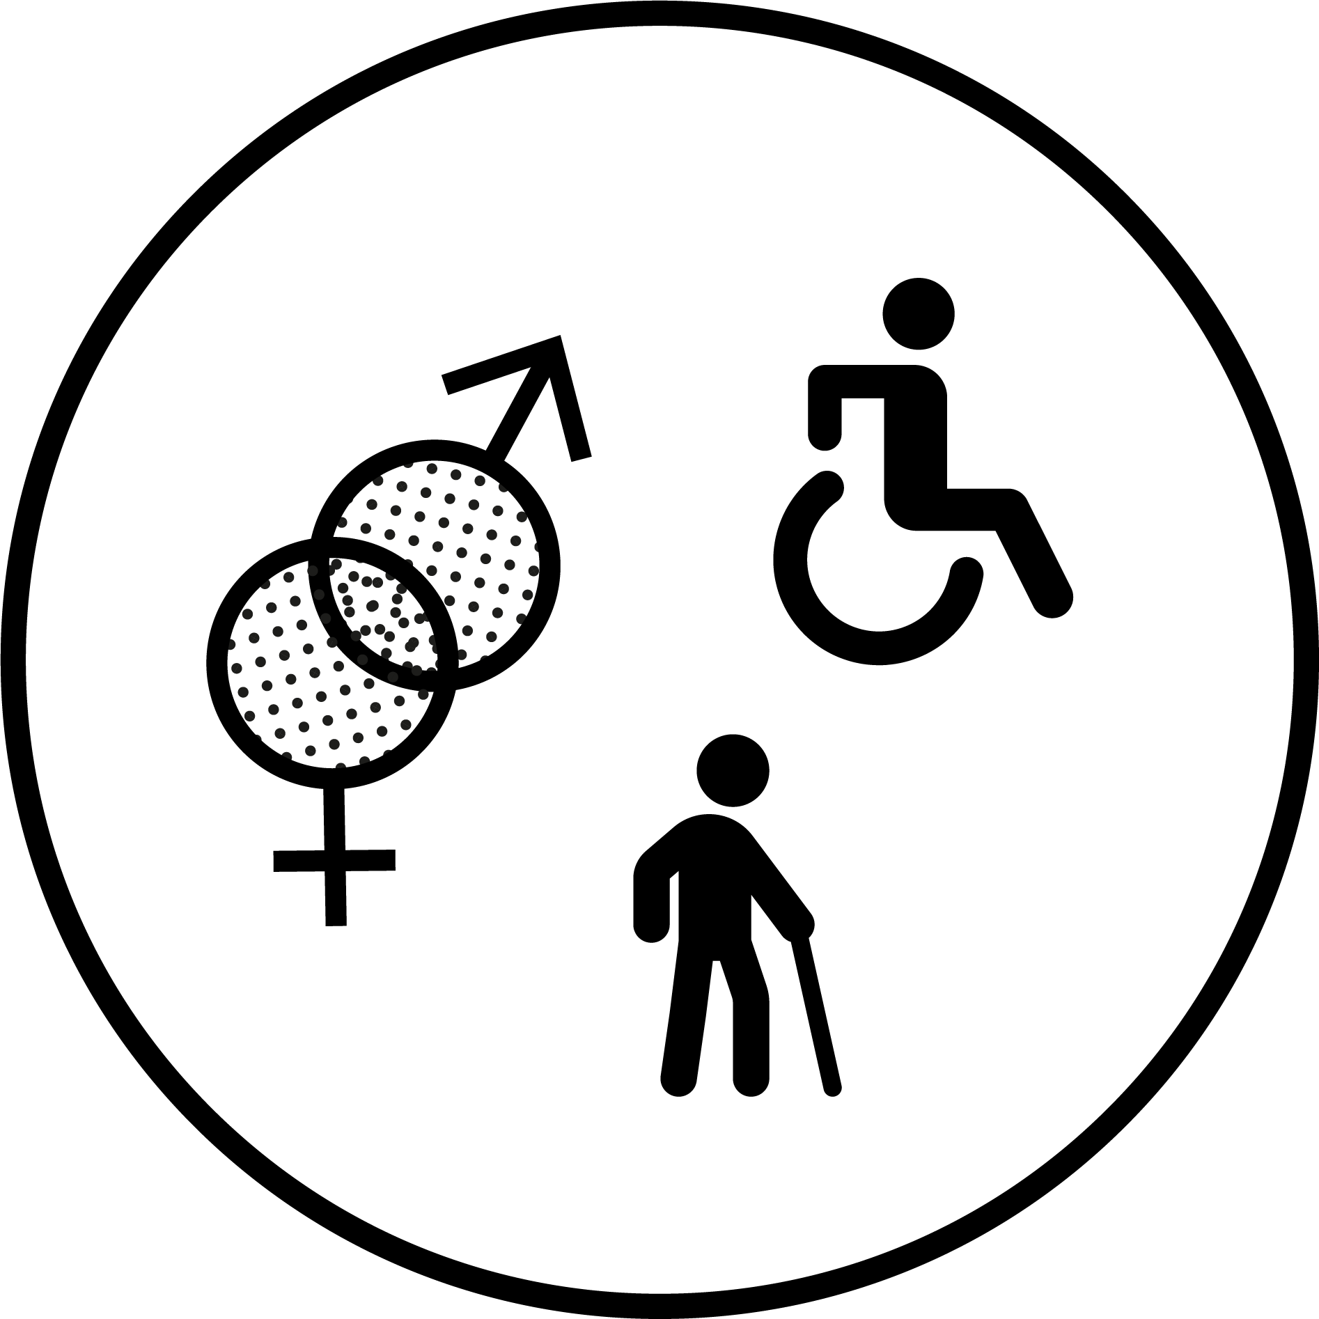
Learning objectives
By the end of this session, you should :
Describe the minimum requirements for safe and sufficient water in health care facilities
Describe the impacts of inadequate water supplies
Outline of the tools available to monitor and improve water quality and quantity
Describe of common plumbing problems and simple improvements that can be made
Understand the causes of Legionella and how to address it
Understand how climate change can affect a facility’s water supply and some simple, low-cost improvements to address it
Group
work
Links to climate resilience
Icons to look out for
Links to GEDSI
Notes:
READ SLIDE and make sure participants are clear on the outline of this module and what they will learn.
SAY:
the symbols here are ones you will se throughout the module to indicate activities

Slide 4
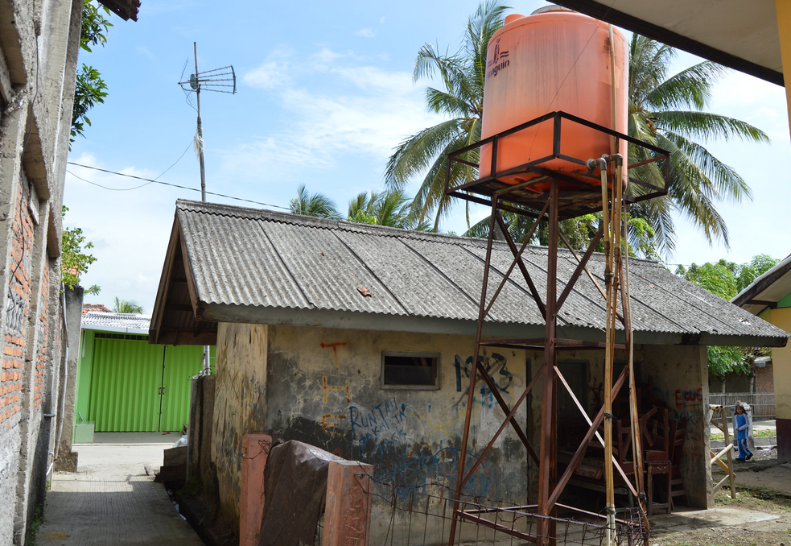
Part 1: Minimum water requirements
Minimum water requirements for health care facilities
Impacts of an inadequate water supply
Water supply definitions
Water quantity and storage
Notes:
READ SLIDE

Slide 5
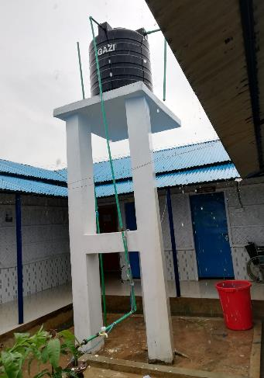
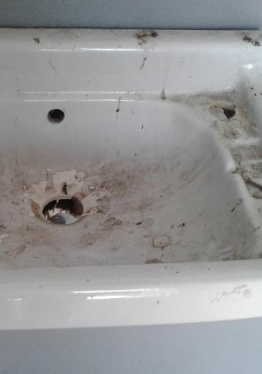
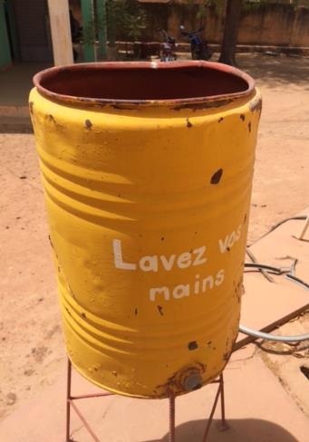
What are the impacts of an inadequate water supply in health care facilities ?
Notes:
READ THE SLIDE (this can act as an ice breaker exercise to warm up participants, you may wish to write the suggestions on a flip chart and refer back to them throughout the session.

Slide 6
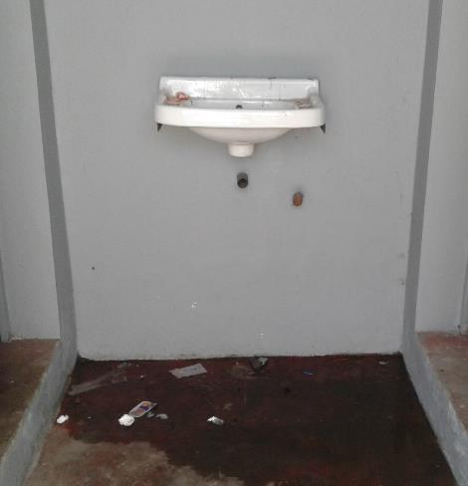
Effects of an inadequate water supply
No/ insufficient drinking water
Staff & patient dehydration
Inability to take medicines
Contaminated water
Diarrhoea
Waterborne disease outbreaks (e.g. Cholera)
Insufficient water for hand hygiene
Spread of infections; risks to patient and staff safety, inability to control outbreaks
Spread of fecal contamination, antimicrobial resistant infections
Insufficient water for cleaning, showers, toilets
Visually dirty, smells, decrease in care seeking and trust in health care, decrease in staff satisfaction and motivation
Notes:
READ THE SLIDE
SAY:
water supply is fundamental to a well functioning and safe health care facility. It is often the most “visible” element of WASH and affects every other area of WASH as well as safe, provision of care.

Slide 7
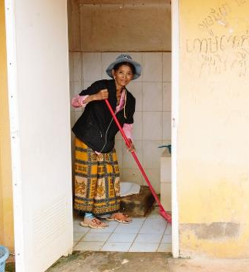
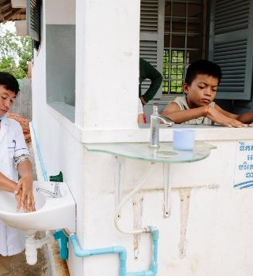
What are the minimum water requirements (and related standards) in a health care facility?
2 mins
Notes:
READ THE SLDIE
SAY:
Discuss together in pairs for a moment and then shout out some ideas.
NOTE FOR TRAINER:
The next slides includes some basic prompts/categories to discuss in more detail.

Slide 8
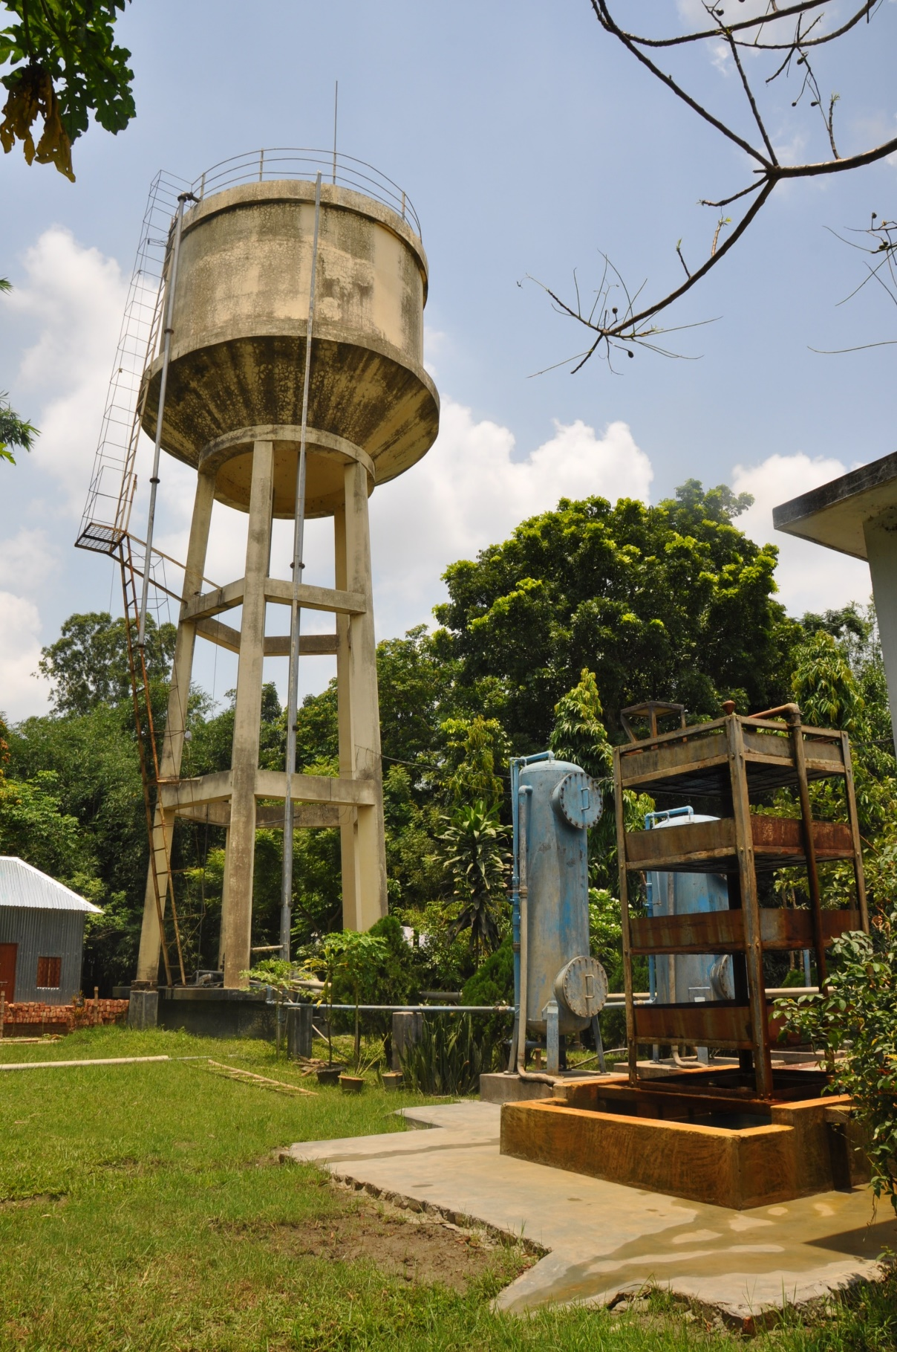
Basic water requirements
Availability
Quality
Quantity
Reliability
2 mins
Notes:
SAY:
discuss for a couple of moments and shout out what you think is meant by each item. What standards exist for each? (answers are on the next slide)
Availability: what types of activities should water be available for?
Quantity: how much water is enough? How is “sufficient quantity” defined by WHO and/or national standards?
Quality: what are some of the key contaminant that can pollute water and impact health? What are “safe” levels of these contaminants as defined by WHO and national standards?

Slide 9
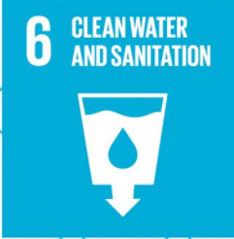
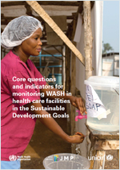
Minimum water requirements
Water should be available for
drinking
personal hygiene including hand washing, bathing and cleaning
cleaning
medical activities
cooking
laundry
Water must be on-site from an improved source and available at all points of care
Water should be safely treated and reliable
Water must be of sufficient quantity to meet the facility’s needs for 2 days
SDG 6 calls for safely managed water and sanitation for all people, in all settings including in health care facilities. Read more about UN coordinated efforts on SDG 6 at UN Water (https://www.unwater.org/)
For global monitoring, WHO/UNICEF have defined core questions and indicators for monitoring WASH in health care
Notes:
READ THE SLIDE
SAY:
Availability:
For primary facilities, water may be piped into the building or simply on premises. These both count as a basic water service according to the JMP. The requirements for secondary or tertiary facility are higher. For secondary/tertiary care hospitals, water needs to be piped into the facility, at a minimum to high-risk wards and service areas (e.g., decontamination/reprocessing area and environmental services area). In large facilities, there should be a functional tap available in areas on every floor and every major ward or wing of the facility, for environmental cleaning purposes.
If relevant, say:
It is important to note that the JMP definitions are not the same as minimum requirements. JMP does not, for example, monitor water quality in health care facilities even though this a basic standard according to WHO and a pre-requisite for meeting SDG 6 which is defined as safely managed water and sanitation services for all people in all settings.
NOTE FOR TRAINER: The next slide shows some examples of improved water supplies and includes the definition in the notes. The WHO/UNICEF core questions document is also available in French, Spanish, Russian and Arabic at https://washdata.org/reports.

Slide 10
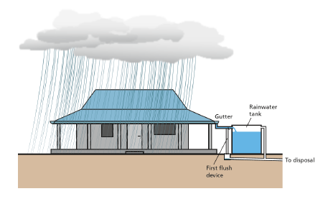
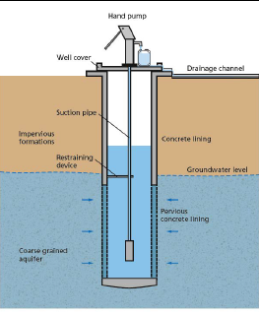
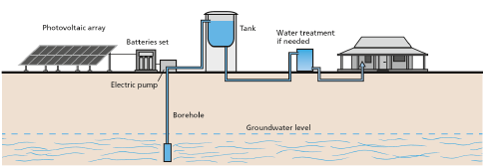
What is an “improved” water supply?
Protected well with handpump
Rainwater harvesting
Solar powered borehole with piped-in network
2 mins
Source: Compendium of water technologies. EAWAG, Switzerland. Forthcoming.
Notes:
SAY:
discuss in pairs for a couple of moments if you can define what “improved” means and then shout out some ideas
THEN SAY:
“Improved drinking water sources” includes sources that, by nature of their construction or through active intervention, are protected from outside contamination, particularly faecal matter .
Improved sources include piped water, boreholes or tube wells, protected dug wells, protected springs, rainwater, and packaged or delivered water.
Unimproved sources include unprotected dug wells or springs and surface water (e.g. lake, river, stream,
pond, canals, irrigation ditches).

Slide 11
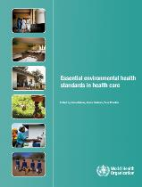
Minimum water quantities for health care facilities
Outpatients | 5 litres/consultation
In patients | 40–60 litres/patient/day
Operating theatre / maternity | 100 litres/ intervention
Dry or supplementary feeding centre | 0.5–5 litres/ consultation
Wet supplementary feeding centre | 15 litres/ consultation
Inpatient therapeutic feeding centre | 30 litres/ patient/day
Cholera treatment centre | 60 litres/ patient/ day
Severe acute respiratory diseases isolation centre | 100 litres/ patient/ day
Viral haemorrahagic fever isolation centre | 300–400 litres/ patient/ day
“Sufficient” water –
Enough to meet the needs of facility for 48 hours
https://www.who.int/publications/i/item/9789241547239
Notes:
READ THE SLIDE
SAY:
These quantities come from the WHO 2008 Essential environmental health standards. Each facility needs to assess what their needs are and depending on climate change risks may need to assure more than 2 days/48 hours of storage, especially for example, during the dry season.
These quantities are estimates and take into account water required for drinking, environmental cleaning and laundry, hand hygiene and waste management. Note, water for specific medical uses (such as dialysis) is not included.
To calculate the requirements for a facility, consider how many days the facility is open, average numbers of patients, what services are available and potential changes in demand (e.g. seasonal fluctuations linked to farming cycles, climate, infectious disease outbreaks, frequency of births) when planning for or upgrading water supplies.

Slide 12
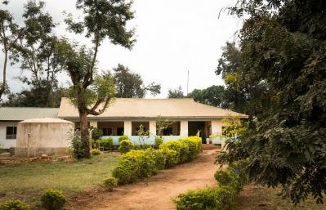
How much water does this facility need in one week?
QUIZ:
5 min
Background information - this primary care facility:
Is open 7 days a week
10 women give birth every week
Of these, on average, two women spend the night and the rest return home after a few hours
Treats 40 outpatients a week (average)
Holds a vaccination clinic once a week which 50 children attend.
. https://www.who.int/water_sanitation_health/publications/ehs_hc/en/
© WaterAid
Notes:
READ THE SLIDE
SAY:
take 5 mins to discuss the questions in pairs and then be prepare to feedback your answers to the group

Slide 13
Answer
10 births x 100 litres /birth = 1,000 L
2 inpatients x 50 litres /patient = 100 L
40 patients x 5 L/patient = 200 L
50 children x 5 L/patient = 250 L
Weekly total = 1,550L
© WaterAid
Notes:
READ THE SLIDE
NOTE FOR TRAINER:
Refer back to the previous slide for the quantity of water needed

Slide 14
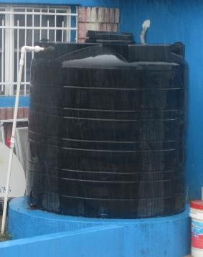
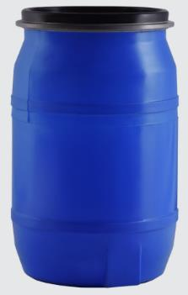
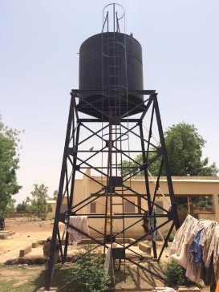
Water storage
Your facility needs 1,550 L of water a month
Which of the following storage containers do you recommend?
How does climate resilience affect your decision?
2 min
5,000 L
1,000 L
100 L
Notes:
READ THE SLIDE
SAY:
briefly discuss with the person next to you these questions and then shout out your answers
THEN SAY:
The most appropriate type will depend on the local availability of water storage containers, the amount that needs to be stored and durability/climate. Any container should be easily accessible for cleaning and if connected to a piped system, raised, to allow water to flow by gravity and protect against flooding.
Remember: Clean and disinfect water tanks regularly. Covering, routinely cleaning and disinfecting tanks will provide immediate health gains and build resilience over many future rainfall scenarios.
We will talk about water quality and storage later on

Slide 15
Answer
Facility uses 1,550 L of water / week
1,550 L / 7 days = 221 L /day
Storage for 2 days = 221 x 2 = 442 L
+100 L if births occur daily + 2 days extra (e.g.500L) for climate resilience
✓
5,000 L
1,000 L
100 L
Notes:
READ THE SLIDE
SAY:
In this example, 1,000 liters of water is the minimum recommended storage. If funds are available to store more water this may be useful, especially as disease outbreaks (e.g. Ebola, cholera, covid-19) require more water because of an increase in patients and often greater cleaning and disinfection needs.
Where climate change is a problem, extra storage is useful to provide a buffer during dry spells. Tanks should also be raised if in flood prone areas. Additional backup storage should be provided during high risk periods. Where possible, storage of more than 2 days should be provided and water prioritized for essential/life-saving services (i.e. delivery rooms acute care wards).

Slide 16
Part 2: Water quality
Drinking water requirements
Water requirements during outbreaks
Applying a risk-based approach, including water safety planning and other WHO guidance
Water treatment and the WHO Scheme to evaluate treatment technologies
Notes:
READ THE SLIDE

Slide 17
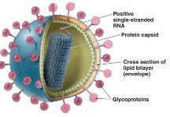
Microbial groups commonly associated with waterborne diarrhoea
Viruses
E.g. Hepatitis A, poliovirus A
Smallest; 0.02-0.3 μm
Protozoan cysts
E.g. Giardia, Cryptosporidium
Largest; >2 μm-2 mm
Bacteria
E.g. Escherichia coli, Vibrio cholerae
0.5-2.0 μm in diameter
Viruses
E.g. Hepatitis A, poliovirus A
Smallest; 0.02-0.3 μm
SARS-CoV-2 & Ebola viruses not fecal oral pathogens
Neither virus has been detected in water supplies or water sources and both are relatively fragile compared to fecal/oral viruses
Legionella:
Bacterium increasingly associated with waterborne outbreaks in health care facilities
Bacteria
E.g. Escherichia coli, Vibrio cholerae
0.5-2.0 μm in diameter
https://www.who.int/water_sanitation_health/publications/legionella/en/
https://www.who.int/publications-detail-redirect/WHO-2019-nCoV-IPC-WASH-2020.4
https://www.who.int/publications/i/item/WHO-EVD-WSH-14
Notes:
READ THE SLIDE
SAY:
This slide provides a spotlight on microbial contamination of drinking water.
SARS-CoV-2 is not a fecal oral disease and there is no documented evidence of SARS-CoV2 in drinking-water or water sources. The main route of transmission is airborne and thus respiratory precautions important (e.g. distancing, ventilation, use of masks). Both SARS-CoV-2 and Ebola are enveloped viruses which makes them more fragile in the environment and more easily destroyed/killed with UV (sunlight) or heat compared to non-enveloped viruses such as hepatitis A. Enveloped viruses usually survive a matter of days (at most) whereas non-enveloped viruses can survive for weeks or months in the environment.
We will come back to Legionella shortly.

Slide 18
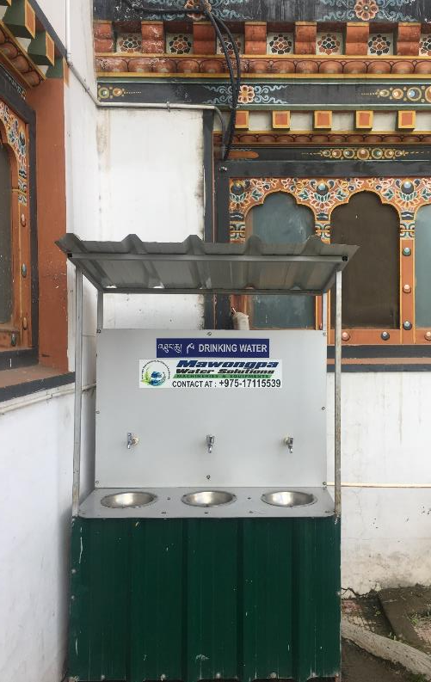
Drinking water
Safe drinking water must be present and accessible for staff, patients (including those with disabilities) and carers, at all times and locations/wards
Safe:
no fecal contamination (0 CFU E. Coli/100 ml)
appropriate chlorine residual (0.2mg/l or 0.5mg/l in emergencies) or
not turbid (5 NTU or ideally less)
Safely stored:
clean bucket/ tank with cover and tap.
regularly cleaned & disinfected
Accessible:
clear signs
pathway to drinking water station clear
Drinking water station in Thimpu, Bhutan
What to do in emergencies/ climate-related events?
Staff fill drinking-water stations and treat more regularly (meet increased patient load)
Procure more water
In-line treatment for piped water (filter + disinfection)
Notes:
READ THE SLIDE
SAY:
Safe drinking-water, as defined by the WHO Guidelines, does not represent any significant risk to health over a lifetime of consumption, including different sensitivities that may occur between life stages.
Absence of fecal contamination may be indicated by the absence of indicator organisms such as E. coli (or thermotolerant faecal coliforms). Where this cannot be tested, the presence of a free chlorine residual (at least 0.2 mg/l) can be used as a surrogate indication.
Safely stored: in a clean bucket/tank with cover and tap, which is regularly cleaned and disinfected (unless it is dispensed from a water fountain).
Accessibility: (an important consideration for GEDSI)
- Pathway to drinking water area: width is minimum 120 cm, is flat and even, is dry and is clear of obstacles.
- Sign for drinking water station has words, pictures and braille and is displayed on the wall at 140 cm-160 cm from the ground.
- The drinking water station tap is 75 cm from the floor and a cup is available to patients. If cups are used, they should reusable and washed with warm water and soap and dried.

Slide 19
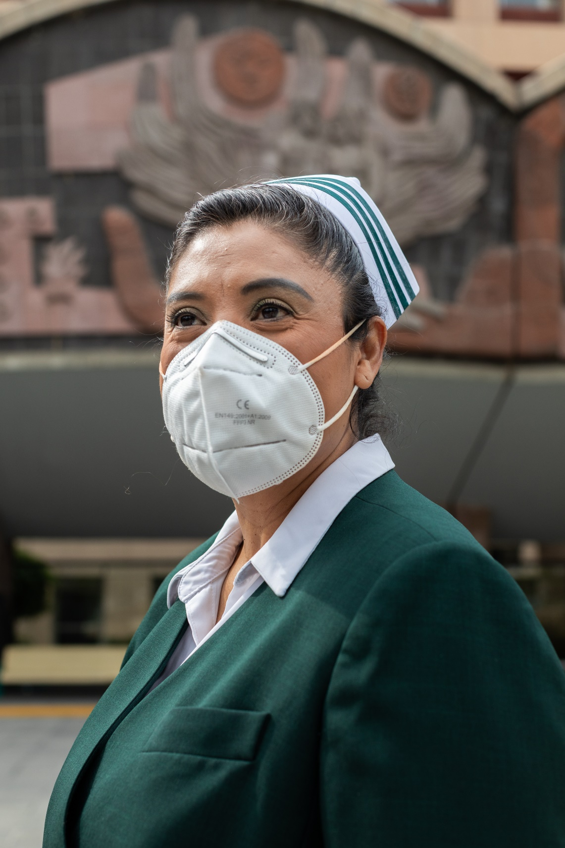
Drinking water & SARS-CoV-2
COVID-19 virus has not been detected in drinking water supplies.
Other coronaviruses have not been detected in surface or groundwater sources
More susceptible to chlorine than other viruses
Ensure a residual concentration of free chlorine of ≥0.5 mg/L after at least 30 minutes of contact time at pH < 8.0.
Residual maintained throughout distribution system, regularly checked and dosing adjusted as needed.
→ Risk of coronaviruses to water supplies is low.
Notes:
READ THE SLIDE
SAY:
While the presence of the COVID-19 virus in untreated drinking-water is possible, it has not been detected in drinking-water supplies.
Reminder: more susceptible to chlorine because COVID-19 is an enveloped virus. As such it has a fragile outer lipid membrane which makes it less stable, compared to non-enveloped viruses in the environment.

Slide 20
Water rHow much water is needed for handwashing in resource-limited settings?
Water requirements & COVID-19
Quality: Drinking water should be from an improved source; water should be treated and have an appropriate chlorine residual.
Be prepared: Contingency plans for securing additional safe and sufficient water during outbreaks.
Availability & quantity:
Water, at a minimum for hand hygiene, cleaning and drinking.
Install simple handwashing stations if no piped supply available.
This is not well studied. If a tap was kept open for 20-40 seconds, about 2.5-5 litres per handwashing event would be needed (assuming a flow of 7.5 litres per minute).
Hand rubbing is essential for cleaning and can be done with the tap off (to save water).
In low-resource settings use of 0.5-2 litres per wash has been shown to reduce faecal contamination of hands. ALL facilities should aim to reduce water while keeping hands clean.
Notes:
READ THE SLIDE
SAY:
While water is important in any situation, it is especially important during infectious disease outbreaks where increased quantities of water are needed for cleaning and hygiene and where hydration with safe drinking water for those infected and often overworked health care workers is critical.
Ask participants if they know what is considered an “appropriate chlorine residual”?
Answer: Drinking-water should have a free chlorine residual of ≥0.2mg/L or ≥0.5mg/L in emergencies
For effective disinfection, there should be a residual concentration of free chlorine of ≥ 0.5 mg/l after at least 30 min contact time at pH < 8.0. A chlorine residual should be maintained throughout the distribution system. At the point of delivery, the minimum residual concentration of free chlorine should be ≥0.2 mg/l.
Chlorine residual should be frequently measured and dosing adjusted if residual is not met (changes in pH, temperature, organic content and water source will affect chlorine efficacy). Evidence of documented chlorine residuals should be available from previous testing. In the event of a flood, chlorine alone will not disinfect water sufficiently as the water is likely too turbid.

Slide 21
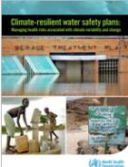
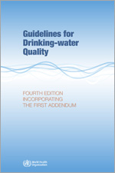
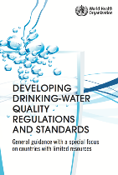
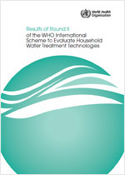
Applying a risk-based approach to water quality: WHO guidance
Water safety planning and climate
Guidelines
Regulations
Risk-based approach principles
Health based targets
Risk assessment and risk management
Surveillance
Health care facilities
Water treatment performance
Notes:
SAY:
The WHO Guidelines for Drinking-water quality are some of the oldest (1956) and most downloaded guidelines at WHO.
They are based on a risk-based approach for understanding and incrementally addressing water related health risks. While the guidelines cover both microbiological and chemical risks, in low and middle income countries, microbiological (e.g. fecal contamination) constitute the great majority of the health burden associated with unsafe water.
The other documents shown here are accompanying documents and tools which are grounded in the principles of the guidelines. These include
climate resilient water safety plans
regulations and standards
environmental health standards in health care facilities
the results of performance testing of major household water treatment products.
Water safety planning is a proactive risk-based approach, with a strong focus on operations and maintenance, and monitoring – elements which can be applied to health care facilities to ensure safe drinking-water delivery. Countries and communities already implementing water safety plans (WSPs) are encouraged to expand efforts to health care facilities. This means, in practice, that the water domain within the WASH FIT assessment, would incorporate more detailed indicators for additional elements of water safety planning, including:
describing the entire water supply system
monitoring the system i.e.
monitoring of control measures through operational monitoring plans
monitoring water quality for compliance with regulatory requirements or internal water quality targets (through compliance monitoring)
developing management procedures (i.e. standard operating procedures for key operations and maintenance activities, and emergency response plans) and
engaging with the appropriate authorities on water quality surveillance.
Links to all documents are provided in the final slide. Alternatively, click on the thumbnail to download.

Slide 22
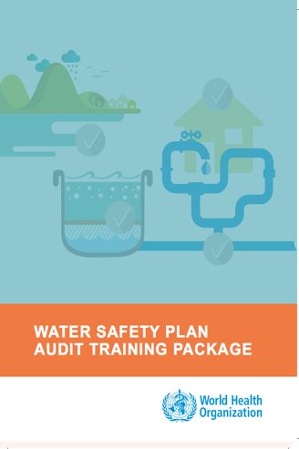
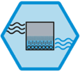
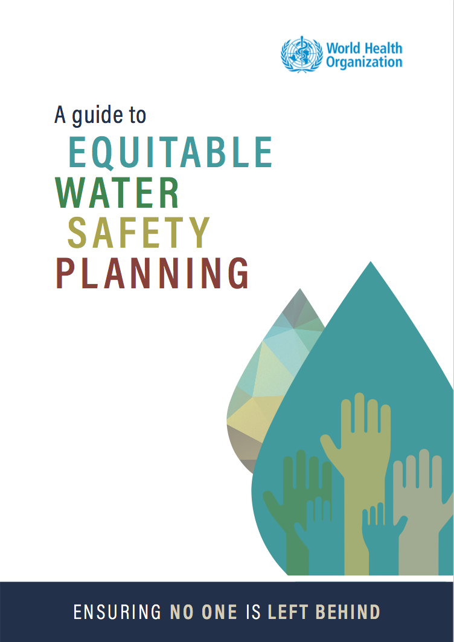
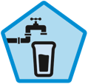
What is a Water Safety Plan?
WATER SAFETY PLAN (WSP)
A comprehensive risk assessment and risk management approach that includes all steps in the water supply from catchment to consumer
Notes:
SAY:
WSPs require a risk assessment including all steps in water supply from catchment to consumer, followed by implementation and monitoring of risk management control measures, with a focus on high priority risks. Where risks cannot be immediately addressed, the WSP approach allows for incremental improvements to be implemented systematically over time. WSPs should be implemented within a public health context, responding to clear health-based targets and quality-checked through independent surveillance.
WSPs have been adapted and implemented specifically for health care facilities. While WASH FIT incorporates the WSP methodology and many of the same support tools (e.g. Sanitary Inspection Forms) WASH FIT does not provide as much detail, especially on surveillance and how to regulate internally and/or work with water quality regulators to ensure water supplies. Facilities wishing to do this, should talk to local WSPs experts and/or incorporate additional WSP tools into WASH FIT efforts.
Additional resources: https://www.who.int/teams/environment-climate-change-and-health/water-sanitation-and-health/water-safety-and-quality/water-safety-planning

Slide 23
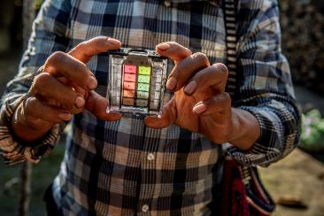
What methods can you use to measure water quality risks?
QUIZ
5 mins
Notes:
READ THE QUESTION
SAY: You now have 5 minutes to discuss this in small groups and please be prepared to give feedback.

Slide 24
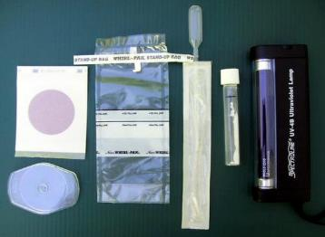
ANSWERS
Sanitary inspection forms
To address risks at water source
Regulatory data review
To understand water quality over time and corrective, if any, actions taken
Check chlorine residual-regularly (daily-weekly)
To ensure appropriate residual and adjust dosing as needed
Conduct fecal indicator bacteria testing
To understand level of bacteriological contamination and whether control measures (e.g. source protection or water treatment) are working!
All of the above!
4
Notes:
READ THE SLIDE
SAY:
All of the above actions can be taken, but it is the most effective use of resources to start with sanitary inspections and regulatory data (if it exists). If you see that there are obvious risks to the water source (e.g. animals defecating nearby, open cracks in well) you can be fairly sure there are a strong likelihood of contamination and thus start with addressing those risks.
Checking the chlorine residual is a relatively cheap measures to check water quality and if there is chlorine it is highly unlikely there is any fecal contamination as with sufficient contact time (at least 30 min) and dosing, chlorine is effective in killing/deactivating bacteria (4 log, or 99.99% removal or more) and viruses (up to 2 log removal) in non-turbid or clean water.
Conducting fecal indicator bacteria testing is important to see if control measures are working (e.g. source water improvements) and/or for regulatory purposes. A number of portable water quality test kits include testing for fecal indicators. It is important to establish a strong protocol of sampling, test procedure and data analysis to ensure the results can be accurately interpreted to inform risk assessments and next actions.

Slide 25
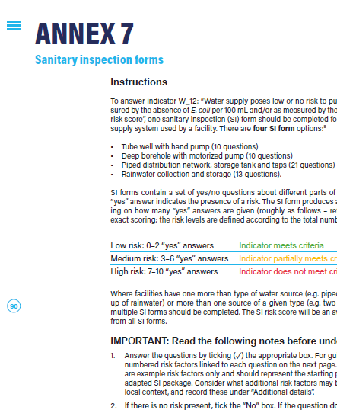
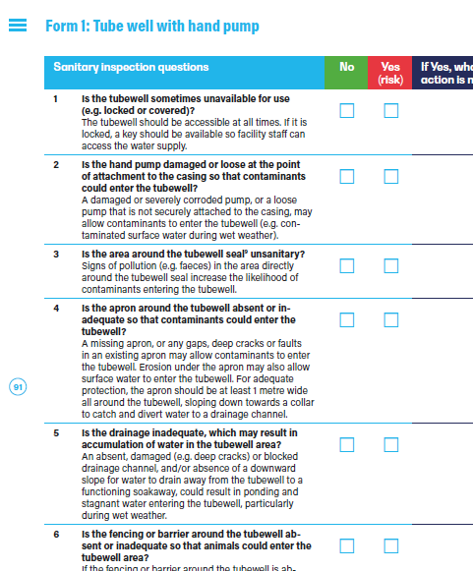
Sanitary inspection (SI) forms
An on-site evaluation of all conditions, components and practices in the water supply system that pose an actual or potential risk to public health
WASH FIT SI forms:
Tube well with hand pump
Borehole with motorized pump
Piped distribution network, storage tank and taps
Rainwater collection and storage
Notes:
READ THE SLIDE
SAY:
It is important that a SI form is completed as part of the field visit to a facility. If not, an optional classroom-based exercise is provided on the next slide.
Why use an SI form?
The WHO SI forms have been adapted for use in a health care setting.
SI forms help to evaluate actual and potential sources of contamination for different types of water sources.
They allow facilities to undertake a more detailed evaluation of their water supply to inform more specific measures to be taken to reduce the risk of water contamination, shortages etc.
Which SI form should you use?
The WASH FIT guide includes four forms.
Where facilities have one more than type of water source (e.g. piped water and a back-up of rainwater) or more than one of a given type (e.g. two storage reservoirs), multiple SI forms should be completed. The SI risk score will be an average of the scores from all SI forms.
How to use the SI forms:
SI forms contain a set of yes/no questions about different parts of the water supply. A “yes” answer indicates the presence of a risk.
The SI form produces a risk score depending on how many “yes” answers you have (roughly as follows, refer to each form for exact scoring, the risk levels are defined according to the total number of questions)
Corrective actions should be made to address all the risks identified. Focus on addressing the most serious risks first. Consider low/no cost improvements that can be made immediately.

Slide 26
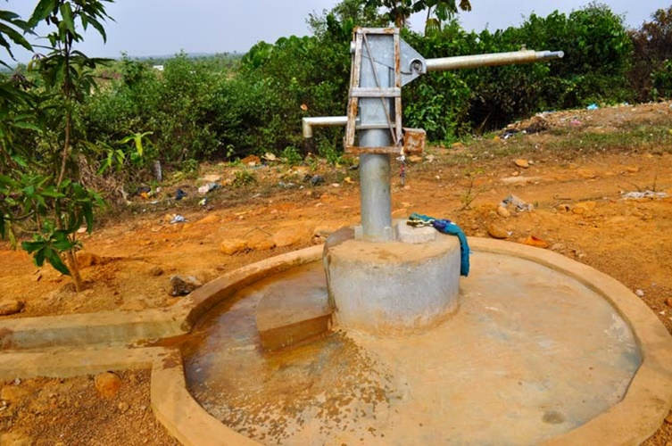
Complete a Sanitary Inspection form
Use SI form 1: Tube well with hand pump
EXERCISE
Instructions
Read the handout
In groups
answer all 10 SI form questions
discuss the guiding questions (page 3)
30 mins
Notes:
Refer to handout: “Virtual SI exercise”
NOTE FOR TRAINER:
Suggested energizer
Get the participants to stand in a line based on their total risk score (i.e. 0 to the left of the room, and 10 to the right). This gives a chance to explore the questions a bit more, and why some people scored differently than other etc. Why did the person on the right score so much higher than on the far left? Where were the biggest differences?
Field visit option
If a field visit to a facility is part of the training, ask participants to complete the relevant SI form for the facility being visited. If no field visit takes place, this exercise may be done instead. Refer to the handout for full instructions.
Adapting this exercise
The example provided is for a tube well with pump. For other settings, you may wish to adapt this example, e.g. using the tube well with handpump or rainwater collection and storage SI package.

Slide 27
What technology should you use if safely managed, treated piped water is not available?
Consult WHO Scheme to Evaluate Household Water Treatment Performance
Water treatment technologies should meet WHO’s performance standards for point-of-use / household water treatment and safe storage (HWTS).
Higher performing technologies:
Include high quality membrane filters, UV disinfectants & flocculant-disinfectants, boiling, solar disinfection
Are recommended for vulnerable groups (i.e. those with HIV or young infants)
Are recommended where the specific pathogen of concern is not known
Choose wisely! In the latest list of evaluated technologies (Feb 2022)
7 out of 47 technologies do not meet WHO performance criteria. See supplementary slides for a full list
https://www.who.int/tools/international-scheme-to-evaluate-household-water-treatment-technologies
Notes:
SAY:
A number technologies have been evaluated by WHO as part of the Household Water Treatment Scheme (references at end). The WHO International Scheme to Evaluate Household Water Treatment Technologies (“Scheme”) was established to evaluate the microbial performance of household water treatment (HWT) technologies against WHO health-based criteria. The results of the Scheme evaluation are intended to guide HWT product selection by Member States and procuring UN agencies.
The treatment method should provide comprehensive protection against all three classes of pathogens. (Ask participants to recap what the 3 types of pathogens are). This will protect against changes in water quality due to climate change or other events.
If the technology only provides limited protection, measures should be in place to adjust chlorine dosing and/or employ additional technologies to provide multi-barrier protection.
Make adjustments if water quality changes.
Water treatment may be conducted by the facility or, in the case of piped supplies, by the water utility.

Slide 28
What kind of water treatment would you use?
2 min
You are back at the facility.
The team conducted a sanitation inspection and found a medium risk from the water supply. You check and there is no chlorine in the water.
You spoke with the local regulator and in the past 30 days the water has exceeded E. Coli limits 5 times.
In the past 5 years there have been 3 major flooding events.
Furthermore, there is not reliable power at the facility.
You decide to install water treatment. What kind of treatment do you select and why?
© WaterAid
Notes:
READ THE SLIDE
SAY:
discuss briefly in pairs the question here and shout out answers
THEN SAY:
Many types of point of use and/or small scale water treatment technologies exist. It is important in selecting a technology to first confirm that it removes the main pathogens of concern (bacteria, viruses and protozoa) either through data from the manufacturer or an independent agency (such as the WHO Scheme to Evaluate Household Water Treatment Technologies). WHO classifies technologies into three tiers (three stars, two stars, one star or fail). The current list of evaluated technologies includes 41 technologies (as of July 2021) of which 7 do not meet WHO performance criteria. In addition to performance, it is important to understand initial source water quality (e.g disinfection is less/not effective for turbid, surface water sources) power requirements, supply chains, and ease of use. https://www.who.int/tools/international-scheme-to-evaluate-household-water-treatment-technologies/products-evaluated
Higher performing technologies (i.e. two or three stars including membrane filters, UV and coagulants/flocculants) are recommended for vulnerable groups (i.e. those with HIV or young infants) and where the specific pathogen of concern is not known. National water quality standards should exist and the facility water supply is regulated according to these standards.

Slide 29
ANSWERS & DISCUSSION POINTS
Chlorination is important to provide ongoing disinfectant protection, especially as water supply is often faecally contaminated.
Floods will add a lot of organic matter, both naturally and from overflowing septic tanks → consider filtration.
Recommend an option that is off the grid due to unreliable power → consider a device that is solar powered or powered by a 12-volt battery.
Possible treatment technologies:
Ultra or nano Membrane filter + chlorination
Solar water pasteurization
Chlorine alone (need to increase dose or find alternative supply if water highly turbid during a flood)
Notes:
READ THE SLIDE

Slide 30
Part 3: Safe plumbing
Common plumbing problems
Simple, low-cost actions to improve the water supply
Spotlight on Legionella
Notes:
READ THE SLIDE

Slide 31
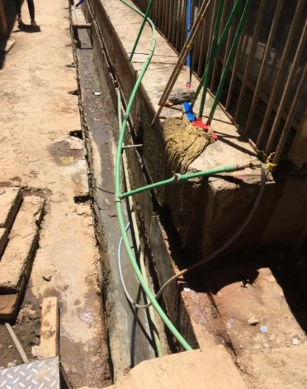
Common plumbing problems
Faulty of leaking pipework & taps
→ wastes water, increases costs to facility (higher utility payments and/or pumping and energy costs)
Poor water quality
→ due to corrosion, chemical contamination (e.g. lead) or deadlegs leading to stagnation.
Blocked and hand basins, sinks (and toilets):
→ spreads pathogens and increases risk of infections for staff, patients and carers
Pooling of water on floors
→ spreading pathogens and increasing risk of infections for staff, patients, carers
Failing drainage/septic system
→ stagnant water (presence of mosquitoes), risk of flooding, water contamination
What risks, linked to unsafe plumbing, do you notice in this photo?
Notes:
READ THE SLIDE:
SAY:
Specifically in the photo there are the following risks/problems:
-potential for cross contamination as the drinking water pipes are within an open drain and water from the drain or from some of the other pipes could enter the drinking water supply
-pipes are exposed to elements and could become damaged from some stepping on them, animals, sunlight or storm, resulting in leaks (water wastage) and cross contamination between drinking water and non-potable water supplies
-the water in the open drain could become an breeding ground for mosquitoes, increasing risk of vector born disease such as malaria or dengue

Slide 32
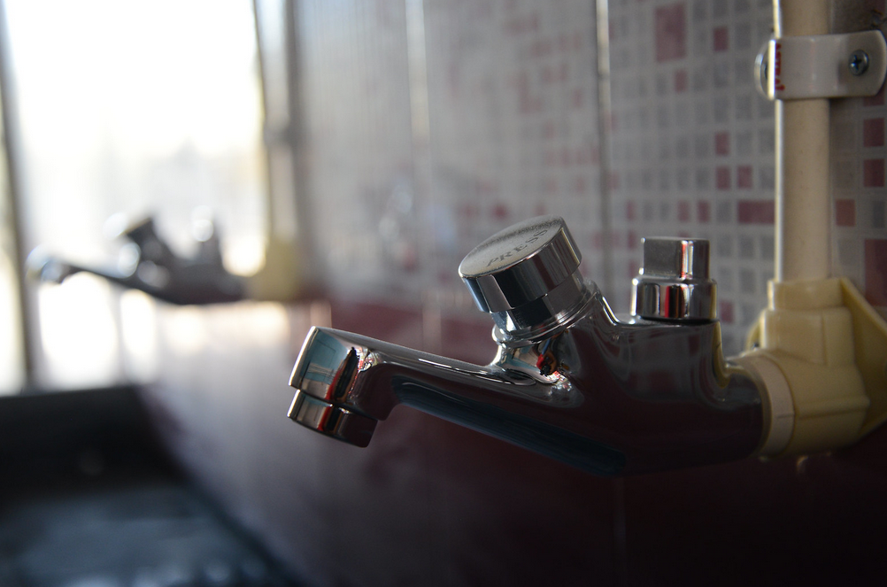
Simple, low-cost improvements
Plumbing should not have any cross connections (e.g., between safe water supply and wastewater system)
Piping connections should be regularly checked, and leaks fixed
Safe water pipes should be placed above black or grey water pipes to avoid cross contamination from leaks and water flowing by gravity
Bathroom showers and sprayers should have backflow protectors to prevent blackwater or fecal matter entering system
After an adverse event where water quality is compromised, treatment should be used, and water system flushed
Water conserving push-tap
Notes:
READ THE SLIDE
SAY:
what personnel is needed for safe plumbing? What expertise is available in their setting? Do HCF typically have access to trained plumbers? How is plumbing regulated/licensed in their country? (take feedback from the participants if there is time)
Plumbing is an essential service which needs to be considered in the overall planning, operation and maintenance of WASH services in health care facilities. Regardless of the location, health care facilities must enlist the services of competent, trained plumbers to install and maintain plumbing systems and components.
The availability of quality, water plumbing fixtures and fittings in the local area or region is also important to facilitate repair and service to the installed products and components.
Skilled plumbers should be considered as key members of the WASH FIT team as it applies to installing and maintaining water sanitation systems in the facility. If such certifications and/or regulations exist, teams should look for a certified, accredited or licensed plumber or technician.
Many countries have plumbing codes that can serve as an important reference for design standards. The World Plumbing Council has a number of resources that also may be useful: https://www.worldplumbing.org/
To summarise:
There are a number of simple, low-cost improvements that can be made including
fixing/replacing taps, leaking pipes
regular cleaning of toilets.
More intensive improvements (e.g. installing a septic tank, upgrading wastewater systems) will necessitate securing additional capital and funds for operation and maintenance.
Remind participants to refer to the safe plumbing factsheet in the WASH FIT guide.

Slide 33
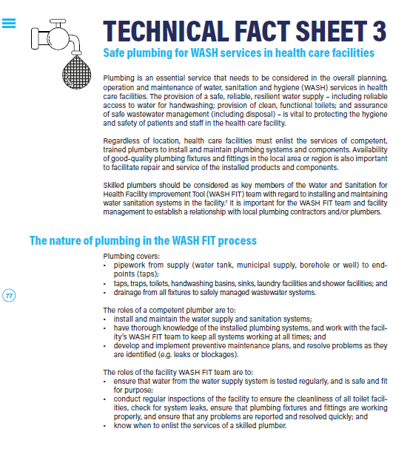
Improvements (continued)
Carry out regular water quality inspections and testing
Check for basic visual indicators (e.g. colour, solids), check for tastes and odours and carry out regular water quality testing
Maintain, clean and disinfect storage tanks on a regular basis
Maintain functioning sinks and taps
Confirm the reliability and frequency of delivery/supply from municipal supply
Maintain and clean washing rooms
Refer to the WASH FIT technical fact sheet on safe plumbing
Notes:
READ THE SLIDE
SAY:
“Regular” water quality testing means testing that occurs periodically using the same indicators (e.g. chlorine residual, turbidity, possibly fecal indicactor bacteria if budget allows) and allows for an assessment of any changes in water quality. How often this regular testing occurs will depend on the size of the facility, the type of the water source and system, the risks identified and the budget. Some test, like for chlorine residual should be done more often to ensure dosing is appropriate (e.g. weekly) while others may be done less frequently if all other factors remain the same.
Gutters and roofs used for rainwater catchment and storage tanks should be regularly cleaned at least monthly or as needed during heavy storms and rainfall. The system should also use a first flush device which is designed to divert the first portion of contaminated rainwater so it does not enter the storage tank and a filter box.

Slide 34
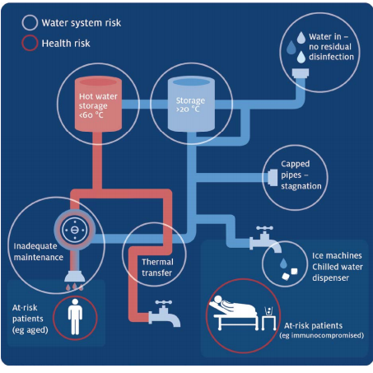
Spotlight on Legionella
A bacteria that naturally occurs in freshwater and can multiply under certain conditions
Can cause Legionellosis: people contract this disease by inhaling small droplets of the contaminated water through mist or vapor
What conditions encourage legionella to grow?
Stagnant water and/or low-flow water devices
Lukewarm water (25°C - 45°C)
Insufficient disinfectant
Inadequate corrosion control
Cross connections
Notes:
READ THE SLIDE
SAY:
Legionella are naturally occurring bacteria found in freshwater sources, such as rivers and lakes, where the bacteria generally are present in low amounts and do not lead to disease.
Legionella can multiply to dangerous levels under certain conditions and potentially cause Legionnaires’ disease, or Legionellosis. People contract this disease by inhaling small droplets of the contaminated water through mist or vapor.
Ask participants: what conditions encourage legionella to grow? (there are at least 5 answers)
Stagnant water (excessive water age).
The longer water sits in a system or piping in a system, the greater likelihood the water disinfectant will dissipate over time, leading to pathogen growth.
Lukewarm water.
Legionella growth is enabled by lukewarm water temperatures, usually in the range of 77 degrees Fahrenheit to 108 degrees Fahrenheit.
Insufficient disinfectant.
Effective water disinfectant strategies are necessary to control Legionella in a water system. For example, chlorination is one method used by water districts to disinfect drinking water that provides a lasting residual disinfectant.
Inadequate corrosion control.
Corrosion can occur in system pipes, depending on several water quality variables, including disinfectants used, water temperature and pH levels. Improper corrosion control can create the ideal environment for Legionella growth.
Cross connections.
Cross connections between potable and non-potable water can introduce Legionella into the potable water supply system.

Slide 35
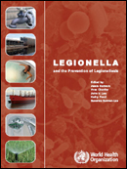
What can you do to prevent Legionella?
Keep hot and cold water outside growth range of Legionella (i.e. hot water at point of distribution > 50°C, cold water stored and distributed below 20 °C )
Ensure there are no cross connections between drinking-water and non-potable water (e.g. backflow valves should be bathroom sprays/shower heads)
Regularly monitor and adjust disinfectant dose to achieve minimum concentration at point of distribution (>0.2 mg/l chlorine)
Ensure there is no stagnant or low flow water in the water system.
Develop and implement a water risk management plan considering the factors above.
WHO (2007) Legionella and the prevention of legionellosis
Notes:
READ THE SLIDE
SAY:
You ca download the document at https://www.who.int/water_sanitation_health/emerging/legionella.pdf

Slide 36
Part 4: Climate change
How climate change impacts water supply
What solutions exist?
Climate resilience of water technologies
Notes:
READ THE SLIDE

Slide 37
Floods
Credit: IWA/Chris Wells.
Notes:
SAY:
Drought and floods and other extreme weather events can worsen water quality, both from municipal water treatment plants shutting down or having reduced capacity, and compromised sanitation systems. Procuring low-cost, rapid water quality test kits along with water treatment (e.g. filters, chlorine) can allow for quick detection of contamination and adjustments to treatment. Ensure an adequate stock of consumable reagents onsite as a buffer to climate-related supply disruptions (e.g. road closures following storms/floods) and robust procurement and supply chains are in place with adequate redundancy to ensure continuity of supply during emergencies.
For more information see: WHO guidance for climate resilient and environmentally sustainable health care facilities (WHO, 2020)
https://www.who.int/publications/i/item/9789240012226

Slide 38
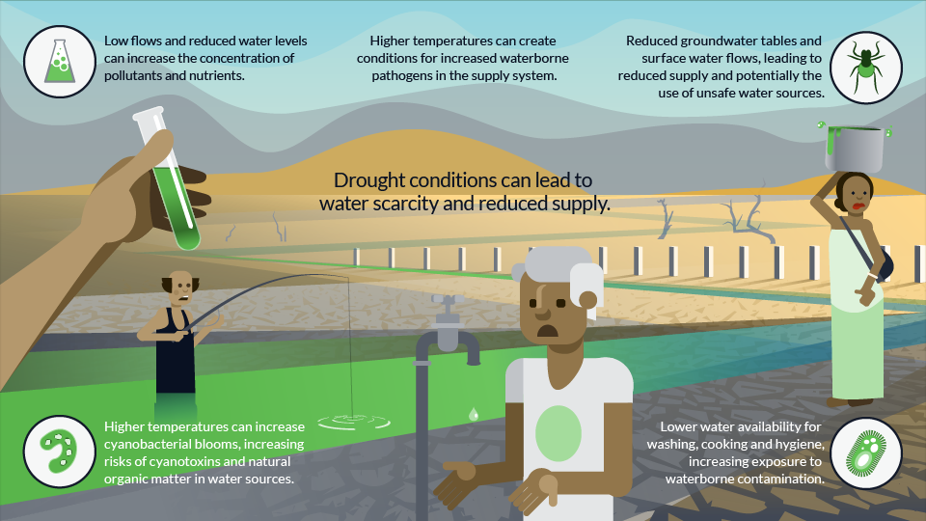
Droughts
Credit: IWA/Chris Wells.
Notes:
SAY:
Drought and floods and other extreme weather events can worsen water quality, both from municipal water treatment plants shutting down or having reduced capacity, and compromised sanitation systems. Procuring low-cost, rapid water quality test kits along with water treatment (e.g. filters, chlorine) can allow for quick detection of contamination and adjustments to treatment. Ensure an adequate stock of consumable reagents onsite as a buffer to climate-related supply disruptions (e.g. road closures following storms/floods) and robust procurement and supply chains are in place with adequate redundancy to ensure continuity of supply during emergencies.
For more information see: WHO guidance for climate resilient and environmentally sustainable health care facilities (WHO, 2020)
https://www.who.int/publications/i/item/9789240012226

Slide 39
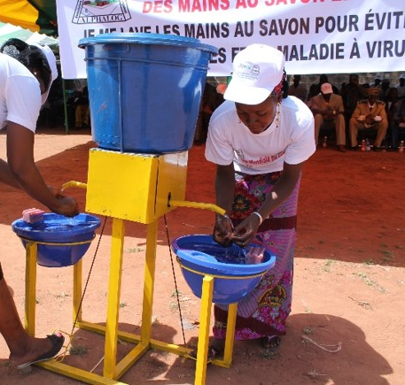
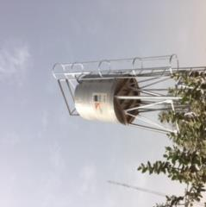
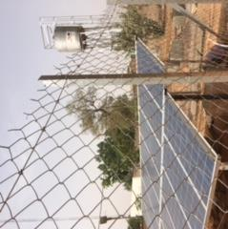
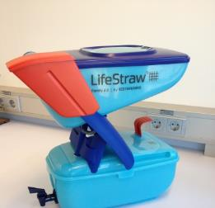
What solutions exist?
Raise water storage tanks (reducing risk of contamination or structural damage from flooding)
Rainwater harvesting with sufficient water storage
Back-up water supplies in event of drought, flooding, fires, high wind events, power outages
Water reduction strategies
Re-use of greywater/washwater for watering grounds, flushing toilets
Fixing leaking taps and pipes
Turn off water when scrubbing hands
Low-flow toilets
Clear drainage
Water treatment
Prioritize water for drinking, cleaning and other essential services
Notes:
READ THE SLIDE
SAY:
New infrastructure should be designed and operated to ensure continuity of services when they are needed most and with minimal negative impact on the environment. Over time, such adaptations save costs, support effective resource use and limit environmental waste and contamination (carbon emissions, persistent organic pollutants, chemical contamination of air, water and soil and other contaminants).
Rainwater catchment: Gutters and roofs used for rainwater catchment and storage tanks should be regularly cleaned at least monthly or as needed during heavy storms and rainfall. The system should also use a first flush device which is designed to divert the first portion of contaminated rainwater so it does not enter the storage tank and a filter box.
Backup supplies: Water treatment may be needed for backup supplies as it may have high arsenic or similar issues.
Ask participants for other examples of water reduction strategies.
Answers:
use of high-efficiency, low flow sinks for hand washing,
low-water washing machines (and other strategies for laundry and cleaning),
ensuring pipes and fixtures do not leak: using a system to report and fix leaking faucets the same day),
checking meters to analyse water use,
using greywater and/or rainwater where available to flush toilets, clean outdoor pavement areas, water plants etc.
turn off water while scrubbing hands
In cases of climate-events or emergencies additional measures may be needed, e.g. water is prioritized for essential/life-saving services (i.e. delivery rooms, acute care wards); priority users identified in case of shortages (priority users might include birthing mothers, young children, the elderly or undernourished).

Slide 40
Key take-aways
Water is fundamental for providing safe and clean care and for respecting the dignity and rights of staff, patients and caregivers
Water quantity needs depend on the types of health services provided and number of patients and their caregivers
When possible, water should be treated: many low-cost options exist
The risk of corona and Ebola viruses to water supplies is low and chlorination is effective in inactivating both types of viruses
Climate resilient water systems require back-up supplies, storage, additional treatment and infrastructure that can withstand floods, droughts and extreme events
Legionella can be prevented through good water system management.
Notes:
READ THE SLIDE

Slide 41
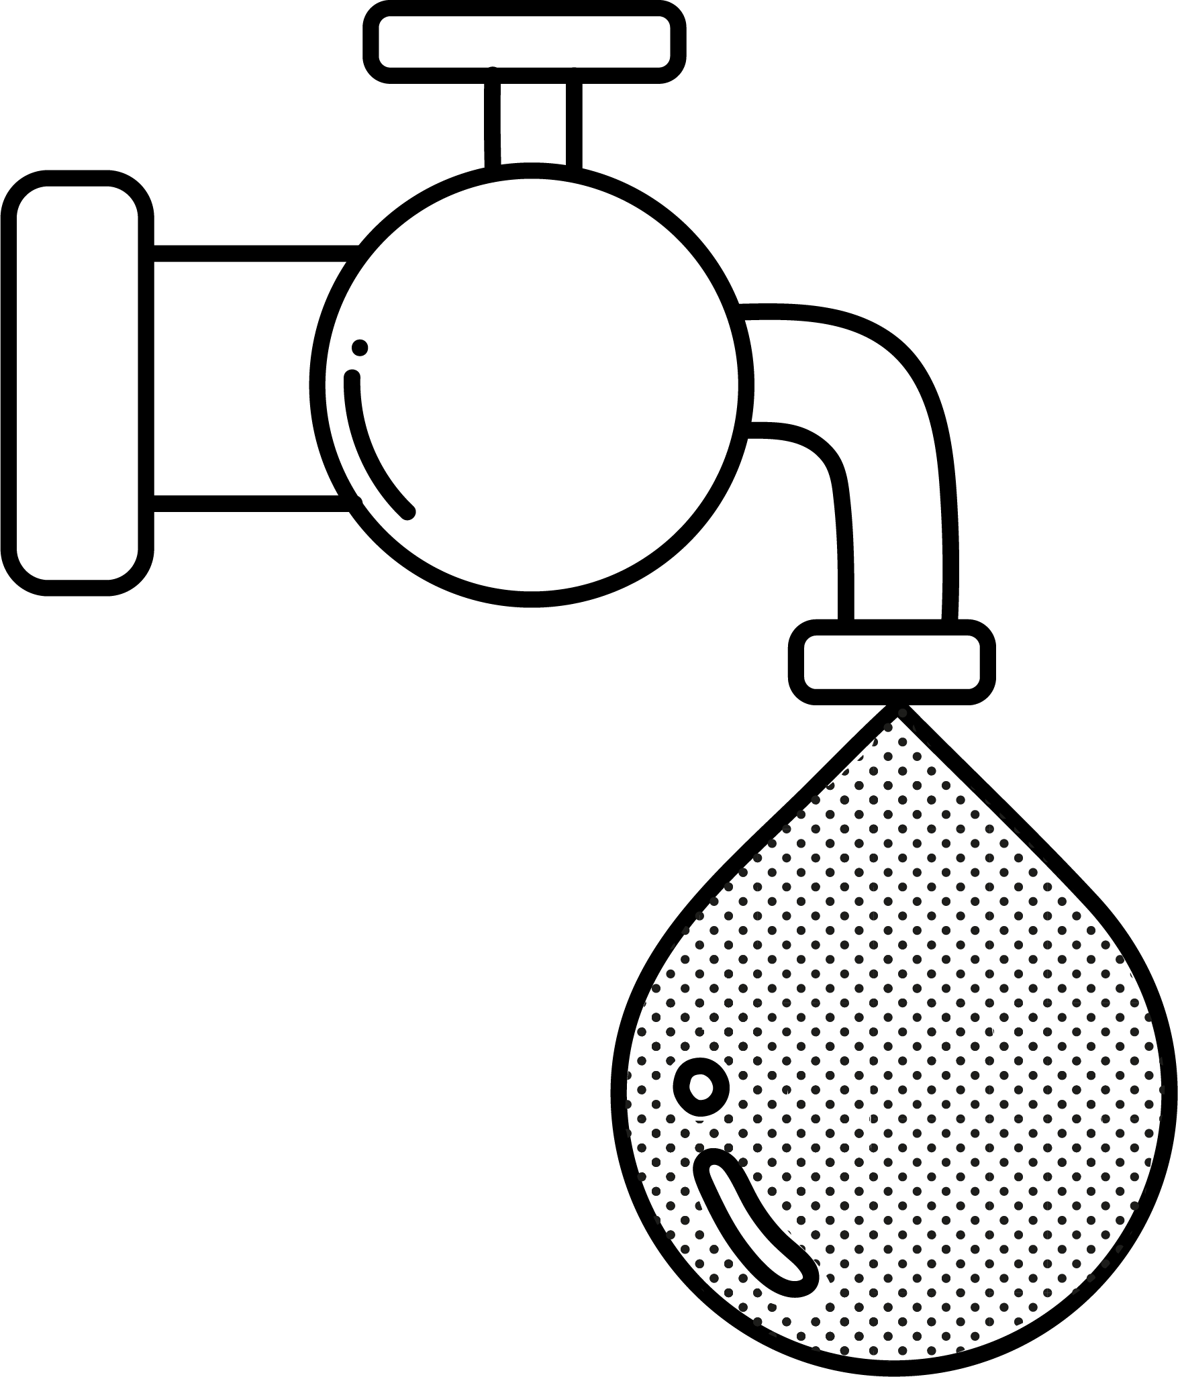
WASH FIT water indicators
Indicators in bold are “essential”
1a | An improved water supply is piped into the facility or located on premises | Supply
1b | The facility has piped water supplies on premises | Supply
2 | All taps are connected to an available and functioning water supply, with no leaks in pipes | Supply / Plumbing
3a | Water is available during all operating times of the facility | Availability
3b | Water is available at the time the WASH FIT assessment is carried out | Availability
4 | Water is available throughout the year (i.e. not affected by seasonality, weather variability/extreme events or other constraints) | Availability
5 | Main water supply system has been functional for the last 3 months with no major breakdowns | Availability
6 | Additional improved water source(s) are identified, available and can be accessed (and adequately treated if necessary) in case the main source is no longer functioning/available | Availability
7 | Water is of sufficient quantity for all uses | Availability
8 | The facility has tanks to store water in case of disruption to the main supply and water storage tanks are protected (e.g. from climate-related extreme weather events) and adequately managed (e.g. inspected, cleaned/disinfected regularly) and are sufficient to meet the needs of the facility for two days | Availability
Notes:
Look out for the water icon at the top right of the slide – this appears throughout the WASH FIT guide and highlights any examples linked to water.

Slide 42
WASH FIT water indicators
Indicators in bold are “essential”
9 | Rainwater harvesting system(s) (with safe storage) is functional and stores water safely | Availability
10 | Water reduction strategies are used to reduce water wastage. | Reduction
11 | [Where chlorine disinfection takes place] Drinking-water has appropriate chlorine residual (≥0.2mg/L or ≥0.5mg/L in emergencies) | Drinking water
12 | Water supply poses low or no risk to public health, as measured by the absence of E. coli per 100 mL and/or as measured by the Sanitary Inspection (SI) risk score. | Quality
13 | Piped water is treated and regulated through safe water management by municipal authorities or water is treated onsite | Quality
14 | The quality of water from all water supplies (primary, back-up and supplemental supplies) is routinely tested by a staff member/and or independent authority (e.g. a surveillance agency) | Quality
15 | A drinking-water station with safe drinking water is available and functioning at all times in main waiting areas and/or entrance to each ward AND in all rooms where patients stay overnight or receive care | Drinking water
16 | At least one shower or bathing area is available per 40 in-patients or per ward (whichever is lower) and is functioning and accessible | Showers
17 | A functional shower of space for women which is private and lockable is available in the labour and delivery area | Showers
Notes:
Look out for the water icon at the top right of the slide – this appears throughout the WASH FIT guide and highlights any examples linked to water.

Slide 43
Further reading
General
WHO (2008). Essential environmental health standards in health care. https://www.who.int/publications/i/item/9789241547239
WHO (2022). Guidelines for drinking-water quality: Fourth edition incorporating the first and second addenda. https://www.who.int/publications/i/item/9789240045064
WHO (2018). Developing drinking-water quality regulations and standards. https://www.who.int/publications/i/item/9789241513944
Emergencies
WHO (2011). Technical notes on drinking water, sanitation and hygiene in emergencies. http://www.who.int/water_sanitation_health/publications/2011/tn9_how_much_water_en.pdf
WHO/WEDC (2013). Updated technical notes on WASH in emergencies (set of 15). https://www.who.int/teams/environment-climate-change-and-health/water-sanitation-and-health/environmental-health-in-emergencies/technical-notes-on-wash-in-emergencies
WHO (2007). Legionella and the prevention of Legionellosis. https://apps.who.int/iris/handle/10665/43233
WHO/UNICEF (2020). Water, sanitation, hygiene and waste management for SARS-CoV-2. https://www.who.int/publications-detail-redirect/WHO-2019-nCoV-IPC-WASH-2020.4

Slide 44
Further reading
Climate
WHO (2017). Climate-resilient water safety plans: managing health risks associated with climate variability and change. https://apps.who.int/iris/handle/10665/258722
WHO (2020). Climate resilient health care facilities. https://www.who.int/news/item/12-10-2020-who-publishes-guidance-on-climate-resilient-and-environmentally-sustainable-health-care-facilities
Water quality & treatment
WHO (2021). Sanitation inspection packages for drinking-water. https://www.who.int/teams/environment-climate-change-and-health/water-sanitation-and-health/water-safety-and-quality/water-safety-planning/sanitary-inspection-packages
WHO (2019). Results of Round II of the WHO Household Water Treatment Evaluation Scheme. https://www.who.int/publications/i/item/9789241516037
Plumbing
WHO and World Plumbing Council (2006). Health Aspects of Plumbing. https://apps.who.int/iris/bitstream/handle/10665/43423/9241563184_eng.pdf?sequence=1&isAllowed=y
Netherlands Water Partnership (2006). Smart water solutions: examples of innovative, low-cost technologies for wells, pumps, storage, irrigation and water treatment. https://www.joinforwater.ngo/sites/default/files/library_assets/330_NWP_E9_smart_water.pdf
WHO webpages
WHO Water safety and quality https://www.who.int/teams/environment-climate-change-and-health/water-sanitation-and-health/water-safety-and-quality
WHO International Scheme to Evaluate Household Water Treatment Technologies
Full list of relevant reading available at:
https://washinhcf.org/resource/summary-of-all-who-and-related-resources-on-wash-in-hcf/

Slide 45
Supplementary slides
Notes:
Read from the slide and explain that this section of the training will address each of these three areas.

Slide 46
Results of WHO Scheme to Evaluate Household Water Treatment Performance
Level of protection:
Comprehensive
★   or  
Targeted
★
Little or no
-
Aquapak
Aquasure TAB10
DayOne Waterbag™
JAMEBI Solar Water Pasteurizer
SolarBag®
Lifestraw Family 1.0 & 2.0
Lifestraw community filter
P&G Purifer of H20
Waterlogic Hybrid Filter
Sydney 905 purifier
ROAMFilter
Puri Bag
Drop2Drink
ORISA
Aquatabs; Aquatabs Flo
Bishan Gari
BluAct; BlueQ™ 2-stage
Gongoli Nanofilter
H2g0 Purifier
Katadyn Rapidyn Filter
Katadyn Bee Free
Mesita Azul °
MNCH Filter
Nazava Water Filter
Oasis Water Purification Tablets*
Rubicon
SPOUTS Water Purifaaya Filter
Sydney 905 Filter
Tulip Table Top Water Filter
Uzima Filters UZ-01
VF 100 Home Filter
WATA-Standard™; Water Elephant; Wadi Solar; WaterMaker
Aquacare
Biocool CleanWater
Chloritard
GrifAid®M3
LifeFilta LFJC Jerrycan
Silverdyne
Tembo ceramic pot
https://www.who.int/tools/international-scheme-to-evaluate-household-water-treatment-technologies
Notes:
A number technologies have been evaluated by WHO as part of the Household Water Treatment Scheme (references at end). The WHO International Scheme to Evaluate Household Water Treatment Technologies (“Scheme”) was established to evaluate the microbial performance of household water treatment (HWT) technologies against WHO health-based criteria. The results of the Scheme evaluation are intended to guide HWT product selection by Member States and procuring UN agencies.
- Water treatment technologies should meet WHO’s performance standards for point-of-use / household water treatment and safe storage (HWTS).
Technologies / methods that meet these performance standards generally include high quality filters, chlorine (for non-turbid water) flocculant-disinfectants as well as boiling, or solar disinfection.
Higher performing technologies (i.e. two or three stars)
E.g. high quality membrane filters,
UV disinfectants
flocculant-disinfectants
recommended for vulnerable groups (i.e. those with HIV or young infants)
recommended where the specific pathogen of concern is not known.
The treatment method should provide comprehensive protection against all three classes of pathogens. (Ask participants to recap what the 3 types of pathogens are). This will protect against changes in water quality due to climate change or other events.
If the technology only provides limited protection, measures should be in place to adjust chlorine dosing and/or employ additional technologies to provide multi-barrier protection.
Make adjustments if water quality changes.
Water treatment may be conducted by the facility or, in the case of piped supplies, by the water utility.

