Slide 2
HYGIÈNE DES MAINS
WASH FIT – Module technique
Ajouter la date et le lieu
Notes:
Introduce yourself if you have not already, and make sure you insert the date and location to the slide before you start

Slide 3



Objectifs pédagogiques
À l’issue de la séance, les participants seront capables de :
Comprendre comment les services WASH vont de pair avec les cinq règles d’or de l’hygiène des mains
Comprendre et expliquer pourquoi il est important d’utiliser une stratégie d’amélioration multimodale et comment y intégrer les services WASH
Décrire pourquoi il est important de former et de rappeler aux agents de santé et au personnel d’encadrement à quels moments se laver les mains, de même que les bonnes techniques à utiliser
Souligner l’utilité des indicateurs WASH FIT dans le cadre de la prévention et de la lutte contre les infections et de l’hygiène des mains pour prévenir la propagation des infections associées aux soins de santé et la résistance aux antimicrobiens (notamment les infrastructures/ressources nécessaires à une meilleure hygiène des mains)
Travail
de groupe
Symboles à connaître
Discussion en groupe entier
Notes:
READ SLIDE
NOTE FOR TRAINER: you can make sure participants are clear on the outline of this module and what they will learn.
SAY:
the symbols here are ones you will se throughout the module to indicate activities
we will now watch a short (less than 2 mins) video to introduce the main terminology and concepts that will be covered during the session, n relation to a hand hygiene improvement approach
NOTE FOR TRAINER:
This video is upbeat and energizing and intended to secure participants attention from the start!
The video will start automatically on the click of the slide – you should hear a drum beat and then words and images will start to appear on the screen.

Slide 4

Vidéo
Chaîne YouTube de l’OMS, « Applying the WHO multimodal strategy for successful infection prevention improvements in health care » https://www.youtube.com/watch?v=pcKBIltlE3c
Notes:
PLAY VIDEO

Slide 5
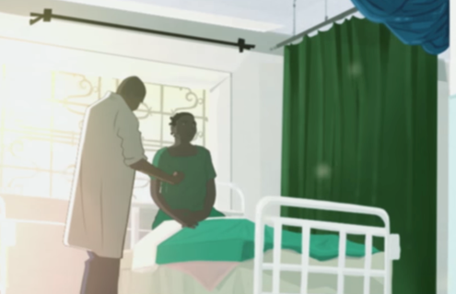
Pendant les prestations de soins de santé, les mains des agents de santé peuvent être contaminées par des microbes potentiellement dangereux provenant de différentes sources
Certains de ces microbes peuvent provoquer et alimenter des épidémies, et certains peuvent résister aux antibiotiques
Une bonne hygiène des mains empêche la prolifération de ces microbes, et protège les patients et le personnel
Une bonne hygiène des mains respectant les cinq indications de l’OMS reste difficile partout
L’eau, l’assainissement, la propreté et la gestion des déchets sont essentiels pour permettre une bonne hygiène des mains
Source de l’illustration : Vidéo de l’OMS « Health care without avoidable infections – peoples’ lives depend on it ». Disponible à l’adresse suivante : https://youtu.be/K-2XWtEjfl8
Notes:
READ SLIDE
SAY:
Hands can be contaminated by touching people, i.e. patients, and the environment and then germs can transfer from hands to enter vulnerable people during different health care procedures/interventions
Microbes can become resistant to antibiotics due to antibioitic misuse & overuse and the problem of resistance varies between health care settings and countries (this module does not cover the topic of antibiotic resistance, but it is a global challenge)
WHO guidelines on infection prevention and control and hand hygiene which summarize infrastructure, behavioural and practice issues that if not applied contribute to the problem of avoidable infections in health care. You can read more on the evidence in the WHO Guidelines (listed at the end of this module),
The link at the bottom of the slide is a short video (participants should be encouraged to watch in their own time and may find it useful to show to others to demonstrate the problem of health care associated (nosocomial) infections)

Slide 6

Question d’introduction
Fait : Nous perdons tous des peaux mortes chaque jour, et celles-ci peuvent contenir des microbes vivants (qui peuvent s’avérer dangereux pour certaines personnes).
Question : Combien de peaux mortes perdons-nous en moyenne chaque jour ?
  100
  1 000
  1 000 000
Notes:
READ SLIDE
SAY: think for a moment about the answer and shout out what you think
NOTE FOR TRAINER: this question is concerned with engaging the participants in the module through using a powerful, relevant piece of information

Slide 7

Réponse
En moyenne, une personne perd environ 1 million de peaux mortes par jour (ce qui équivaut à peu près au nombre d’habitants du Bhoutan et de la Barbade combinés !).
Les microbes vivent sur la peau non lésée (mais aussi à d’autres endroits).
Les mains des agents de santé peuvent être contaminées par des milliers de microbes lorsqu’ils effectuent les prestations de soins qui requièrent de manipuler les patients, par exemple lorsqu’ils prennent leur pouls, leur tension artérielle ou leur température, ou lorsqu’ils les aident à se déplacer.
Certains microbes peuvent survivre sur les mains pendant deux minutes, d’autres plusieurs heures.
Certains microbes peuvent survivre dans l’environnement pendant de longues périodes.
Ce module ne se concentre pas spécifiquement sur les virus qui se transmettent par voie aérienne.
Source : Pittet D et al., « Evidence-based model for hand transmission during patient care and the role of improved practices ». Lancet Infectious Diseases, 2006, 6:641–652
Notes:
READ SLIDE
SAY:
the reference at the bottom of the screen is available if you want to read more
NOTE FOR TRAINER:
If there are questions on airborne microbes, such as coronavirus, take a note of this and explain this will be returned to another time - this module focuses on stopping spread via hands and an approach to hand hygiene improvement
SAY: this module is on microbes spread by “touch” via hands. It is concerned with a) the importance of achieving hand hygiene action at the right times to prevent the spread of these microbes in health care & b) encouraging participants to appreciate the importance of WASH in enabling hand hygiene at the right moment

Slide 8
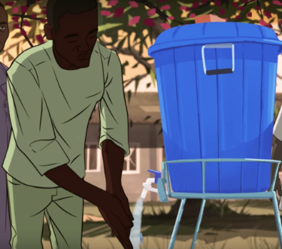

Problème et solution – Que savons-nous ?
Les données au service de l’amélioration
Infections associées aux soins de santé
Infections du site opératoire
Prévention des infections
10 %
50 %
70 %
1 patient sur 10 développe une infection à la suite de prestations de soins de santé
Plus de 50 % des infections du site opératoire peuvent être résistantes aux antibiotiques
Des protocoles de prévention et de lutte contre les infections adaptés peuvent réduire de 70 % les infections associées aux soins de santé
Problème : Même dans les régions riches en ressources, la conformité aux pratiques d’hygiène des mains peut être nulle, et elle est souvent inférieure à 40 %.
Solution : Des stratégies efficaces visant à améliorer l’hygiène des mains peuvent prévenir jusqu’à 50 % des infections évitables dans les établissements de santé et permettre de réaliser des économies.
Q. Connaissez-vous les taux d’infections associées aux soins de santé et les taux de conformité aux pratiques d’hygiène des mains dans votre pays ?
Notes:
READ SLIDE
SAY:
This slide summarises the problem and burden on health care
With reference to the problem – recent WHO global surveys show that many countries continue to score low in relation to a range of hand hygiene improvement efforts - the reference list will provide more information on the problem of infection in health care
We will find out more about what is required to influence hand hygiene behaviour as we go through the main part of this session which is about an approach to improving hand hygiene & also how WASH fits into this approach
SAY:
Please take a moment to think and then share any information you have on your own national or local hand hygiene rates - shouting examples to the whole group
NOTE FOR TRAINER - additional information if needed to explain at this point, depending on the audience:
Reminder of the relevant WASH data (2021):
One third of health care facilities do not have what is needed to clean hands where care is provided; one in four facilities lack basic water services and one in 10 have no sanitation services.
1.8 billion people use facilities lack basic water services
Across the world’s 47 least-developed countries, the problem is even greater: half of health care facilities lack basic water services. Furthermore, the extent of the problem remains hidden because major gaps in data persist, especially on environmental cleaning
A clean environment goes hand in hand with effective hand hygiene – environmental cleaning reduces the burden of germs in the environment and therefore reduces the risks of health workers contaminating their hands from the environment
A key message is that both WASH surveys and IPC and Hand Hygiene assessments provide data to drive improvement

Slide 9
Les cinq règles d’or de l’hygiène des mains
1
Se laver les mains au point de prestation de soins*.
(bon moment)
Pendant les prestations de soins de santé, il est essentiel de se laver les mains à cinq moments clés.
2
Se frotter les mains avec une solution hydroalcoolique (s’il y en a) permet d’avoir une bonne hygiène des mains au point de prestation de soins plus rapidement et efficacement ; cette méthode est également mieux tolérée.
3
4
Se laver les mains avec de l’eau et du savon est nécessaire lorsque les mains sont visiblement souillées.
(bonne technique)
Il est également important d’utiliser la bonne technique et de prendre le temps de bien se laver les mains.
5
Notes:
READ SLIDE
SAY:
this session will now focus on what WHO describe as the five golden rules for hand hygiene.
These rules focus on
The right times for hand hygiene, so that you can understand how key moments fit within the flow of activities that happen in a range of health care settings, and
The right technique.
For the first two rules to be met they require essential WASH services in the facility

Slide 10
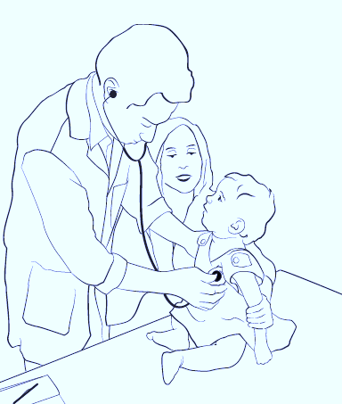
Point de prestation de soins – Définition
1
Le point de prestation de soins regroupe trois éléments :
  L’agent de santé
  Le patient
  Les soins ou le traitement impliquant un contact physique
Des produits et installations de lavage des mains (solution hydroalcoolique, eau, savon, lavabos) doivent être disponibles et accessibles facilement sur le point de prestation de soins afin de permettre aux agents de santé de se laver les mains lorsque nécessaire.
1. Agent de santé
3. Soins ou traitement impliquant un contact physique
« Puis-je me laver les mains facilement pour protéger cet enfant ? »
2. Patient
Notes:
READ THE SLIDE
SAY:
The point of care helps to explains “when” hand hygiene should occur to keep people safe – i.e. it is about understanding that the right time for hand hygiene matters
The phrase point of care is important, e.g. in WASH FIT you will see this mentioned
Understanding the point of care helps to make sense of the need for a supportive and enabling infrastructure for hand hygiene – as the physician in the image asks “can I easily clean my hands to keep this child safe?” If a health worker has to leave a patient and walk a considerable distance to a hand hygiene station this reduces the likelihood of them cleaning their hands.
Performing hand hygiene at the point of care, immediately where health workers touch patients is critical, to protect those most vulnerable

Slide 11
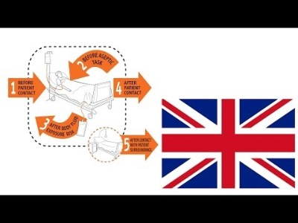
Vidéo sur les moments opportuns de l’hygiène des mains (indications)
https://www.youtube.com/watch?v=sa1iFq2YuUE
Notes:
SAY:
We will now watch a short video to help understand hand hygiene in healthcare including where it should occur in the flow of work of a health worker and therefore highlighting the most important times for hand decontamination to protect patient and health workers.
Copy paste the URL into a browser and show from 2m44s to 6m16s to help participants visually understand the patient zone and moments for HH - if you have time you may want to show more.

Slide 12
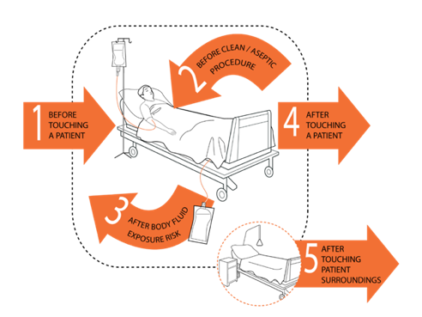
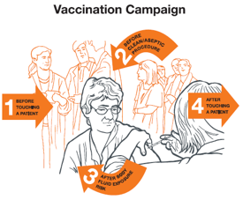
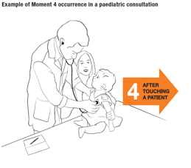
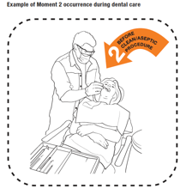
Cinq indications de l’hygiène des mains – Le bon moment
2
Pourquoi suivre l’approche des cinq indications de l’hygiène des mains
Simplifie les moments auxquels se laver les mains dans différentes situations
Intègre l’hygiène des mains au flux de travail des agents de santé de manière logique
Simple à mémoriser
Encourage une approche cohérente pour la formation, le suivi et les rappels
Applicable à tous les environnements de soins de santé
Notes:
READ SLIDE
SAY:
This builds on what has been seen about the importance of hand hygiene at the point of care as described in the video.
The simplicity of the Five Moments images/pictures is that it is:
Is a powerful training tool
It can be used as a poster or reminder on the wall
It is based on the evidence of microbe transmission and risk of spread of microbes in a real world setting
It highlights the critical times when hand hygiene action will prevent infection
The 5 moments is a universally used approach and the evidence on its role in infection prevention is well established
Applying hand hygiene at the right times helps address water issues/availability (see the WASH FIT water module for more information)
To fully understand the 5 Moments there are other WHO documents and training slides that explain how it works in detail

Slide 13
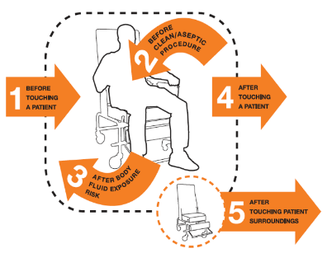
Exemple
2
Un médecin reçoit un patient dans son cabinet.
Ils s’asseyent et discutent pendant que le médecin parcourt le dossier de son patient.
Le médecin demande au patient de s’allonger sur le divan d’examen.
Consultation au cabinet du médecin de famille/généraliste
Le médecin examine le patient : il écoute son cœur et ses poumons, vérifie ses réflexes avec un marteau et prend sa tension artérielle.
1
À la fin de l’examen, le médecin aide le patient à se relever.
4
Le médecin retourne s’asseoir à son bureau, prend quelques notes sur son ordinateur et rédige une ordonnance.
Le patient se rassied, puis ils discutent du traitement.
Le patient quitte le cabinet, et un autre patient le remplace.
Réfléchissez à la meilleure façon d’intégrer les cinq indications de l’OMS dans des exemples concrets dans les établissements de santé où le WASH FIT est mis en œuvre.
Notes:
READ SLIDE
SAY:
Here we see an example of a workflow scenario: a visit to a family practitioner/general practitioner’s office
This further illustrates how the 5 Moments apply in a sequence of care, commonly experienced in a general practice/family practice setting.
The numbers in the orange circle represent the moment for hand hygiene according to the Five Moment
1) the moment is: before touching a patient and 4) the moment is: after touching a patient (Be sure to read these words out to help explain hand hygiene within the example workflow scenario given)
Think about how the Five Moments might be integrated into real life workflow examples that you can think of from the facilities where WASH FIT is being implemented. An example could be attending to a pregnant woman during an antenatal check – think about all the actions and interactions that occur part in a detailed step by step way through the woman's journey and how many times she might be touched by a health worker (this aims to stimulate participants to think about different scenarios and then consider at which moments hand hygiene will be required). Shout out any examples if you wish before we move on
There is a document in the references that is available if people want to learn more about these scenarios (WHO Hand hygiene in outpatient and home-based care and long-term care facilities: a guide to the application of the WHO multimodal hand hygiene improvement strategy and the “My 5 moments for hand hygiene” approach).
NOTE FOR TRAINER:
EXPLAIN THIS SLIDE, DEPENDING ON THE AUDIENCE AND YOUR CONFIDENCE IN EXPLAINING THE SCENARIO

Slide 14
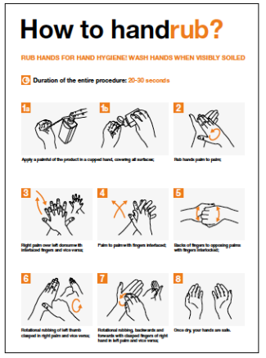
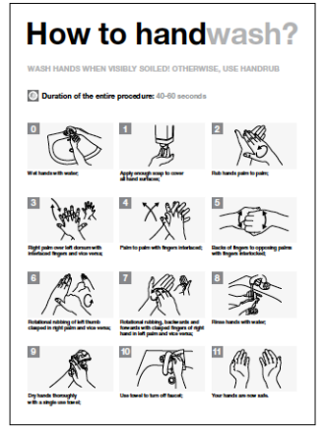

Cinq indications de l’hygiène des mains – La bonne technique
4
3
5
Solution hydroalcoolique : 20 à 30 secondes
Eau, savon et serviettes propres : 40 à 60 secondes
Notes:
SAY
Considering WHO’s 5 golden rules for hand hygiene, this is a reminder that the technique of handrubbing and handwashing is also an important part of ensuring hand hygiene action is effective.
On its own, understanding and practicing how to clean hands will not ensure the safety of both patients and health workers.
This is because the “when” is key.
Performing hand hygiene at the right time and using the correct technique is what keeps people safe.

Slide 15






La stratégie d’amélioration multimodale de l’OMS
Q. Selon vous, que représentent les cinq symboles de la stratégie d’amélioration multimodale ?
modale :
Multi
Plusieurs
méthodes
Durée : 2 min
Notes:
READ SLIDE
SAY:
The evidence tells us that to improve hand hygiene behaviours in health care requires more than one approach or method.
WHO describe this as a multimodal improvement strategy – an evidence based approach for improving hand hygiene and other infection prevention actions, which has 5 elements
NOTES FOR TRAINER:
If the multimodal video was played at the start of the session, SAY: ”think back to the first video we watched – what do each of these symbols represent?” Take one minute to wok with the person next to you and be prepared to shout out some ideas and I will capture these on a flipchart.
If the video was not played, SAY: Take one minute to wok with the person next to you and be prepared to shout out some ideas of what you think these 5 symbols represent, and I will capture these on a flipchart.
These symbols provide a clue
NOTE FOR TRAINER
Write down the answers on flip chart.
In general the answers are (and these will be fully explained in the next slides)
Systems that enable hand hygiene at the point of care - that means the right infrastructure, resources and equipment in place
Training and education
Monitoring/auditing and feedback
Reminders and communications
A supportive culture in the facility
FINALLY SAY:
that this multimodal strategy is recommended by WHO in its evidence based hand hygiene guidance and has been tried and tested in many countries and settings. Improvement in hand hygiene is achievable using a combination of many, namely 5 things, as described, each of which can be adapted to the local situation. However, if you focus on just one thing this is known not to lead to improvement in hand hygiene. E.g. running training sessions every year is good, but will not change health worker behavior on its own - why not?

Slide 16

La stratégie d’amélioration multimodale de l’OMS en bref
Installations et ressources disponibles pour se laver les mains (eau, lavabos, solution hydroalcoolique)
Formation des agents sur les raisons, les moments et les techniques de l’hygiène des mains
Contrôles permettant de suivre la conformité des pratiques d’hygiène des mains et retours d’informations rapides afin de résoudre les problèmes
Rappels des bonnes pratiques d’hygiène des mains
Culture de l’hygiène des mains au sein de l’établissement, avec le soutien des responsables et des superviseurs
Notes:
READ SLIDE
SAY:
Based on the previous slides and discussion it is clear that hand hygiene is a behavior that is influenced by many factors.
WASH plays an important role in enabling and supporting hand hygiene. WASH helps to build the right infrastructure and a clean safe environment that supports hand hygiene.
The multimodal strategy canalso be summarised in these five simple phrases, as mentioned in the video (if played):
Build it, Teach it, Check it, Sell it & Live it.

Slide 17
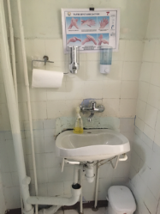
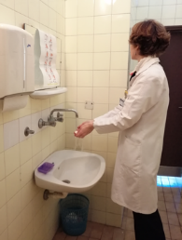
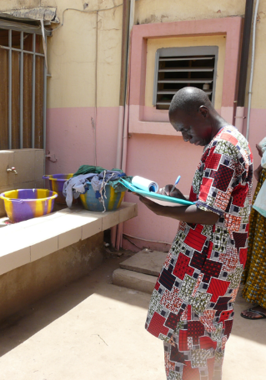
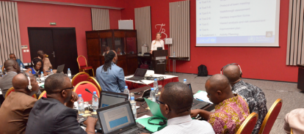
Lisez le scénario détaillé dans le document fourni et répondez aux questions posées.
Travail de groupe – Exemple concret
Durée : 10 min
Notes:
READ THE SLIDE, REFER STUDENTS TO THE HANDOUT EXERCISE AND READ OUT THE INSTRUCTION FROM IT TO BE SURE EVERYONE IS CLEAR ON WHAT TO DO

Slide 18

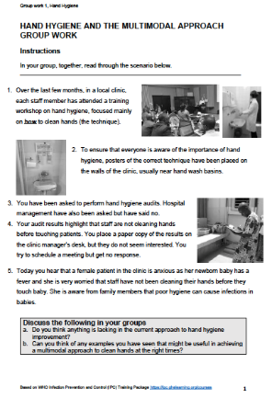
Travail de groupe – Commentaires et discussion
X
Comprendre la stratégie d’amélioration multimodale encourage la modification des comportements et une hygiène des mains durable
X
Notes:
SAY:
Please read out the findings of your group discussion so that everyone can hear.
NOTES FOR TRAINER:
Prompts to use if needed, especially if the feedback is limited
What does this exercise tell us about training? About monitoring/auditing? About promoting hand hygiene (posters), about hand hygiene infrastructures? About the culture? What does this tell us about there being ‘no one single magic bullet to change hand hygiene behaviour??
When considering gaps in the current approach, here are some ideas to discuss:
In this facility, staff are currently being trained which is positive, but how frequent is this?
What is included in the training? Training must be provided on the why and the when and not just the how.
Likewise, use of posters in the workplace to remind staff about hand hygiene is a good thing but it is useful to consider posters that promote and reinforce the when, i.e. the moments when hand hygiene should occur. Are posters attractive to the audience? Are they changed regularly?
Audits (checks) are taking place but the senior managers do not seem to be interested in being involved, including not interested in the results.
This is indicative of a wider challenge here – the culture of the clinic does not seem to value hand hygiene. We will come back to this later in the session.
Lastly, have questions been asked about the availability of ’infrastructure/resources’ to support hand hygiene in the right places at the right time (alcohol handrub, soap, water, clean towels)?
If people are trained to clean their hands at the point of care but there is no way to do this, the overall health system is not supportive of hand hygiene and may not be dedicating budget to this! This has an impact on the staff but also the fears of patients and potential infection risks.

Slide 19
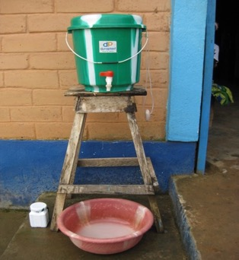
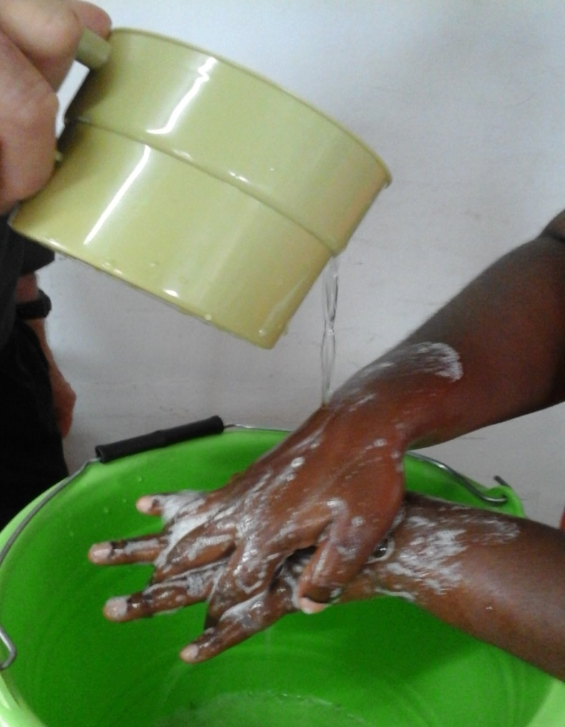
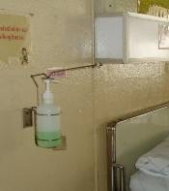
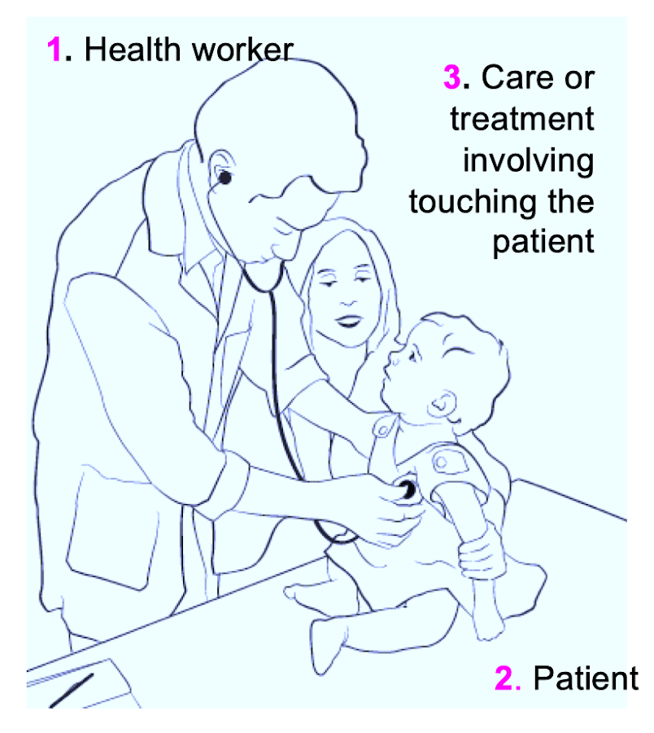
Changement systémique
Changement systémique (construire) au regard de WASH FIT
Indicateurs WASH FIT à évaluer* :
Des installations de lavage des mains fonctionnelles sont disponibles à chaque point de prestation de soins, y compris dans les salles d’accouchement
Des installations de lavage des mains fonctionnelles sont disponibles dans toutes les salles d’attente et/ou les zones publiques ainsi que dans les zones d’évacuation des déchets
Des installations de lavage des mains fonctionnelles sont disponibles à moins de 5 mètres des toilettes
Les coûts liés au personnel d’entretien et de maintenance, aux formations aux procédures WASH/de prévention et de lutte contre les infections, aux consommables pour les procédures WASH/de prévention et de lutte contre les infections (p. ex., savon, chlore), et à l’ensemble des activités répertoriées dans le protocole ci-dessus sont pris en charge
*Remarque : Un approvisionnement en eau de bonne qualité, la gestion des déchets et les ressources humaines sont également des indicateurs à prendre en compte pour assurer la conformité aux pratiques d’hygiène des mains.
Notes:
FIRST SAY (THEN READ THE SLIDE)
We will now focus on learning in more detail what each element of the multimodal improvement strategy means in practice and how it fits with WASH
We will drill down into each of the five elements of the multimodal strategy - there is no particular order to follow for each of the 5 elements, it depends on as assessment of the local situation and what is needed.
This slide explains how system change relates to WASH FIT.
These WASH FIT indicators focus on building the right infrastructure for hand hygiene which will support your improvement strategy alongside other actions.
Examples of how hand hygiene stations have been established where needed are available and you can read more in the WHO/UNICEF practical steps document and on the washinhcf.org web platform.
But remember, to truly influence patient and health worker safety, the infrastructure and resources must be reliably available at the point of care.

Slide 20
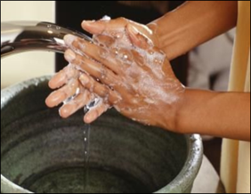
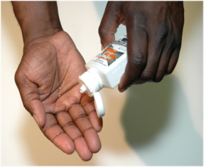
Changement systémique
Changement systémique/Construire – Principaux points à retenir
Dans l’établissement où le WASH FIT est mis en œuvre, posez les questions suivantes :
Le personnel peut-il se laver les mains facilement à chaque point de prestations de soins, conformément aux cinq indications ?
Les bonnes personnes sont-elles mobilisées pour garantir la réussite du changement systémique ?
Rappel :
Se laver les mains avec de l’eau et du savon lorsqu’elles sont visiblement souillées ou si elles sont entrées en contact avec des sécrétions
Utiliser une solution hydroalcoolique dans tous les autres cas
Notes:
READ SLIDE
SAY:
These questions are key for understanding the importance of “Build It” or system change (the terms are interchangeable, which ever works to help people understand).
Reflect for a moment, thinking about these questions and the relevence to your setting.
From a WASH perspective, system change improvement may be critical as action may not be possible without the right infrastrucutre and resources.
However, even where there are challenges in infrastructure – all of the other elements of the multimodal improvement strategy should still be considered to help understand everything needed for improvement.
NOTE FOR TRAINER:
if participants are more interested in climate issues that affect water remember this is covered in the module on water.

Slide 21
Formation et éducation
Formation et éducation (former) au regard de WASH FIT
Indicateurs WASH FIT à évaluer :
Tout le personnel auxiliaire, y compris les agents responsables de la gestion des déchets et les agents d’entretien, doivent être formés aux procédures WASH et de prévention et de lutte contre les infections adaptées à leur rôle (notamment à l’hygiène des mains)
Points à prendre en compte pour respecter les normes d’éducation et de formation à l’hygiène des mains :
Une personne est-elle chargée de veiller à ce que les programmes pédagogiques comportent les dernières recommandations en matière d’hygiène des mains ?
Est-il possible d’évaluer précisément les besoins en formation ?
https://www.who.int/infection-prevention/tools/hand-hygiene/workplace_reminders/en/
Notes:
READ SLIDE

Slide 22
Formation et éducation
Formation et éducation/Former – Principaux points à retenir
Dans l’établissement où le WASH FIT est mis en œuvre, posez les questions suivantes :
  Des supports pédagogiques à jour sont-ils disponibles ? Les rôles de formateur ont-ils été attribués ? Un calendrier de formation a-t-il été mis en place ?
  L’ensemble des agents de santé ont-ils été formés aux cinq indications pour l’hygiène des mains ?
  Des lacunes d’ordre théorique ou pratique ont-elles été constatées ?
Notes:
READ SLIDE
SAY:
The key message is that when we think about training and education for hand hygiene improvement we should address the training materials, the human and other resources for delivering training and the focus of the training.
An important clarification is when hands should be washed with soap and water and when alcohol based handrub can be used. WHO recommendations state that hands can safely be cleaned by alcohol handrub at any time except when they are visibly soiled when they should be washed with soap and water and dried.

Slide 23
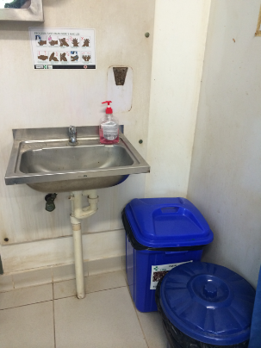

Suivi et retours d’informations
Suivi et retours d’informations (contrôler) au regard de WASH FIT
Indicateurs WASH FIT à évaluer :
Avancé : Des activités d’application des directives relatives à l’hygiène des mains sont organisées au moins une fois par an
Avancé : Des contrôles sont menés régulièrement dans chaque service pour évaluer la disponibilité des solutions hydroalcooliques, du savon, des serviettes à usage unique et des autres ressources pour l’hygiène des mains (au moins trois fois par mois)
Q. Quels sont certaines des difficultés les plus courantes liées au suivi de l’application des directives relatives à l’hygiène des mains ?
Comment peut-on les surmonter ?
Le personnel responsable du suivi dispose-t-il des outils valides et des modèles de retour d’informations nécessaires pour soutenir ces améliorations ? Sinon, que faire pour résoudre ce problème ?
Notes:
READ SLIDE
SAY:
Shout out some of the challenges you can think of (take just a few moments
NOTE FOR TRAINER:
Some of the common challenges to share are:
Securing support for audit from managers and leaders
Audit considered too time and resource consuming
A realistic monitoring schedule
Prompt participants to think of other challenges from their area
SAY:
Tell me whether you have any examples of solutions, of how they have successfully implemented hand hygiene audits.
If WASH FIT is being implemented, it is likely that there will be some general support for associated audits, but there will still be a need for regular communication on the value of the data that will be generated. Hand hygiene audit results feed into the general facility improvement plan.

Slide 24
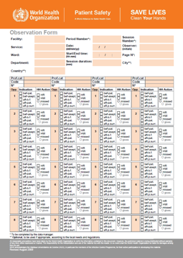
Suivi et retours d’informations
Suivi et retours d’informations (contrôler) – Principaux points à retenir
Dans l’établissement où le WASH FIT est mis en œuvre, posez les questions suivantes :
  L’établissement compte-t-il des agents de santé formés et chargés de contrôler la disponibilité des ressources et l’application des pratiques relatives à l’hygiène des mains, notamment la bonne utilisation d’outils valides et la présence d’un personnel spécialisé aux rôles bien définis ?
  Les points de vue et les connaissances des agents de santé en matière d’hygiène des mains sont-ils suivis par l’établissement ?
  Comment les retours d’informations sont-ils faits ? Sont-ils propices aux améliorations ? Comment les responsables contrôlent-ils les améliorations au niveau de l’établissement ? (suivi et retours d’informations réguliers, etc. ?)
  Tous les éléments de la stratégie multimodale sont-ils contrôlés ? Des rappels sont-ils disponibles ?
Notes:
READ SLIDE
SAY:
The form on the screen shows the WHO hand hygiene observation form. This is used to check compliance and provides feedback according to the Five Moments for hand hygiene.
Detailed instructions are available on the back of the WHO observation form if you chose to use this.
The instructions can be consulted during observations and people should be trained in how to undertake this detailed activity.
A WHO manual and comprehensive slide set exists on how to observe hand hygiene according to the five moments (if this is considered helpful and it is deemed a priority actions during your assessments).

Slide 25
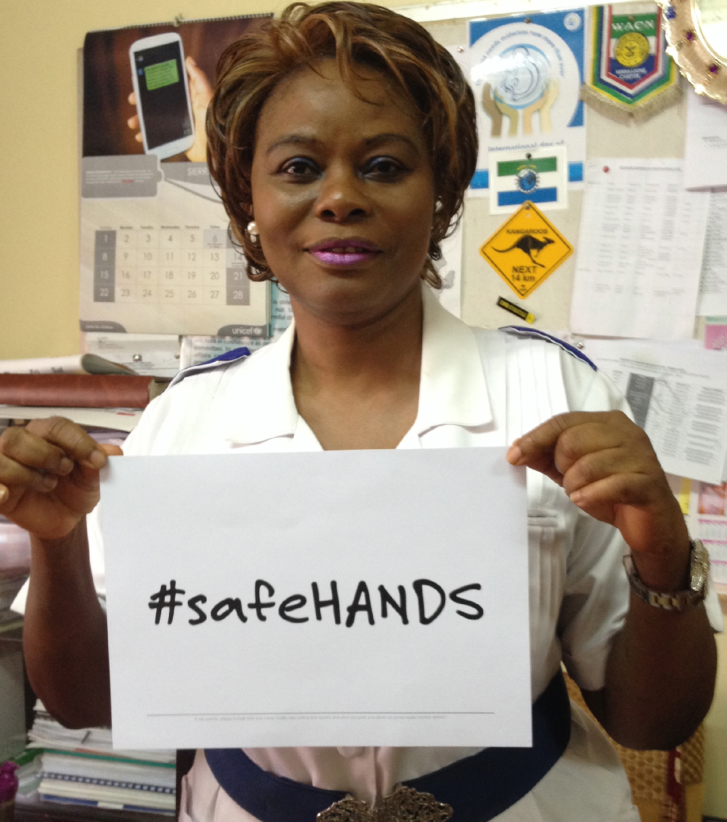

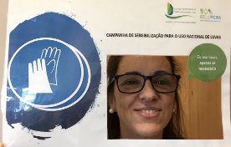
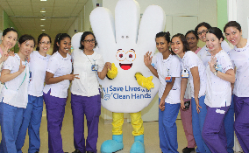
Rappels et communication
Rappels et communication (promouvoir) au regard de WASH FIT
Indicateurs WASH FIT à évaluer :
Essentiel : Des supports de promotion de l’hygiène des mains sont affichés de manière visible et dans un langage clair dans tous les services/zones de traitement.
Rappel :
Ne pas se limiter aux affiches pour promouvoir l’hygiène des mains.
Pour être efficaces, les affiches doivent être renouvelées régulièrement.
Notes:
READ SLIDE
SAY:
Think of other ways hand hygiene promotion can take place to reach a health care facility, e.g. information leaflets, badges and stickers, social media including podcasts, local radio, conventional media e.g. newspapers, messages on t-shirts!
Campaigns are also ways to promote hand hygiene, both global and local campaigns – including radio campaigns, community campaigns etc. Some of the images here relate to WHO’s annual global hand hygiene in health care day that takes place each 5 May.

Slide 26
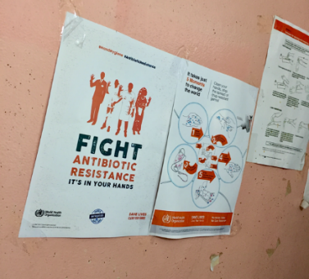
Rappels et communication
Rappels et communication (promouvoir) – Principaux points à retenir
Dans l’établissement où le WASH FIT est mis en œuvre, posez les questions suivantes :
Quelle est la meilleure façon de promouvoir l’hygiène des mains ?
Demandez-vous au personnel de santé/au public de vous aider à mettre en place des rappels ?
Les affiches et rappels utilisés renforcent-ils et promeuvent-ils les cinq indications ?
La mise en place des supports est-elle menée par du personnel spécialisé ?
Notes:
READ SLIDE

Slide 27

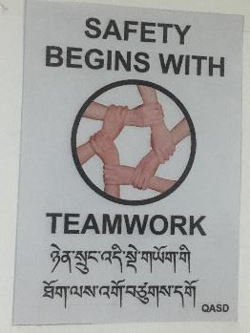

Climat de sécurité/culture institutionnelle
Climat de sécurité/culture institutionnelle (vivre) au regard de WASH FIT
Indicateurs WASH FIT à évaluer :
L’établissement dispose d’une équipe fonctionnelle responsable de la gestion de la qualité/de l’amélioration de la qualité/de la prévention et de la lutte contre les infections/du WASH FIT, et de coordonnateurs en la matière.
Les performances du personnel sont évaluées régulièrement : les bonnes performances sont récompensées, et des mesures d’accompagnement sont prises pour soutenir les agents présentant de moins bons résultats.
Les descriptifs de poste de l’ensemble du personnel auxiliaire, y compris des agents d’entretien et des agents responsables de la gestion des déchets, détaillent clairement par écrit leurs responsabilités en matière de WASH et de prévention et de lutte contre les infections.
Un établissement de santé rural au Bhoutan © Arabella Hayter, OMS
Notes:
READ SLIDE

Slide 28
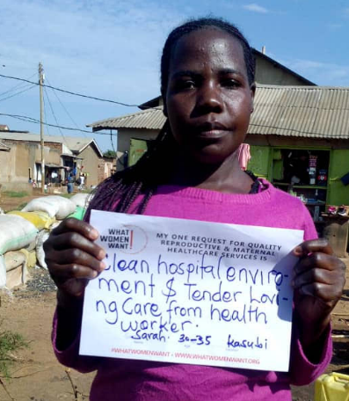
Climat de sécurité/culture institutionnelle
Climat de sécurité/culture institutionnelle (vivre) – Principaux points à retenir
Dans l’établissement où le WASH FIT est mis en œuvre, posez les questions suivantes :
  Comment faire des pratiques d’hygiène des mains une priorité au sein de l’établissement ? Les superviseurs/responsables sont-ils impliqués ?
  Comment mobiliser les responsables, les chefs de file et les leaders d’opinion, et comment peuvent-ils mobiliser les autres à leur tour au fil du temps ?
  L’ensemble du personnel, y compris les responsables et autres chefs de file, comprennent-ils et prennent-ils la mesure des cinq indications de l’hygiène des mains ? Montrent-ils l’exemple ?
  Les modèles pouvant avoir une influence positive sur les comportements pourraient-ils être mis en valeur pendant les réunions/discussions de personnel, par exemple en portant un badge ?
  Les superviseurs et responsables de l’établissement montrent-ils l’intérêt qu’ils portent aux pratiques d’hygiène des mains ?
Source de l’illustration : « What Women Want Global Findings » – Image de la White Ribbon Alliance (WhiteRibbonAlliance)
https://www.dropbox.com/sh/rcw1hn9dnqu1fpl/AAC0qON71SZULyRM3j_Xkd6da?dl=0
Notes:
READ SLIDE
SAY:
This element of the multimodal strategy addresses the importance of an institutional safety climate or culture for hand hygiene
The culture or safety climate of a health care facility is important for the delivery of safe, quality care – leaders and managers influence the culture/safety climate
Their commitment to hand hygiene and other safety initiatives is a big driver of success
If leaders and managers are not committed it is unlikely that hand hygiene will be valued, supported, funded or championed
How familiar are you with the idea of role models and champions – have they used this approach in relation to hand hygiene, IPC, WASH or any other initiative? (Ask people to shout out their examples)

Slide 29
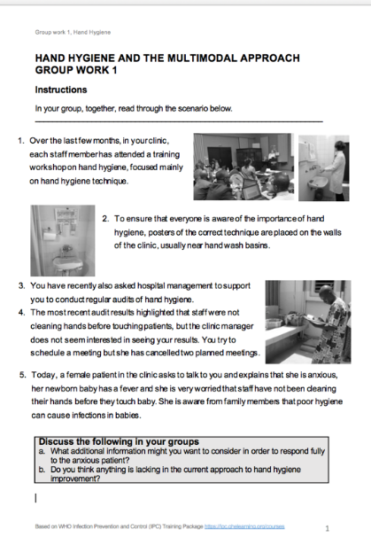
Climat de sécurité/culture institutionnelle
De nombreux éléments sont nécessaires pour favoriser une bonne culture.
Ils dépendront souvent de l’environnement local.
Il n’existe pas de réponse universelle, mais le leadership, sous toutes ses formes, est crucial.
Des agents de santé capables de fournir des prestations de soins de qualité sont également essentiels.
Question : Comment mieux sensibiliser les responsables d’hôpitaux ou de cliniques à la promotion de l’hygiène des mains ?
Durée : 5 min
Notes:
READ SLIDE
SAY:
For the next 5 minutes we will revisit the group work exercise you already read.
Return into your working groups and look again at the scenario.
A key challenge identified earlier was the lack of engagement of senior managers in hand hygiene improvement – it appears in this scenario that managers are not prioritizing hand hygiene.
Discuss some ideas on how managers might be engaged to take hand hygiene more seriously for a few minutes and be ready to feedback
NOTE FOR TRAINER - some ideas and prompts might include:
Persuading managers to participate in some audits and then be part of discussing results and ideas for improvement
Using the concerns of the female patient as a driver to engage managers and trying to secure their support to a) verbally support/promote the importance of hand hygiene to health-care workers b) authorise/mandate a hand hygiene improvement programme
The possibility of the senior manager verbally supporting/promoting the improvement at high-level organizational meetings
Exploring whether it is feasible to identify a Hand Hygiene Co-ordinator/project manager to direct a renewed hand hygiene initiative with manager approval and mandate
Discussing related funding in the broader context of WASH improvements
Messages from managers being planned leaders, which should be both visible/audible and updated regularly
Leaders seen to attend training and role model hand hygiene as per the Five Moments
Staff have WASH and IPC related responsibilities and are appraised, with high performing staff recognized & rewarded and those who do not perform managed according to the local culture
These and other ideas can be found in the WHO IPC Hand Hygiene Resources, Template Letter to Advocate Hand Hygiene to Managers (link in the reading list) and in the WASH FIT guide and assessment tool.

Slide 30
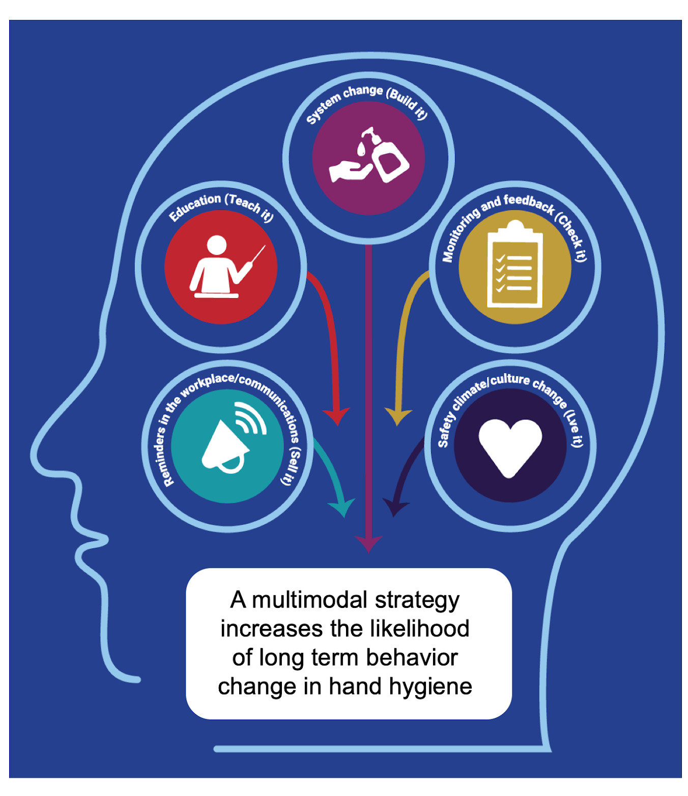
Hygiène des mains et WASH – Points à retenir
Se laver les mains efficacement et au bon moment est indispensable pour garantir des soins de santé de qualité pour tous.
Un environnement favorable (des services WASH) encourage les bonnes pratiques d’hygiène des mains qui respectent les cinq indications de l’OMS.
Adopter et adapter une stratégie multimodale permettra d’améliorer l’accès à l’hygiène des mains et les comportements.
L’hygiène des mains peut ouvrir la voie à d’autres améliorations en matière de prévention et de lutte contre les infections, ainsi qu’à l’adoption d’autres indicateurs WASH pertinents.
L’hygiène des mains est un indicateur clé de performance de la réduction de la résistance aux antimicrobiens, des épidémies et des infections associées aux soins de santé.
Notes:
READ SLIDE
If required, SAY: this module does not specifically focus on COVID however, the information presented applies to all times and will support HH action when coronavirus or other organisms are present

Slide 31
Lectures et ressources complémentaires
Ensemble des outils et ressources de l’OMS pour la promotion de l’hygiène des mains :
  Outils de mise en œuvre : https://www.who.int/teams/integrated-health-services/infection-prevention-control/hand-hygiene/tools-and-resources
  Outils de formation : https://www.who.int/teams/integrated-health-services/infection-prevention-control/hand-hygiene/training-tools
  Outils de suivi : https://www.who.int/teams/integrated-health-services/infection-prevention-control/hand-hygiene/monitoring-tools
  Resource considerations for investing in hand hygiene improvement in health care facilities : https://www.who.int/publications/i/item/9789240025882
Article vidéo du New England Journal of Medicine sur l’hygiène des mains :
  Anglais : https://www.nejm.org/doi/full/10.1056/nejmvcm0903599
  Langues officielles de l’Organisation des Nations Unies et autres langues : https://www.who.int/campaigns/world-hand-hygiene-day
Hand Hygiene: A Handbook for Medical Professionals : https://www.wiley.com/en-gb/Hand+Hygiene:+A+Handbook+for+Medical+Professionals-p-9781118846865
Module sur les précautions standard en matière d’hygiène des mains, OpenWHO : https://openwho.org/courses/IPC-HH-fr

Slide 32
Lectures et ressources complémentaires
Cadre d’autoévaluation de l’OMS pour l’hygiène des mains : https://cdn.who.int/media/docs/default-source/integrated-health-services-(ihs)/hand-hygiene/monitoring/hhsa-framework-october-2010.pdf?sfvrsn=41ba0450_6
Solution hydroalcoolique :
  OMS, Outil de planification et de calcul des coûts (2010) : https://www.who.int/teams/integrated-health-services/infection-prevention-control/hand-hygiene/tools-and-resources
  OMS, « Guide de production locale : formulations des produits hydroalcooliques recommandés par l’OMS », 2010. https://www.who.int/publications/i/item/WHO-IER-PSP-2010.5
Les cinq indications dans les structures de soins :
  OMS, Hand hygiene in outpatient and home-based care and long-term care facilities: a guide to the application of the WHO multimodal hand hygiene improvement strategy and the “My 5 moments for hand hygiene” approach, 2012. https://apps.who.int/iris/handle/10665/78060

Slide 33
Lectures et ressources complémentaires
Supports pédagogiques complémentaires :
Module de formation de prévention et de lutte contre les infections de l’OMS (formation en ligne) : Précautions standards : Hygiène des mains et Précautions standard : Nettoyage de l’environnement : https://openwho.org/courses/IPC-HH-en
Prévention et lutte contre les infections (général) :
  OMS, Minimum Requirements for infection prevention and control (IPC) programmes, 2019. Disponible à l’adresse suivante : https://apps.who.int/iris/handle/10665/330080
  OMS, Lignes directrices sur les principales composantes des programmes de prévention et de contrôle des infections au niveau national et au niveau des établissements de soins de courte durée, 2016. Disponible à l’adresse suivante : https://apps.who.int/iris/handle/10665/272850
  OMS, « Aide-memoire: respiratory and hand hygiene ». In: Infection prevention and control: guidance to action tools, 2021. Disponible à l’adresse suivante : https://apps.who.int/iris/handle/10665/341418
Résistance aux antimicrobiens :
  Pages de l’OMS consacrées à la résistance aux antimicrobiens : https://www.who.int/fr/health-topics/antimicrobial-resistance

Slide 34

Des questions ?
Notes:
TRAINER NOTE:
Try to answer qus by reiterating points covered in the session
Refer back to relevant slides - repeat things that have been said, if necessary verbatim, from the slides
Use the resources highlighted in this session to additionally support you to answer questions (this will require pre reading)
If questions arise that are not related to the content of this module, tell participants that you will take note of them and can attempt to find answers to share with them at a later stage

