Slide 1
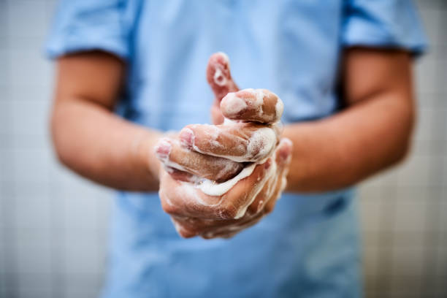
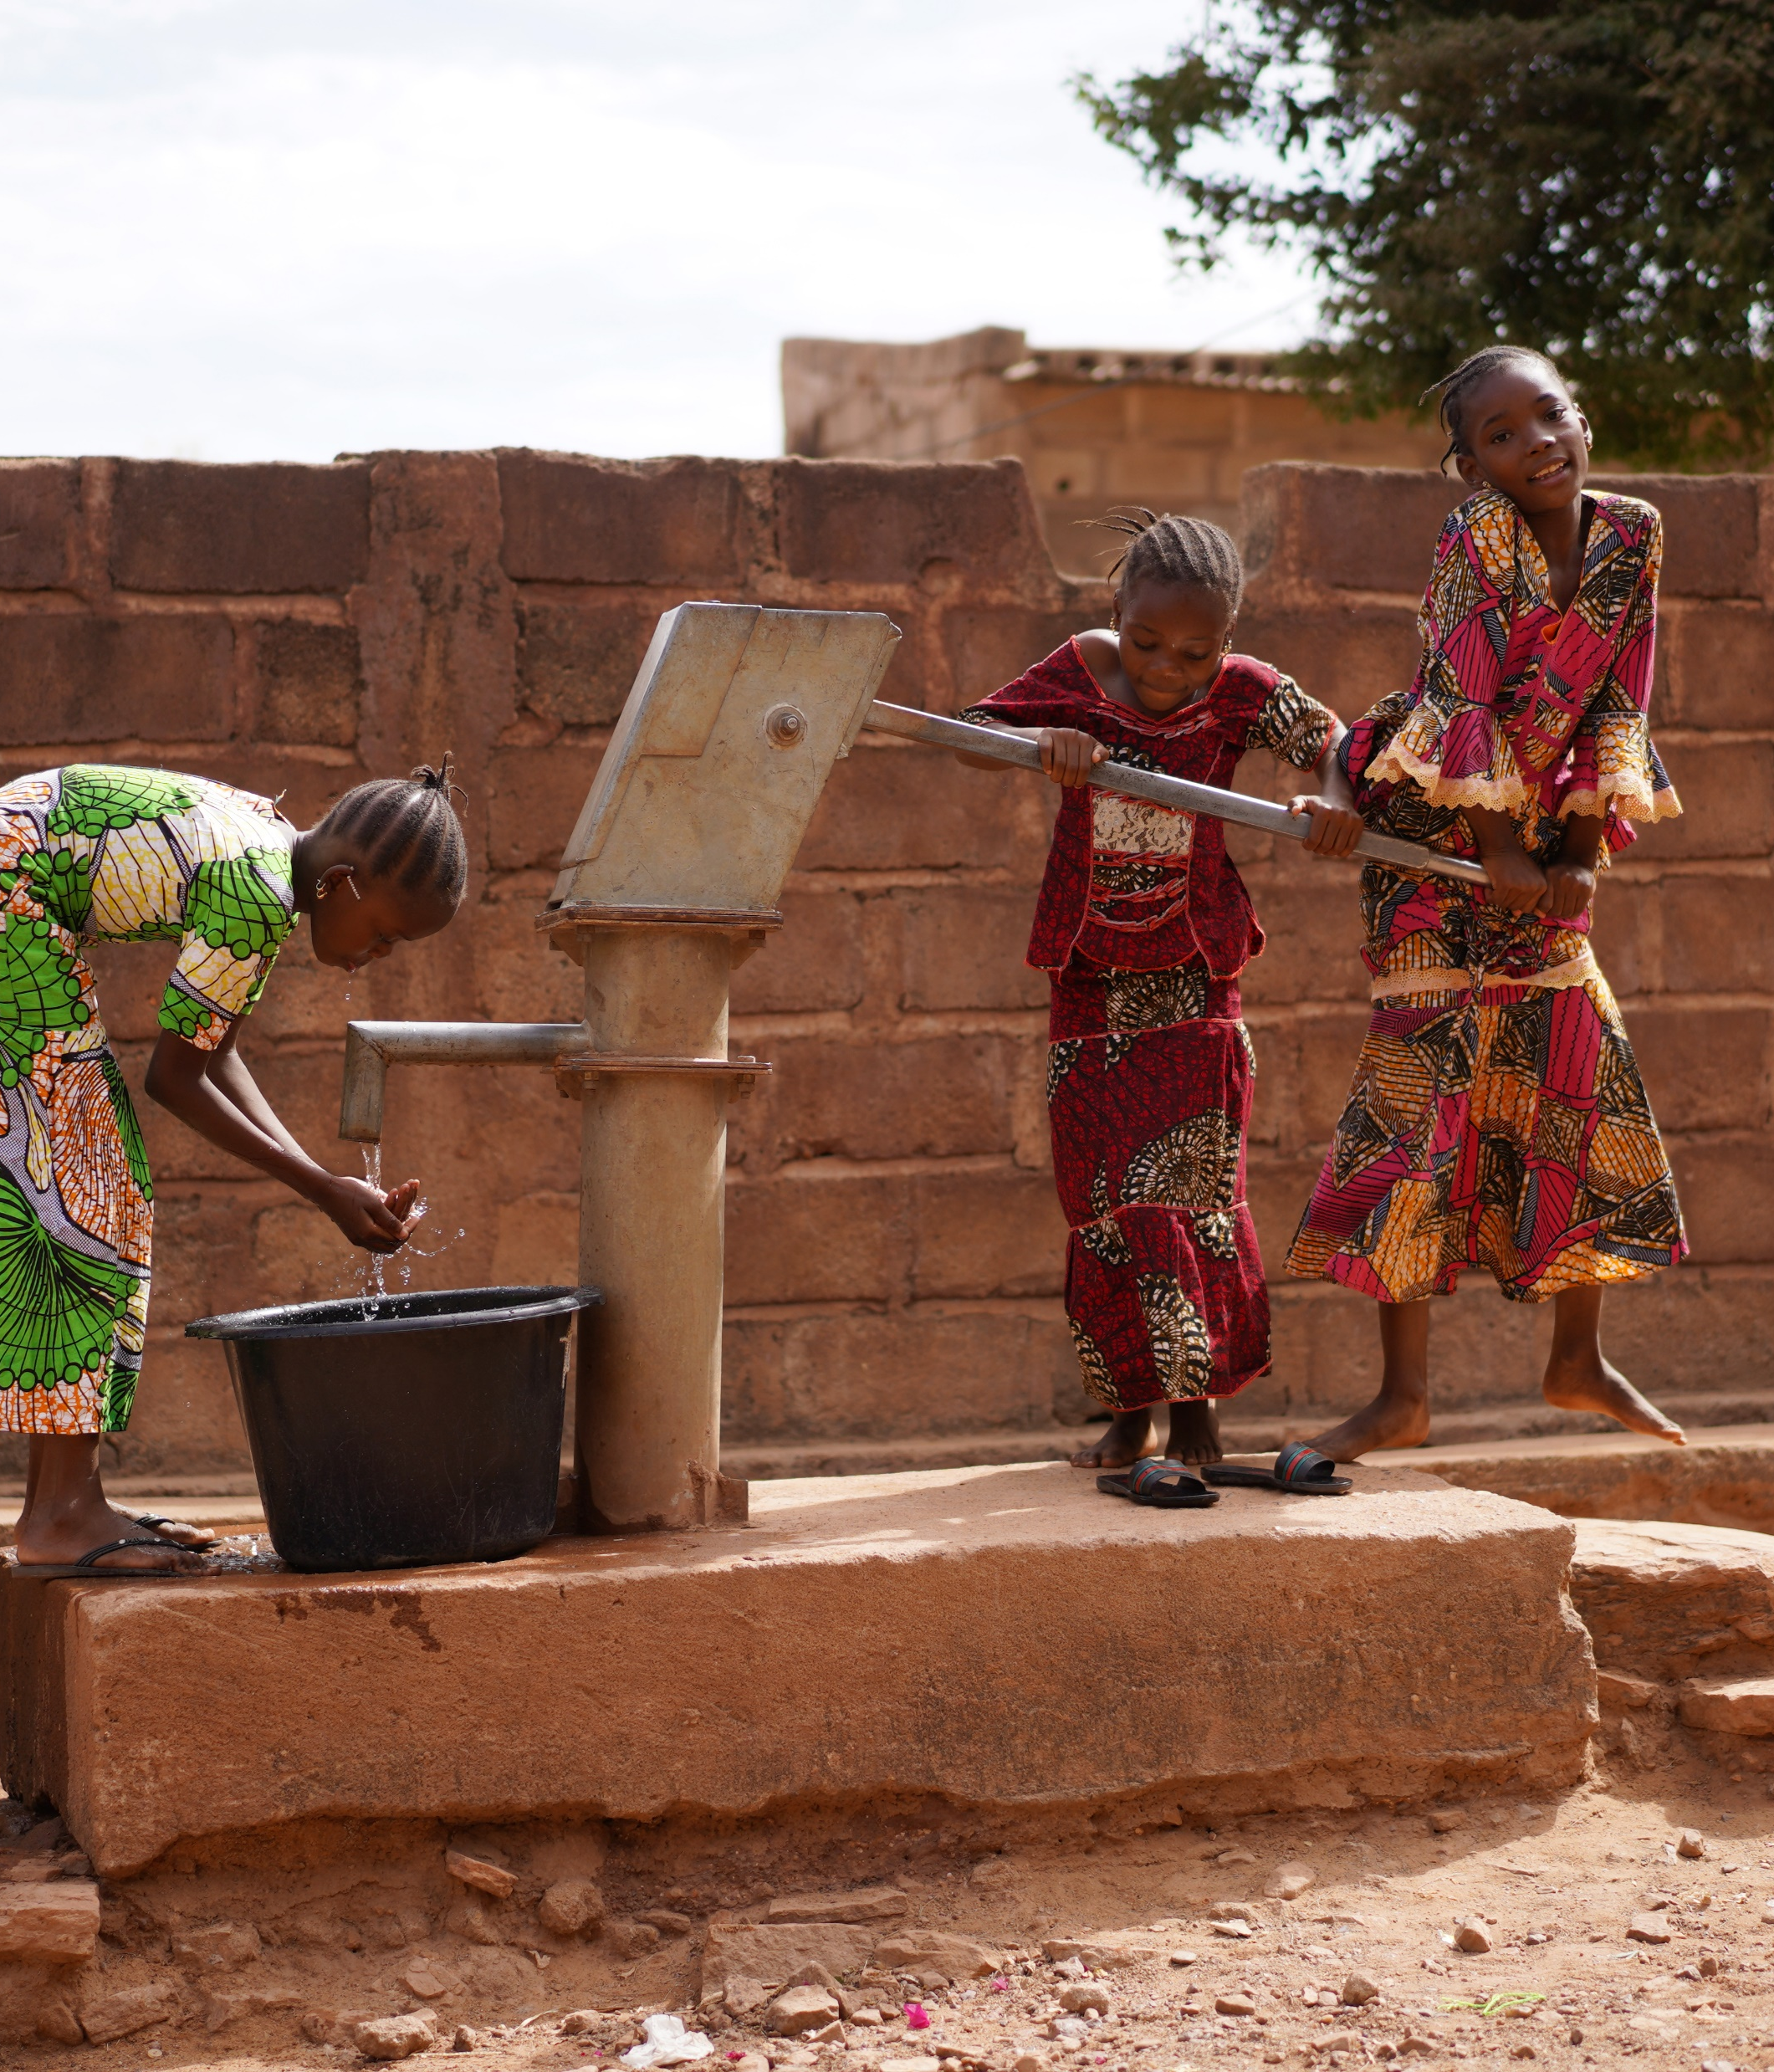
Module 10
Hand hygiene
Credit: WHO
Notes:
Audio: Welcome to Module 10. This is Bonifacio Magtibay from the Philippines again, and our focus now is on hand hygiene in health care facilities and how you can improve it as part of WASH FIT.

Slide 2
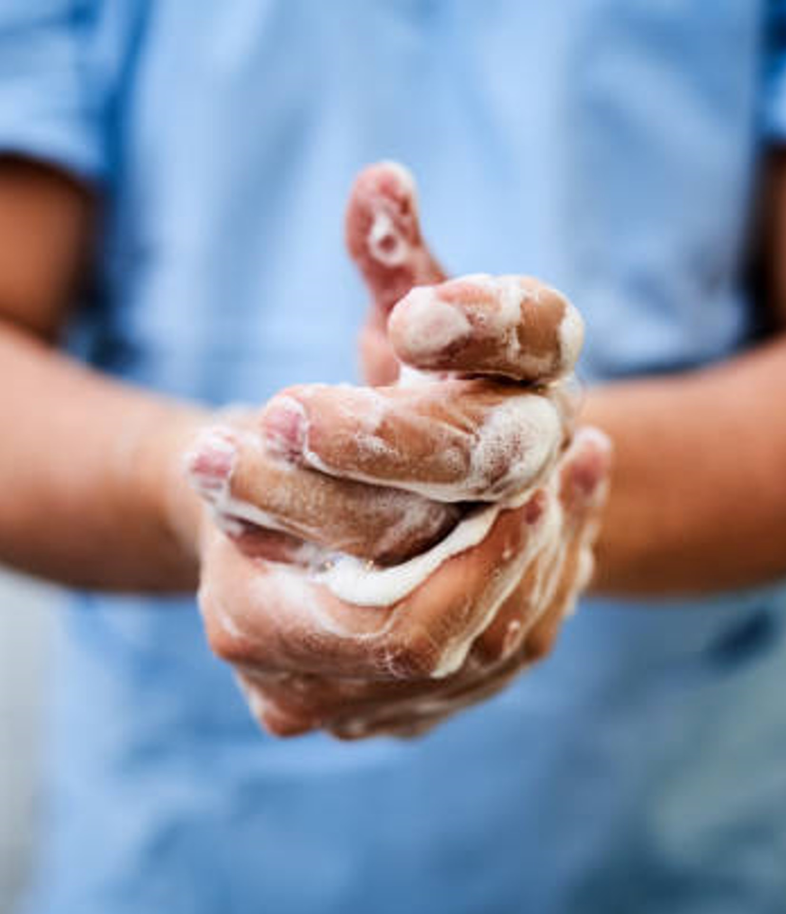
Learning objectives
By the end of this module, you will:
Deepen your understanding of the essential role of WASH in hand hygiene practices within health care settings.
Understand the five golden rules for hand hygiene.
Describe the importance of using a multimodal improvement strategy.
Discover the necessity of ongoing training for health care workers and managers, focusing on the right moments and techniques for hand hygiene.
Credit: WHO
Notes:
Audio: In this module, you will deepen your understanding of the essential role of WASH in hand hygiene practices within healthcare settings. You will learn how WASH underpins the five golden rules for hand hygiene, critical in preventing healthcare-associated infections and fighting antimicrobial resistance.​
​
You will explore the importance of a multimodal strategy for improving hand hygiene.
You will also discover the necessity of ongoing training for healthcare workers and managers, focusing on the right moments and techniques for hand hygiene. You may also wish to take the OpenWHO course on standard precautions for hand hygiene.

Slide 3
Achieving hand hygiene at points of care is still a challenge everywhere
Infections may be spread when delivering care and from the health care environment.
IPC measures are proven to prevent harm.
Everyone can play their part in making health care safer.
Credit: Shutterstock
Notes:
Audio: No health system is free of avoidable infections. These infections, acquired through delivering care and from the health care environment, affect patients, their families and health workers, in many different ways.
Infection prevention and control measures are proven to prevent harm.
Everyone can play their part in making people safer in healthcare – this is a key element of WASH FIT. ​
​
WHO offers guidelines on infection prevention and control, or IPC, and hand hygiene, outlining necessary infrastructure, behaviors, and practices to prevent infections in healthcare settings. These guidelines are crucial for mitigating the risk of infections, including those resistant to antibiotics—a growing global challenge.​
​
Strict hand hygiene standards prevent infection transmission, as touching patients and surfaces can contaminate hands, turning them into vectors for transmitting harmful microbes. ​
​
Achieving consistent hand hygiene remains a challenge globally. We will explore why, and what can be done. ​

Slide 4
Achieving hand hygiene at points of care is still a challenge everywhere
Infections may be spread when delivering care and from the health care environment.
IPC measures are proven to prevent harm.
Everyone can play their part in making health care safer.
Strict hand hygiene prevents infection transmission.
Achieving consistent hand hygiene remains a challenge globally.
Credit: Shutterstock
Notes:
Audio: No health system is free of avoidable infections. These infections, acquired through delivering care and from the health care environment, affect patients, their families and health workers, in many different ways. Infection prevention and control measures are proven to prevent harm. Everyone can play their part in making people safer in healthcare – this is a key element of WASH FIT. ​
​
WHO offers guidelines on infection prevention and control, or IPC, and hand hygiene, outlining necessary infrastructure, behaviors, and practices to prevent infections in healthcare settings. These guidelines are crucial for mitigating the risk of infections, including those resistant to antibiotics—a growing global challenge.​
​
Strict hand hygiene standards prevent infection transmission, as touching patients and surfaces can contaminate hands, turning them into vectors for transmitting harmful microbes. ​
​
Achieving consistent hand hygiene remains a challenge globally. We will explore why, and what can be done. ​

Slide 5
Did you know?
Every day the average person sheds about 1 million skin flakes? That’s about equal to the population of Bhutan and Barbados combined!
Microbes are everywhere – not just on skin.
Hands of health workers can be contaminated with thousands of germs.
How long do germs survive?
Some survive on surfaces for 2 minutes, some for up to an hour.
Some can survive in the environment for long periods.
Notes:
Audio: Did you know that every day, we shed about 1 million skin flakes? Microbes are everywhere, not just on our skin but also in various environments. ​
​
The survival time of these germs on hands varies—some last only 2 minutes, while others can persist for up to an hour. Certain microbes can even survive on surfaces for extended periods, increasing their transmission risk.​
​
For health workers, this is especially relevant. Their daily tasks, whether assisting patients, checking vital signs, or touching surfaces around the patient, even cleaning patient rooms and bathrooms, can lead to hand contamination with thousands of germs.​

Slide 6
1 in 10 patients get an infection receiving care
Effective IPC can reduce these infections by up to 70%.
Hand hygiene compliance often remains below 40% (without specific interventions).
For every US$ 1 invested improving hand hygiene in health care = economic return of US$ 24.6 on average*.
Credit: WHO
*Across the 34 OECD and EU/EEA countries
Notes:
Audio: Data reveal a pressing issue in healthcare: 1 in 10 patients may acquire an infection, with over half of surgical site infections potentially resistant to antibiotics. Effective IPC control can reduce these infections by up to 70%, yet hand hygiene compliance often remains below 40%. Improving hand hygiene practices could prevent up to 50% of avoidable infections,
offering significant health and economic benefits.​
​
Recent WHO surveys show many countries lag in hand hygiene efforts.​
​
Shockingly, one-third of healthcare facilities lack proper hand hygiene resources, and 1.8 billion people use facilities without basic water services. In the least-developed countries, half the facilities lack basic water services, highlighting a dire need for improvement. Effective hand hygiene improvement strategies can prevent up to 50% of avoidable infections in health care and generate economic savings.​

Slide 7
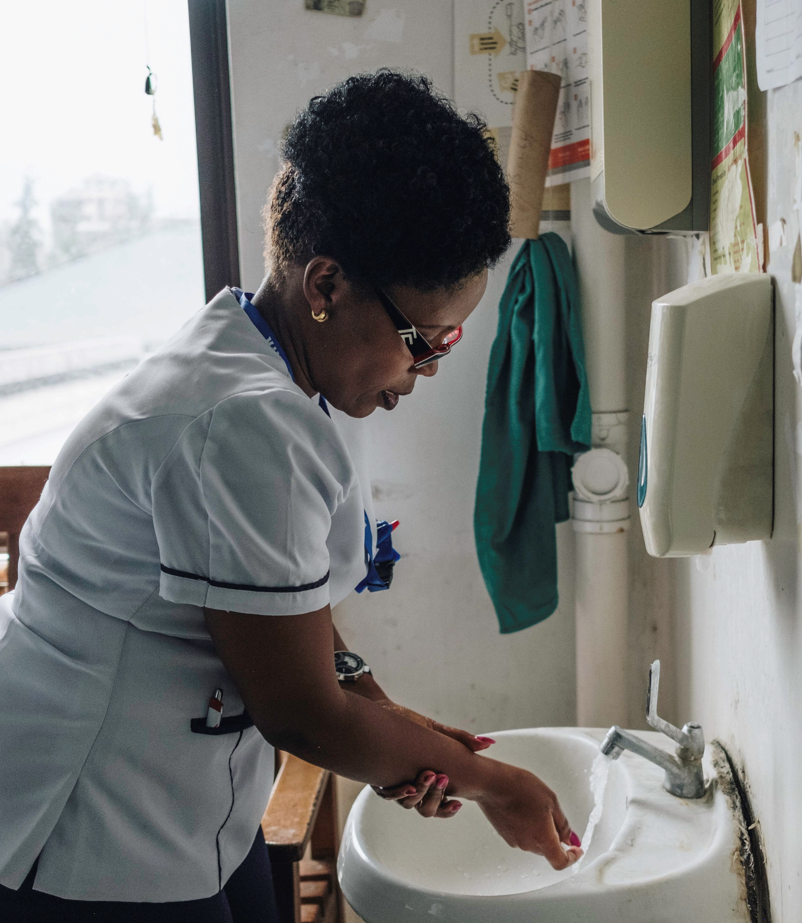
Many countries lack basic hand hygiene services
1/3 facilities lack proper hand hygiene resources.
1.8 billion people use facilities without basic water services.
In LDCs, ½ facilities lack basic water services.
Effective hand hygiene prevents avoidable infections and generates economic savings.
Credit: WHO/Khadija Farah
Notes:
Audio: Data reveal a pressing issue in healthcare: 1 in 10 patients may acquire an infection, with over half of surgical site infections potentially resistant to antibiotics. Effective IPC control can reduce these infections by up to 70%, yet hand hygiene compliance often remains below 40%. Improving hand hygiene practices could prevent up to 50% of avoidable infections, offering significant health and economic benefits.​
​
Recent WHO surveys show many countries lag in hand hygiene efforts.​
​
Shockingly, one-third of healthcare facilities lack proper hand hygiene resources, and 1.8 billion people use facilities without basic water services. In the least-developed countries, half the facilities lack basic water services, highlighting a dire need for improvement. Effective hand hygiene improvement strategies can prevent up to 50% of avoidable infections in health care and generate economic savings.​

Slide 8
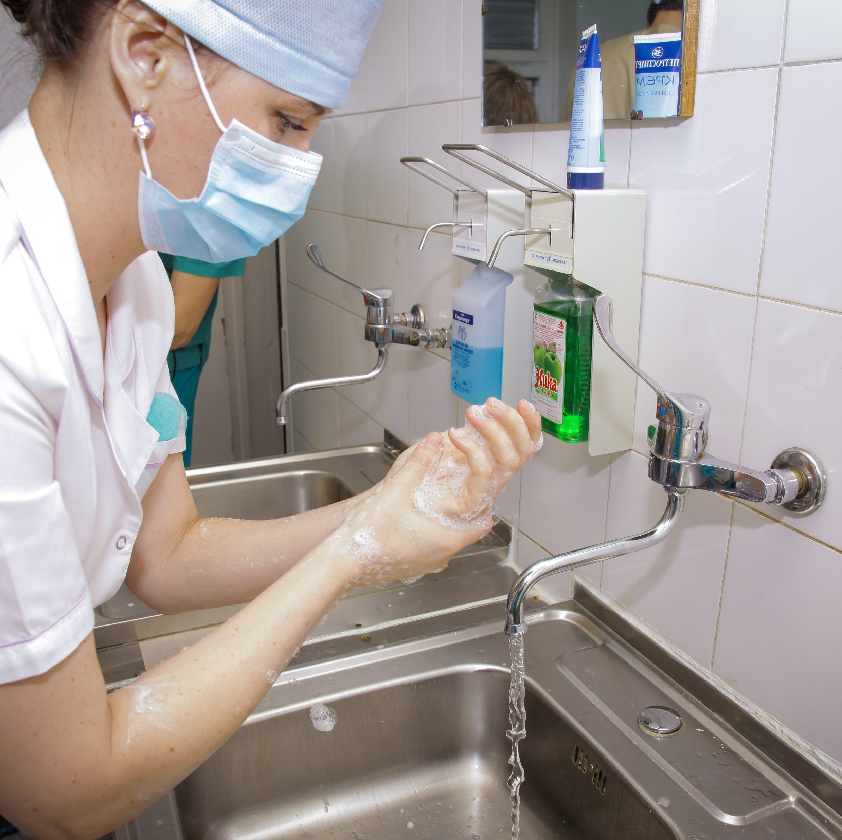
The right time and the right technique
1
Hand hygiene must be performed at the point-of-care.
(right time)
2
During care delivery, there are five moments when it is essential to perform hand hygiene.
Point-of-care:
Intersection of the health worker, the patient and care or treatment involving touch.
There may be multiple points of care across a facility or ward.
Credit: WHO/Sergey Volkov
Notes:
Audio: These rules stress the importance of timing and technique in hand hygiene, integrating seamlessly into routine patient care. Hand hygiene must occur right at the point-of-care and during five critical moments in patient care. What do we mean by 'point of care’? It is defined as the intersection of the health worker, the patient, and care or treatment involving touch. There may be multiple points of care across a facility or ward. ​
​
Hand hygiene infrastructure and products should be in place & easily accessible at all points of care. If health workers have to leave a patient's side to clean their hands, the likelihood of performing hand hygiene drops. ​
​
Alcohol-based handrub is preferred for efficiency, effectiveness, and skin tolerance, though soap and water are required for visibly dirty hands. The right technique and adequate time spent on hand cleaning are essential for effective hand hygiene.

Slide 9
The right time and the right technique
1
Hand hygiene must be performed at the point-of-care.
(right time)
2
During care delivery, there are five moments when it is essential to perform hand hygiene.
3
Hand rubbing (with an alcohol-based formulation) is to be performed when hands are not visibly soiled.
4
Hand washing with soap and water is necessary when hands are visibly soiled (e.g., during/after assisting child birth).
(right technique)
Credit: WHO/Sergey Volkov
5
The appropriate technique and time taken to clean hands is also important.
Notes:
Audio: These rules stress the importance of timing and technique in hand hygiene, integrating seamlessly into routine patient care. Hand hygiene must occur right at the point-of-care and during five critical moments in patient care. What do we mean by 'point of care’? It is defined as the intersection of the health worker, the patient, and care or treatment involving touch. There may be multiple points of care across a facility or ward. ​
​
Hand hygiene infrastructure and products should be in place & easily accessible at all points of care. If health workers have to leave a patient's side to clean their hands, the likelihood of performing hand hygiene drops. ​
​
Alcohol-based handrub is preferred for efficiency, effectiveness, and skin tolerance, though soap and water are required for visibly dirty hands. The right technique and adequate time spent on hand cleaning are essential for effective hand hygiene. ​

Slide 10
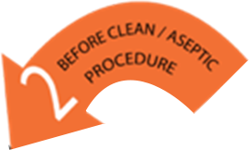
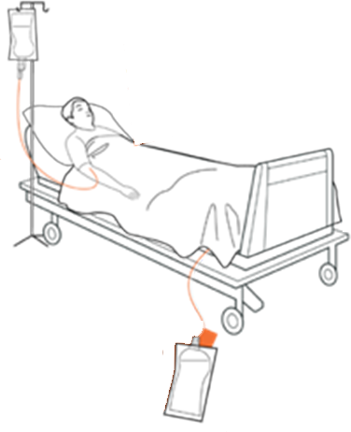
Benefits of using 5 moments
Curbs microbe transmission
Key times for decontaminating hands
Educational tool
Evidence-based
When & how
Notes:
Audio: The "5 Moments" for hand hygiene, a cornerstone of infection prevention, delineates key times for decontaminating hands to curb microbe transmission. This evidence-based strategy doubles as an educational tool, often represented visually on posters throughout healthcare facilities. It emphasizes when and how hand hygiene should occur to prevent infections efficiently and conserve water resources. You can revisit the WASH FIT water module to learn more about other water conservation strategies.
The main benefits of the "5 Moments" approach are that it:
One, Simplifies the concept of timely hand hygiene across different settings.
Two, Seamlessly integrates hand hygiene into healthcare workers' routines.
Three, Enhances recall, ensuring consistent hand hygiene practices.
Four, Facilitates standardized training and monitoring, and finally,
Five, is universally applicable, regardless of the care setting.

Slide 11
Benefits of using 5 moments
1
Simplifies when to do hand hygiene in a range of settings.
2
Integrates hand hygiene action into the workflow of busy health workers.
3
Enhances recall.
4
Facilitates standardized training and monitoring.
5
Universally applicable regardless of setting.
Notes:
Audio: The "5 Moments" for hand hygiene, a cornerstone of infection prevention, delineates key times for decontaminating hands to curb microbe transmission. This evidence-based strategy doubles as an educational tool, often represented visually on posters throughout healthcare facilities. It emphasizes when and how hand hygiene should occur to prevent infections efficiently and conserve water resources. You can revisit the WASH FIT water module to learn more about other water conservation strategies.
The main benefits of the "5 Moments" approach are that it:
One, Simplifies the concept of timely hand hygiene across different settings.
Two, Seamlessly integrates hand hygiene into healthcare workers' routines.
Three, Enhances recall, ensuring consistent hand hygiene practices.
Four, Facilitates standardized training and monitoring, and finally,
Five, is universally applicable, regardless of the care setting.

Slide 12
5 Moments – right technique
Alcohol based hand rub: 20–30 seconds
Water, soap and clean towels: 40–60 seconds
20 to 30 Sec
40 to 60 Sec
For maximum impact, perform with the right technique and for the right length of time.
Notes:
Audio: The timing involved in hand hygiene is as important as the technique. It is the timing - the exact moment in the workflow when hands should be cleaned - that significantly enhances patient and health worker safety.
To ensure that hand hygiene has maximum impact, it must be performed with the right technique for the right length of time: using an alcohol-based handrub should take between 20 to 30 seconds, while washing with water, soap, and drying with clean towels should take between 40 to 60 seconds.

Slide 13
What are the five core elements of the multimodal strategy?
Build it (System Change)
Live it (Culture Change)
Credit: WHO
Teach it (Training)
Sell it (Reminders & Communications)
Check it (Monitoring)
Notes:
Audio: The evidence tells us that to improve hand hygiene behaviours in health care requires more than one approach or method. WHO describe this as a multimodal strategy – an evidence-based approach for improving hand hygiene.
The five core elements of the multimodal hand hygiene improvement strategy are:
Systems that enable hand hygiene at the point of care - that means the right infrastructure, resources and equipment in place
Training and education
Monitoring/auditing and feedback
Reminders and communications
A supportive culture in the facility
Focusing solely on one of these methods is insufficient to change health worker behavior. You will need to employ a combination of strategies alongside the WASH FIT continual improvement framework.

Slide 14
What are the five core elements of the multimodal strategy?
Build it (System Change)
Live it (Culture Change)
Credit: WHO
Teach it (Training)
Sell it (Reminders & Communications)
Check it (Monitoring)
Notes:
Audio: The evidence tells us that to improve hand hygiene behaviours in health care requires more than one approach or method. WHO describe this as a multimodal strategy – an evidence-based approach for improving hand hygiene.
The five core elements of the multimodal hand hygiene improvement strategy are:
Systems that enable hand hygiene at the point of care - that means the right infrastructure, resources and equipment in place
Training and education
Monitoring/auditing and feedback
Reminders and communications
A supportive culture in the facility
Focusing solely on one of these methods is insufficient to change health worker behavior. You will need to employ a combination of strategies alongside the WASH FIT continual improvement framework.

Slide 15
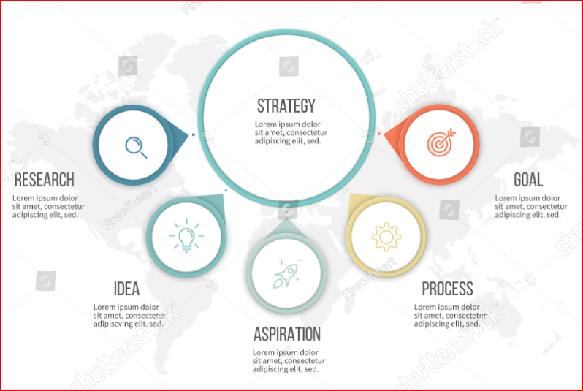
The multimodal improvement strategy explained
The infrastructure & resources available to perform hand hygiene, including water, sinks, soap, alcohol handrub.
Educating health care workers on hand hygiene importance, methods and timing (why, when and how).
Monitoring and evaluating practices while providing feedback (for corrective action).
Reminders and motivating strategies.
Cultivating a culture that values hand hygiene (requires support of managers and supervisors).
Notes:
Audio: Let's explore the five key actions: building the necessary physical infrastructure (like water access, sinks, and alcohol-based hand rubs), educating healthcare workers on hand hygiene importance, methods, and timing, monitoring and evaluating practices while providing feedback, using reminders and motivational strategies to encourage adherence, and cultivating a culture that values hand hygiene. These actions—building, teaching, checking, selling, and living hand hygiene—are interwoven to ensure that practices are not adopted and sustained.

Slide 16
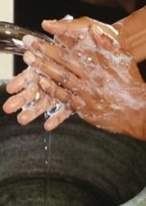
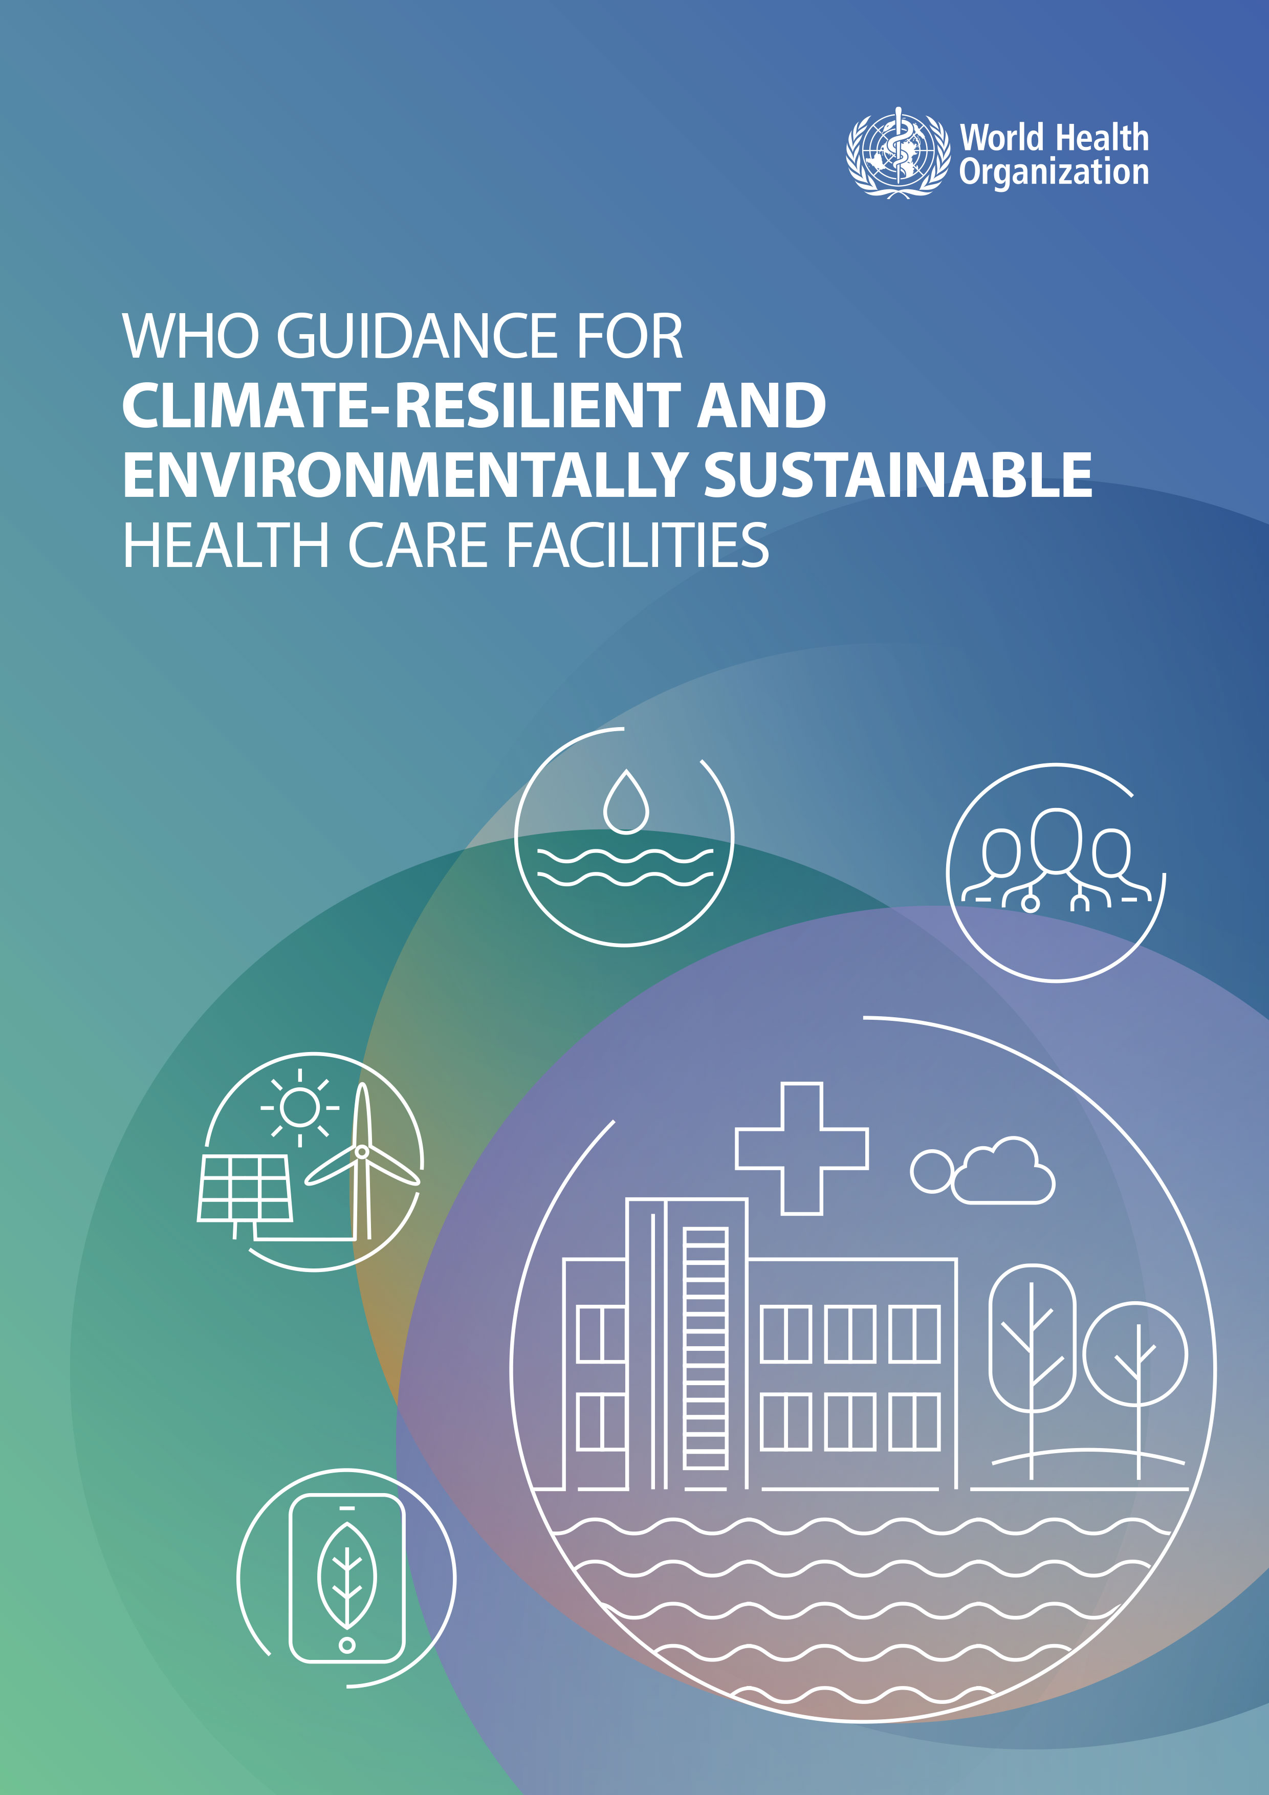
Systems change through the WASH FIT assessment
Can staff readily perform hand hygiene at critical points of care?
Is water and soap and/or alcohol-based hand rub available so can staff clean their hands easily at each (and every) point of care?
Credit: WHO
Are managers and leaders engaged to ensure that system change can be achieved?
Credit: WHO
Notes:
Audio: The WASH FIT assessment asks if staff can readily perform hand hygiene at critical points by checking the availability of hand hygiene stations at all points of care. As we have seen, these points are vital for maintaining high hygiene standards and preventing infections. This assessment aligns with the WHO's 5 Moments for Hand Hygiene, checking for the availability of accessible and functional hand hygiene facilities to ensure compliance and patient safety.
Leadership is crucial in driving the necessary system changes to support effective hand hygiene, including policy implementation, resource allocation, and developing a supportive culture.

Slide 17
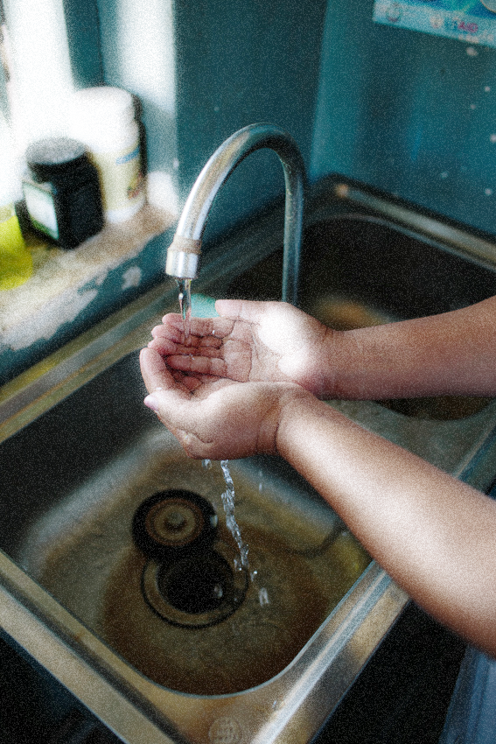
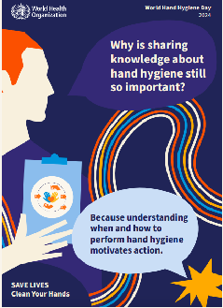
'Teach It': training & education
Comprehensive training for all staff (including auxiliary staff).
Dedicated individual or team regularly reviews and updates training programmes.
Base training on the latest hand hygiene recommendations.
Needs assessments to identify knowledge gaps.
Credit: WaterAid/Tom Greenwood
Credit: WHO
Notes:
Audio: Training and education on hand hygiene are fundamental for IPC to facilitate thorough comprehension and adherence to hand hygiene protocols – this is the “Teach it” component. The WASH FIT assessment asks if there is comprehensive training for all staff, including those in auxiliary roles like waste handling and cleaning
To improve hand hygiene training, you should appoint a dedicated individual or team to regularly review and update training programs with the latest hand hygiene recommendations, reflecting new evidence relating to any new pathogens. Conduct targeted training needs assessments to identify and address knowledge or skill gaps, to create customized and effective training programmes.

Slide 18
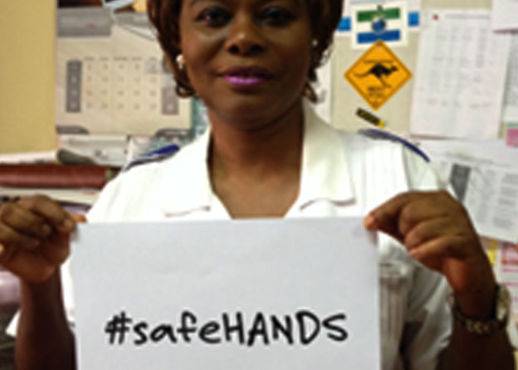
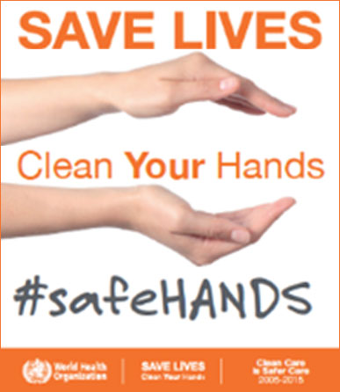
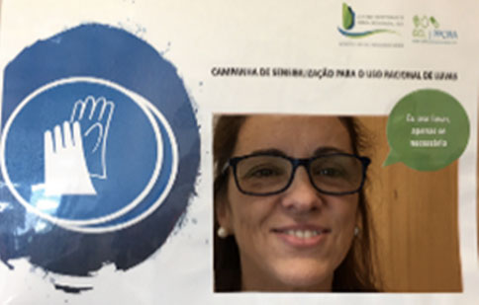
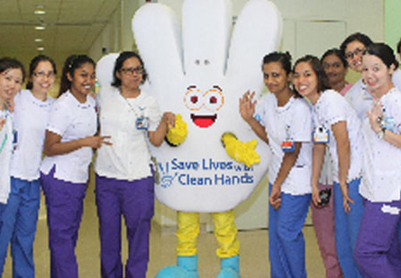
'Sell It': reminders & communications
Promotional materials don’t just mean posters…
Credit: WHO
Credit: WHO
Credit: WHO
Continuous promotion of hand hygiene by engaging health care workers, patients and visitors to develop a culture of cleanliness.
Notes:
Audio: "Sell It" emphasizes the continuous and innovative promotion of hand hygiene, engaging healthcare workers, patients, and visitors to develop a culture of cleanliness. You can use a variety of promotional materials such as digital screens, badges, stickers, and wearable items with hand hygiene messages to maintain interest and avoid message fatigue. Use social media, podcasts, and SMS messages to extend the campaign's reach, making information sharing dynamic. Participating in global campaigns like WHO's annual hand hygiene day on 5th May and local initiatives promotes a sense of community and collective action. Engaging the community through discussions, demonstrations, and competitions, and sharing impactful testimonials from within the healthcare community are also effective. ​

Slide 19
'Sell It': reminders & communications
Promotional materials don’t just mean posters…
Credit: WHO
Credit: WHO
Credit: WHO
Continuous promotion of hand hygiene by engaging health care workers, patients and visitors to develop a culture of cleanliness.
Digital screens, badges, stickers and wearable items.
Social media, podcasts, SMS.
Global campaigns (5th May), local initiatives.
Community engagement, discussions, demonstrations.
Hand hygiene competitions.
Impactful health care testimonials.
Notes:
Audio: "Sell It" emphasizes the continuous and innovative promotion of hand hygiene, engaging healthcare workers, patients, and visitors to develop a culture of cleanliness. You can use a variety of promotional materials such as digital screens, badges, stickers, and wearable items with hand hygiene messages to maintain interest and avoid message fatigue.
Use social media, podcasts, and SMS messages to extend the campaign's reach, making information sharing dynamic. Participating in global campaigns like WHO's annual hand hygiene day on 5th May and local initiatives promotes a sense of community and collective action. Engaging the community through discussions, demonstrations, and competitions, and sharing impactful testimonials from within the healthcare community are also effective. ​

Slide 20
'Live It': safety climate/culture change
Create a culture of safety.
Engage the WASH FIT, IPC or quality team.
Conduct regular performance reviews.
All staff have clear, documented description of WASH/IPC responsibilities.
Credit: WHO/Arabella Hayter
Health care facility in Bhutan
Notes:
Audio: In the "Live It" phase, the emphasis is on creating a culture of safety and initiating a change within the healthcare facility that underscores the critical nature of hand hygiene and infection prevention. This involves engaging the WASH FIT/IPC/quality team within facilities. Indicators in the Management and Workforce domain allow you to assess this. Regular performance reviews are crucial, acknowledging the achievements of high performers and offering constructive support to those in need of improvement. Every member of the auxiliary staff should have a clear, documented description of their WASH and IPC responsibilities. ​

Slide 21
Safety climate/culture change
Is hand hygiene a priority for managers and senior leadership?
Do managers/leaders understand and practice the Five Moments?
Are senior managers, champions, opinion leaders engaged?
How can role models have greater influence?
Credit: White Ribbon Alliance
Notes:
Audio: Cultivating an environment that values accountability and continuous enhancement enables every individual within the healthcare setting to contribute actively to maintaining high standards of hand hygiene and infection prevention. ​This culture is influenced significantly by the leaders and managers. If leaders and managers fail to demonstrate commitment, it's unlikely that hand hygiene will be valued, supported, funded, or championed. ​To improve this culture means regularly asking: ​
​
Is hand hygiene a priority for managers and senior leadership? ​
Are they engaged and do they practice what they preach?
How can you increase the visibility of role models in a facility? Could they wear a badge or receive some other form of recognition to encourage them to influence others?

Slide 22
Key points
Without prompt and proper hand hygiene, achieving health for all through quality care remains unattainable.
An environment equipped with necessary water, sanitation and hygiene services is crucial for enabling hand hygiene practices at the correct times and in the appropriate manner.
Implementing and customizing a multimodal strategy enhances access to hand hygiene facilities and fosters better hygiene behaviours.
Improving hand hygiene serves as a gateway to broader infection prevention and control enhancements.
Credit: WHO
Notes:
Audio: You have reached the end of this module. Essential points to take away:​
​
Without prompt and proper hand hygiene, achieving health for all through quality care remains unattainable.​
An environment equipped with necessary water, sanitation, and hygiene services is crucial for enabling hand hygiene practices at the correct times and in the appropriate manner.​
Implementing and customizing a multimodal strategy enhances access to hand hygiene facilities and fosters better hygiene behaviors.​
Improving hand hygiene serves as a gateway to broader infection prevention and control enhancements.​
Hand hygiene stands as a critical performance metric in diminishing the impact of antimicrobial resistance, controlling outbreaks, and preventing all preventable healthcare-associated infections.​
​
Please explore the reference section of this module for links to all mentioned resources.

Slide 23
Key points
Without prompt and proper hand hygiene, achieving health for all through quality care remains unattainable.
An environment equipped with necessary water, sanitation and hygiene services is crucial for enabling hand hygiene practices at the correct times and in the appropriate manner.
Implementing and customizing a multimodal strategy enhances access to hand hygiene facilities and fosters better hygiene behaviours.
Improving hand hygiene serves as a gateway to broader infection prevention and control enhancements.
Hand hygiene stands as a critical performance metric in diminishing the impact of antimicrobial resistance, controlling outbreaks and preventing all preventable health care-associated infections.
Credit: WHO
Notes:
Audio: You have reached the end of this module. Essential points to take away:​
​
Without prompt and proper hand hygiene, achieving health for all through quality care remains unattainable.​
An environment equipped with necessary water, sanitation, and hygiene services is crucial for enabling hand hygiene practices at the correct times and in the appropriate manner.​
Implementing and customizing a multimodal strategy enhances access to hand hygiene facilities and fosters better hygiene behaviors.​
Improving hand hygiene serves as a gateway to broader infection prevention and control enhancements.​
Hand hygiene stands as a critical performance metric in diminishing the impact of antimicrobial resistance, controlling outbreaks, and preventing all preventable healthcare-associated infections.​
​
Please explore the reference section of this module for links to all mentioned resources.

