Slide 1
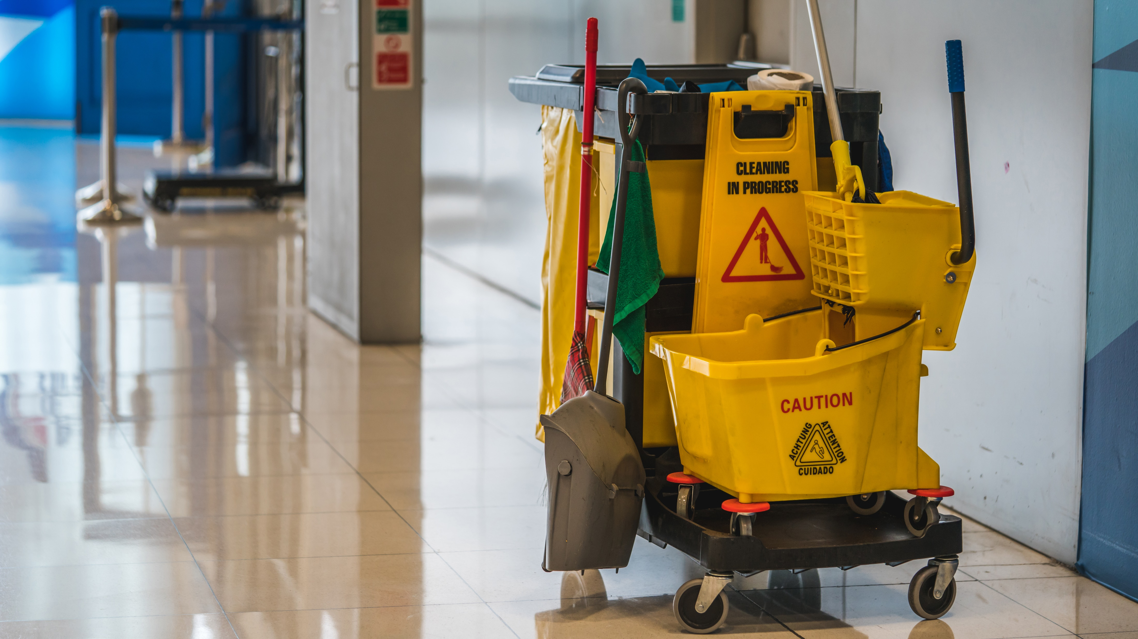
Module 11
Environmental cleaning
Credit: WHO/Aphaluck Bhatiasevi
Credit: Shutterstock
Notes:
Audio: Hello. Dave Trouba here. Welcome to Module 11 on Environmental Cleaning.

Slide 2
Learning objectives
By the end of this module, you will:
Understand why it is important to effectively and clean health care environments.
Describe institutional best practices associated with cleaning.
Describe the most important products/resources, processes, supplies & equipment associated with effective & safe cleaning and disinfection.
Notes:
Audio: By the conclusion of this module, you’ll understand the role of environmental cleaning in maintaining a safe healthcare environment. You’ll also be able to describe institutional best practices as well as needed products, processes, supplies, and equipment.. Along the way, we'll discuss how these practices relate to WASH FIT indicators. ​

Slide 3
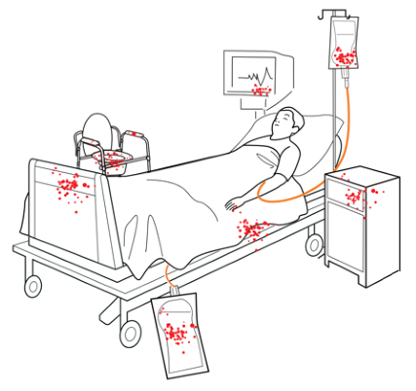
Why is it important to clean and where?
Health care-associated infections (HAIs) affect millions of patients annually, with rates over twice as high in low-resource settings.
Harmful microorganisms can survive on surfaces for months and be transferred to hands if cleaning standards are not met.
Helps prevent the spread of microorganisms that can cause HAIs.
Part of IPC measures and standard precautions.
Notes:
Audio: Today, healthcare associated infections, or HAIs, affect millions of patients each year; and rates are more than two times higher in low-resource settings.​ Potentially harmful microorganisms can survive on environmental surfaces for months and be picked up by people’s hands if cleaning standards are not met. However, environmental cleaning and disinfection can minimize risk and spread of avoidable infections. ​Cleaning helps interrupt the spread of potentially harmful microorganisms that may cause a healthcare associated infection.
Environmental cleaning is a part of Infection, Prevention and Control measures and standard precautions recommended for all health care facilities to prevent infections.

Slide 4
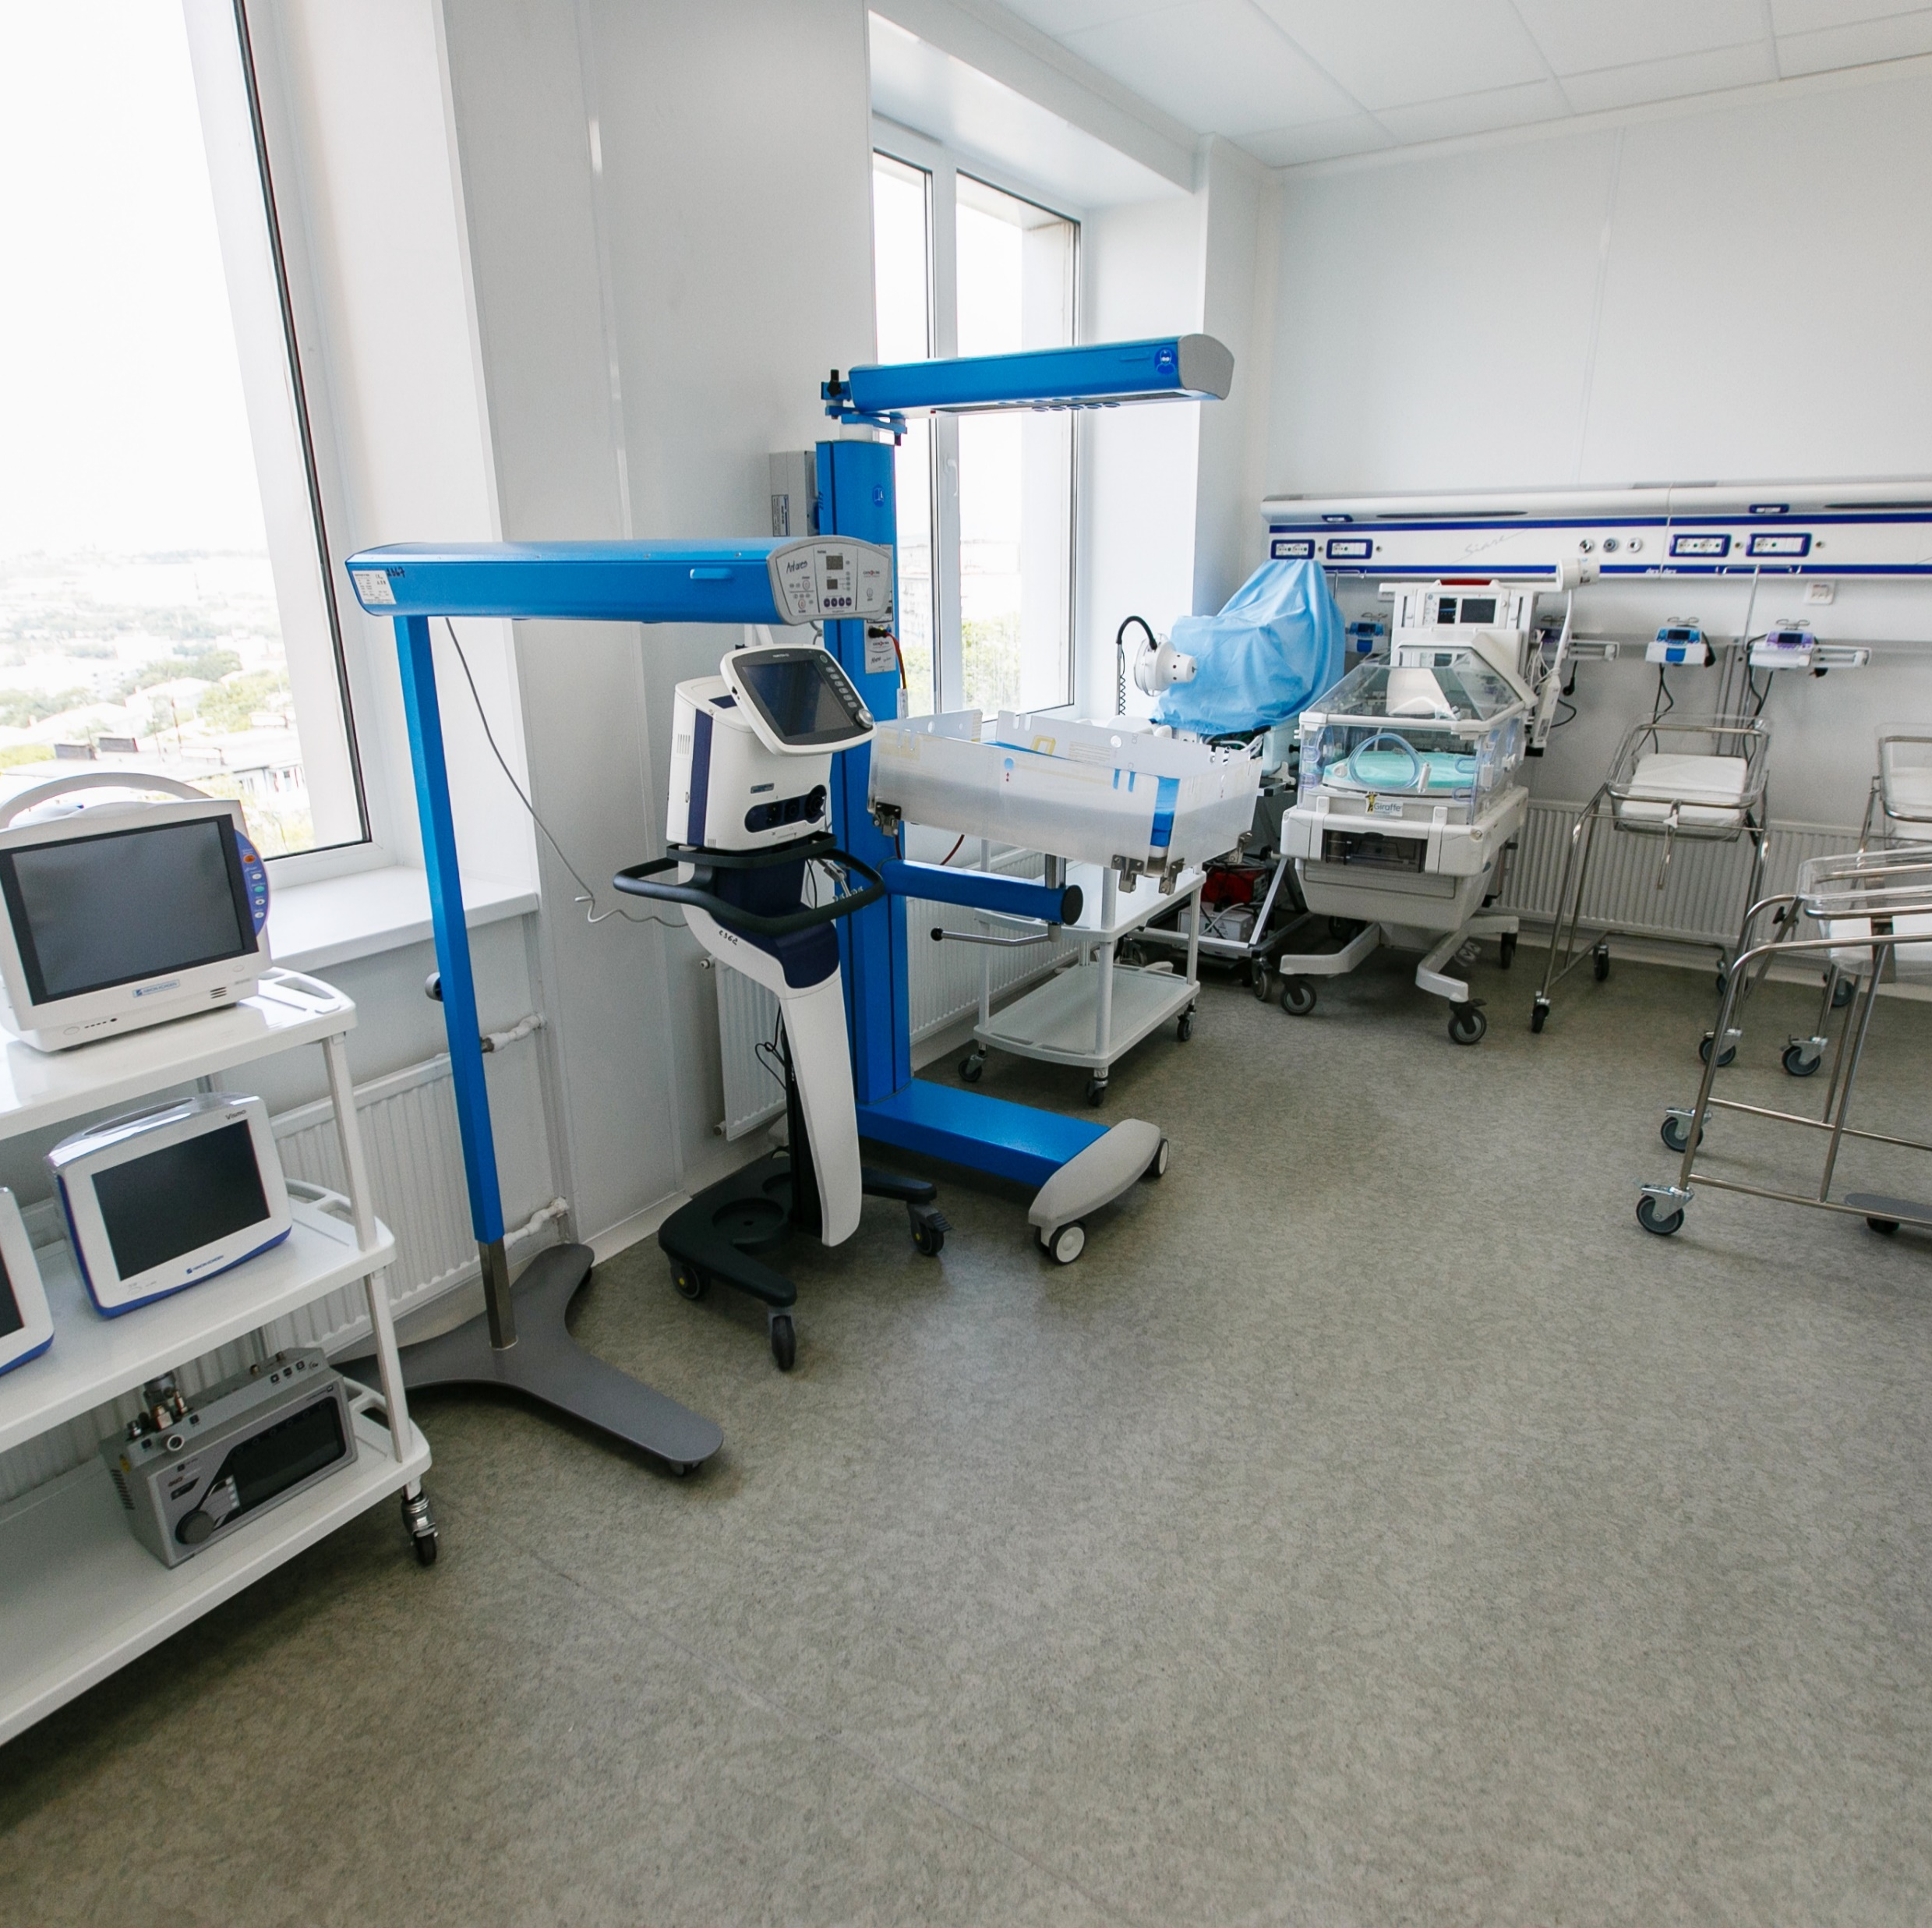
Why is it important to clean and where?
Where should you clean?
Immediate patient care environment.
Surfaces which come into contact with (patient) intact skin or is touched by hands (health workers).
High-touch surfaces.
Include bedrails, IV poles, bedside tables, sink handles, doorknobs.
Visibly soiled surfaces must be cleaned and disinfected promptly.
Credit: Adobe Stock
Notes:
Audio: Cleaning is especially important in the immediate patient care environment and surfaces that come into contact with intact skin or are touched by healthcare workers' hands. Particular attention needs to be given to high touch surfaces, that is any surface frequently touched or in direct physical contact with the patient.
Still, even low touch surfaces like walls and windows can pose a risk and should be cleaned regularly. Anything that is visibly soiled with blood or body fluids must be cleaned and disinfected as soon as possible. Invasive medical equipment requires WHO-guided sterilization, which is outside the scope of this module.

Slide 5
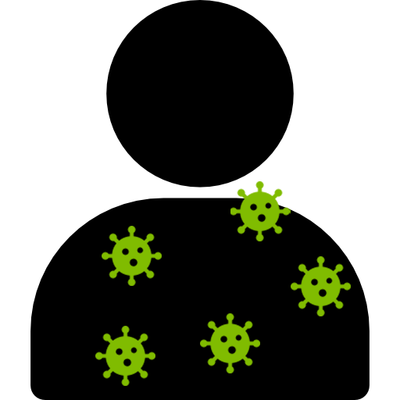
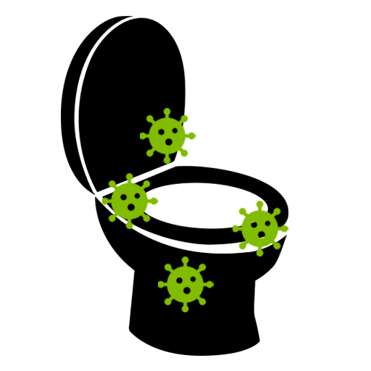
In visuals: Why it is important to clean?
Colonized, or infected patients
Contaminated
environmental surfaces and noncritical equipment
Contaminated hands
or gloves of health care personnel, caretakers, visitors
Susceptible patients
Environmental cleaning breaks pathway.
Glove removal and hand hygiene breaks pathway.
Notes:
Audio: These visuals show a flow of transmission beginning with colonized or infected patients and how microorganisms can transfer to environmental surfaces and equipment. If these surfaces aren't properly cleaned, healthcare workers, caretakers, and visitors can contaminate their hands or gloves, potentially infecting susceptible patients. You can see two critical intervention points where transmission can be interrupted: environmental cleaning and glove removal followed by hand hygiene.

Slide 6
The action of cleaning - a definition:
The physical removal of foreign material (e.g., dust, soil) and organic material (e.g., blood, secretions, excretions, microorganisms) from surfaces.
Achieved with water, detergents and mechanical action (e.g., friction, scrubbing).
Physically removes rather than kills microorganisms.
Always the first step in any environmental cleaning process.
Notes:
Audio: Cleaning is the physical act of removing foreign and organic material such as dust, soil, blood, secretions, and microorganisms from surfaces. This process, which involves wiping or scrubbing, doesn't necessarily kill microorganisms but physically removes them. It is typically done using water, detergents, and mechanical action such as friction. Cleaning is always the first step in the environmental cleaning process.

Slide 7
A structured approach to cleaning involves six elements
Organizational cleaning structure with admin support, integration and supervision.
Cleaning schedules/ procedures summary per area, with reminders.
1
4
Staffing plan with contingencies for each patient area.
Quality control audits (regular monitoring and feedback).
2
5
3
Continuous training and education.
6
Adequate, maintained infrastructure and supplies.
Notes:
Audio: Cleaning best practices involve a structured approach that includes organizational support, a staffing plan for each patient care area with backup options, ongoing training, and specific cleaning schedules and procedures aligned with facility policies. Also important are routine quality control audits, along with ensuring the availability of adequate, well-maintained cleaning supplies and infrastructure.

Slide 8
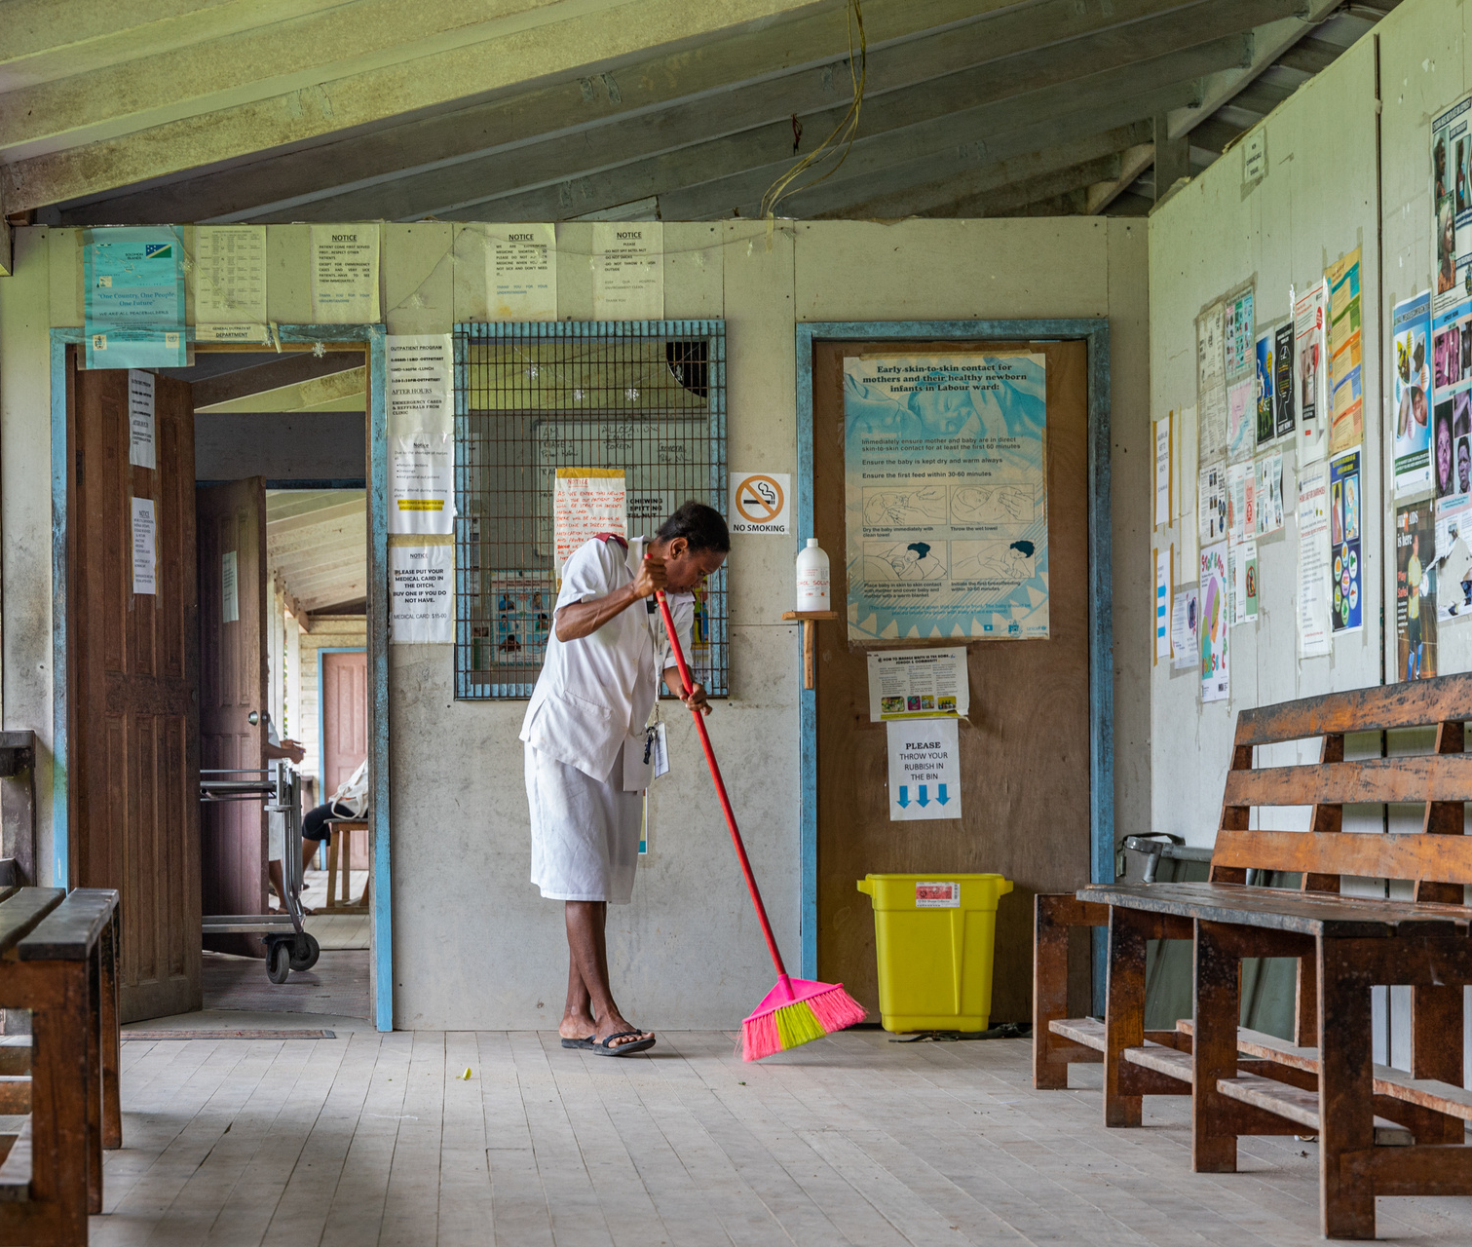
1
Organizational structure
What is needed to ensure effective cleaning?
Administrative support:
Facility-based manager for cleaning oversight.
Approved cleaning policy.
Annual budget.
Integration of the programme in the facility:
Multi-sectorial planning committee including all facility stakeholders & routine meetings with other key stakeholders.
Management and supervisory structures:
Cleaning programme organizational chart.
Facility supervisors.
Environmental cleaning services management.
Which stakeholders need to be engaged for an effective, integrated cleaning programme?
Credit: WHO/Blink Media - Neil Nuia
Notes:
Audio: Effective cleaning in healthcare settings depends on robust organizational structure and administrative support. A dedicated manager should oversee cleaning activities and be guided by am approved policy and with a specific annual budget .
Integrating cleaning into facility operations requires a multi-sectorial planning committee with representatives from all departments, fostering collaboration and aligning cleaning practices with the facility's needs. These discussions can be built into WASH FIT meetings. A clear management structure, with designated supervisors for different areas, ensures thorough oversight.

Slide 9
2
Staffing plans
What do staffing needs depend on?
Number of inpatient beds.
Service types and high-risk areas needing intensive cleaning.
Bed occupancy rates.
Cleaning types: routine vs. terminal.
Should take into account:
Reasonable shift lengths.
Regular breaks.
Contingencies for immediate cleaning needs (e.g., outbreaks).
No single-best practice method for determining staffing needs exists, but consider:
Use workload software for staffing needs.
Compare with other facilities.
Empirical facility-level calculations.
Notes:
Audio: Without adequate staff for cleaning, the quality cleaning will be severely compromised. Staffing needs hinge on factors such as number of beds, service types, bed occupancy rates, and specific cleaning tasks.
Effective staffing plans also account for worker well-being, with reasonable shift lengths and breaks to prevent fatigue. Flexibility is essential for unforeseen demands, such as outbreaks or surges in patient loads due to extreme weather events. While no universal method exists for setting staffing levels, tools like workload software, comparison with similar facilities, and empirical calculations offer guidance.

Slide 10
2
Staffing plans
Cleaning staff have clear roles and performance expectations.
Cleaning staff should be present in the facility on a daily basis.
Notes:
Audio: It is important that cleaning staff have clear roles and performance expectations, ensuring daily presence for sustained cleanliness and infection prevention.
If staff understand these elements, even without authority to change staffing or direct implementation, they can help support cleaning staff and advocate for best practices.

Slide 11
3
Training & education
Basics of IPC (role of cleaning in preventing infections).
Cleaning practices, product use and technique review.
What training is needed to ensure effective cleaning?
Safety in cleaning and disinfection.
Formal training should include:
Water efficiency and conservation.
Notes:
Audio: What should a comprehensive training program include? It should span the basics of infection control, showcasing how diligent cleaning prevents infection spread, to the specifics of using cleaning agents and techniques proficiently.
Safety should be a focus —educating staff on safe cleaning and disinfection practices helps protect themselves and patients. Curricula should also include lessons on water efficiency and conservation, to promote environmentally friendly and climate resilient practices.
Pause the video a minute and think about elements of a participatory training and how you could best support cleaners?

Slide 12
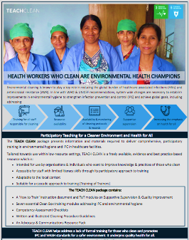
How to support cleaners effectively
Interactive, engaging, practical hands-on methods, suitable for those with low literacy.
Refresher training where staff turn-over is high.
Scheduling training can be challenging → must fit around cleaning rotations.
Consistent availability of equipment and supplies.
Post-training supportive supervision.
Notes:
Audio: Training should be interactive and engaging. It should use practical, hands-on methods which meet staff literacy levels. New staff should receive training before starting work and receive refresher training. Include annual refresher courses to maintain high standards of knowledge and skill particularly when staff turnover is high. These training sessions should fit around cleaners’ busy schedules.
Of course, cleaners will only be able to put into practice what they have learnt with a consistent supply of cleaning materials and post-training support.
TEACH CLEAN, created by The Soapbox Collaborative and the London School of Hygiene & Tropical Medicine is a free training package which has been used in countries like The Gambia, India, Myanmar and Tanzania and emphasizes active participation and practical engagement. See the resources section at the end.

Slide 13
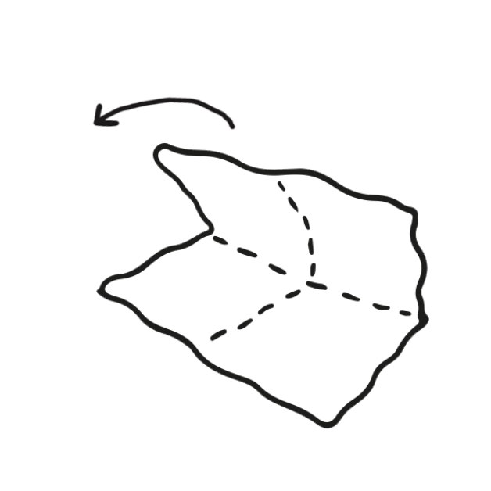
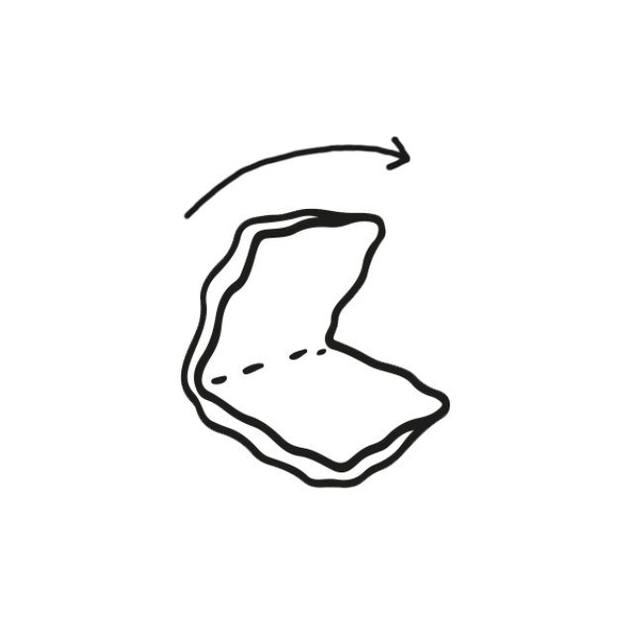
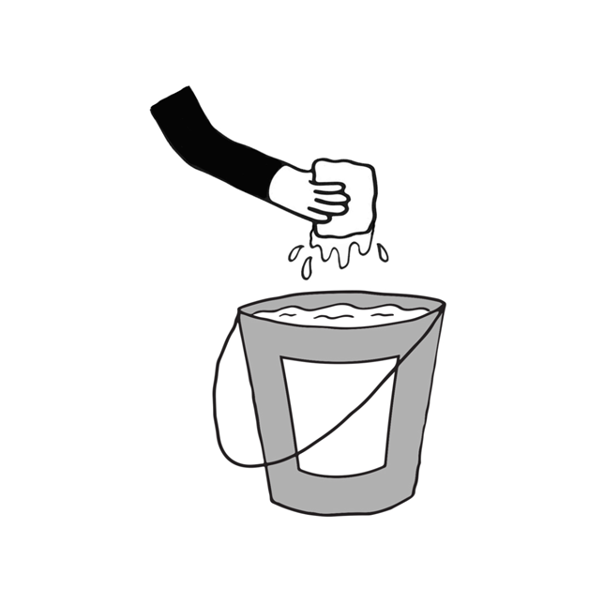
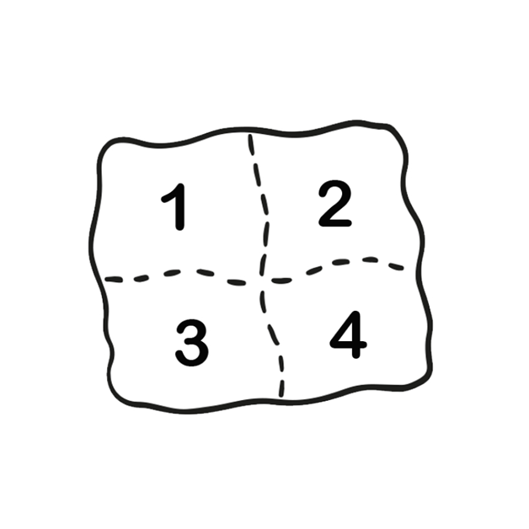
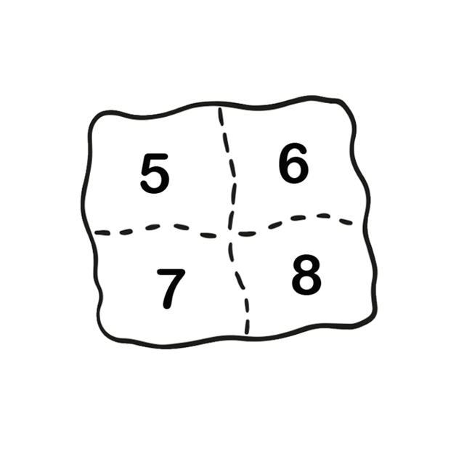
Training example: illustrations of surface cleaning processes
How To Fold A Cleaning Cloth
1
1
Start by folding the cloth in half.
Use fresh cleaning cloths to start.
Immerse the cloth in the cleaning solution once: never double dip!
2
2
Then fold the cloth in half again.
Submerge the folded cloth into cleaning solution only once, do not "double dip" as this will contaminate the solution.
3
3
Change cleaning cloths when saturated
4
You now have a cloth with eight different cleaning surfaces.
Change cleaning cloths between each patient zone (in high-risk areas).
4
Switch to a different side after each one has been soiled. When all sides have been used, dispose of cloth appropriately as waste or laundry and use a new cloth to continue the task.
Make sure you have enough cleaning cloths to finish the cleaning session.
5
5
Notes:
Audio: Let’s now look at proper surface cleaning techniques. Begin with a fresh cloth, folding it to create eight clean surfaces for efficient use. Immerse the cloth in the cleaning solution once to prevent cross-contamination. Use each side of the cloth for cleaning until all are soiled, then dispose of it properly. . Switch cloths when they become saturated or when transitioning between patient zones, especially in high-risk areas, to inhibit pathogen spread. Ensure a sufficient supply of cleaning cloths. . These practices reinforce thorough cleaning and promote effective use of resources.

Slide 14
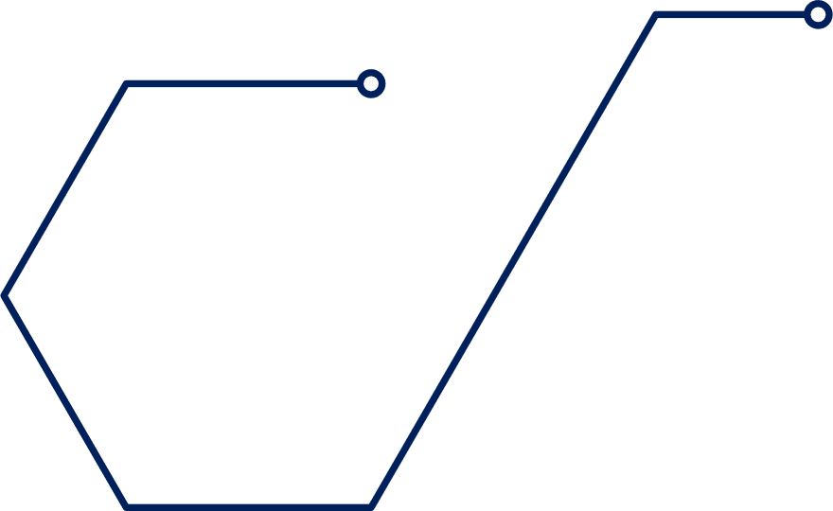
An overview of supplies and equipment
Floor cleaning: Use mop heads/floor cloths, with a two or three-bucket system for disinfection.
Surface cleaning: Use coloured cotton/microfiber cloths for cleaning, disinfection, toilets, patient and isolation areas.
Notes:
Audio: Clean and soiled items should be separated to prevent cross-contamination. Colour-coding cloths can help and floor cleaning should follow clear protocols with designated mop heads and a two or three-bucket system.

Slide 15
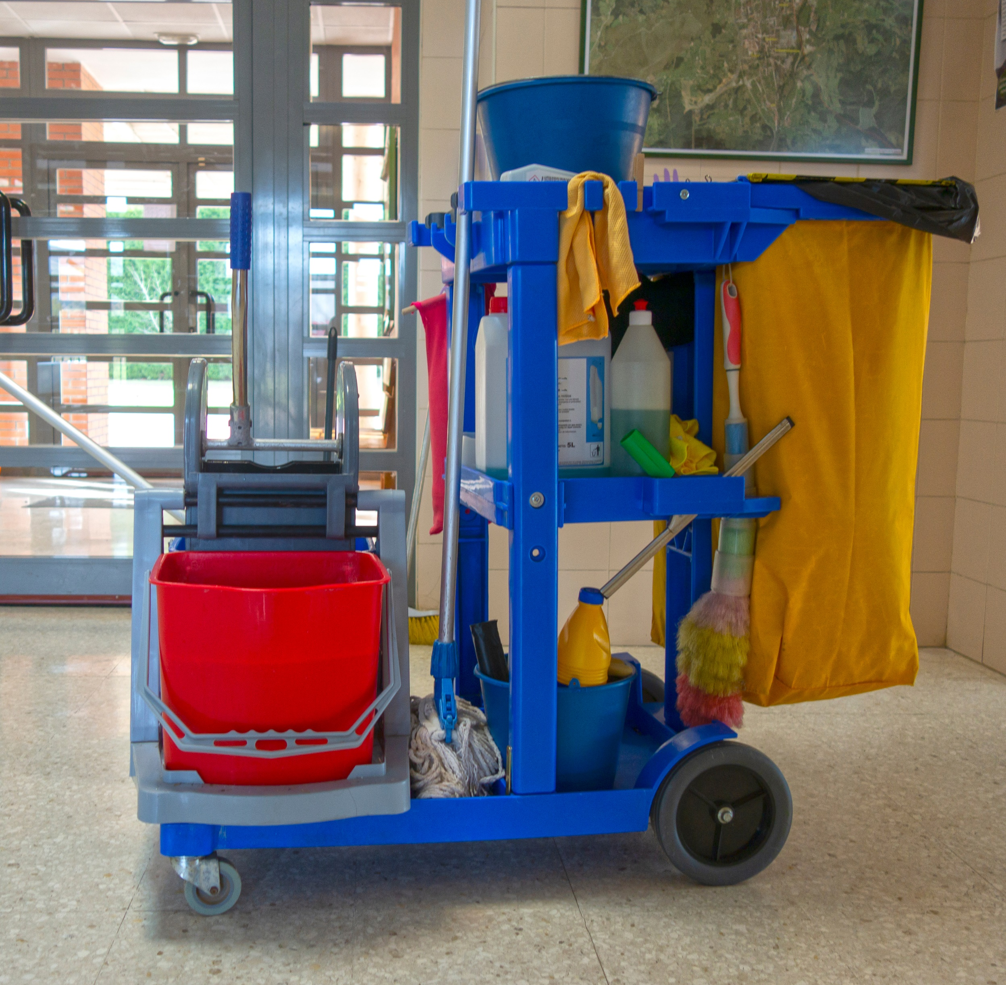
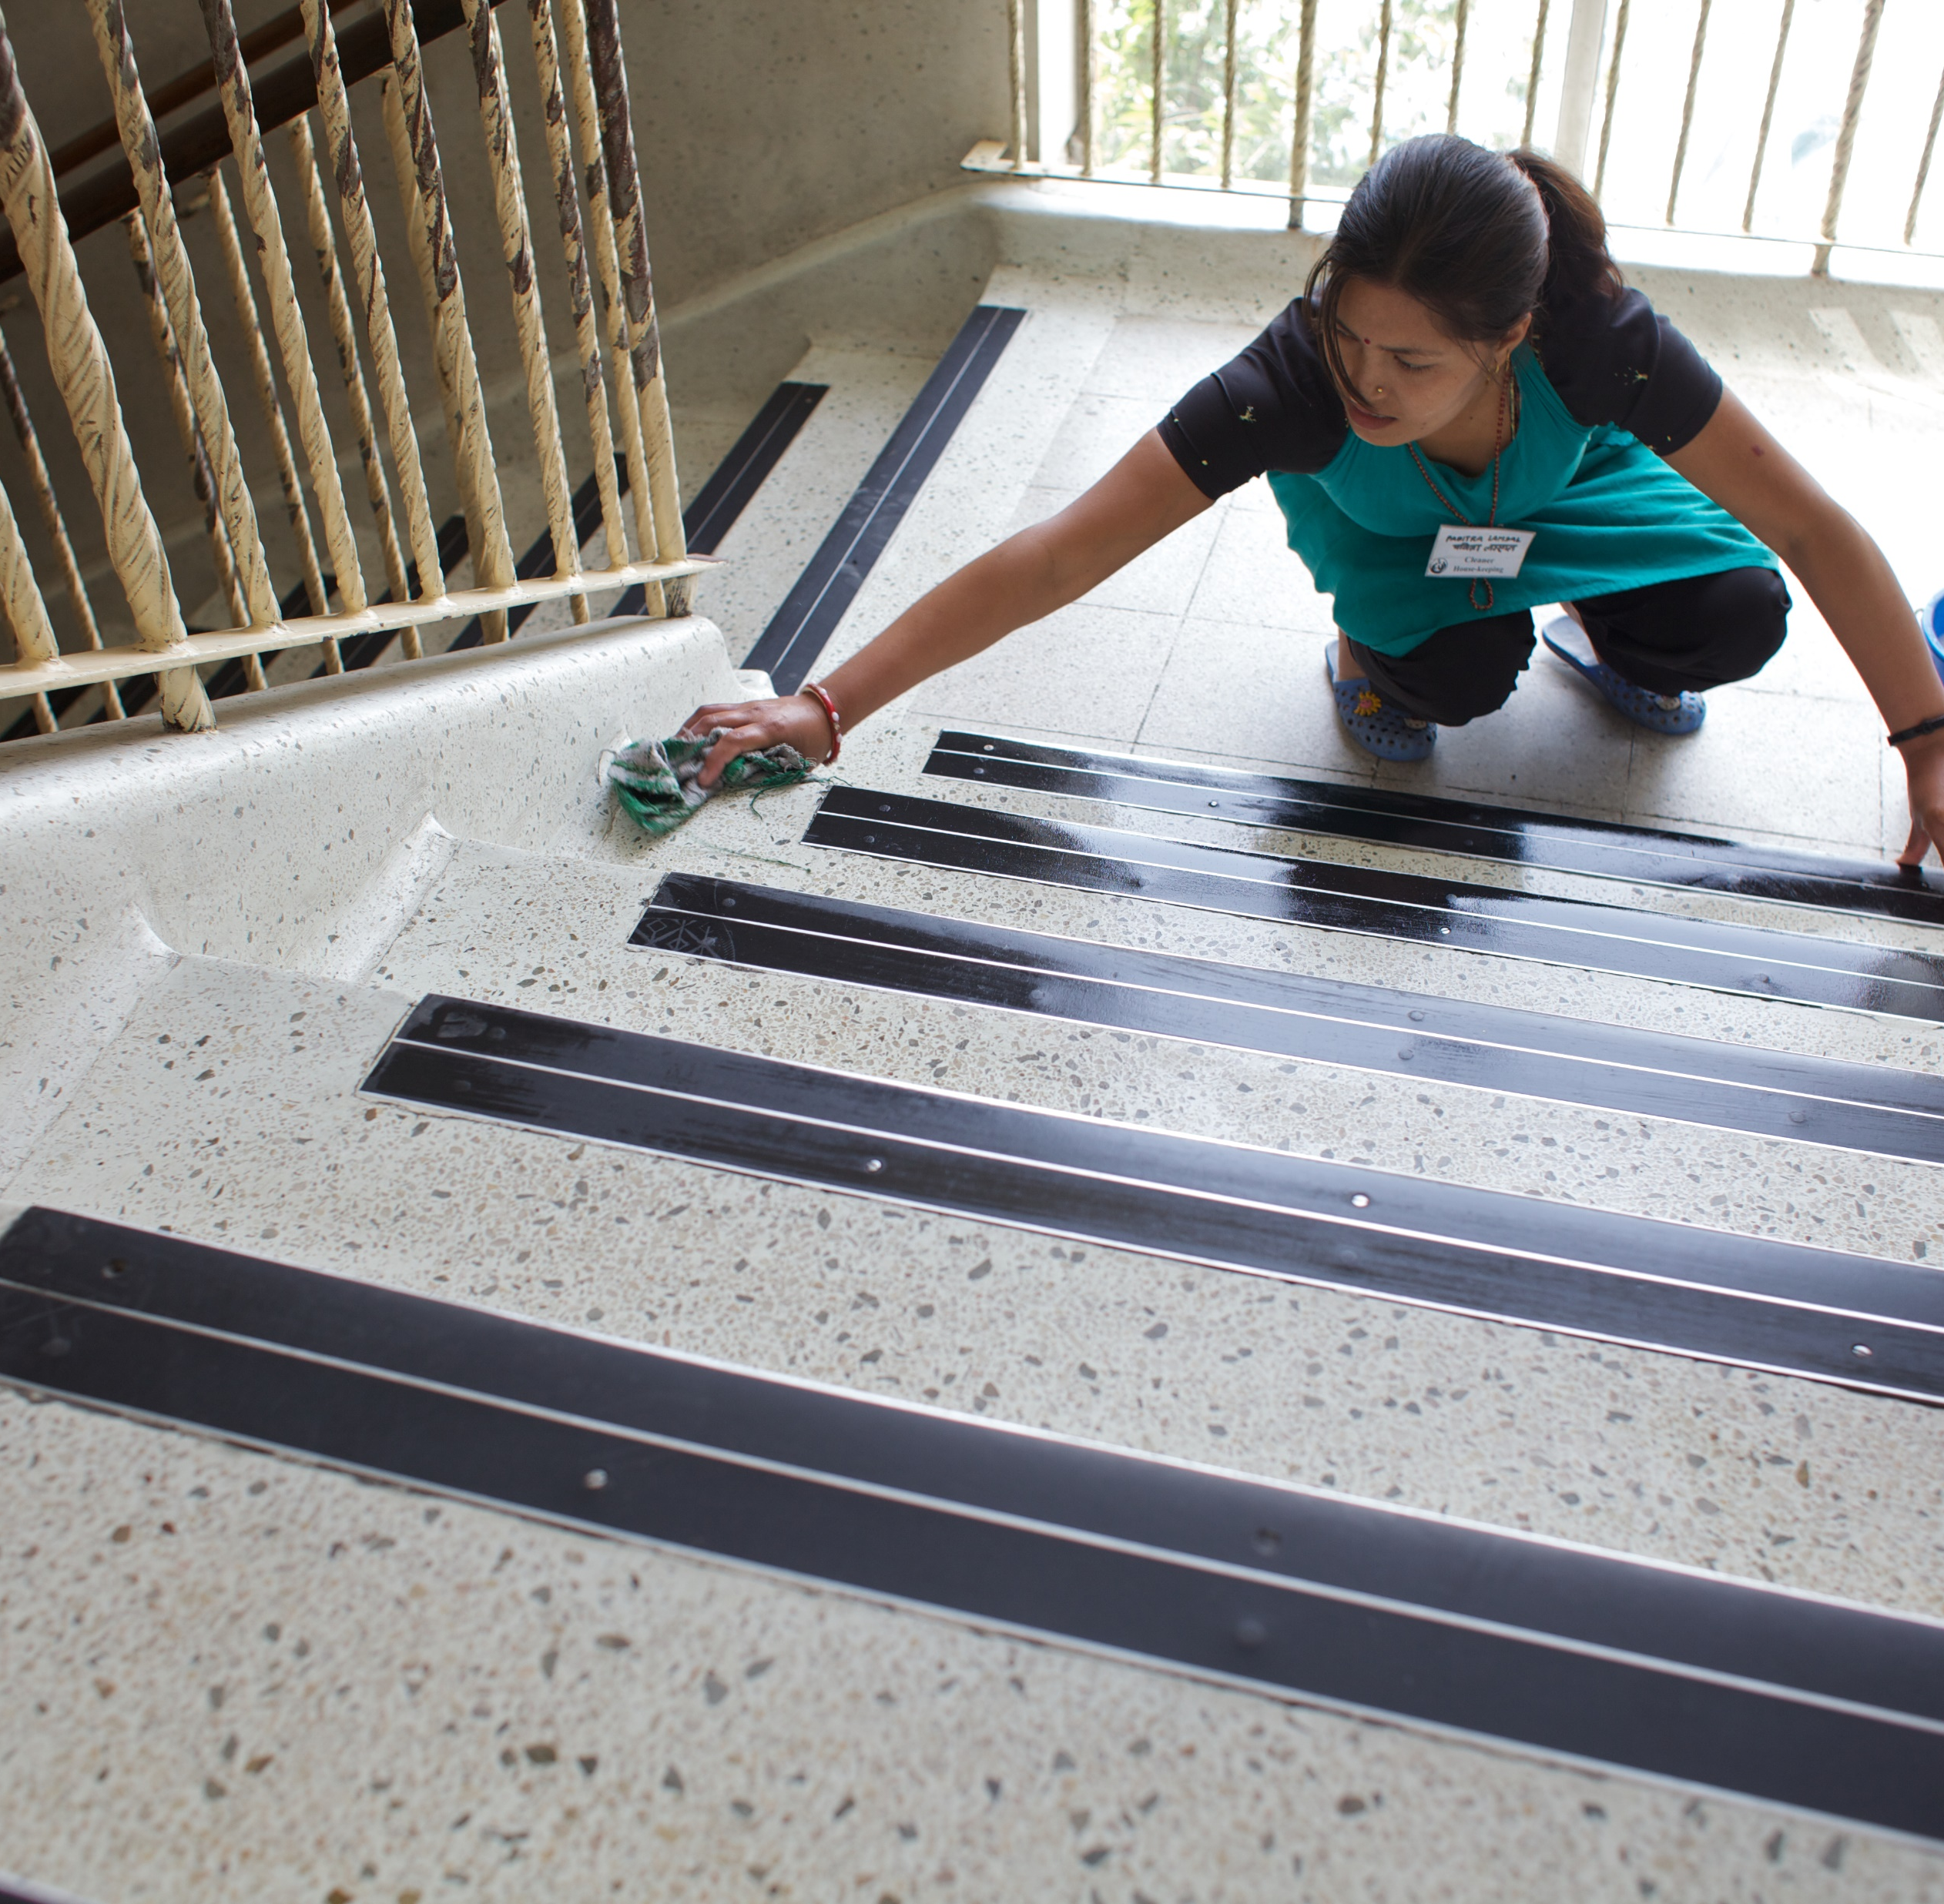
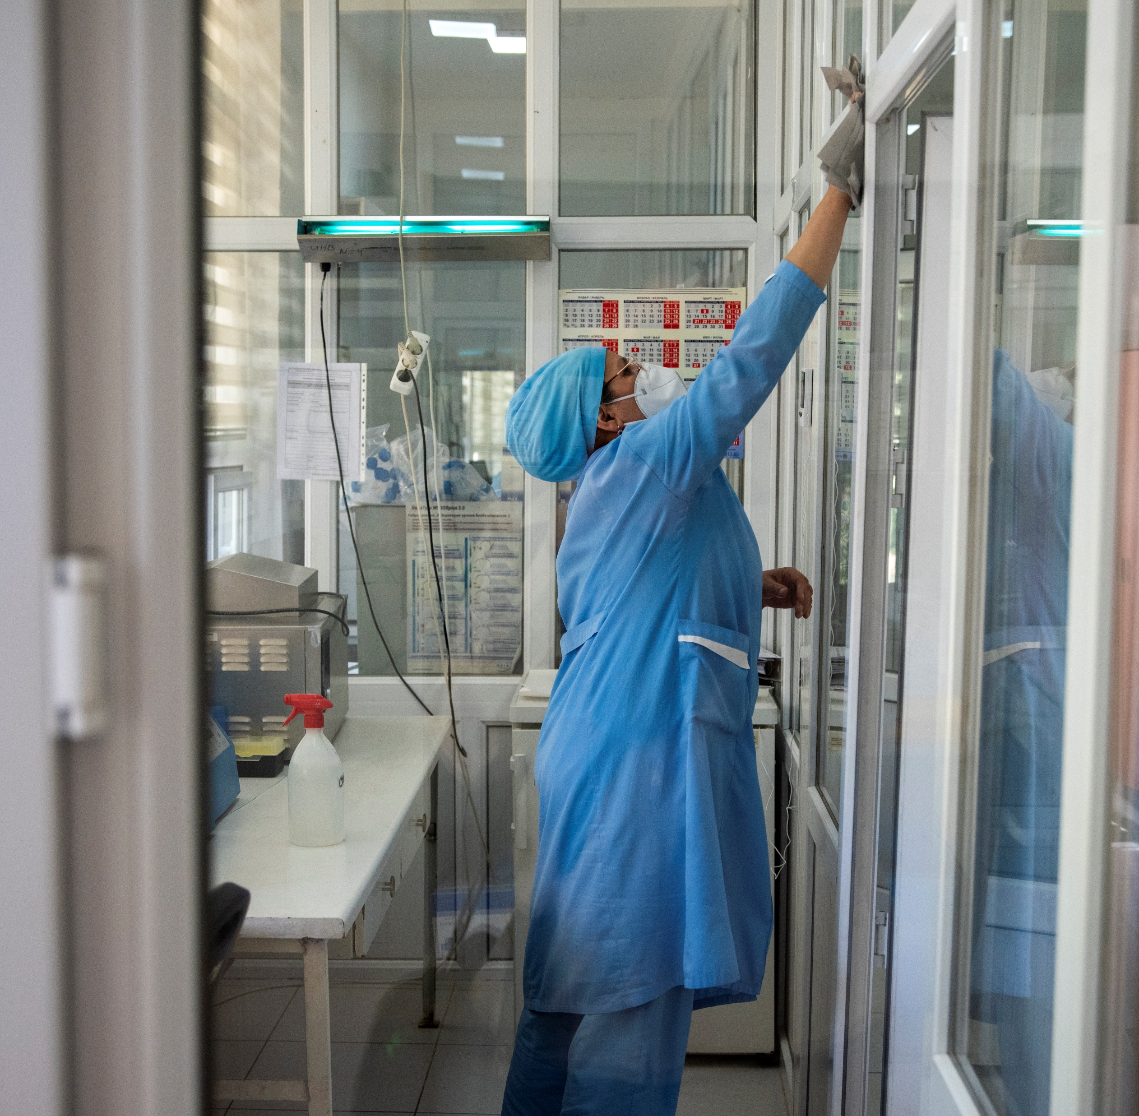
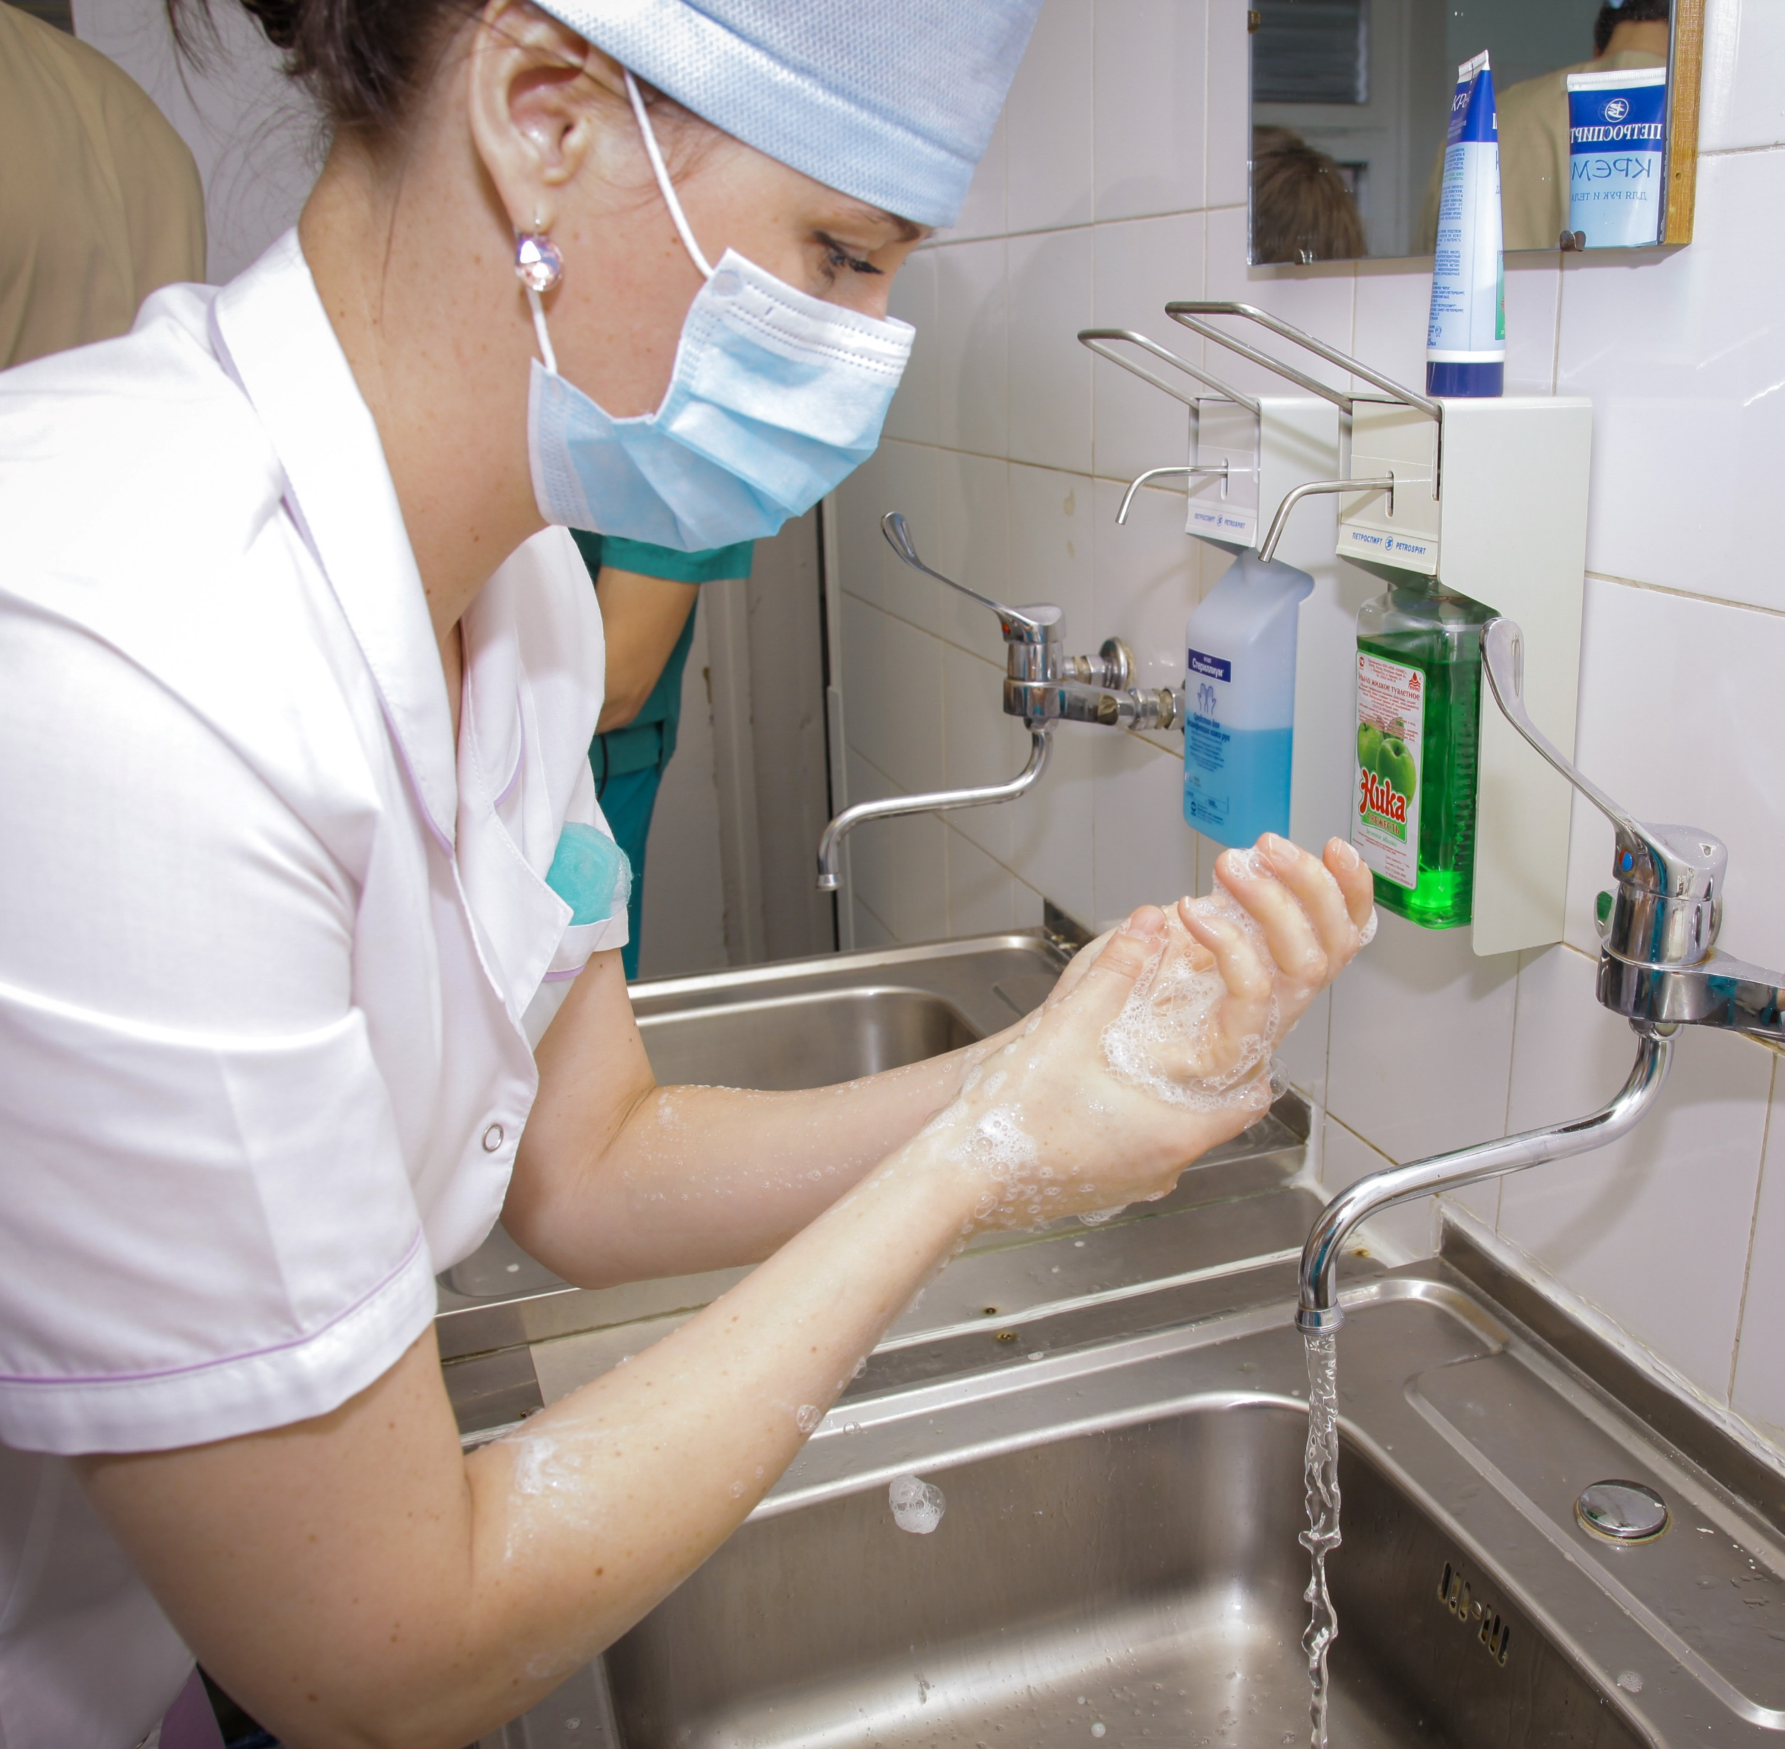
An overview of supplies and equipment
High-risk areas: Wear gowns/plastic aprons, gloves, face protection.
Clean and disinfect cleaning carts after each use.
Routine cleaning: No PPE needed unless spill risk.
Droplet precautions: Use gowns, gloves, facial protection.
Handle disinfectants per Safety Data Sheets; wear appropriate PPE.
Perform hand hygiene after PPE removal to minimize contamination and ensure safety.
Contact precautions: Use gowns, gloves, eye protection.
Store carts securely; never leave unattended.
Terminal cleaning: Use reusable rubber gloves.
Airborne precautions: Wear fit-tested respirators, gloves.
Credit: Shutterstock
Credit: WHO/Sergey Volkov
Credit: WHO/Lindsay Mackenzie
Credit: WHO/Tim Pietrasik
Notes:
Audio: Cleaning carts must be cleaned and disinfected after each use, stored securely, and never left unattended.
For routine cleaning, no personal protective equipment, or PPE, is typically needed unless there's a spill risk. Terminal cleaning demands reusable rubber gloves. Cleaning high-risk areas requires gowns or plastic aprons, gloves, and face protection. Droplet precautions call for gowns, gloves, and facial protection. Contact precautions need gowns, gloves, and eye protection. Airborne precautions mandate fit-tested respirators and gloves. When handling disinfectants, staff must consult Safety Data Sheets and wear appropriate PPE. Hand hygiene is crucial after PPE removal to minimize contamination spread and ensure staff and patient safety.

Slide 16
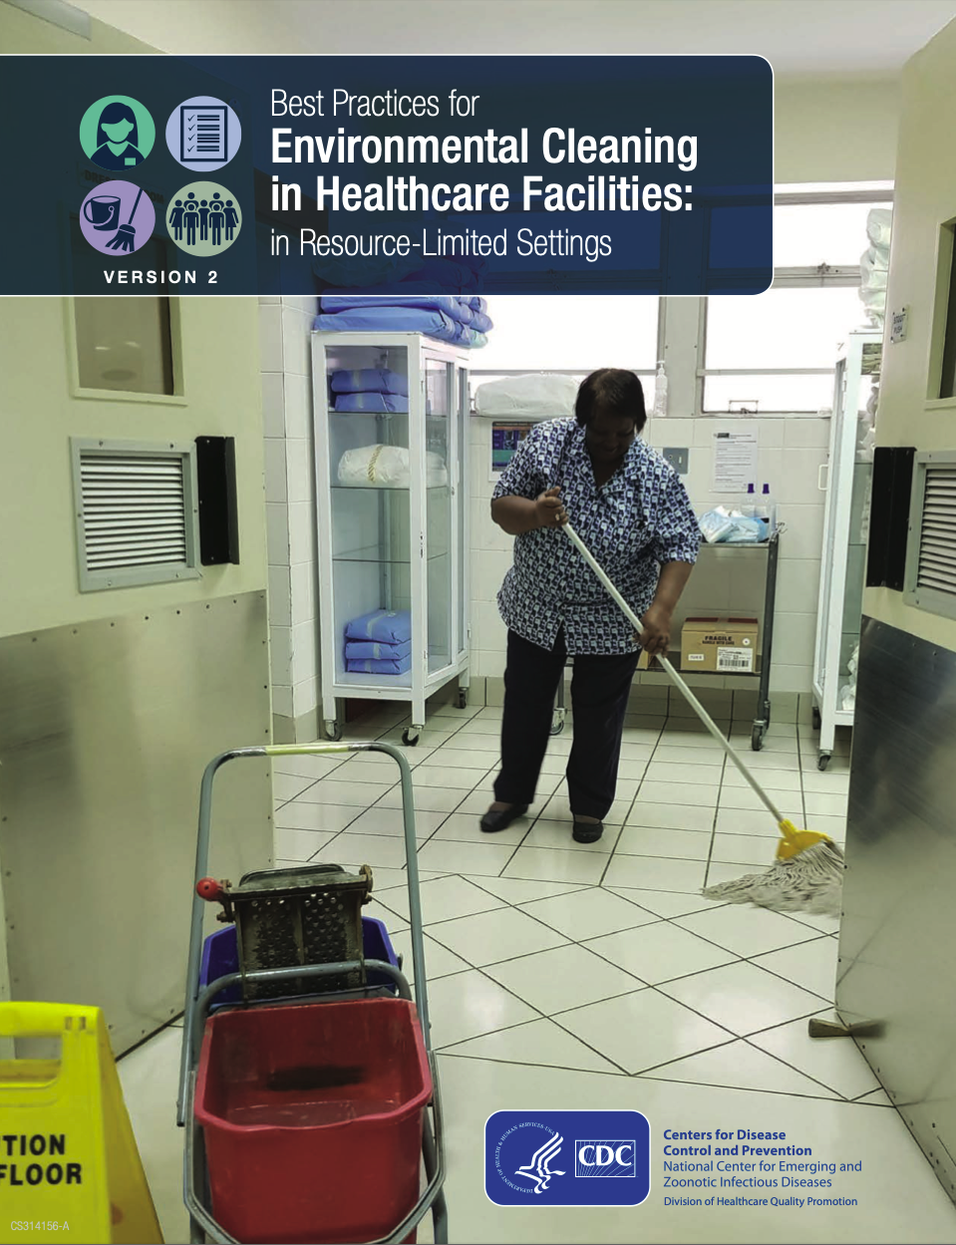
4a
Cleaning schedules
Cleaning schedules should include:
Frequency of cleaning.
Method of cleaning:
Product(s).
Processes (for all surfaces).
Person(s) responsible.
Schedules, determined on transmission risk level:
A risk level can be applied to a specific room, ward or entire department.
Higher risk may require different product(s) or processes.
Notes:
Audio: Cleaning schedules should indicate the frequency and methods of cleaning. This includes specifying the products to be used, the processes for cleaning surfaces, andthe persons responsible. Schedules should be informed by the transmission risk level, which can vary from one room or ward to another, or between departments. Areas with higher risk may necessitate the use of different products or processes.
For guidance on creating cleaning schedules for patient care areas that correspond to specific risk levels, as well as instructions for calculating your own facility's risk levels, refer to the CDC Best Practices document found in the resource page.

Slide 17
4b
Cleaning procedures
Standard Operating Procedures
Cleaning processes in a clear, step-by-step manner (visual and written instructions).
Regular supply of materials, equipment, PPE
For cleaning and hand hygiene.
Disposal and reprocessing steps for waste and laundry
Post-use handling of supplies and equipment (do they require cleaning, disinfection, or disposal?).
Notes:
Audio: Now let’s look at cleaning procedures. Well-defined Standard Operating Procedures, or SOPs, should outline cleaning processes in a clear, step-by-step manner, accommodating different learning styles with both visual and written instructions.
A regular supply of cleaning materials, equipment, and PPE, along with hand hygiene supplies, is required. SOPs must also cover the safe disposal and reprocessing of materials, including waste and laundry , and the post-use handling of supplies and equipment, whether they require cleaning, disinfection, or disposal.

Slide 18
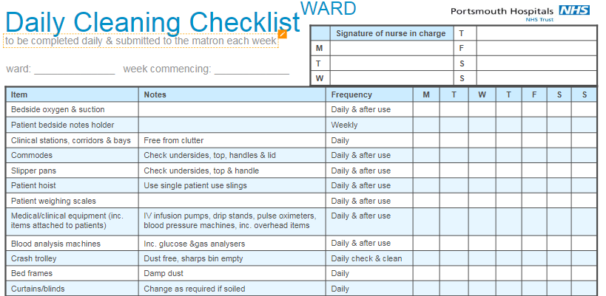
4c
Timely reminders
Long-term visual cleaning records (e.g., checklists) maintained in every ward.
Ensure specified cleaning with prompts.
Accountability and positive feedback opportunities.
Detail location, session type, date and cleaner's signature.
Example cleaning checklist
Tailor to the staff literacy levels.
Notes:
Audio: In addition to schedules and SOPs, visual cleaning records like checklists, maintained in each ward and backed by an SOP, should be available. These records encourage adherence to cleaning policies, provide reminders for consistency, enable task tracking for accountability, and provide a basis for feedback to cleaning staff. They detail the cleaning location, session type, date, and the cleaner's identity, tailored to the staff's literacy levels and placed prominently for easy monitoring.

Slide 19
5
Monitoring & feedback
Routine monitoring can be achieved in different ways:
Objective (ATP systems) vs. subjective (visual assessment) methods for cleaning outcomes.
Direct (observation) methods are more simple but may introduce subjectivity.
Indirect (e.g., fluorescent gel) methods are less obtrusive.
Direct feedback is critical for improvement
Timely feedback to staff.
For coaching, to inform training needs.
Monthly reporting, summary & trends also useful.
Credit: Shutterstock
Notes:
Audio: How do you monitor that cleaning is happening correctly and sufficiently? High-tech options like Adenosine Triphosphate, or ATP, monitoring systems offer precise cleanliness measures, but they aren't always accessible. Less costly methods can still provide valuable assessments of cleaning efficacy.
Direct observation and visual checks, though they are simple and might introduce subjectivity, support immediate assessment. Indirect strategies, such as fluorescent gels, identify any remaining residues and offer a less obtrusive way to verify the cleaning, especially in critical touchpoint areas.
Immediate, direct feedback to cleaning staff functions can pinpoint areas needing attention and help shape future training. Compile monthly reports to track how well protocols are being adhered to over time.
It is important to use a combination of measures that directly assess cleaning in addition to observational assessments in order to have the best picture of the performance of the environmental cleaning program.

Slide 20
6
Infrastructure, supplies & product management
Characteristic | Selection guidance
Cleanable | Avoid items with hard-to-clean features (e.g., crevasses). Do not use carpet in patient care areas. Select material that can withstand repeated cleaning.
Easy to maintain and repair | Avoid materials that are prone to cracks, scratches and quickly patch/repair if they occur. Select materials that are durable or easy to repair.
Resistant to microbial growth | Avoid materials that hold moisture, such as wood or cloth, because these facilitate microbial growth. Select metals and hard plastics.
Nonporous | Avoid items with porous surfaces, such as cotton, wood and nylon. Avoid porous plastics, such as polypropylene, in patient care areas.
Seamless | Avoid items with seams. Avoid upholstered furniture in patient care areas.
Designate an "environmental cleaning services area" at the facility.
Ensure approved cleaning products and supplies are available.
Implement procurement and supply management systems.
Bacteria Harbouring Propensity by Material
Notes:
Audio: Infrastructure should include a dedicated environmental cleaning services area to store products and tools for ready access and use.
The facility is responsible for providing approved cleaning supplies that are effective against a broad spectrum of pathogens. A reliable procurement and supply management system will facilitate this.
Lastly, when outfitting patient care areas, materials should be easy to clean, maintain, and repair; resistant to microbial growth; nonporous; and, ideally, without seams. Hard plastics and metals are preferred over wood or cloth, due to their lower propensity for harboring bacteria.

Slide 21
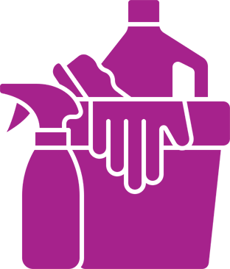
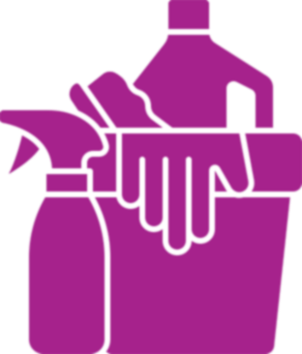
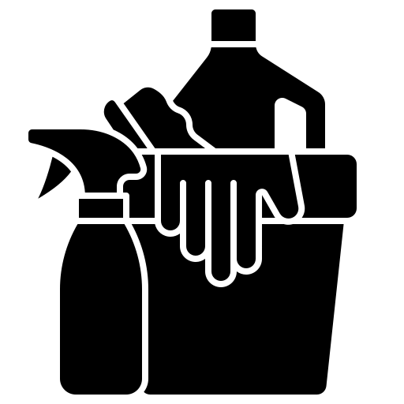
Cleaning products vs. disinfectants
Cleaning products are:
liquids, powders, sprays, or granules for removing organic material and grease/oil, such as liquid soap, enzymatic cleaners and detergents.
Disinfectants are:
chemical compounds that kill pathogens/ microbes, categorized as low, mid or high-level, used only on inanimate objects.
All organic material (body fluids) and dirt/soilage must be removed by a cleaning product before application of disinfectants.
Notes:
Audio: Let’s look at the difference between cleaning and disinfection products. Cleaning products, like liquid soap and detergents, tackle organic material, such as dirt and bodily fluids. Disinfectants, categorized by potency, eradicate microbes, from low-level to high-level efficacy. Thorough cleaning should be done before disinfection to remove any organic material that might re-contaminate.
Routine cleaning often uses neutral detergents, while combined detergent-disinfectants also exist. For most tasks, low-level disinfection suffices, but mid-level disinfection may be needed during outbreaks or for blood spills.
Please note that all organic material (body fluids) and dirt/soilage must be removed by a cleaning product before application of disinfectants.

Slide 22
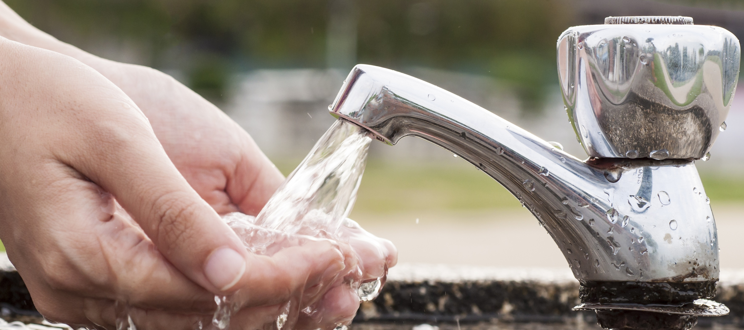
Best practices for conserving water
Over 2 billion face inadequate water supply, with scarcity expected to rise.
Don't let taps run continuously, especially outdoors.
Use a filled bucket for cleaning to limit water use.
Minimize tap use for wetting cloths.
Regularly inspect taps during cleaning.
Promptly repair leaks.
Credit: Shutterstock
Notes:
Audio: Environmental cleaning requires a reliable water source. With over 2 billion people facing inadequate water supply, it's essential to conserve water effectively. Avoid letting taps run continuously, especially outdoors. Use a filled bucket for cleaning to limit water use. Minimize tap use for wetting cloths. Regularly inspect taps during cleaning and promptly repair any leaks. Refer to the water module for additional water conservation strategies.

Slide 23
Key points
Effective environmental cleaning hinges on robust organization, leadership, staffing, policies, procedures and budget.
Training and positive reinforcement through feedback are crucial for cleaning staff.
Develop cleaning schedules and SOPs tailored to the risk level of patient areas.
Select and manage cleaning products and disinfectants with care, considering environmental factors.
Credit: Shutterstock
Notes:
Audio: Thanks for reaching the end of this module. Key points to remember:
Environmental cleaning best practices require solid organizational infrastructure, leadership, staffing, policies, procedures, and budgeting.
Training for environmental cleaning staff is essential, as is positive reinforcement through monitoring and feedback.
Cleaning schedules and Standard Operating Procedures for all patient areas should be based on their risk level.
Selection and management of cleaning products and disinfectants must consider environmental and climate impacts and be carefully managed at the facility level.
Don't forget to explore the reference section of this module for links to all mentioned resources.

