Slide 1
Module 3
Undertake an assessment of the facility (Step 2)
Credit: Shutterstock
Notes:
Audio: Hello. I am Faustina Gomez, a technical officer on Climate Change and Health in WHO’s South-east Asia Regional Office. Welcome to Module 3 of our course, Undertake an assessment of the facility.​

Slide 2
Learning objectives
By the end of this module, you will:
Conduct thorough evaluations, and adapt and align WASH FIT assessments with different contexts, national standards and local needs.
Gain awareness of efficient data collection using Excel and Kobo Toolbox.
Comprehend gender, equality and disability inclusion throughout the assessment process.
Be able to carry out inclusive and effective evaluations of a facility’s WASH services.
Notes:
Audio: In this module, you'll learn to conduct thorough evaluations, and adapt and align assessments with different contexts, national standards and local needs. We'll introduce efficient data collection methods with tools like Excel and Kobo Toolbox. Additionally, we'll cover integrating gender, equality, and disability considerations. Our goal is to prepare you for inclusive and effective evaluations of a health care facility’s WASH services.

Slide 3
WASH FIT improvement cycle
Step 1
Step 1
Establish and train the team and document decisions
Establish and train the team and document decisions
Step 2
Step 5
Step 2
Step 5
Monitor, review, adapt, improve
Monitor, review, adapt, improve
Undertake an assessment of the facility
Undertake an assessment of the facility
Step 4
Step 4
Step 3
Step 3
Conduct a risk assessment to identify and prioritize areas for improvement
Develop an incremental improvement plan and take action
Conduct a risk assessment to identify and prioritize areas for improvement
Develop an incremental improvement plan and take action
Notes:
Audio: As a reminder, we are working our way through the WASH FIT cycle and are now onto the second step, undertake an assessment of the facility.

Slide 4
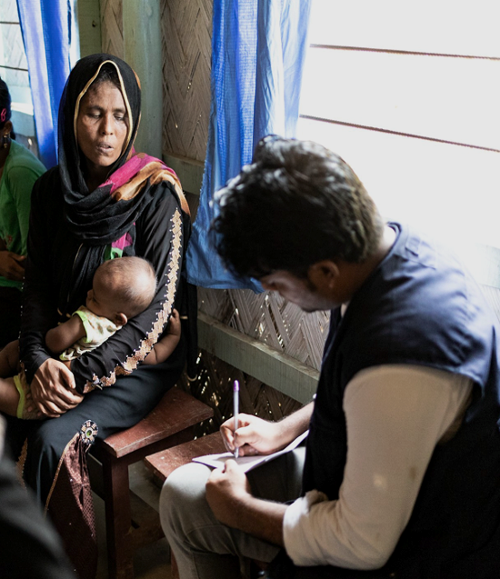
Step 2: Undertake an assessment of the facility
Main tasks
Use an adapted version of the assessment form, tailored to the facility’s needs, aligned with national standards.
Regularly conduct an assessment (every 6-12 months) and keep records of previous assessments to compare progress over time.
Credit: WHO
Notes:
Audio: In Step 2 of the WASH FIT improvement cycle, we conduct a detailed assessment of the facility. Before doing so, you must adapt the assessment form to the facility’s unique context and needs and align it with national standards.​ An assessment should be conducted at baseline, then every 6-12 months. ​This allows you to compare assessments and see progress over time.

Slide 5
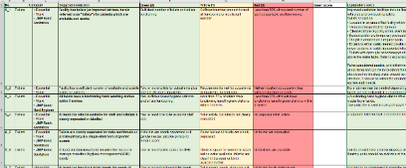
Step 2: Undertake an assessment of the facility
Tasks
Customize form.
Regularly conduct an assessment.
Establish a baseline and track progress over time.
Complete a full assessment every 12 months with some indicators monitored more frequently.
Supporting tools
Assessment form
Excel
Kobo (online version)
Notes:
Audio: Key tasks of this step include customizing the form, regularly conducting assessments to establish a baseline, and tracking progress over time. We use tools like a customizable assessment form in Excel for data collection and analysis, and Kobo Toolbox for online assessments. These tools make data collection, analysis, and storage more efficient and time saving.

Slide 6
Structure of assessment form
> 90 indicators sorted into 7 domains.
Available in Excel or Kobo Toolbox.
Water
Sanitation
Health care waste
Hand hygiene
Environmental cleaning
Energy & environment
Facility management
Notes:
Audio: The assessment form serves as a comprehensive tool for evaluating adherence to WASH standards, encompassing over 90 indicators across seven domains. As a reminder these are: water, sanitation, health care waste, hand hygiene, environmental cleaning and energy, environment & Facility management. The form can be used in Excel and Kobo Toolbox. Guidance on using Kobo Toolbox is available in the reference section of this module, including a video.​

Slide 7
Structure of assessment form
Not all indicators apply universally.
Depends on facility type (primary health care or hospitals) and service level.
Essential indicators should be calculated by all facilities, regardless of their size or location.
Data from essential indicators can be used to calculate JMP service levels (basic or advanced services).
Note: Not all indicators will need to be measured at each assessment.
Credit: WHO/Christopher Black
Notes:
Audio: It's important to note that not all indicators will apply universally, as their relevance varies depending on the facility type and service level. Indicators are categorized as essential or advanced. Indicators that are “essential” should be calculated by all facilities, regardless of their size or location.
These data can be used to calculate service levels which can contribute to JMP national service level estimates. Not all indicators will need to be measured at each assessment, meaning subsequent assessments will be quicker than the initial, in depth assessment.

Slide 8
Structure of assessment form
Three-point scoring:
Meets minimum standards (2/2)
Maintenance needed to sustain score
Partially meets standards (1/2)
Needs minor improvement
Does not meet standards (0/2)
Needs minor improvement
Example indicator Domain: health care waste | Meets standards: | Partially meets: | Does not meet:
Waste correctly segregated at all waste generation points | Yes, at all points (2) | Some sorting but not all correctly, or not practiced throughout the facility (1) | Waste not correctly sorted at any waste generation points (0)
Credit: WHO/Christopher Black
Notes:
Audio: Indicators are scored according to three levels: meeting minimum standards, partially meeting standards, or not meeting standards, shown here in green, yellow and red. These contribute to the facility’s overall score, measured as a percentage. The idea is that facilities should make incremental improvements to work their way up to meeting minimum standards. ​Alternative scoring systems can be used if preferred.
An example of how indicators are scored is shown here, this one on waste segregation.

Slide 9
Adapt the assessment tool
Refer to WASH FIT Guide:
Annex 2 for further instructions
Adaptation usually happens at national level by Ministry of Health - all partners should be mandated to use the same version.
Notes:
Audio: Adapting the WASH FIT assessment tool begins at the national level under the leadership of the Ministry of Health. This ensures alignment with national standards and applicability across various facility types and service levels. The Ministry will approve the final, adapted version with the expectation that all facilities and partners use a standardized form. If you are starting to use WASH FIT, check with the Ministry of Health or WHO and UNICEF colleagues whether there is already a nationally approved version of the tool that you should be using.

Slide 10
Adapt the assessment tool
Modify scoring criteria to suit different facility levels (make more achievable or more aspirational).
Add new indicators for other areas of interest and higher service levels.
Align indicators with national standards.
Reduce number of indicators for small facilities (remove those that are not relevant, e.g., in-patients, on-site waste treatment).
Focus on a specific WASH domain, (e.g., water or health care waste or specific area within facility).
Use local terminology and translate to local language.
Refer to WASH FIT Guide:
Annex 2 for further instructions
Adaptation usually happens at national level by Ministry of Health - all partners should be mandated to use the same version.
Notes:
Audio: Strategies for adaptation include aligning indicators with national standards on WASH, waste and energy, modifying scoring criteria to suit different facility levels, adding new indicators for additional areas of interest, such as indicators from the WHO IPCAF – the Infection Prevention and control assessment framework - and reducing the number of indicators for smaller facilities. Some facilities may wish to only focus on one of the 7 domains to start with or only the essential indicators.
Guidance on adaptation, including translations and local terminology, is available in the WASH FIT Guide, Annex 2, which you can download from the reference section of this module.

Slide 11
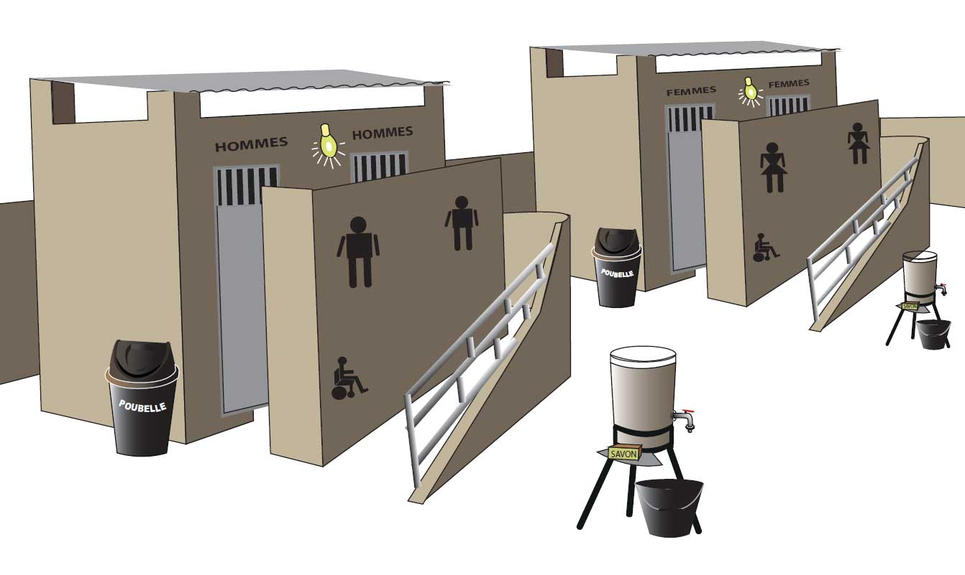
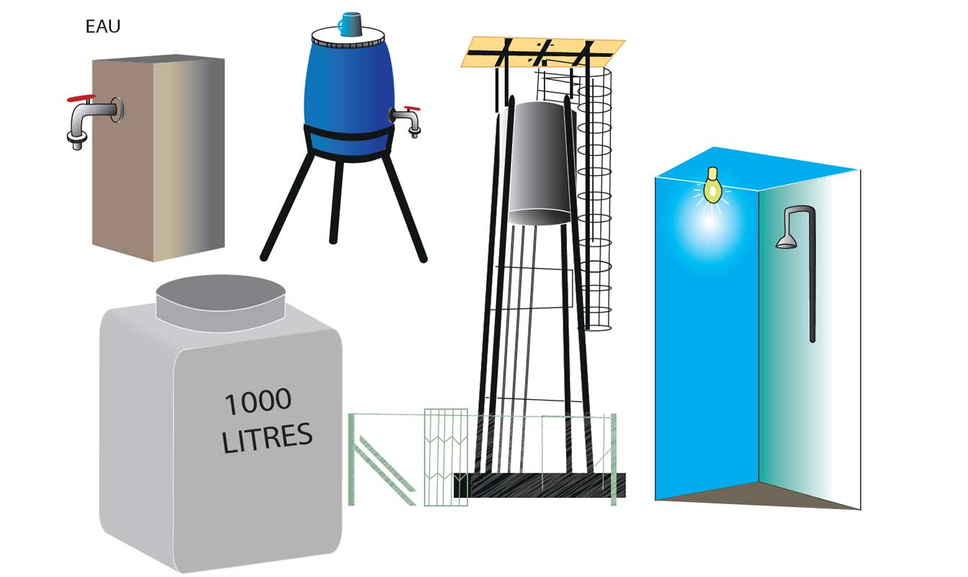
Simplifying the assessment for smaller facilities
Country example: Mali
Target facilities: very small, PHCs in rural areas, extremely limited resources & capacity.
Used locally drawn illustrations to show necessary improvements.
Reduced the number of indicators by half.
Credit: WaterAid, OneDrop, Hilton Foundation
Notes:
Audio: Let's take a look at an example from Mali with an approach to simplifying the WASH FIT assessment for smaller facilities, particularly those in rural areas with extremely limited resources and capacity. Recognizing that the full set of over 90 indicators was overwhelming for these smaller facilities which have limited staff, resources and indeed patients, the number of indicators was reduced by half. This made the assessment more manageable and relevant to the facilities' specific context. Additionally, to aid understanding and implementation, locally drawn illustrations were used, effectively communicating what needed to be done in a clear and culturally resonant manner, especially useful for those with limited literacy.​

Slide 12
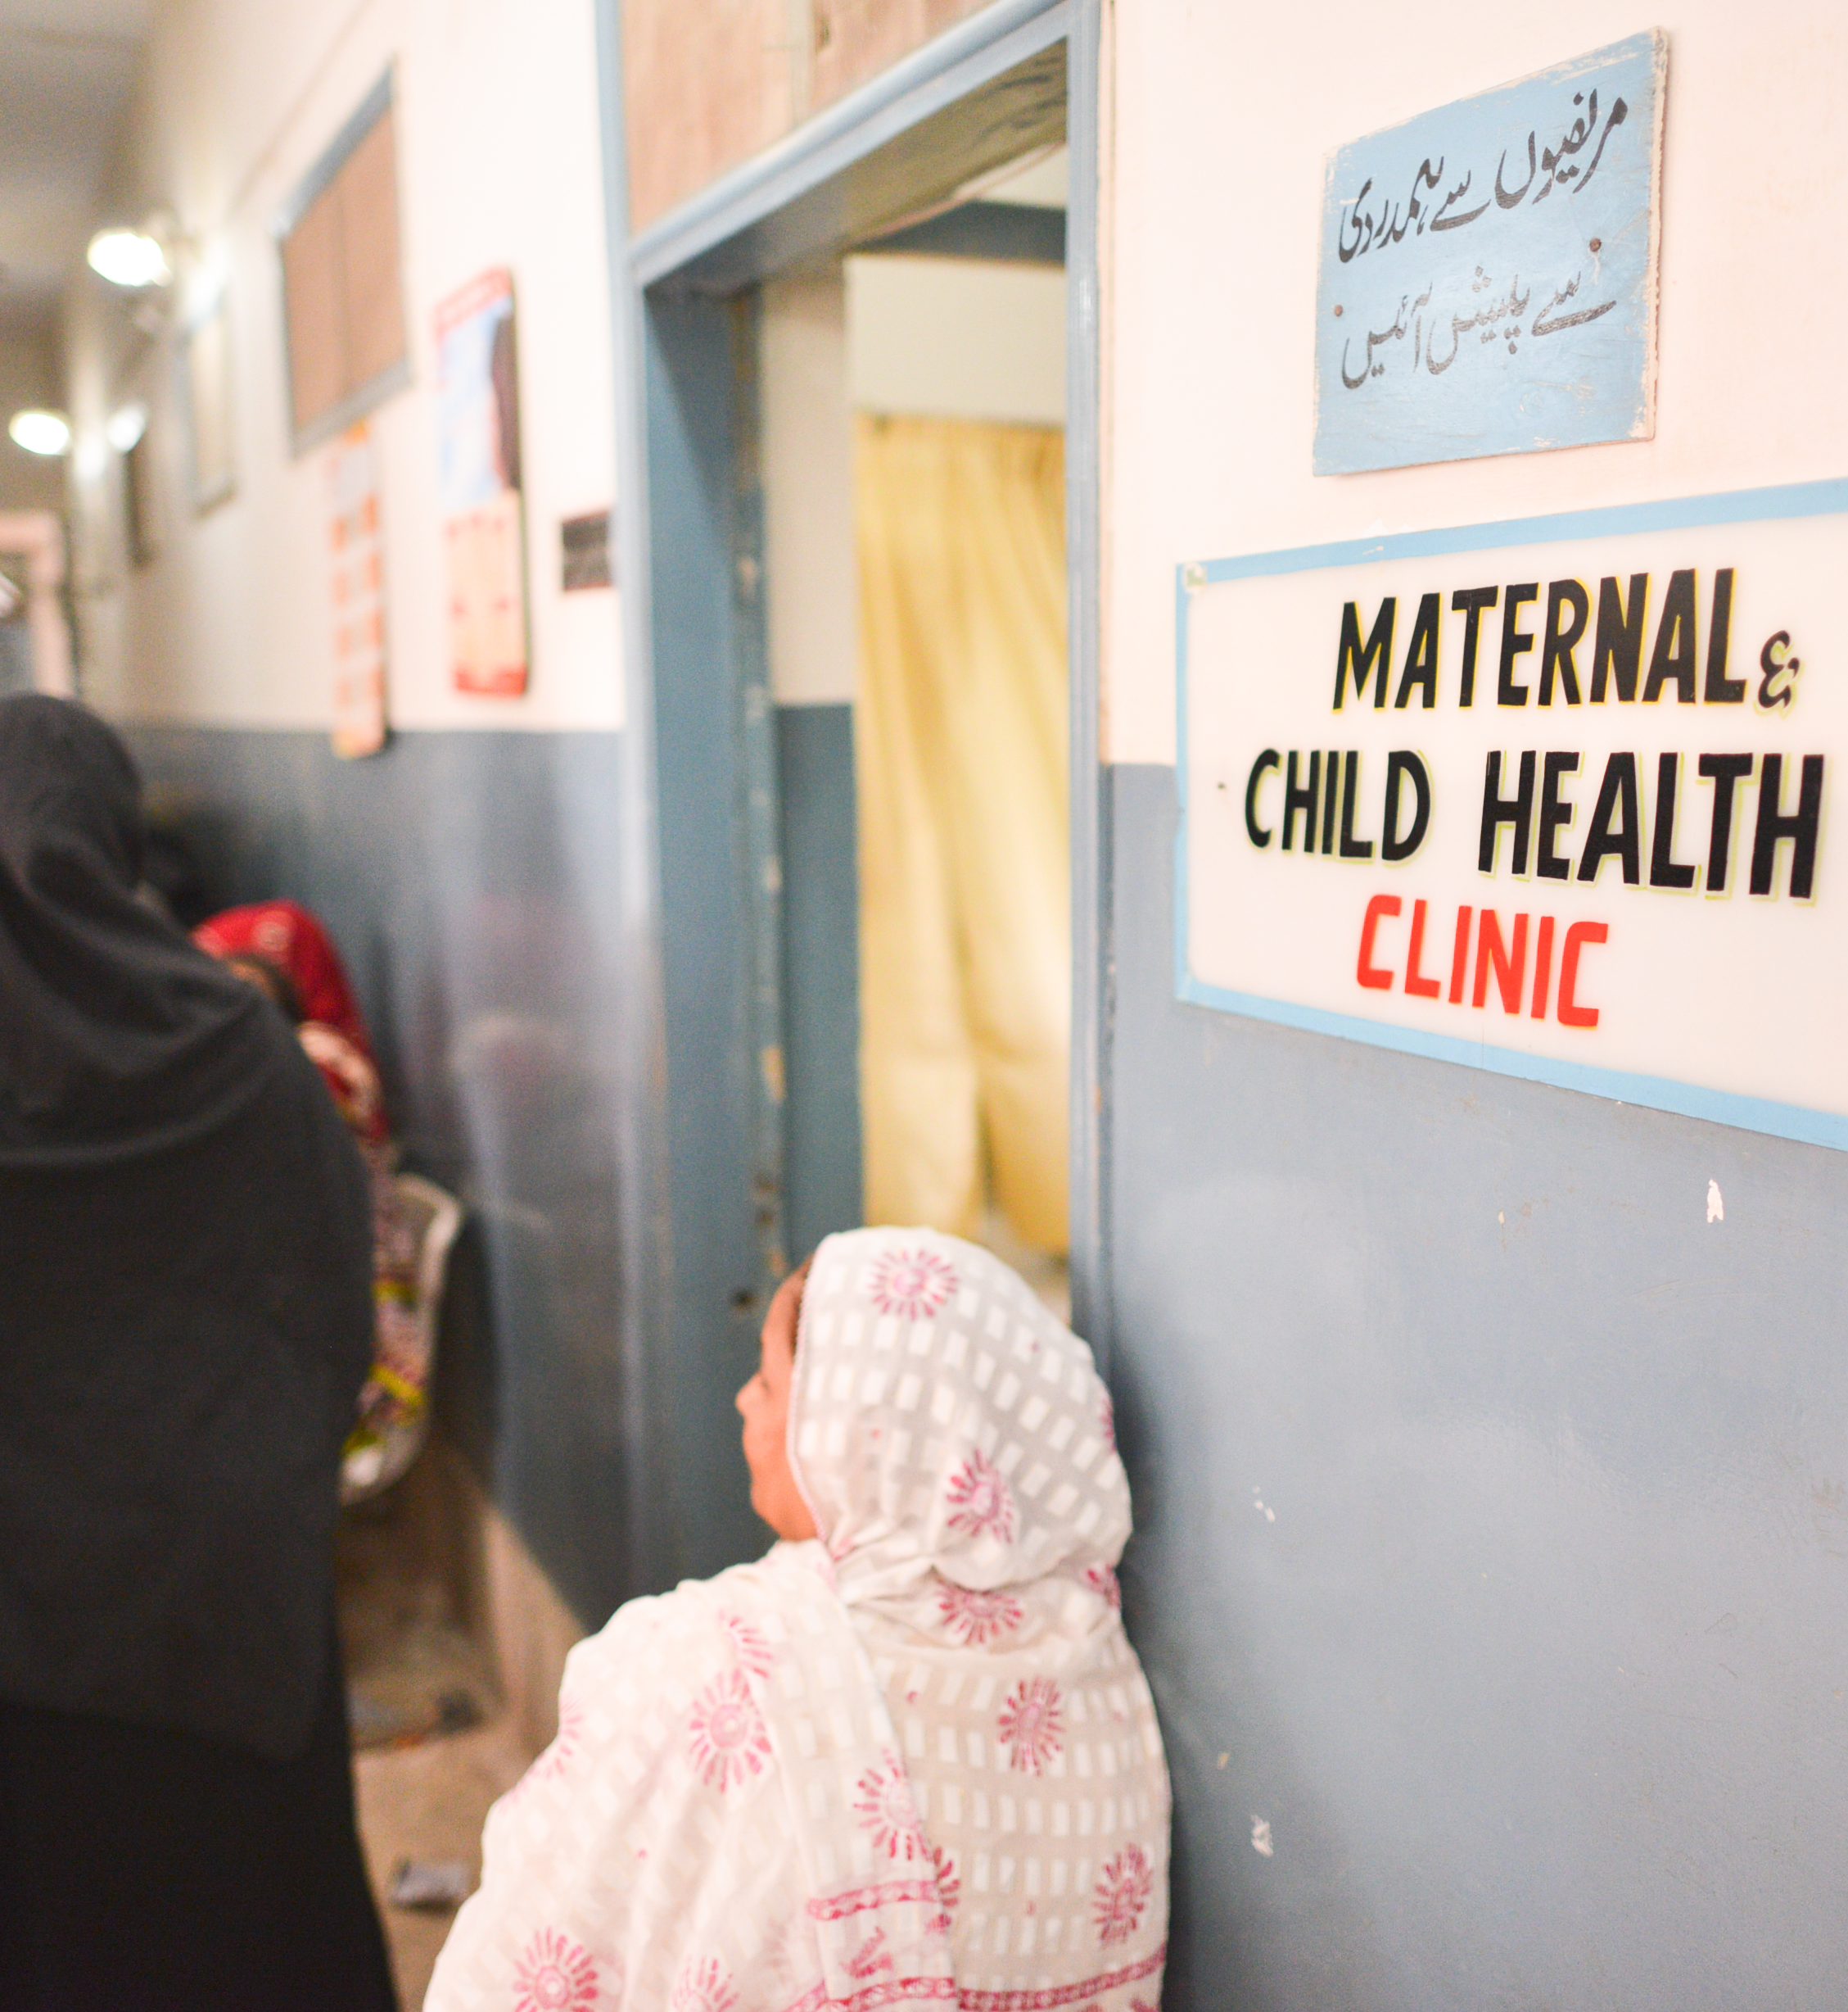
Hospitals & bigger facilities
Start WASH FIT in one ward or department.
→ Choose departments with obvious needs + motivated staff.
→ Helps identify poor performing wards.
Targeted assessments help to allocate resources more efficiently.
Assess some indicators multiple times (e.g., once per area [or ward]) & take an average of the score.
Specific departments or wards may require tailored indicators specific to their needs.
Maternity services are often underserved – a good place to prioritize WASH FIT.
Include more indicators.
Credit: MCSP/Ali Khurshid
Notes:
Audio: You can also start the WASH FIT process in one ward or department, particularly those with clear needs and motivated staff, before expanding to the full facility. This can help identify poor-performing wards. These more targeted assessments will help you to allocate resources more efficiently.​
Take care to note that you should assess certain indicators repeatedly (e.g., once for each area) and find the average. As well, specific departments or wards may require tailored indicators specific to their needs.​
For hospitals and larger facilities, labor, delivery, and neonatal departments are often provide significant opportunities to improve quality of care, especially given the critical role of hygiene during child delivery. In general, hospitals and bigger facilities include more indicators.

Slide 13
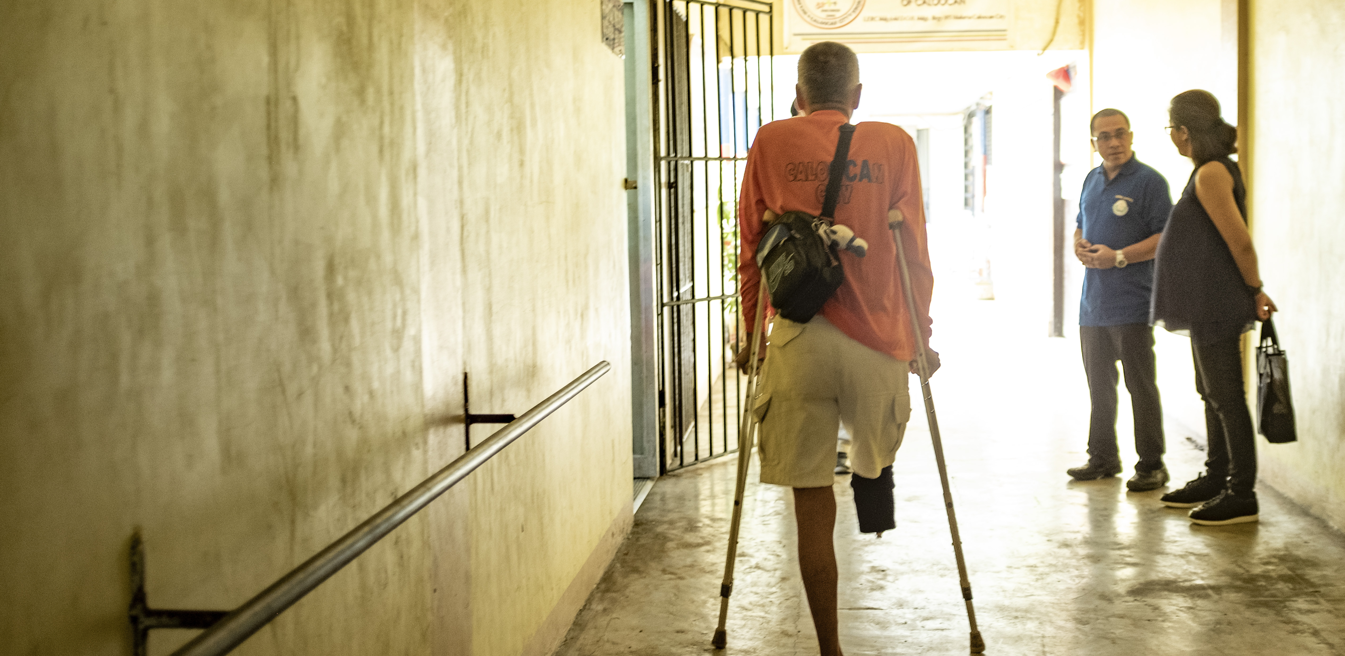
Assessing gender, equality and disability inclusion
Gender-specific facilities and infrastructure (e.g., toilets, menstrual hygiene management).
Accessibility of services (e.g., drinking water, showers).
Delivery rooms, neonatal care unit and postnatal care rooms.
Discriminatory attitudes and practices.
Power imbalances.
Credit: WHO/Sebastian Liste
Notes:
Audio: How do we pay particular attention to the needs of vulnerable groups in the WASH FIT assessment? ​
The WASH FIT assessment requires you check the availability of gender-specific facilities and infrastructure, including solutions for toilets and menstrual hygiene management, or MHM, the accessibility of drinking water, toilets and showers, including access paths, and gets you to think about how people with disabilities use and will benefit from the facility. Special attention should be given to critical areas such as delivery rooms, neonatal care units, and postnatal care rooms. Engaging in conversations with healthcare workers and facility management is crucial to identify and address any discriminatory attitudes or practices. It's important to acknowledge that power imbalances may prevent some staff from openly discussing issues.
For a deeper understanding of these topics, refer to Module 12 of this course on Gender Equality, Disability, and Social Inclusion, or GEDSI, or take the OpenWHO course 'Mainstreaming of gender equality, disability and social inclusion in WASH in Health Care Facilities.

Slide 14
Assessing gender, equality and disability inclusion
Gender-specific facilities and infrastructure (e.g., toilets, menstrual hygiene management).
Accessibility of services (e.g., drinking water, showers).
Delivery rooms, neonatal care unit and postnatal care rooms.
Discriminatory attitudes and practices.
Power imbalances.
Credit: WHO/Sebastian Liste
Notes:
Audio: How do we pay particular attention to the needs of vulnerable groups in the WASH FIT assessment? ​
The WASH FIT assessment requires you check the availability of gender-specific facilities and infrastructure, including solutions for toilets and menstrual hygiene management, or MHM, the accessibility of drinking water, toilets and showers, including access paths, and gets you to think about how people with disabilities use and will benefit from the facility. Special attention should be given to critical areas such as delivery rooms, neonatal care units, and postnatal care rooms. Engaging in conversations with healthcare workers and facility management is crucial to identify and address any discriminatory attitudes or practices. It's important to acknowledge that power imbalances may prevent some staff from openly discussing issues.
For a deeper understanding of these topics, refer to Module 12 of this course on Gender Equality, Disability, and Social Inclusion, or GEDSI, or take the OpenWHO course 'Mainstreaming of gender equality, disability and social inclusion in WASH in Health Care Facilities.

Slide 15
WASH FIT facility score
Can be calculated for whole facility or by ward or domain.
Track progress over time.
Enables comparisons between facilities.
How to calculate the score?
Total score of all indicators assessed
Max possible score [no. of indicators assessed x 2]
Credit: Shutterstock
Notes:
Audio: The WASH FIT facility score offers a broad overview of a facility's overall condition. ​The score can be calculated for the whole facility, for a particular ward (in a bigger facility) or a domain (for example water or sanitation). The score also facilitates progress tracking and enables comparisons between different facilities. ​
While the score can be a useful tool for tracking progress over time, it's important to note that the score is a relatively crude measure as all indicators carry the same weighting. This means an overall increase in the score might not reflect improvements across all indicators. A critical indicator which has a large impact (for example availability of an improved water supply) may get worse while the overall score remains the same or improves.​
The significance of the score and the determination of cutoff points for evaluation should be tailored to specific needs and agreed upon either at the national level or by the facility's WASH FIT team.

Slide 16
WASH FIT facility score
Can be calculated for whole facility or by ward or domain.
Track progress over time.
Enables comparisons between facilities.
How to calculate the score?
Total score of all indicators assessed
Max possible score [no. of indicators assessed x 2]
Suggested cut offs
> 75%
Good
Facility is doing well but continue making improvements to meet minimum standards.
67-75%
Average
Additional efforts are needed and ongoing maintenance.
< 67%
Poor
Major efforts and resources needed for improvements, poor quality of care.
Notes:
Audio: For facilities scoring above 75%, performance is good, but improvements are still needed. Scores between 67-75% indicate average performance with additional efforts required. Scores below 67% reflect poor quality of care, necessitating major improvements.

Slide 17
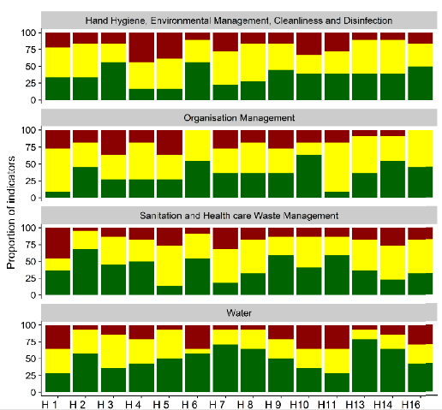
WASH FIT score and data visualization in Kenya
Comparison of 16 district hospitals in Kenya
% of indicators scoring 0, 1 or 2 across four domains.
Highest scoring domain = water.
Helpful for government/policy makers to compare facility performance.
Motivates staff to make improvements.
Meets target
Partially meets target
Does not meet target
Notes:
Audio: Let’s look at an example from Kenya. There, the WASH FIT score was used to conduct a comparative analysis across 16 district hospitals. This analysis focused on the percentage of indicators scoring 0, 1, or 2 within four key domains, which the chart on the screen shows. The results highlighted water as the highest scoring domain, providing valuable insights for government officials and policymakers to benchmark facility performance. Such data visualization not only facilitates comparison between facilities but also motivates staff towards consistent improvement by clearly illustrating areas of strength and those requiring attention. ​More complicated data visualization can be done using online software, such as PowerBI.

Slide 18
Key points
A comprehensive assessment of the facility informs all subsequent phases.
A facility WASH FIT score is calculated to give an overall picture of performance.
Assessment identifies gaps and challenges.
Results of assessment should be shared with relevant stakeholders.
Assessment/monitoring should be repeated after 6-12 months.
Credit: Shutterstock
Notes:
Audio: Thank you for reaching the end of this module. Key points include:
The process begins with a comprehensive assessment of the facility, guiding all subsequent phases.
A facility's performance is evaluated through a WASH FIT score, offering an overall picture.
The assessment identifies where gaps and challenges lie.
Sharing the assessment results with relevant stakeholders is crucial.
It's recommended to repeat the assessment and monitoring process every 6-12 months for continuous improvement.
Please explore the reference section of this module to access links to all the resources mentioned.

