Slide 1
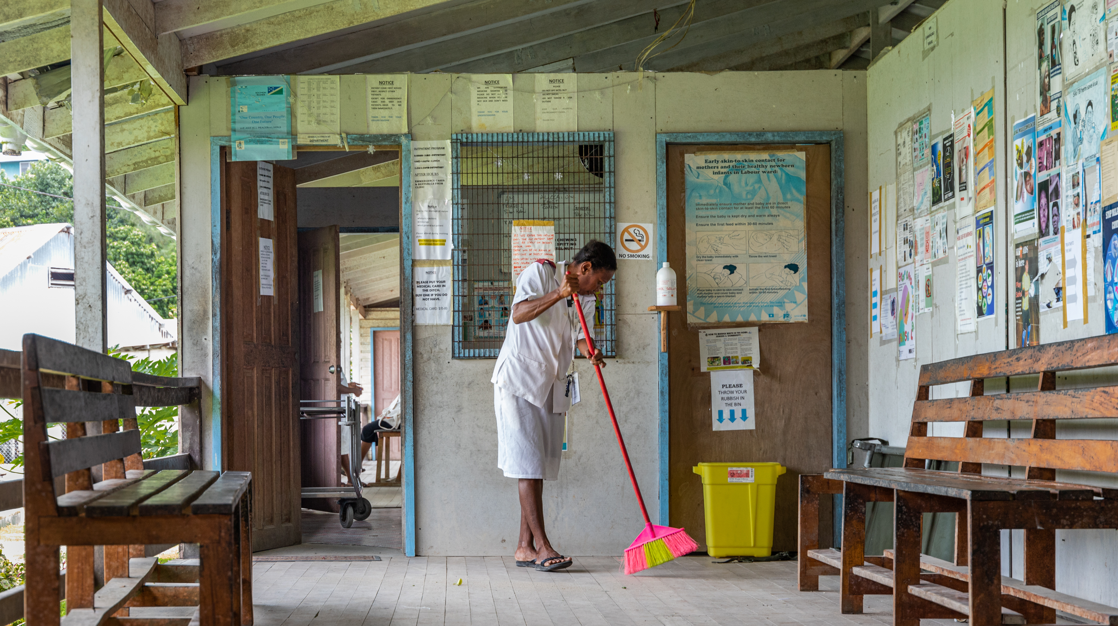
Module 5
Develop an incremental improvement plan and take action (Step 4)
Credit: WHO/Neil Nuia
Notes:
Audio: Hello. My name is Bonifacio Magtibay, and I am a technical officer working on WASH in the Philippines country office. In Module 5, we will discuss how to develop an incremental improvement plan and take action (Step 4).​

Slide 2
Learning objectives
By the end of this module, you will:
Develop a comprehensive, incremental improvement plan prioritizing high-risk problems in health care facilities.
Gain insight into short-term and long-term improvement measures.
Comprehend how to assess resource availability.
Understand how to review and adjust strategies.
Credit: WHO/Aphaluck Bhatiasevi
Notes:
Audio: By the end of this module, you'll be equipped to develop a comprehensive improvement plan tailored to healthcare facilities. You'll learn to prioritize high-risk issues, ensuring timely and environmentally sustainable actions. Through the exploration of short and long-term strategies, you'll gain insight into balancing immediate needs with future goals. Assessing resource availability will enable you to plan effectively for both present and forthcoming initiatives. Additionally, you'll understand the importance of regularly reviewing and adjusting improvement strategies, ensuring adaptability and efficacy in managing healthcare facilities dynamically.​

Slide 3
WASH FIT improvement cycle
Step 1
Step 1
Establish and train the team and document decisions
Establish and train the team and document decisions
Step 2
Step 5
Step 2
Step 5
Monitor, review, adapt, improve
Monitor, review, adapt, improve
Undertake an assessment of the facility
Undertake an assessment of the facility
Step 4
Step 4
Step 3
Step 3
Conduct a risk assessment to identify and prioritize areas for improvement
Develop an incremental improvement plan and take action
Conduct a risk assessment to identify and prioritize areas for improvement
Develop an incremental improvement plan and take action
Notes:
Audio: Now that you know what risks you are facing in the facility, it’s time to start addressing them in Step 4: Develop an incremental improvement plan and take action.

Slide 4
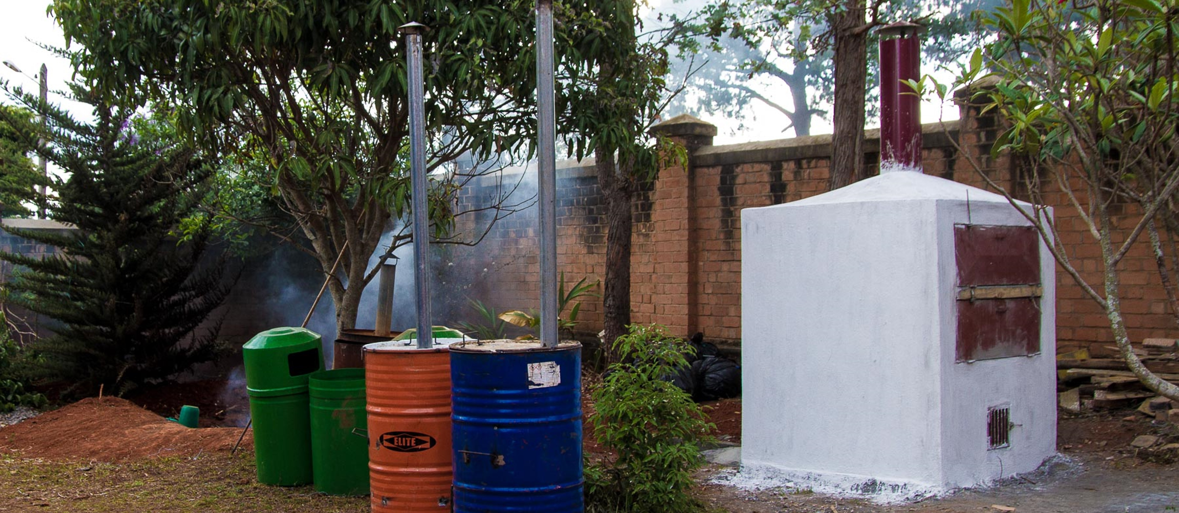
Step 4: Develop an incremental improvement plan and take action
Tasks
Develop a comprehensive plan with detailed improvements and timelines.
Assign costs and budgets to improvement plan.
Integrate strategies for managing current and future climate-related risks and resilience.
Credit: WHO/Hery Razafindralambo
Notes:
Audio: In Step 4, you'll focus on crafting and executing an incremental improvement plan tailored to enhance healthcare facility operations and infrastructure maintenance. This plan, shaped by the team and endorsed by senior management, aims for the prompt and efficient implementation of incremental improvements.
Key tasks involve developing a comprehensive plan detailing intended improvements and their timelines, along with assigning costs and a budget to the improvement plan. This plan doesn't just address immediate enhancements but also integrates strategies for managing current and future climate-related risks and fortifying long-term resilience against future challenges.
To streamline this process, a planning tool, often an Excel spreadsheet, is recommended. This tool assists in organizing improvement activities, setting deadlines, and tracking progress, ensuring each action occurs within a designated timeframe. Using paper-based forms is also ok.

Slide 5
Step 4: Develop an incremental improvement plan and take action
Tasks
Develop a comprehensive plan with detailed improvements and timelines.
Assign costs and budgets to improvement plan.
Integrate strategies for managing current and future climate-related risks and resilience.
Supporting tools: Improvement plan (Excel)
Notes:
Audio: In Step 4, you'll focus on crafting and executing an incremental improvement plan tailored to enhance healthcare facility operations and infrastructure maintenance. This plan, shaped by the team and endorsed by senior management, aims for the prompt and efficient implementation of incremental improvements.
Key tasks involve developing a comprehensive plan detailing intended improvements and their timelines, along with assigning costs and a budget to the improvement plan. This plan doesn't just address immediate enhancements but also integrates strategies for managing current and future climate-related risks and fortifying long-term resilience against future challenges.
To streamline this process, a planning tool, often an Excel spreadsheet, is recommended. This tool assists in organizing improvement activities, setting deadlines, and tracking progress, ensuring each action occurs within a designated timeframe. Using paper-based forms is also ok.

Slide 6
Step 4: Develop an improvement plan and take action
In the last step, you prioritized where urgent action is needed. Other items will be addressed later.
What actions are required (immediate & longer term)?
Estimated budget (and source of funding).
What other resources are needed (e.g., technical, human)?
Deadline for completion.
Notes:
Audio: Remember, you don't have to do everything at once, so tackling significant risks first to optimize limited resources is a great way to start. This phased strategy involves identifying quick, low-cost actions to promptly mitigate risks while planning comprehensive, long-term measures. The plan's focus is on reducing risk systematically, and targeting limited resources where they are needed most. To improve effectiveness, the planning horizon is limited to 6 months, with shorter-term goals set for 1, 3, and 6 months, followed by periodic reviews for adjustments. Each item in the plan outlines specific actions, estimated budgets, required resources, and clear deadlines, ensuring actionable and adaptable strategies for continual improvement. Make sure activities are specific, measurable and achievable.

Slide 7
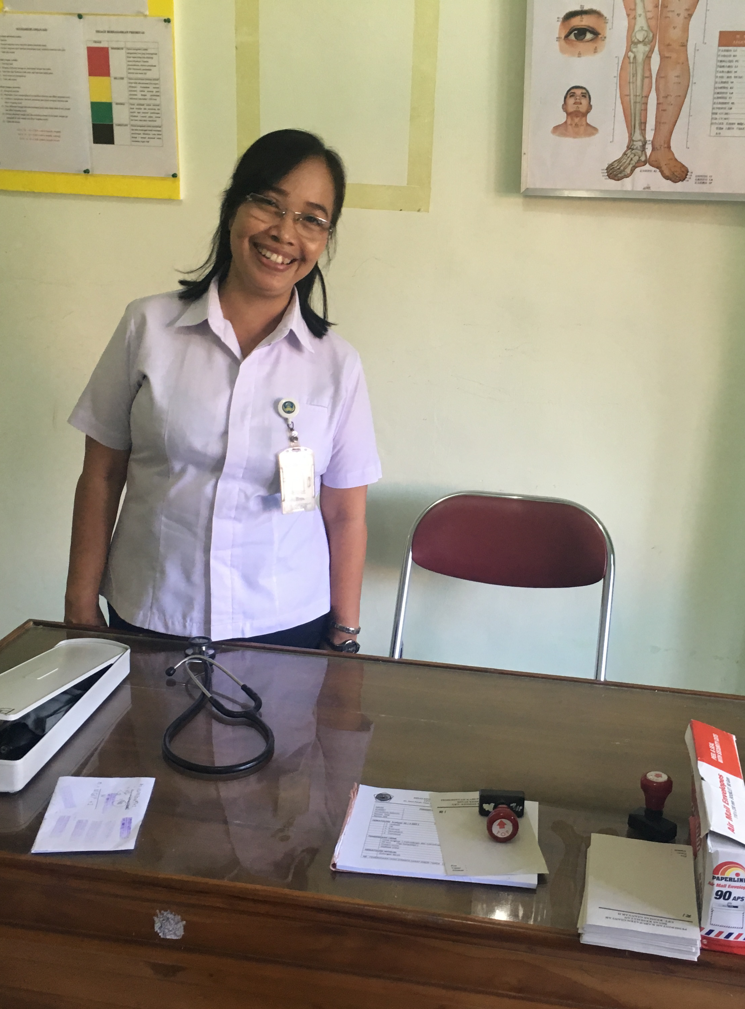
What can be improved?
Constructing new infrastructure.
Upgrading existing facilities to make more climate resilient or GEDSI friendly.
Updating protocols and SOPs.
Staff training in new techniques or procedures.
Improving management methods.
Simple, low-cost improvements can have a big impact.
But may require some imagination and creativity!
Credit: WHO/Arabella Hayter
Notes:
Audio: What sort of improvements might you make? Most facilities require a range of improvements, these might include constructing new infrastructure, updating existing facilities for climate resilience and inclusivity, and aligning with GEDSI principles. Updating protocols and Standard Operating Procedures, alongside staff training, is crucial. Improving management process also enhances facility operations.​
​Simple, low-cost interventions significantly impact care quality and safety and improve staff morale and patient satisfaction. Facilities are encouraged to gather ideas from neighboring facilities, local success stories, and consider external expertise if needed. This holistic approach ensures feasible and sustainable improvements, benefiting healthcare facilities in the long term.​

Slide 8
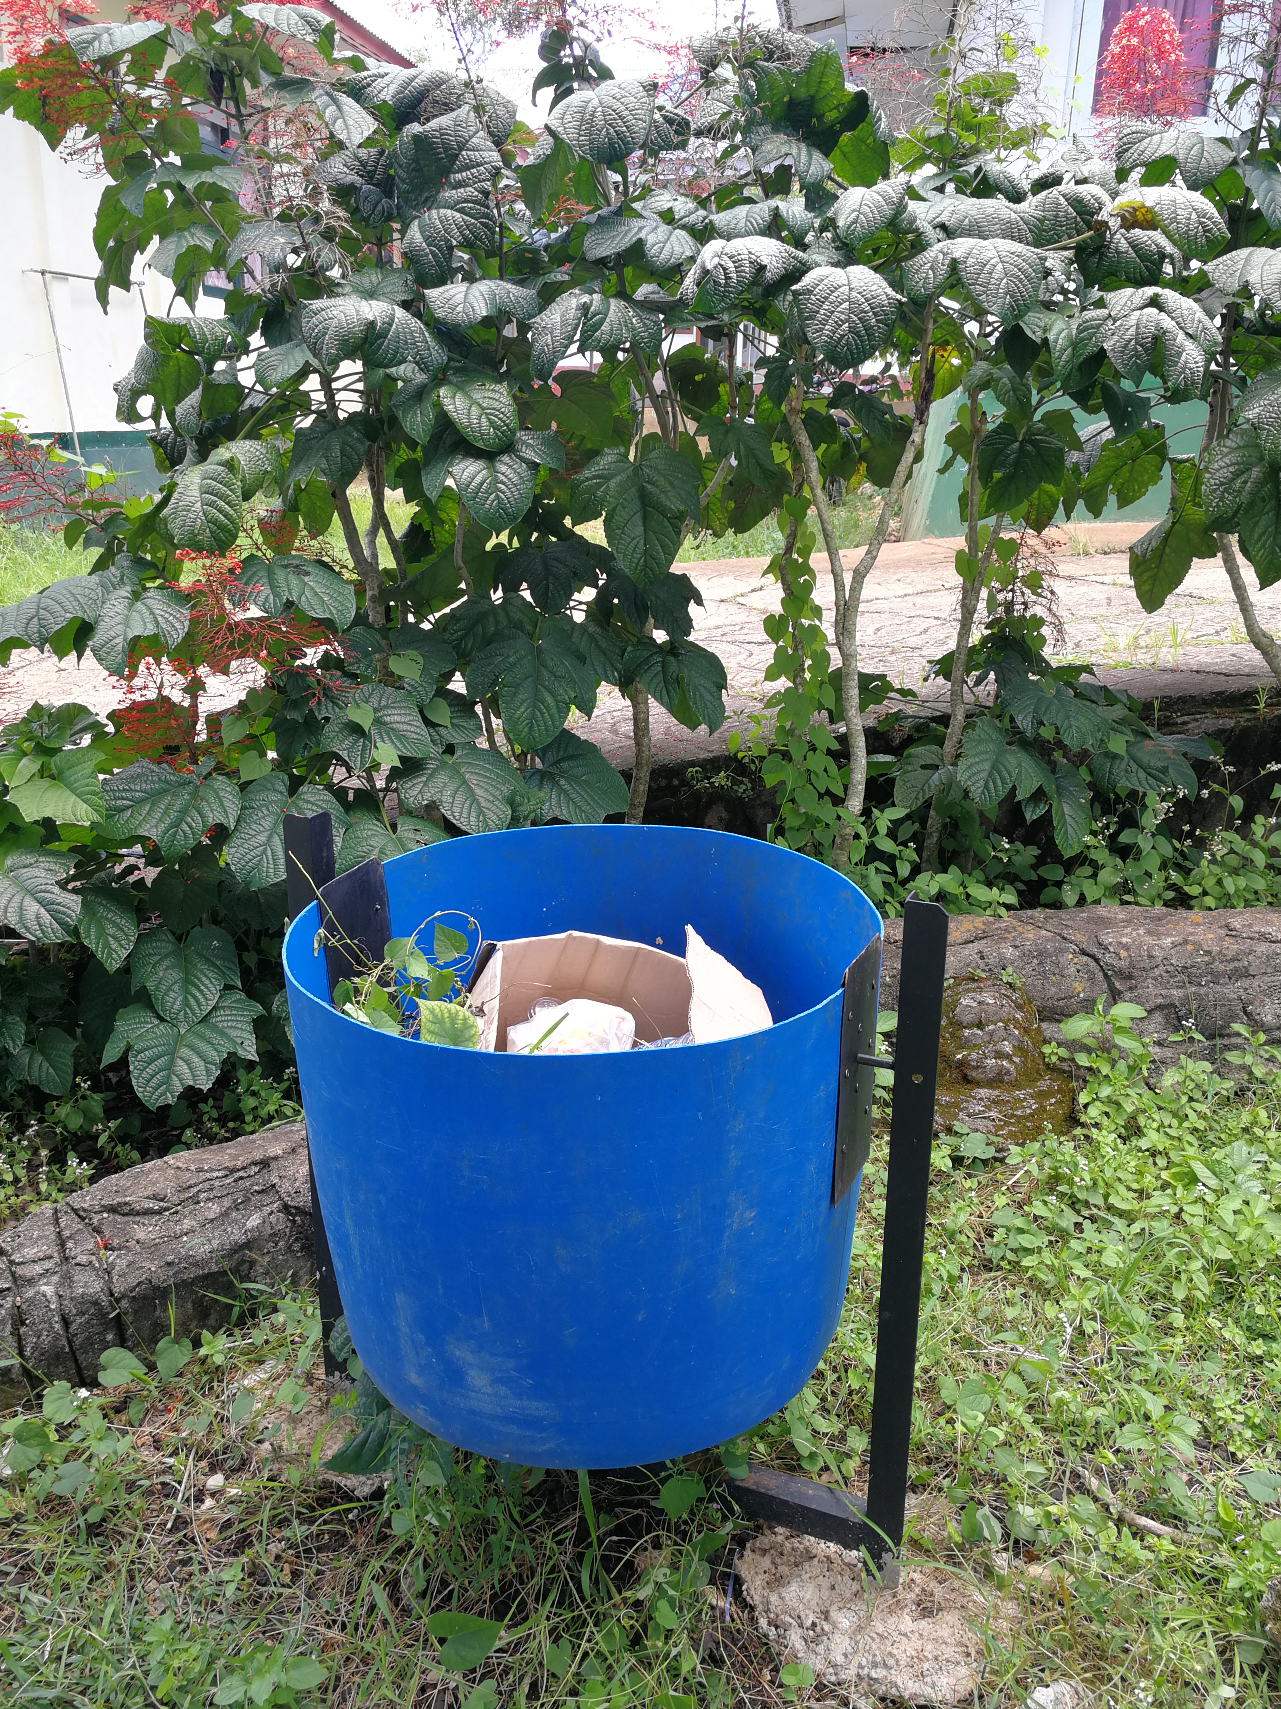
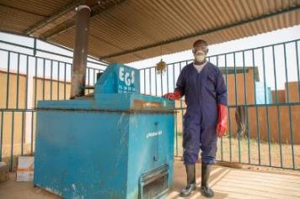
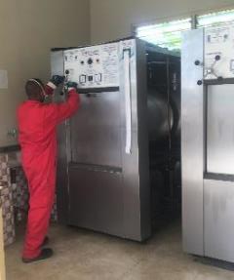
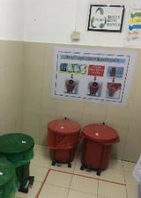
Making incremental improvements
Immediate improvements, minimal cost
40
Long term, most expensive
Medium term
Credit: WHO/Arabella Hayter
Credit: WHO/Arabella Hayter
Credit: WHO/Arabella Hayter
Notes:
Audio: We will cover this example in more detail in the module on health care waste management but let’s take a quick look now.
An incremental approach is often needed to improve waste management: This structured strategy begins with quicker, low-cost actions, progresses to medium-term infrastructural changes, and longer term systems improvements culminating in a sustainable waste management system. Emphasizing training and reminders enhances daily practices, while infrastructure enhancements ensure a robust and future-proof system.

Slide 9
Making incremental improvements
Immediate improvements, minimal cost
40
Long term, most expensive
Medium term
Credit: WHO/Arabella Hayter
Credit: WHO/Arabella Hayter
Credit: WHO/Arabella Hayter
Training on waste segregation & rationale use of PPE.
Reminders at points of care.
Waste minimization.
Regular cleaning of outside grounds and waste bins.
Notes:
Audio: Immediate steps involve training on waste segregation and personal protective equipment use, coupled with reminders at care points. Waste minimization and regular cleaning of outside grounds and waste bins are also important incremental improvements.

Slide 10
Making incremental improvements
Immediate improvements, minimal cost
Long term, most expensive
Medium term
Credit: WHO/Arabella Hayter
Credit: WHO/Arabella Hayter
Credit: WHO/Arabella Hayter
Build lockable, covered storage areas.
Build low-cost incinerator as interim solution.
Notes:
Audio: Medium-term plans include constructing covered waste storage areas and building low-cost incinerators.

Slide 11
Making incremental improvements
Immediate improvements, minimal cost
Long term, most expensive
Medium term
Credit: WHO/Arabella Hayter
Credit: WHO/Arabella Hayter
Credit: WHO/Arabella Hayter
Reverse logistics system.
Waste is regularly & safely transported to centralized plan with non-burn technology.
Solar power.
Notes:
Audio: Long-term goals entail establishing a reverse logistics system for safe waste transport to a centralized facility with non-burn technology, ideally using renewable energy such as solar power.

Slide 12
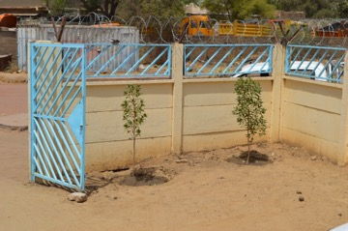
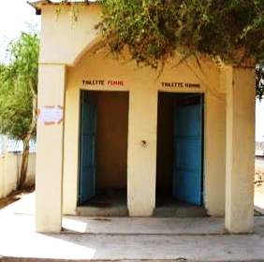
Improvements in a low-resource setting
Chad
Planting greenery by entrance for aesthetics.
Clear signs demonstrating gender separation of latrines.
Hand washing poster drawn by head of facility.
Credit: WHO/Arabella Hayter
Notes:
Audio: In a rural primary healthcare facility in Chad, where resources are scarce, small-scale improvements were prioritized. These practical, low-cost actions included planting greenery near the entrance for aesthetics, erecting clear signage for gender-segregated latrines to enhance privacy and sensitivity, and displaying hand drawn handwashing posters to promote hygiene practices. Even in resource-constrained settings, meaningful improvements are achievable by focusing on small changes that enhance the healthcare environment and prioritize health and safety.​

Slide 13
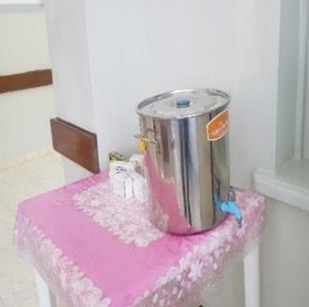
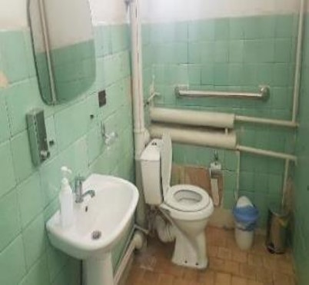
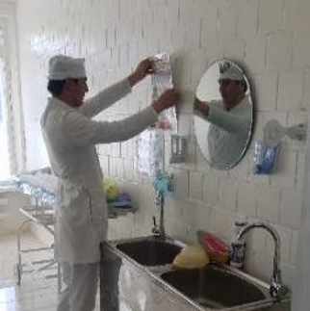
Improvements in a lower-middle income setting
Tajikistan
Water tanks with lid and tap accessible for patients.
Sanitation facility adapted for patients with physical impairment.
Hand washing posters.
Credit: WHO
Notes:
Audio: These photos are taken in a rural primary healthcare facility in Tajikistan where resources are also limited. Here, the facility opted for manageable improvements achievable without external assistance and with only minimal funds. They installed water tanks with lids and taps for easy patient access to clean water, adapted sanitation facilities to accommodate patients with physical impairments, and displayed handwashing posters to promote better hygiene practices.

Slide 14
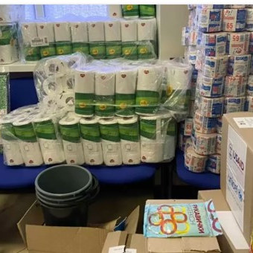
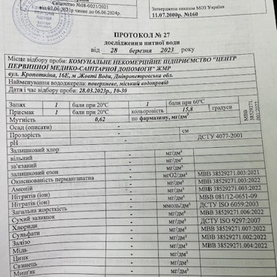
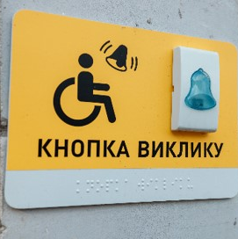
Improvements in a middle income setting
Ukraine
Credits: WHO/Maggie Montgomery
Notes:
Audio: This last example comes from Ukraine where WASH FIT has been implemented in nearly 100 facilities, including hospitals and primary care.
This work is supported by the Ministry of Health, Regional Centres for Disease Control, WHO and UNICEF.
WASH FIT catalyzed facilities to make positive changes, resulting in all facilities improving upon their baseline score. A combination of in-person training with on-site and virtual support allowed for regular engagement with facility staff. Improvements included providing hygiene supplies such as detergent, disinfectant and paper towels; reviewing water quality data from water suppliers, installing water meters, replacing broken taps, and installing boreholes to serve as a backup water supply; and improving access to toilets for all users. In addition, ineffective waste chlorination practices were replaced with safe segregation and treatment. These small, more easily addressed improvements catalyzed larger ones.

Slide 15
Improvements in a middle income setting
Ukraine
Hygiene supplies
Water supply and quality
Sanitation and waste segregation
Credits: WHO/Maggie Montgomery
Notes:
Audio: This last example comes from Ukraine where WASH FIT has been implemented in nearly 100 facilities, including hospitals and primary care.
This work is supported by the Ministry of Health, Regional Centres for Disease Control, WHO and UNICEF.
WASH FIT catalyzed facilities to make positive changes, resulting in all facilities improving upon their baseline score. A combination of in-person training with on-site and virtual support allowed for regular engagement with facility staff. Improvements included providing hygiene supplies such as detergent, disinfectant and paper towels; reviewing water quality data from water suppliers, installing water meters, replacing broken taps, and installing boreholes to serve as a backup water supply; and improving access to toilets for all users. In addition, ineffective waste chlorination practices were replaced with safe segregation and treatment. These small, more easily addressed improvements catalyzed larger ones.

Slide 16
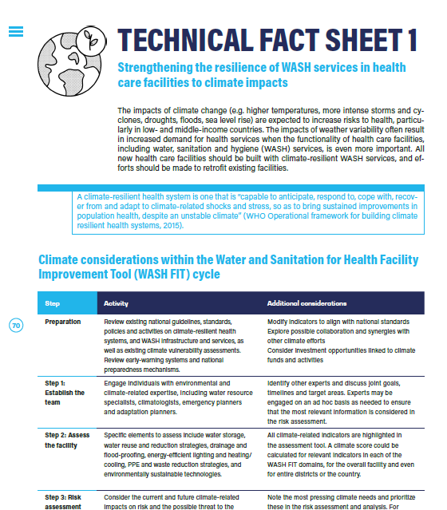
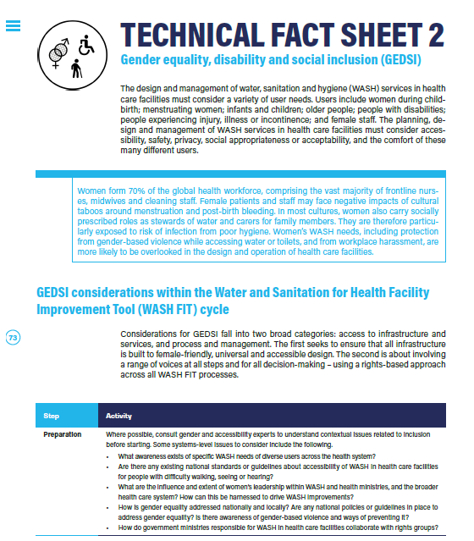
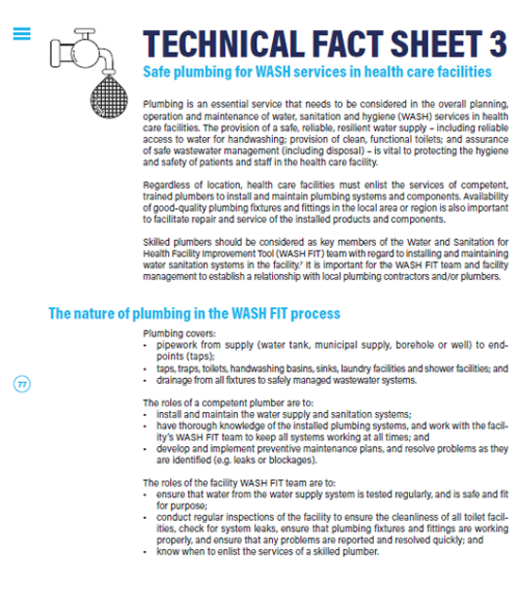
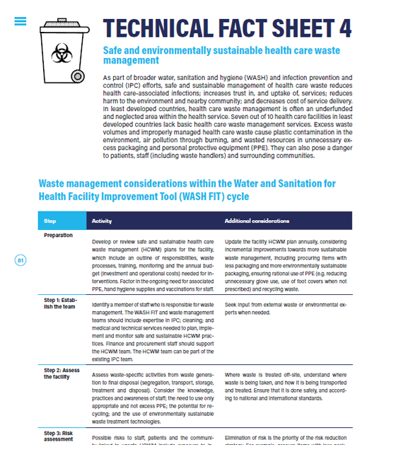
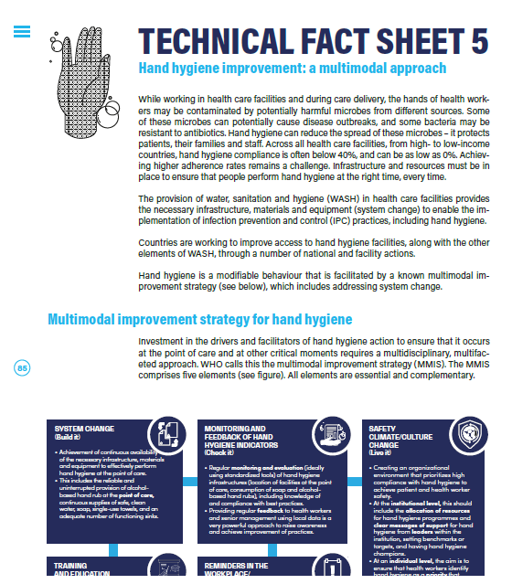
Technical fact sheets provide example actions and improvements
Climate resilience
Gender equality, disability and social inclusion (GEDSI)
Safe plumbing
Health care waste
Hand hygiene
Notes:
Audio: Technical factsheets are available to support facilities seeking to address specific areas. These factsheets provide practical interventions for enhancing climate resilience, promoting gender equality, ensuring disability and social inclusion, maintaining safe plumbing systems, managing healthcare waste, and promoting effective hand hygiene practices.
Each factsheet offers comprehensive guidance on how to adapt improvement strategies to the facility's unique circumstances, empowering healthcare professionals to make informed decisions and implement sustainable solutions. This module's resource section has links to these technical fact sheets.

Slide 17
Key points
Identify necessary improvements for each facility issue.
Prioritize quick wins and cost-effective solutions.
Categorize improvements into short-term and long-term actions.
Implement improvements urgently for better facility standards.
Ensure alignment with GEDSI principles and climate resilience.
Credit: WHO/Aphaluck Bhatiasevi
Credit: WHO/Neil Nuia
Notes:
Audio: Thank you for completing this module. Key takeaways include:​
Identifying necessary improvements for each facility issue.​
Prioritizing quick wins and cost-effective solutions.​
Categorizing improvements into short-term and long-term actions.​
Implementing improvements urgently to enhance facility standards.​
Ensuring that actions align with GEDSI principles and climate resilience.​
Please consult the references mentioned in this module for further information.​

