Slide 1
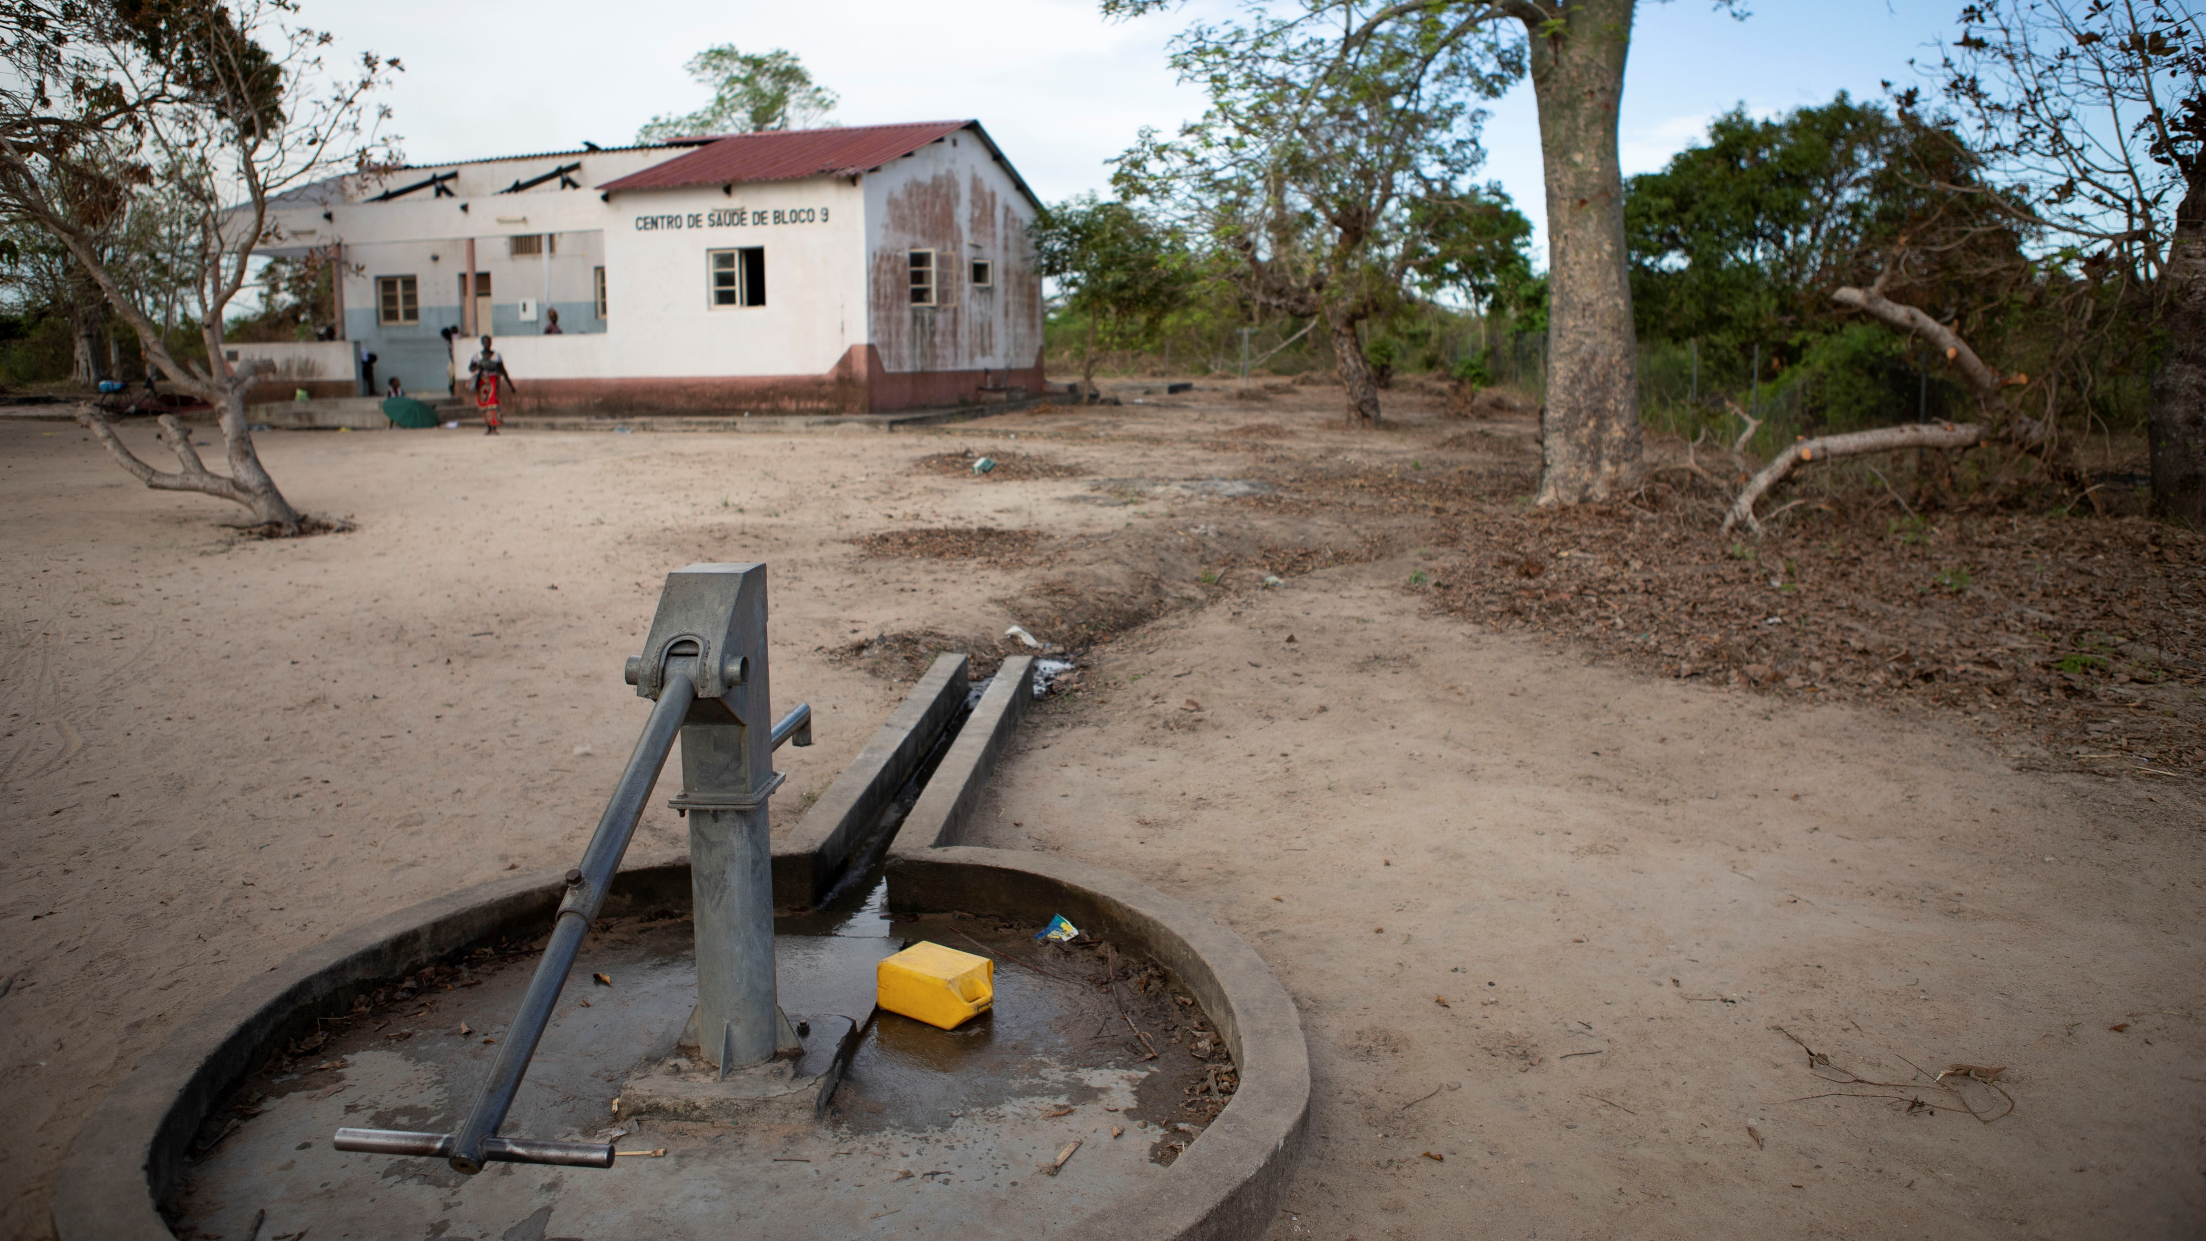
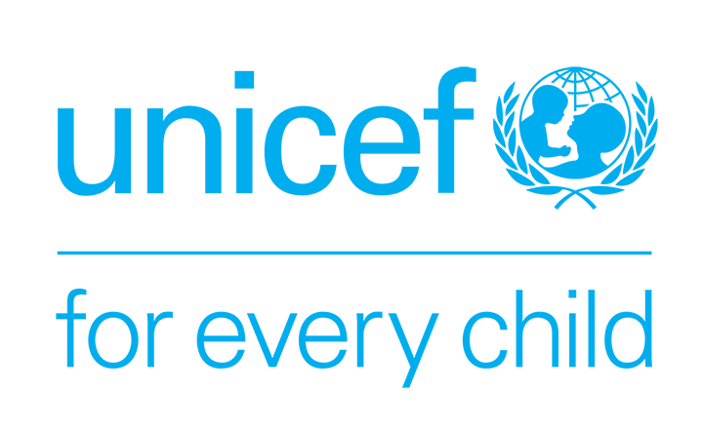
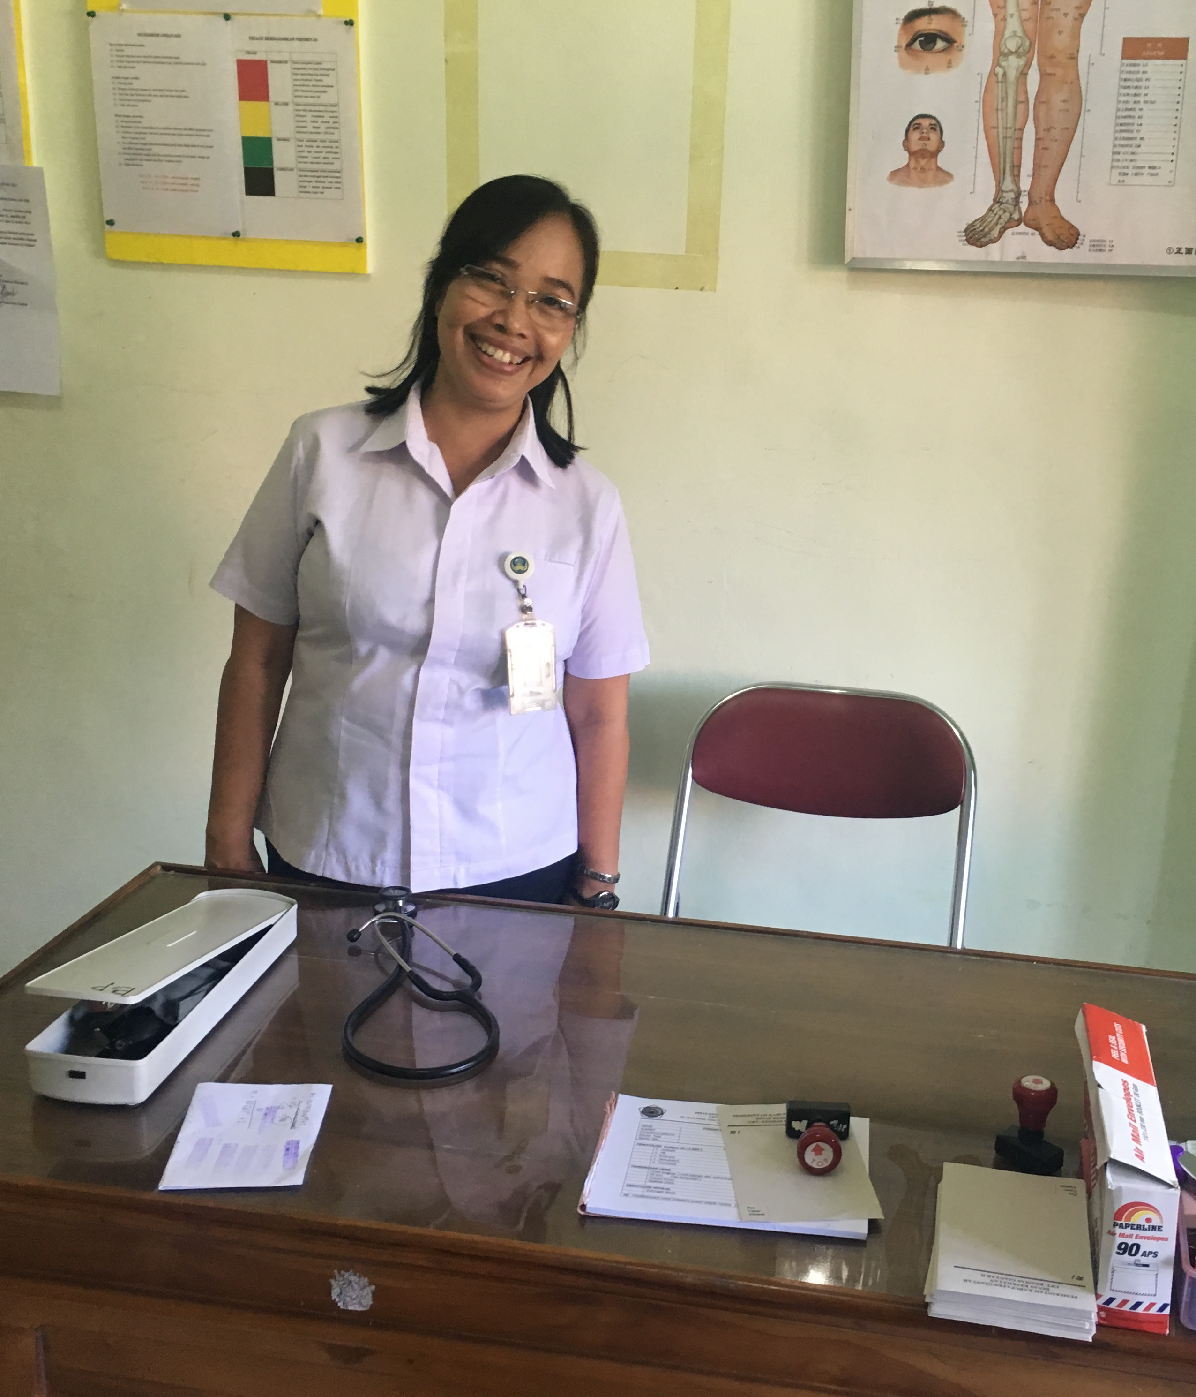
Module 7
Managing safe water supplies in health care facilities
Credit: WHO/Arabella Hayter
Credit: WHO/Mark Nieuwenhof
Notes:
Welcome back. This is Arabella Hayter again. Following the journey through the WASH FIT Improvement Process in the previous modules, we will now move on to a series of technical modules designed to deepen your expertise and practical skills in specific areas critical to health care facility management and quality improvement. These modules cover water, sanitation, hand hygiene, environmental cleaning, waste management and gender equality, disability, social inclusion (referred to as GEDSI). Climate considerations have been integrated throughout. ​

Slide 2
Learning objectives
By the end of this module, you will:
Understand the effects of an inadequate water supply.
Describe minimum requirements for a water supply (quality and quantity).
Learn how to apply a risk-based approach to managing water quality.
Look at water safety planning.
Review common plumbing issues and solutions.
Explore the impact of climate change on water supply and some adaptive measures.
Notes:
In this module, we will learn about requirements for safe water, which is crucial for the safe functioning of a health care facility. We will look at the effects of an inadequate water supply, and describe minimum requirements for a water supply, including quality and quantity. We will look at how to apply a risk-based approach to managing water quality and briefly touch on water safety planning.
We will also look at plumbing issues and solutions for a better functioning facility and explore the impact of climate change on water supply and some adaptive measures. Let's begin.​

Slide 3
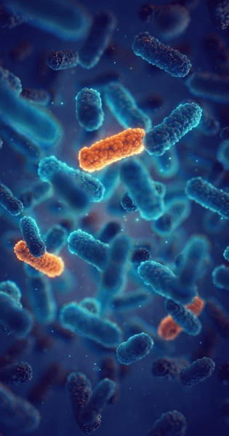
Effects of an inadequate water supply
Staff & patient dehydration
No/insufficient drinking water
Inability to take medications
Diarrhoea
Contaminated water
Waterborne disease outbreaks (e.g., Cholera)
Insufficient water for hand hygiene
Spread of infections; inability to control outbreaks; risks to patient and staff safety
Spread of fecal contamination, antimicrobial resistant infections
Insufficient water for cleaning, showers, toilets
Visually dirty, smells, decrease in care seeking and trust in health care, decrease in staff satisfaction and motivation
Credit: Shutterstock
Notes:
Insufficient drinking water poses health risks such as dehydration and limits patients’ ability to take medications. Contaminated water can lead to diarrhoea and waterborne disease outbreaks like cholera. Insufficient water for hand hygiene leads to the spread of infections, making it difficult to contain outbreaks and risking patient and staff safety. Water is also needed for cleaning, showers and toilets, without which there is a risk of spread of fecal contamination and antimicrobial resistant infections. Beyond the risk of infection, this also leads to an unsanitary environment which may be visibly dirty, decreasing care seeking and staff satisfaction and motivation. Water should be a top priority within all quality improvement, infection prevention and control and of course, WASH FIT efforts.

Slide 4
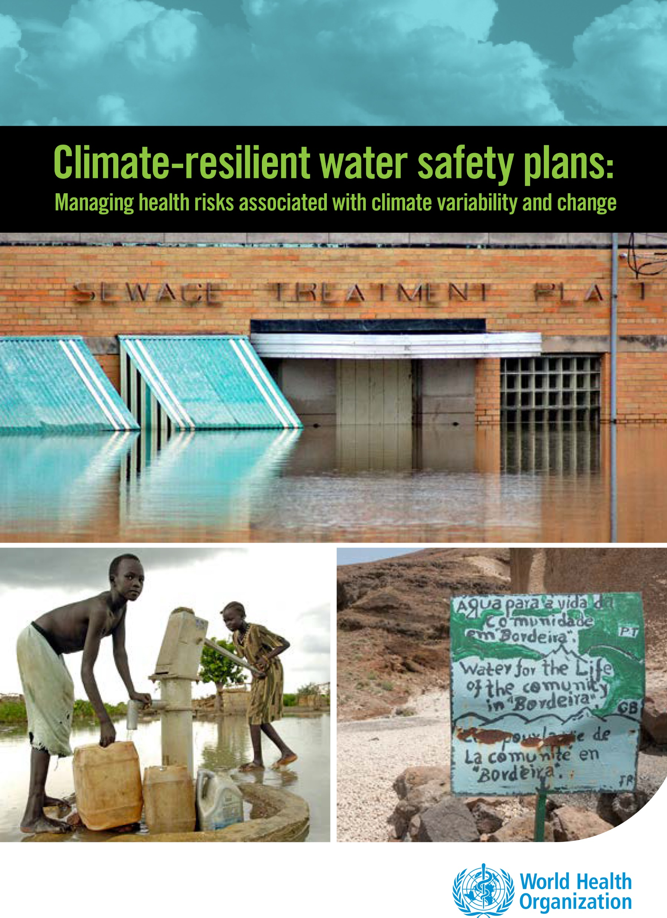
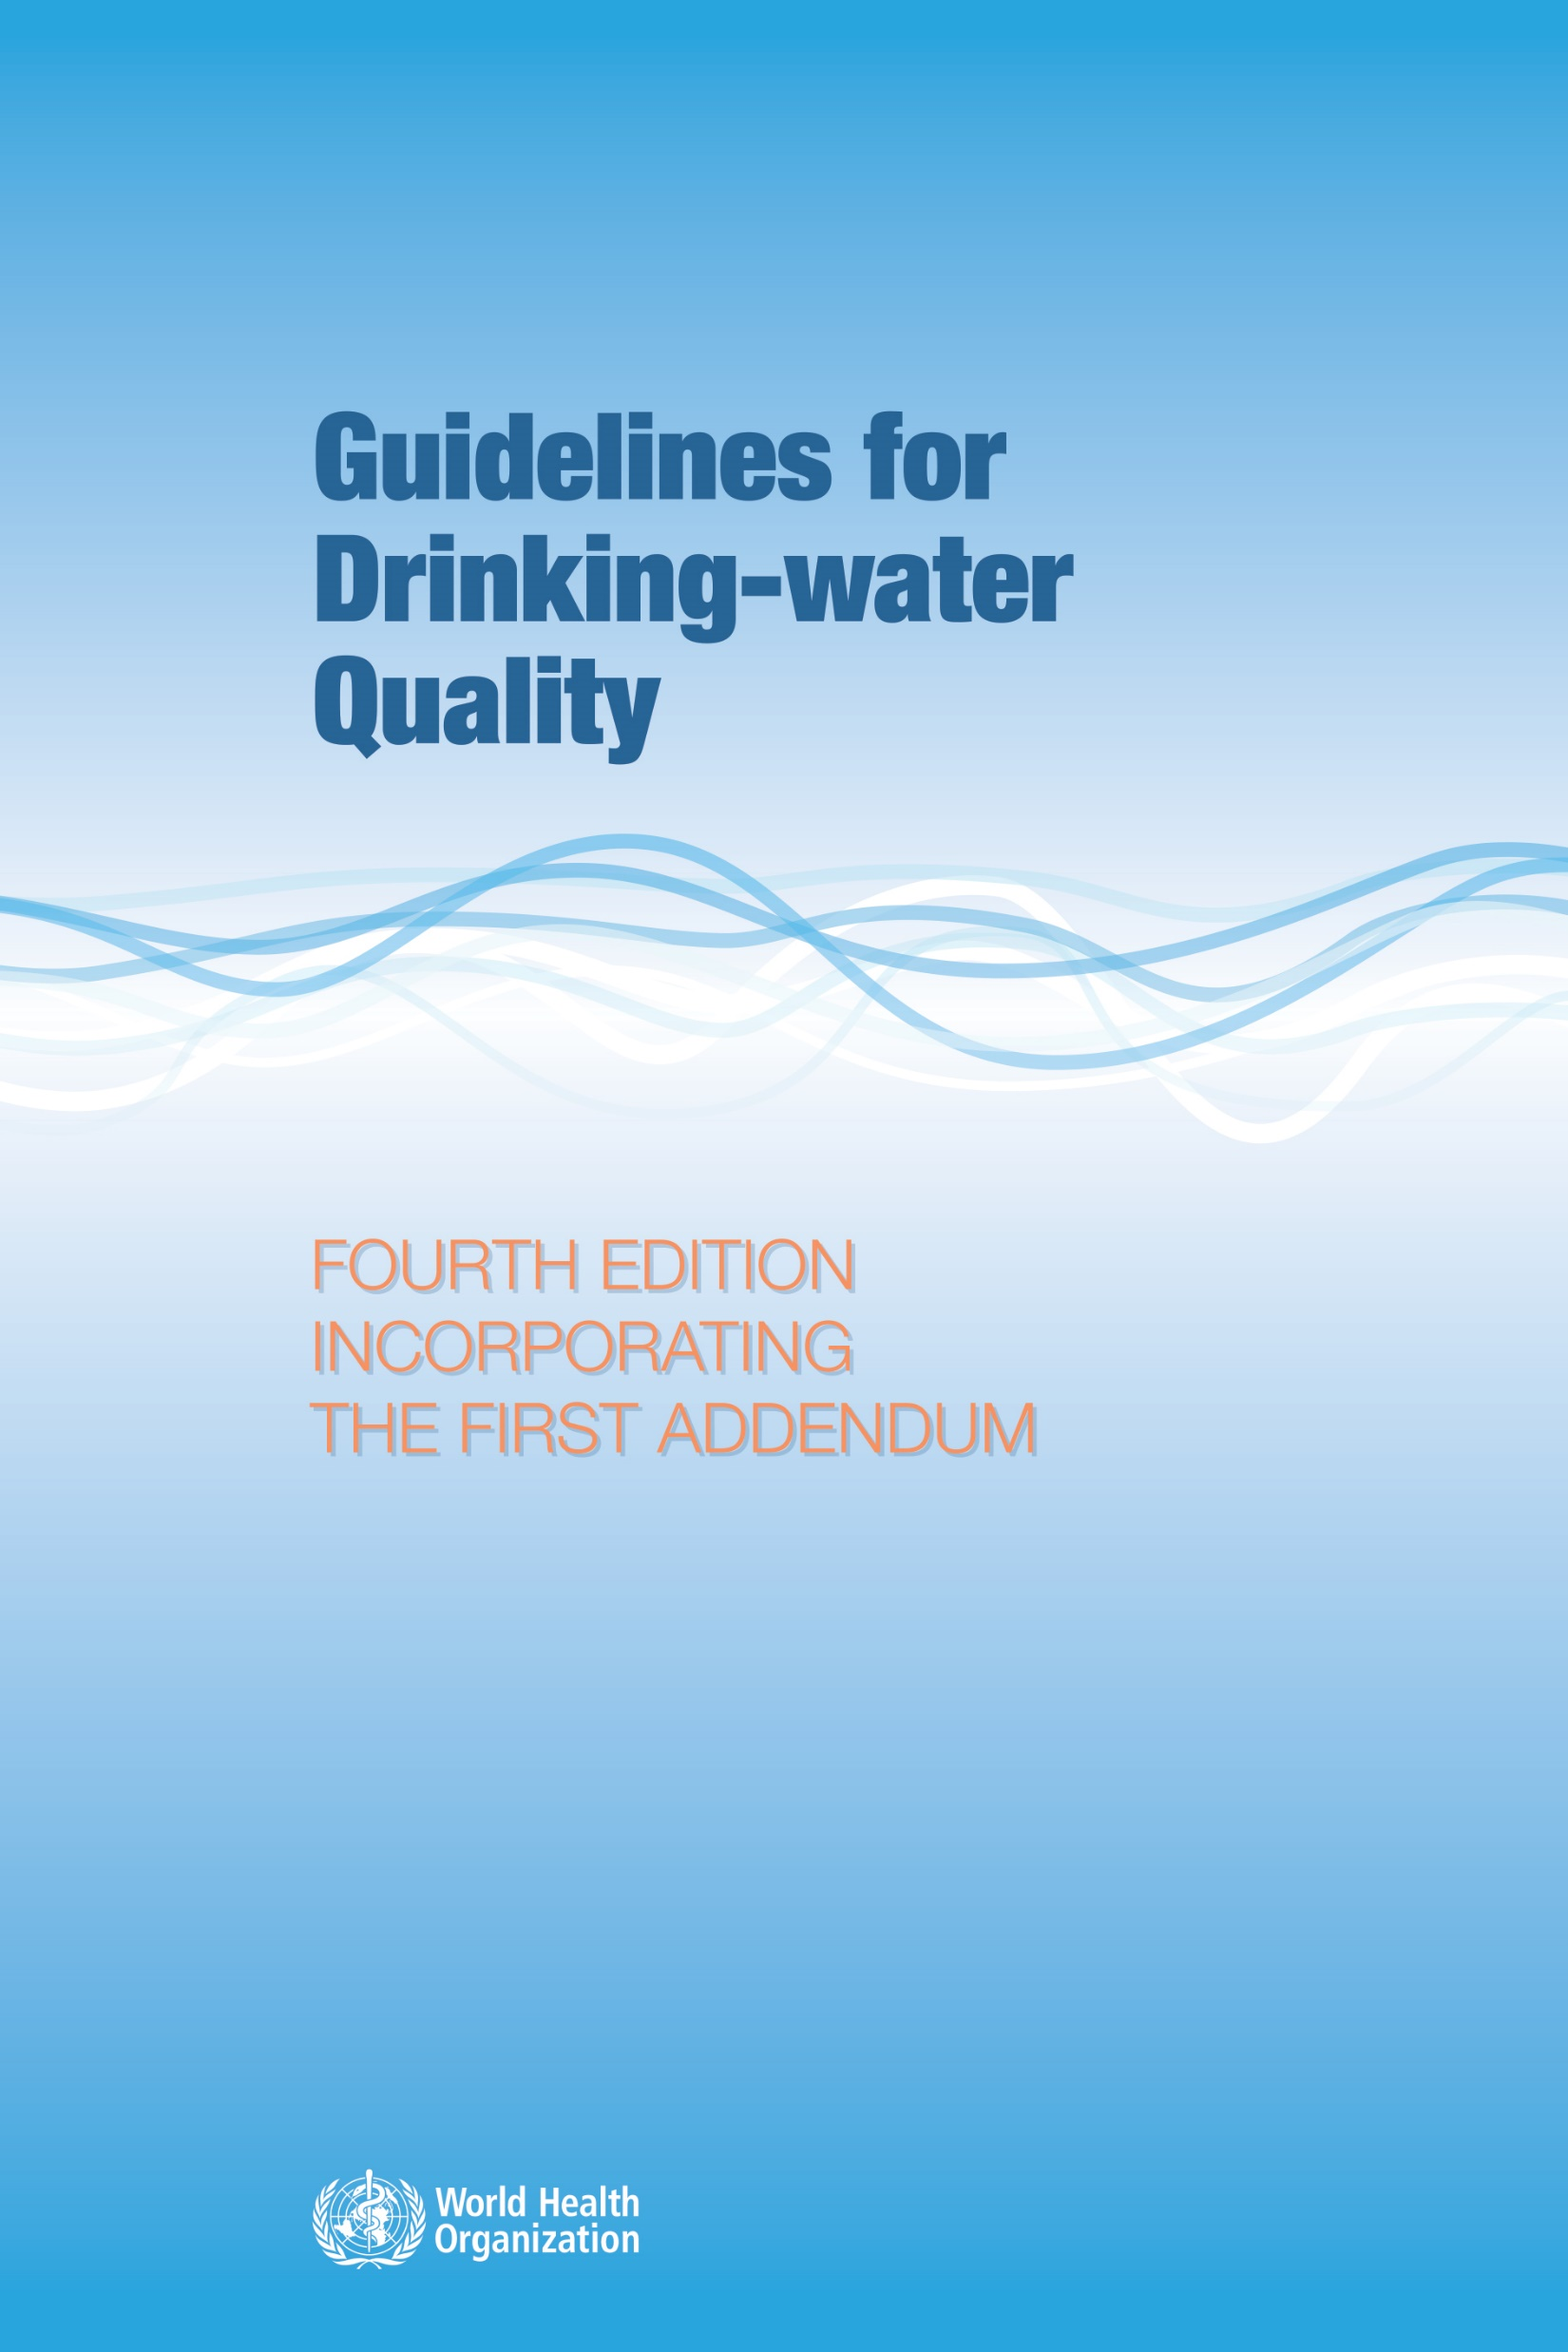
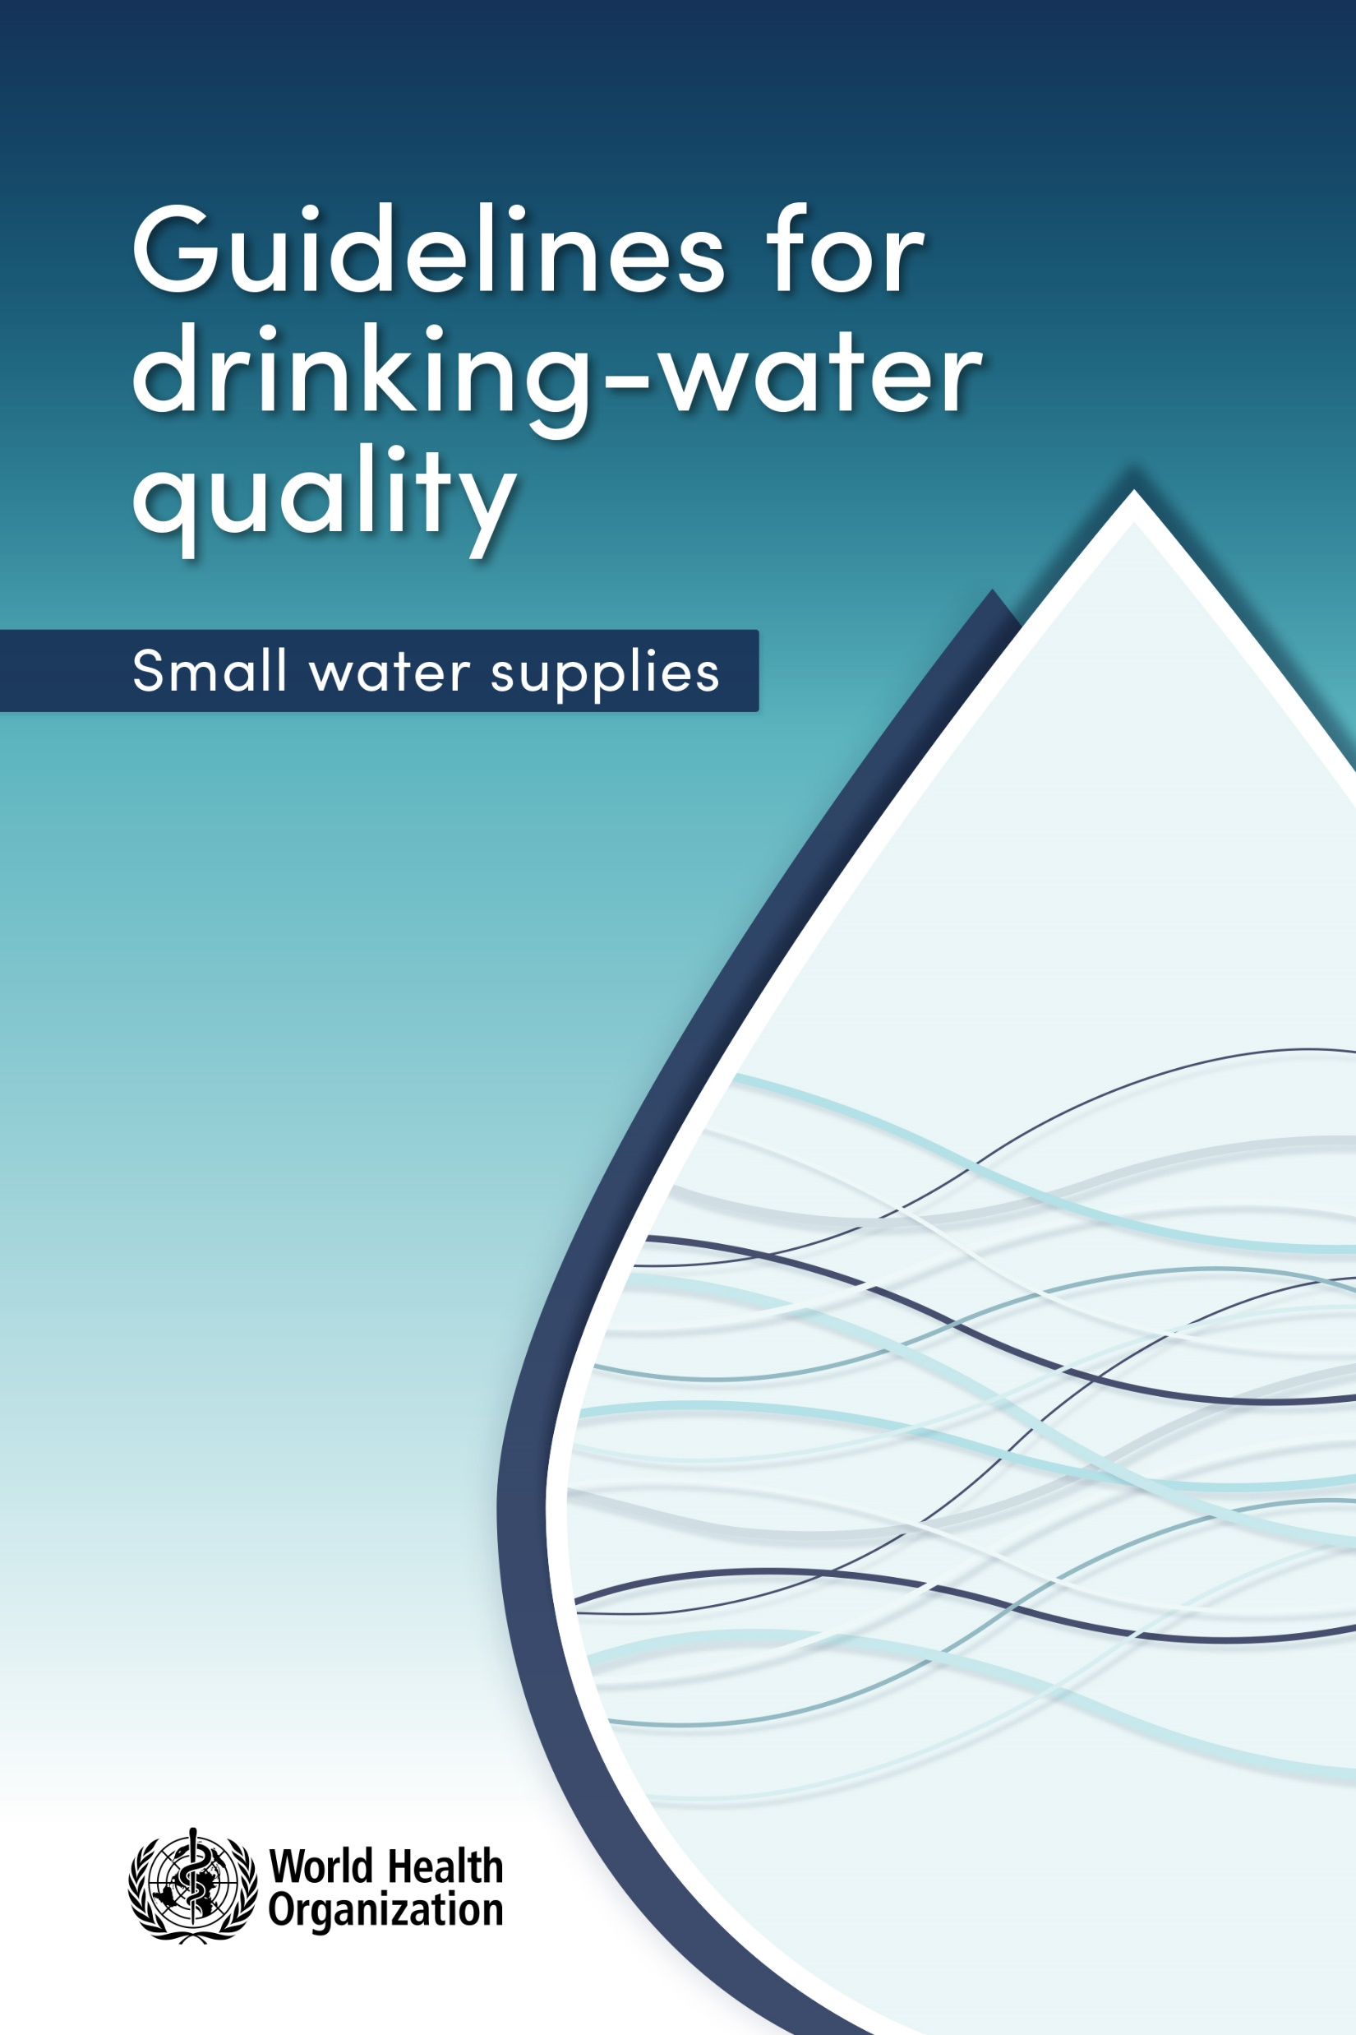
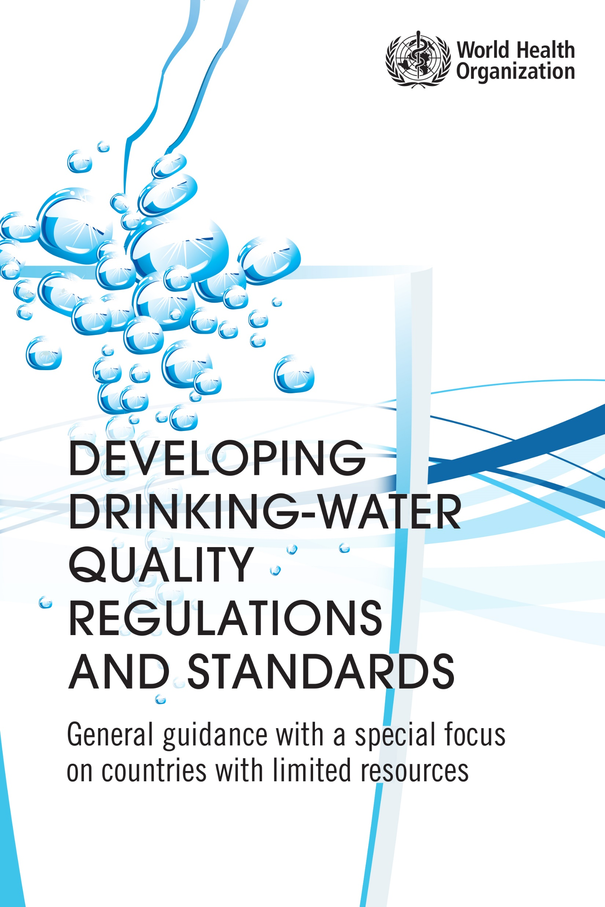
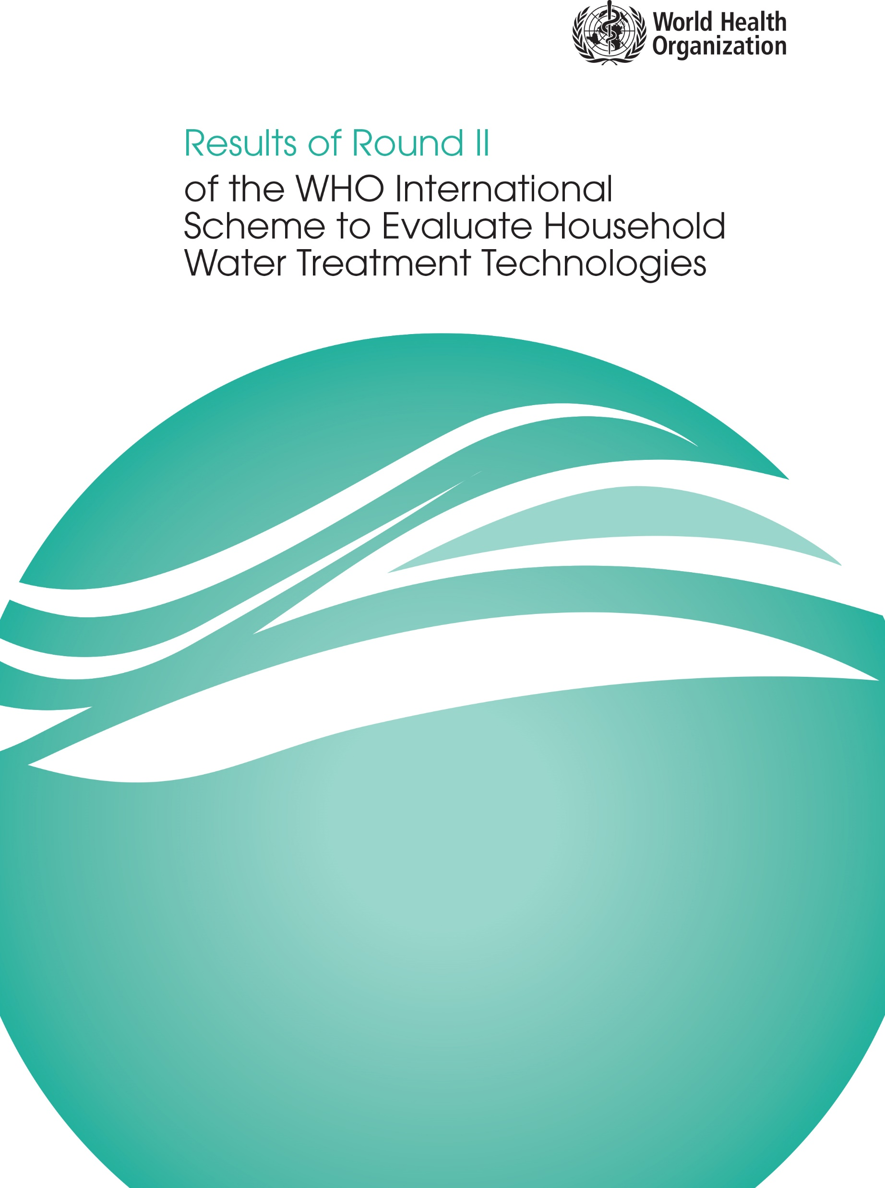
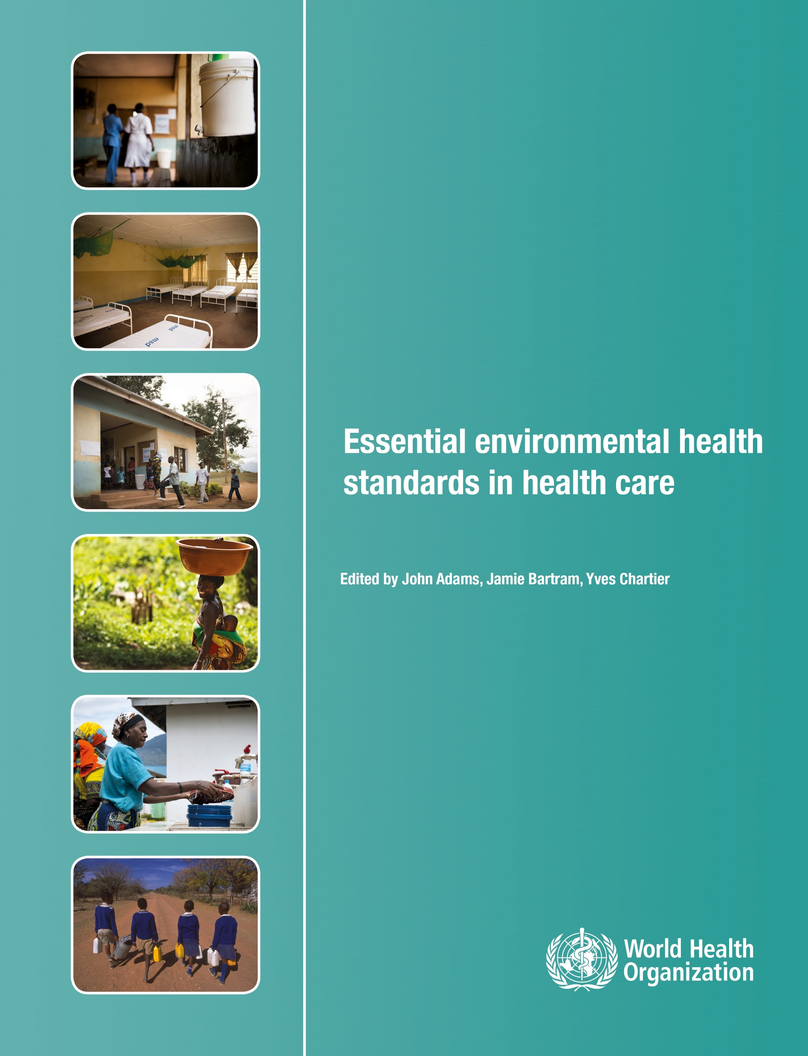
Applying a risk-based approach to water quality: WHO guidance
Water safety plan manual
Water safety planning and climate resilience
Guideline
Regulations
Water treatment performance
Health care facilities
Risk-based approach principles
1
2
Risk assessment and risk management
3
Health-based targets
Surveillance
Notes:
Since 1956, WHO’s Drinking-water Quality Guidelines have been crucial in tackling health risks from unsafe water, providing a risk-based approach to address microbiological and chemical hazards. In lower-income areas, the focus is on combatting microbiological contaminants, such as fecal matter, which pose significant health risks.
These guidelines are supported by additional resources like climate-resilient water safety plans and regulatory frameworks; you will find links to them in the resources section.
Water safety planning, through preventive measures, maintenance, and monitoring, ensures water safety in healthcare settings. It is the most effective means of consistently ensuring the safety of a drinking-water supply, and it is the methodology on which WASH FIT is based.
We will now look at Water Safety planning in more detail.

Slide 5
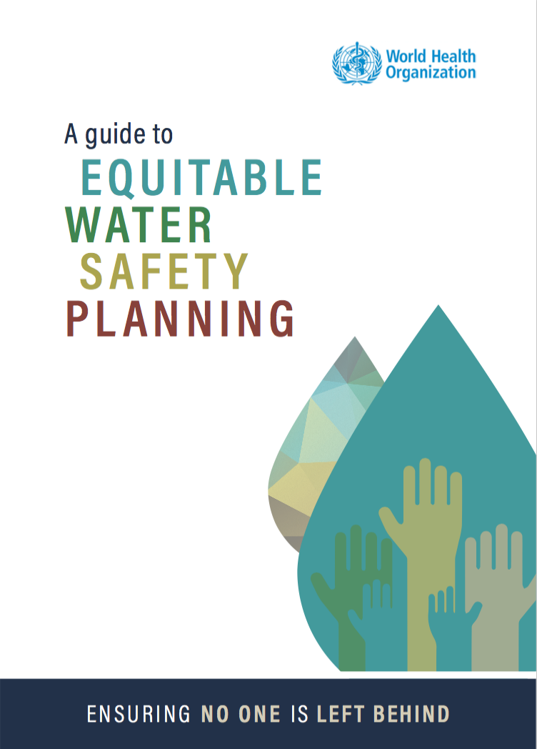
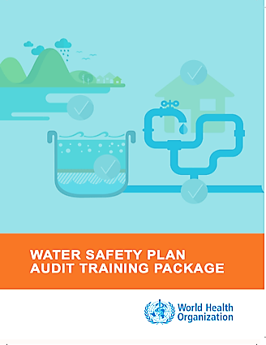
What is a Water Safety Plan?
WATER SAFETY PLAN (WSP)
MANAGE WATER QUALITY RISKS HERE…
A comprehensive risk assessment and risk management approach that includes all steps in the water supply from catchment to consumer.
…TO PROVIDE SAFE WATER HERE
Notes:
A Water Safety Plan, or WSP, is a comprehensive risk assessment and risk management approach that includes all steps in the water supply from catchment to consumer. WASH FIT incorporates parts of the WSP methodology, such as Sanitary Inspection Forms, however WASH FIT does not cover aspects like surveillance or regulatory compliance deeply.
Countries and communities already implementing WSPs are encouraged to expand these efforts to health care facilities.
This means, in practice, that the water domain within the WASH FIT assessment will incorporate more detailed indicators for additional elements of water safety planning, including: describing the entire water supply system; monitoring control measures through operational monitoring plans, monitoring water quality for compliance with regulatory requirements and engaging with the appropriate authorities on water quality surveillance. Facilities seeking to enhance water safety can consult local WSP experts for support. For further information and resources on WSPs, please look at the WHO website and the course's resource section. There is also an OpenWHO course on WSPs you may wish to take.

Slide 6
What is a Water Safety Plan?
WATER SAFETY PLAN (WSP)
MANAGE WATER QUALITY RISKS HERE…
A comprehensive risk assessment and risk management approach that includes all steps in the water supply from catchment to consumer.
Entire water supply system
Operational monitoring plan
Water quality compliance
Engagement with authorities
…TO PROVIDE SAFE WATER HERE
Notes:
A Water Safety Plan, or WSP, is a comprehensive risk assessment and risk management approach that includes all steps in the water supply from catchment to consumer. WASH FIT incorporates parts of the WSP methodology, such as Sanitary Inspection Forms, however WASH FIT does not cover aspects like surveillance or regulatory compliance deeply.
Countries and communities already implementing WSPs are encouraged to expand these efforts to health care facilities.
This means, in practice, that the water domain within the WASH FIT assessment will incorporate more detailed indicators for additional elements of water safety planning, including: describing the entire water supply system; monitoring control measures through operational monitoring plans, monitoring water quality for compliance with regulatory requirements and engaging with the appropriate authorities on water quality surveillance. Facilities seeking to enhance water safety can consult local WSP experts for support. For further information and resources on WSPs, please look at the WHO website and the course's resource section. There is also an OpenWHO course on WSPs you may wish to take.

Slide 7
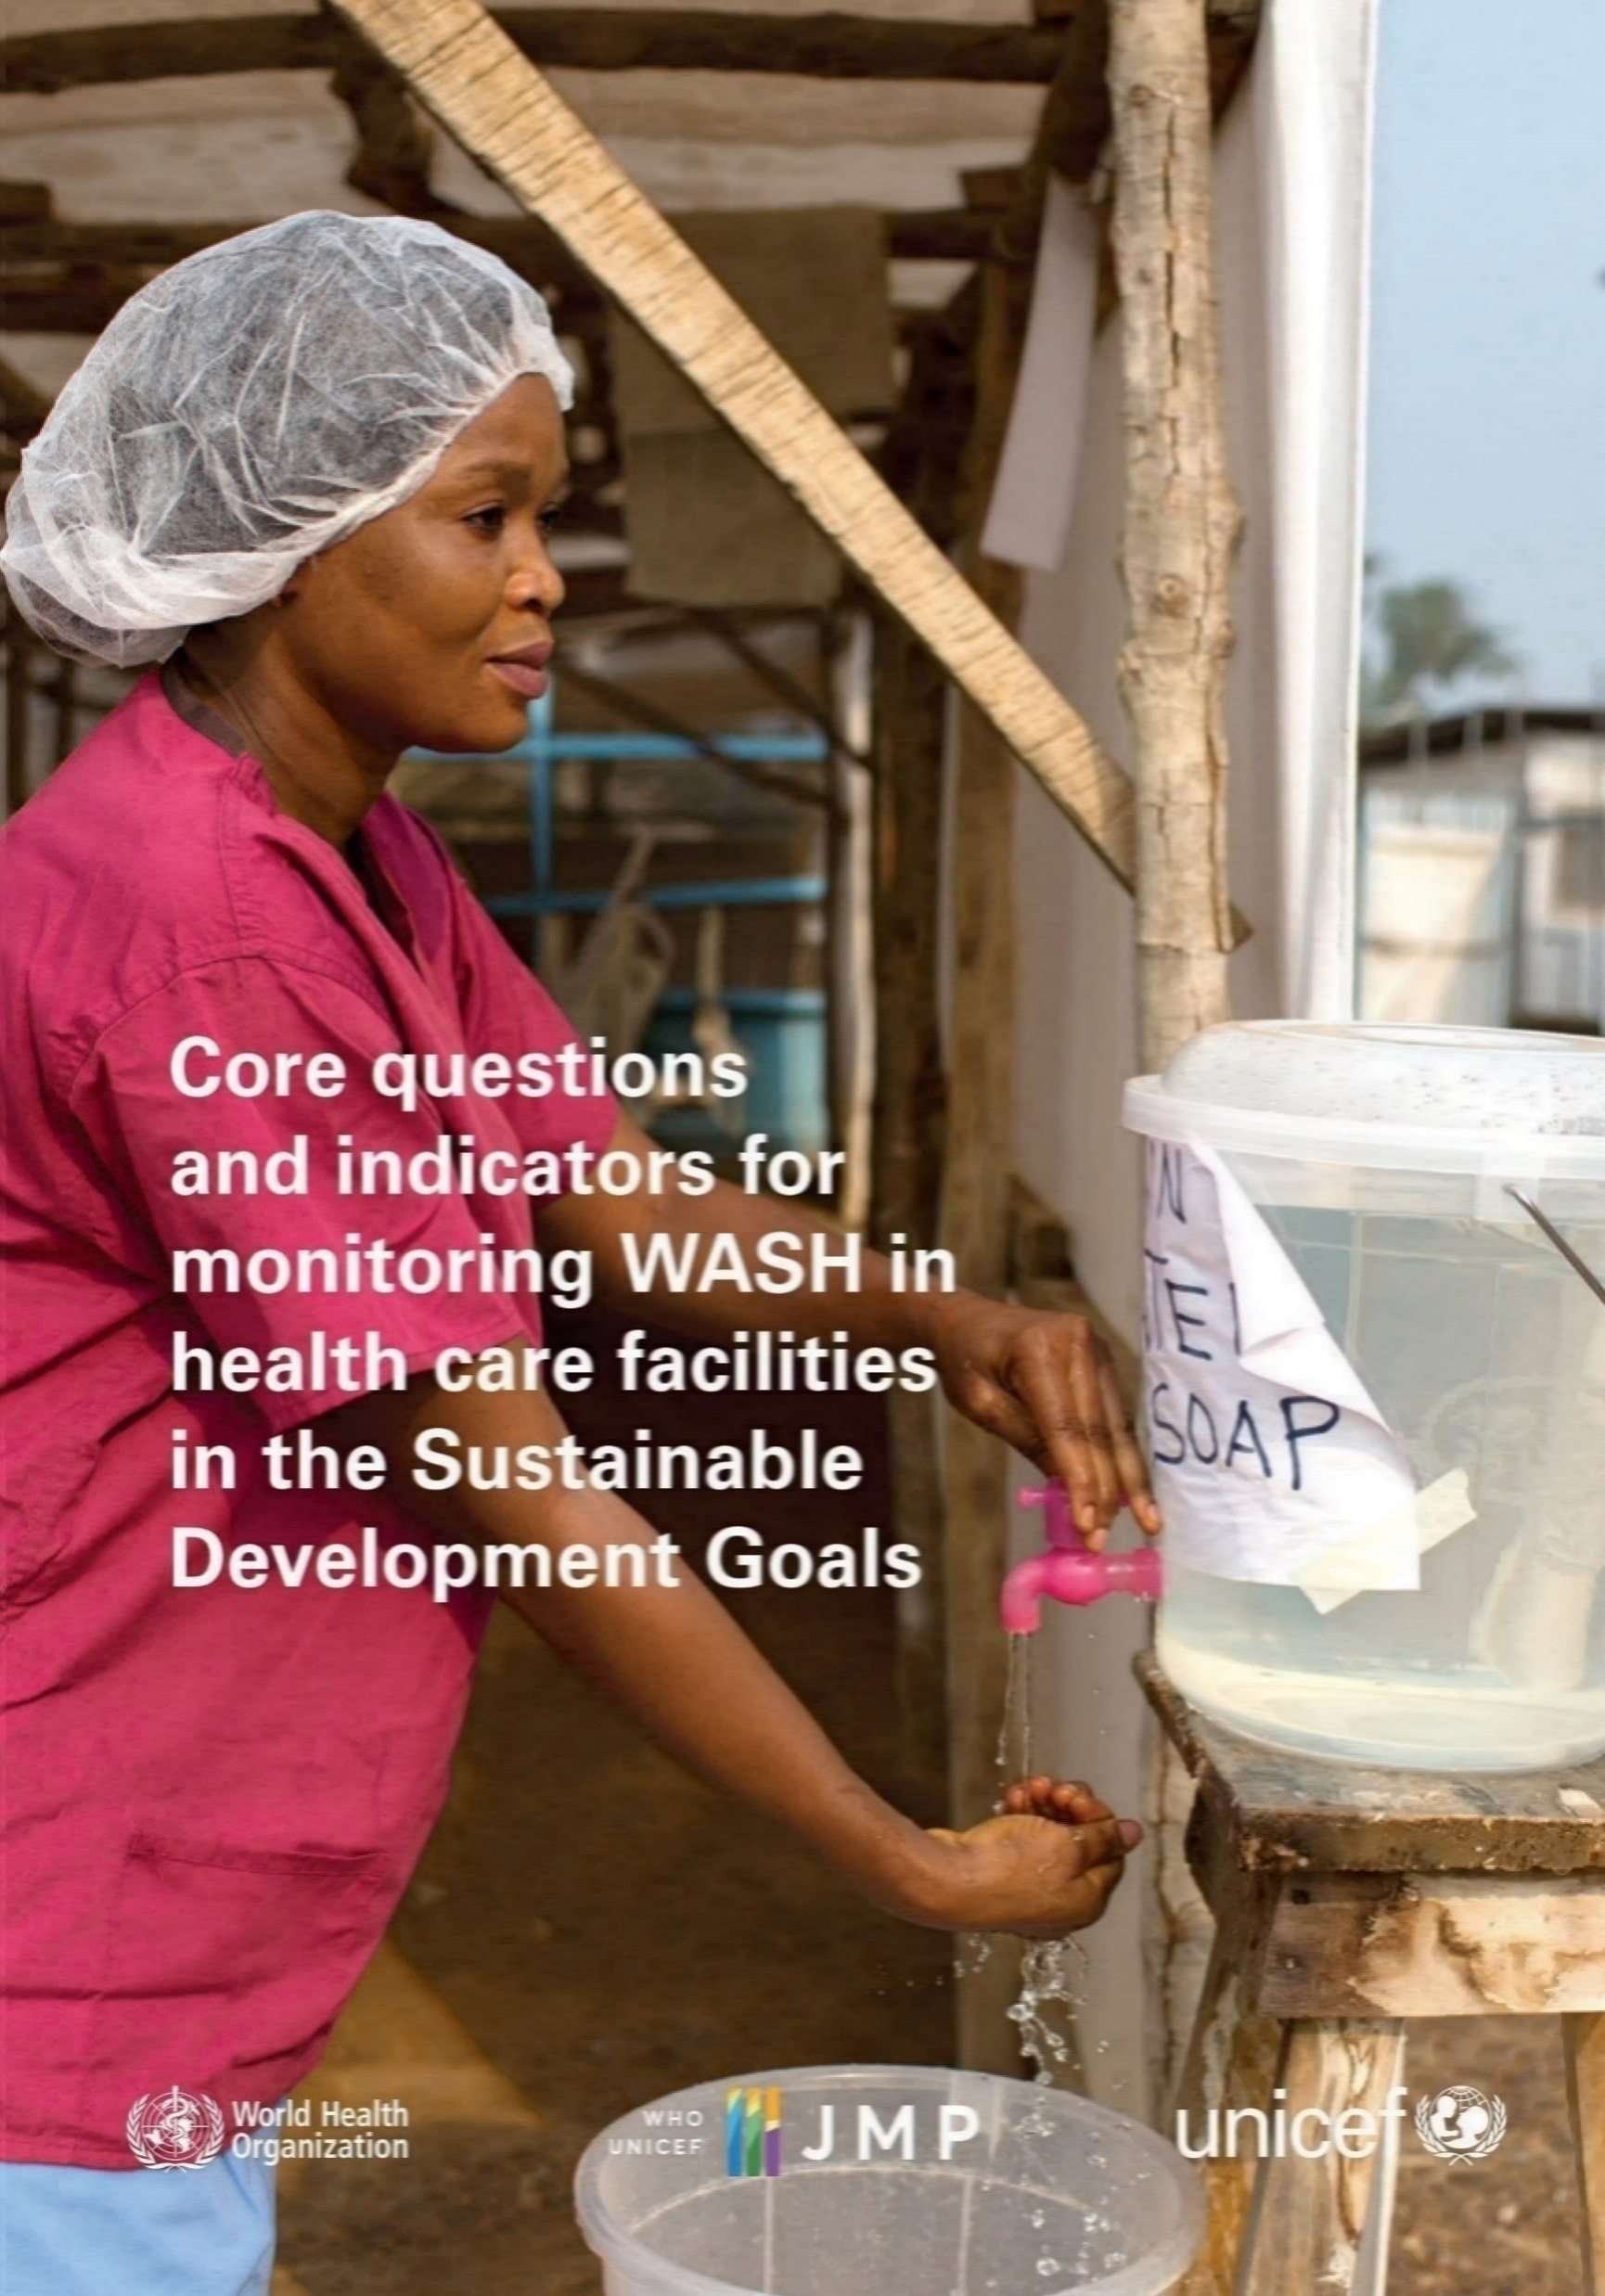
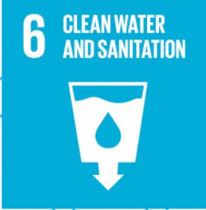
Minimum water requirements and quantities for health are facilities
For global monitoring, WHO/UNICEF have defined basic questions and indicators for monitoring water, sanitation, hygiene, waste and cleaning in health care.
SDG 6 calls for safely managed water and sanitation for all people, in all settings including in health care facilities. Read more about UN coordinated efforts on SDG 6 at UN Water (https://www.unwater.org/).
Water must be on-site from an improved source and available at all points of care.
Water should be safely treated and reliable.
Water must be of sufficient quantity to meet the facility’s needs for 2 days.
Notes:
Now let’s take a look at some other requirements for a facility’s water supply. Water requirements in healthcare settings vary based on the level of care provided. Regardless of the type of facility, water should meet WHO minimum standards on quantity and quality. For secondary and tertiary facilities, water may need to meet even higher standards, especially if there are intensive care units or highly infectious disease services provided.
Minimum requirements state that water must be on-site, from an improved source and available at all points of care. It must be safely treated and reliable and of sufficient quantity to meet the facility’s needed for 2 days. This covers a range of purposes such as drinking, bathing and environmental cleaning.

Slide 8
Minimum water requirements and quantities for health care facilities
Water should be available for
Outpatients | 5 litres/consultation
In patients | 40–60 litres/patient/day
Operating theatre / maternity | 100 litres/ intervention
Dry or supplementary feeding centre | 0.5–5 litres/ consultation
Wet supplementary feeding centre | 15 litres/ consultation
Inpatient therapeutic feeding centre | 30 litres/ patient/day
Cholera treatment centre | 60 litres/ patient/ day
Severe acute respiratory diseases isolation centre | 100 litres/ patient/ day
Viral haemorrahagic fever isolation centre | 300–400 litres/patient/ day
Drinking
Cleaning
Personal hygiene including hand washing, bathing and cleaning
Medical activities
Cooking
Laundry
Notes:
How do you calculate how much water a facility needs? The WHO 2008 Essential Environmental Health Standards in Health Care outline minimum water quantities and can help facilities to assess their unique water needs.
These cover the quantities required for drinking, cleaning, hand hygiene, and waste management. Specific medical applications like dialysis are not included.
Factors influencing water needs include a facility’s operational days, patient turnover, services offered, and fluctuations in demand affected by seasonal patterns, climate changes, disease outbreaks, or births. For example, an outpatient only requires 5 litres per consultation while treating an Ebola patient requires up to 400 litre of water per day and woman delivering will require 100 litres.
At least 48 hours’ worth of water storage is recommended. Facilities may need more storage during periods of scarcity, like in the dry season.

Slide 9
Minimum water requirements and quantities for health care facilities
Outpatients | 5 litres/consultation
In patients | 40–60 litres/patient/day
Operating theatre / maternity | 100 litres/ intervention
Dry or supplementary feeding centre | 0.5–5 litres/ consultation
Wet supplementary feeding centre | 15 litres/ consultation
Inpatient therapeutic feeding centre | 30 litres/ patient/day
Cholera treatment centre | 60 litres/ patient/ day
Severe acute respiratory diseases isolation centre | 100 litres/ patient/ day
Viral haemorrahagic fever isolation centre | 300–400 litres/patient/ day
“Sufficient” water –
Enough to meet the needs of facility for 48 hours
Notes:
How do you calculate how much water a facility needs? The WHO 2008 Essential Environmental Health Standards in Health Care outline minimum water quantities and can help facilities to assess their unique water needs.
These cover the quantities required for drinking, cleaning, hand hygiene, and waste management. Specific medical applications like dialysis are not included.
Factors influencing water needs include a facility’s operational days, patient turnover, services offered, and fluctuations in demand affected by seasonal patterns, climate changes, disease outbreaks, or births. For example, an outpatient only requires 5 litres per consultation while treating an Ebola patient requires up to 400 litre of water per day and woman delivering will require 100 litres.
At least 48 hours’ worth of water storage is recommended. Facilities may need more storage during periods of scarcity, like in the dry season.

Slide 10
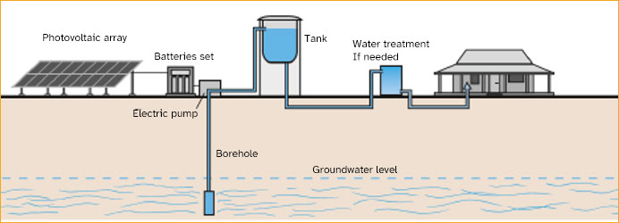
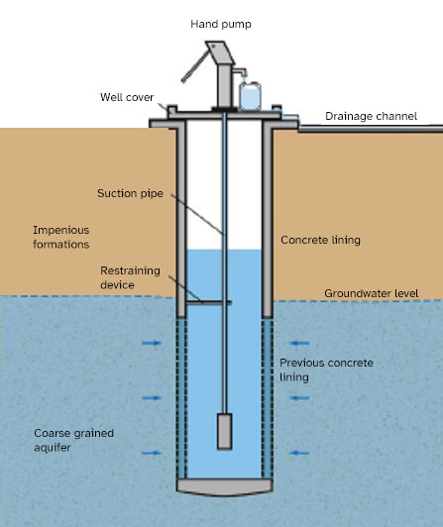
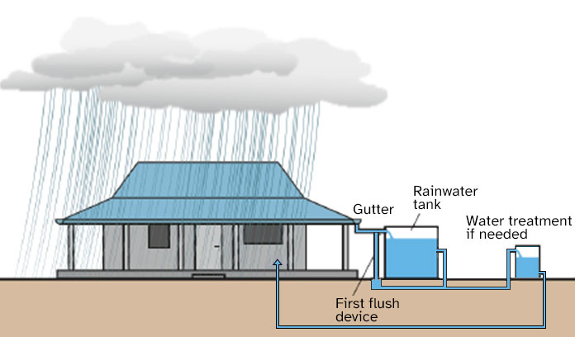
What is an “improved” water supply?
Improved water sources are those which are designed or modified to protect against environmental contamination.
Solar powered borehole with piped-in network
Rainwater harvesting
Protected well with handpump
Notes:
Improved water sources are those which are designed or modified to protect against environmental contamination, particularly from fecal matter. These include piped water systems, boreholes, protected dug wells, springs, and collected rainwater. Treated water delivered through bottles or tanker trucks is also considered improved. In contrast, unimproved sources lack protection from contamination, and these include open dug wells, springs, and surface water like lakes or rivers. Regardless of the source, water should be treated to ensure it is safe.

Slide 11
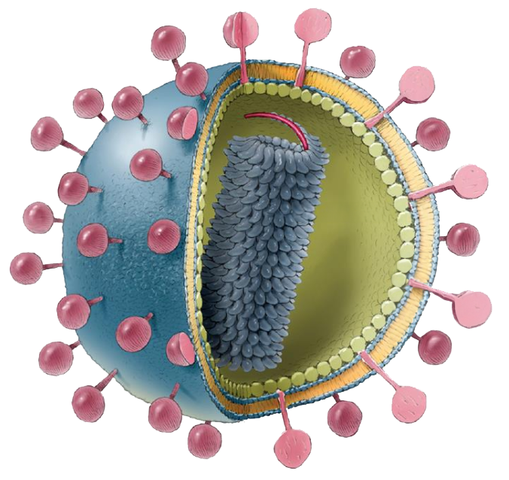
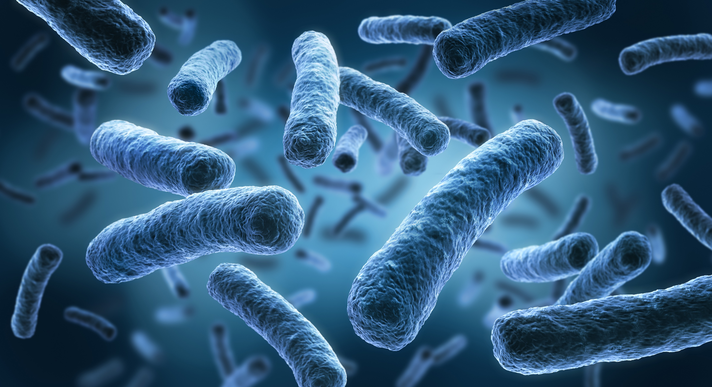
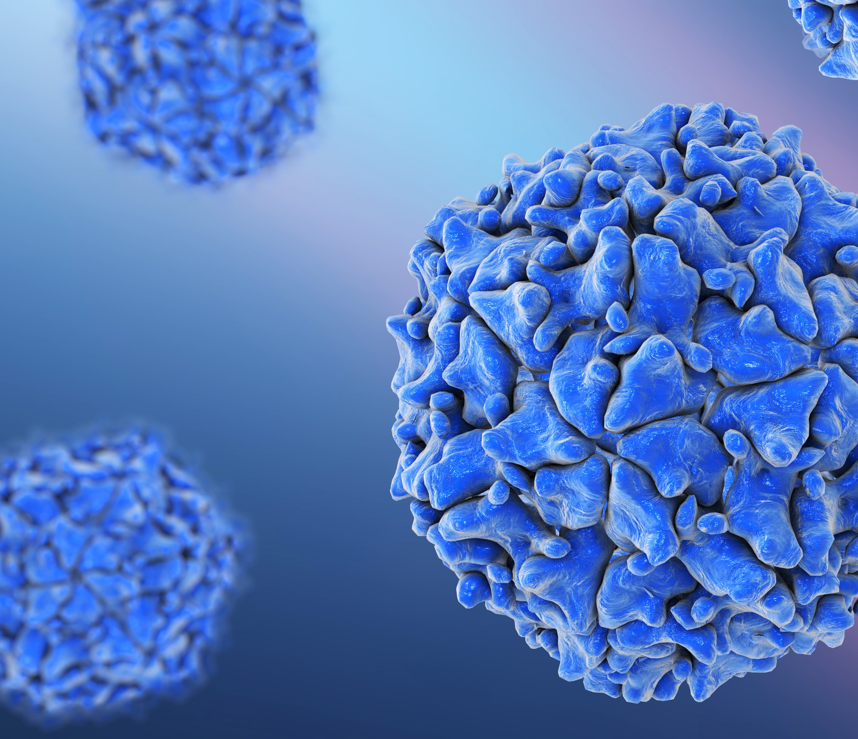
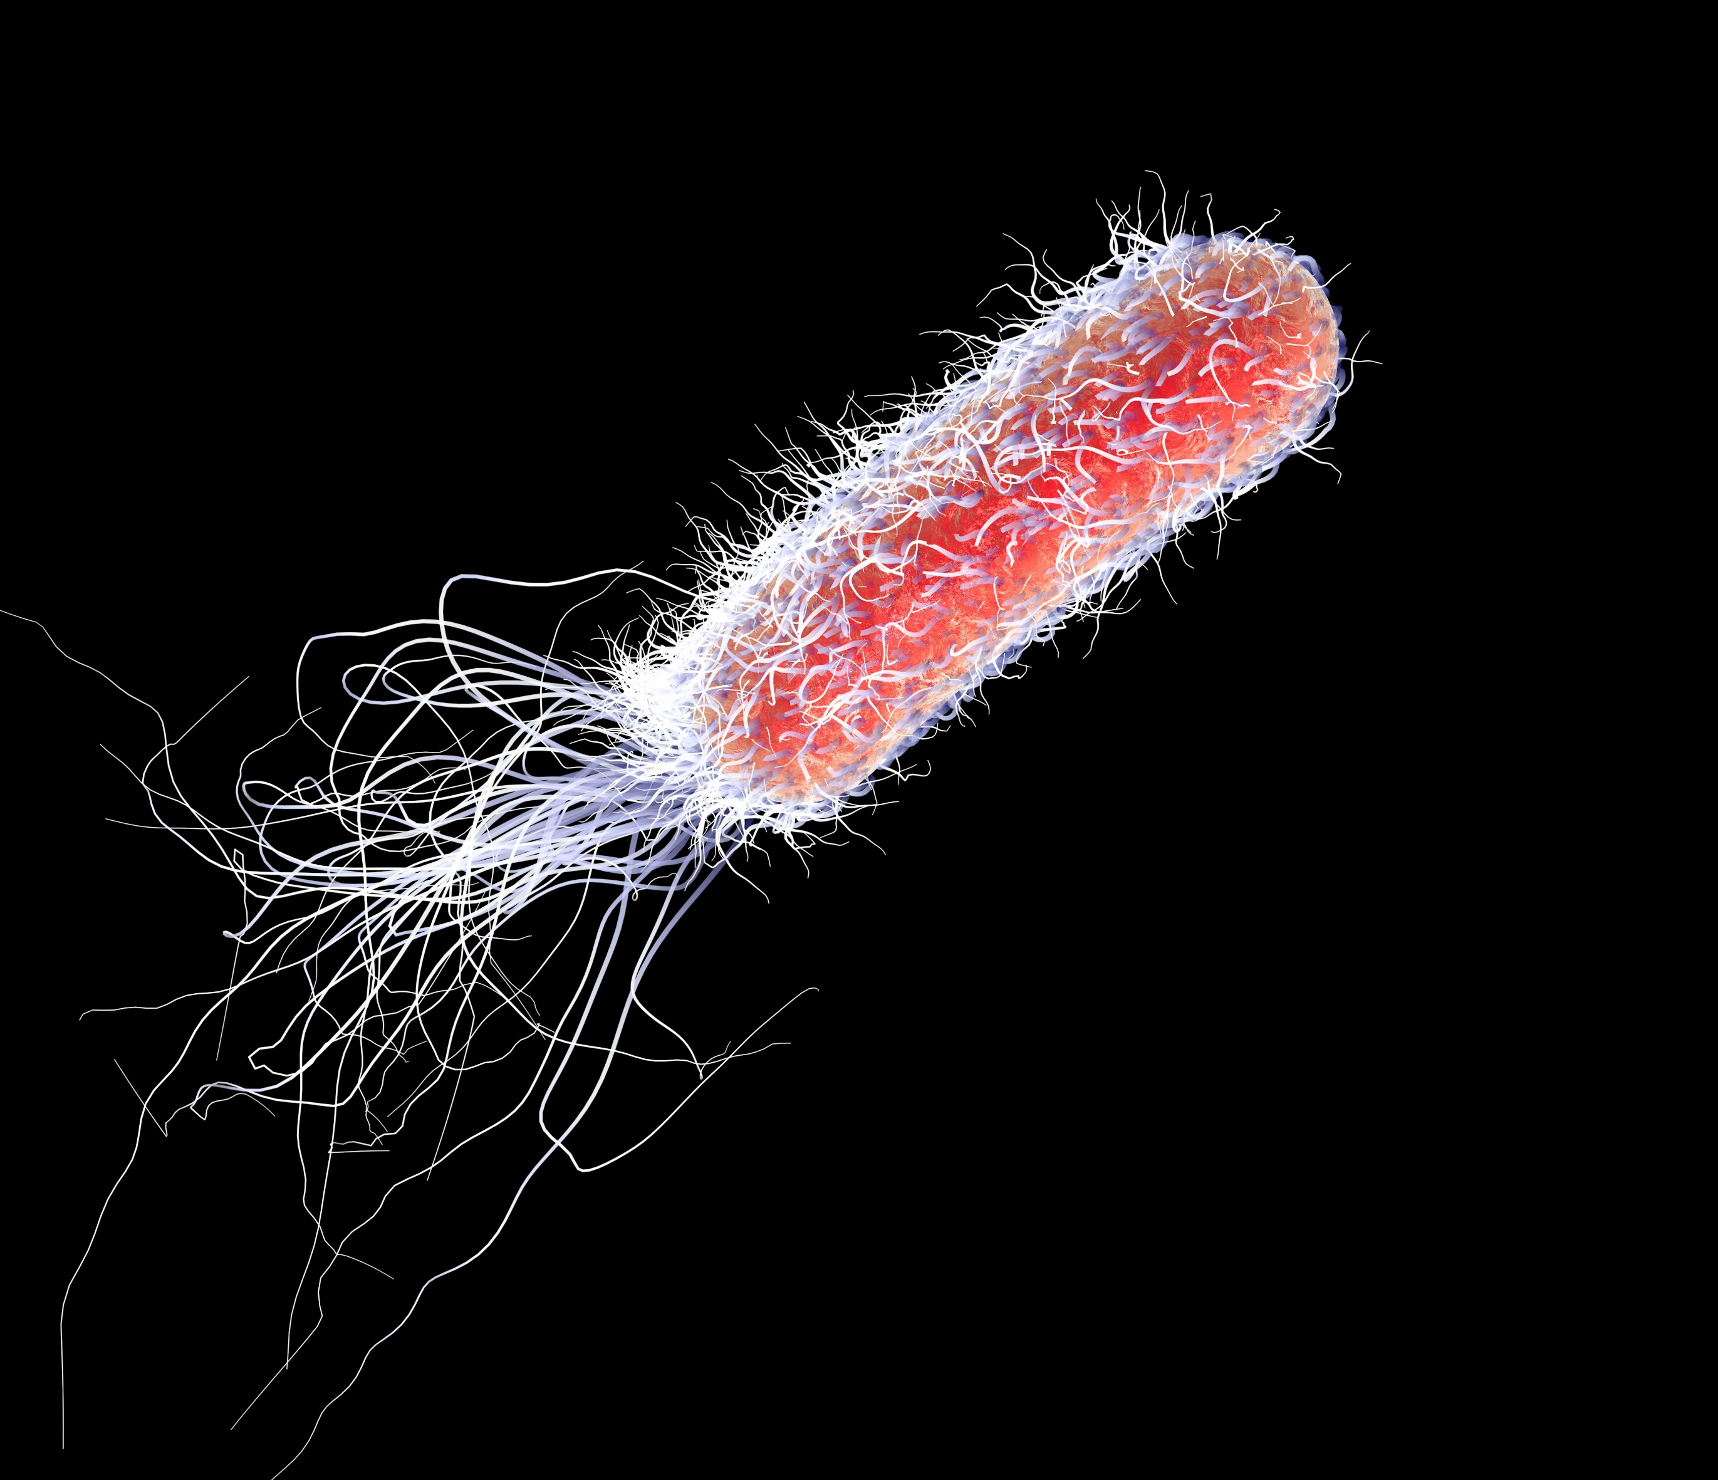
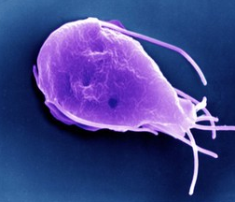
Microbial groups commonly associated with waterborne diseases
Positive sing-strand RNA
Protein capsid
Cross section of lipid bilayer (envelope)
Viruses
E.g., Hepatitis A, poliovirus
Smallest; 0.02-0.3 μm
Glycoproteins
Credit: Shutterstock
SARS-CoV-2 & Ebola viruses not fecal oral pathogens.
Neither virus has been detected in water supplies or water sources and both are relatively fragile compared to fecal/oral viruses.
Bacteria
E.g., Escherichia coli, Vibrio cholerae
0.5-2.0 μm in diameter
Credit: Shutterstock
Legionella:
A bacterial respiratory disease with symptoms similar to pneumonia.
Credit: Shutterstock
Protozoan cysts
E.g., Giardia, Cryptosporidium
Largest; >2 μm-2 mm
Credit: Shutterstock
Credit: Shutterstock
Notes:
Three types of microbes are commonly associated with waterborne diseases.
Viruses like Hepatitis A and Poliovirus are the smallest, ranging from 0.02 to 0.3 micrometers, while bacteria such as E. coli and Vibrio cholerae span 0.5 to 2 micrometers. These contribute significantly to diarrheal diseases. Viruses like SARS-CoV-2 and Ebola, primarily transmitted through non-fecal-oral routes, pose minimal waterborne risk.
Protozoan cysts like Giardia and Cryptosporidium are larger, exceeding 2 micrometers. Legionella is becoming increasingly common in health care settings and requires special attention.

Slide 12
Spotlight on Legionella
Credit: Shutterstock
Legionella, in freshwater, grows in plumbing systems, causing Legionnaires' disease via inhaled droplets.
Rising rates due to stagnation, aging systems, climate change, better surveillance.
Notes:
Legionella is a naturally occurring bacterium in freshwater sources like rivers and lakes. In these environments, Legionella typically exists in harmless amounts, posing little threat to human health. However, under certain conditions, Legionella can multiply to dangerous levels and cause Legionnaires' disease, a serious form of pneumonia. This disease is contracted by inhaling small droplets of water contaminated with the bacteria, often through mist or vapor. The incidence of legionnaires disease is on the rise, most likely due to aging water systems, climate change, and better surveillance.
For health care facilities it is important that a water risk management plan is developed as part of WASH FIT. This involves describing the building water system and identifying areas where Legionella could grow and spread (these could be fountains, cooling towers, showers).

Slide 13
Spotlight on Legionella
Credit: Shutterstock
Maintain hot water >50°C and cold <20°C.
Prevent water stagnation.
Appropriate disinfection concentrations.
Keep plumbing free from sediment, scale, corrosion and biofilm.
Consult plumbing experts.
Notes:
There are several basic preventive measures you can take, including maintaining water temperatures above 50 degrees Centigrade or below 20, preventing stagnation by fixing “dead ends”, ensuring appropriate disinfection concentrations, including after adverse events and proper plumbing to prevent a habitat suitable for Legionella. You may need to consult skilled plumbers and water systems experts for support.
WHO and the US Centres for Disease Control both have guidance on mitigating the risk of waterborne diseases and Legionnaires' disease.

Slide 14
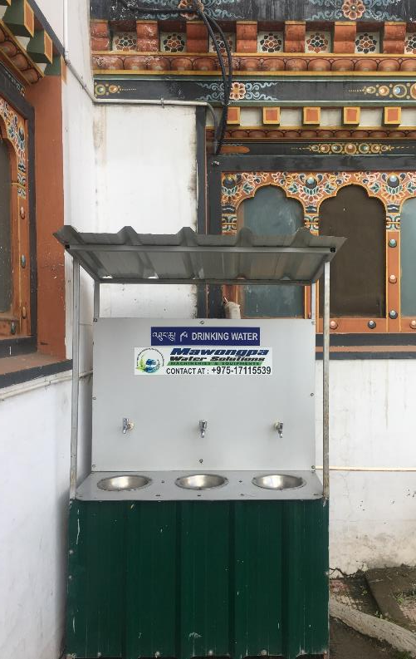
Safe drinking water
Safe drinking water must be present and accessible for staff, patients (including those with disabilities) and carers, at all times and locations/wards.
Safe:
No fecal contamination (0 CFU E. Coli/100 ml).
Appropriate chlorine residual (0.2mg/l or 0.5mg/l in emergencies).
Not turbid (5 NTU or ideally less).
Drinking water station in Thimpu, Bhutan
Credit: WHO/Arabella Hayter
Notes:
Safe drinking water is indispensable in healthcare facilities, protecting the health of staff, patients, and caregivers.
According to WHO guidelines, safe water should pose no significant health risks across all life stages. There should be no fecal contamination, indicated by a lack of fecal coliforms or E. coli. Alternatively there should be a free chlorine residual of at least 0.2 milligrams per litre and the water should not be turbid.
Water should be safely stored which means in clean containers with covers and taps. They should be regularly cleaned and disinfected. Water should be accessible to all users which requires pathways to drinking water and hand washing stations to be wide, flat and obstacle-free and clearly signed. Taps should be an appropriate height, and if cups are provided, they must be kept clean. During emergencies you will need to fill drinking-water stations and treat the water more frequently to meet increased patient load, procure more water, and arrange in-line treatment for piped water.

Slide 15
Safe drinking water
Safe drinking water must be present and accessible for staff, patients (including those with disabilities) and carers, at all times and locations/wards.
Safe:
No fecal contamination (0 CFU E. Coli/100 ml).
Appropriate chlorine residual (0.2mg/l or 0.5mg/l in emergencies).
Not turbid (5 NTU or ideally less).
Safely stored:
Clean bucket/tank with cover and tap.
Regularly cleaned & disinfected.
What to do in emergencies/climate-related events?
Staff fill drinking water stations and treat more regularly (meet increased patient load).
Procure more water.
In-line treatment for piped water (filter + disinfection).
Drinking water station in Thimpu, Bhutan
Accessible:
Credit: Arabella Hayter, WHO
Pathway to drinking water station clear.
Clearly signed.
Notes:
Safe drinking water is indispensable in healthcare facilities, protecting the health of staff, patients, and caregivers.
According to WHO guidelines, safe water should pose no significant health risks across all life stages. There should be no fecal contamination, indicated by a lack of fecal coliforms or E. coli. Alternatively there should be a free chlorine residual of at least 0.2 milligrams per litre and the water should not be turbid.
Water should be safely stored which means in clean containers with covers and taps. They should be regularly cleaned and disinfected. Water should be accessible to all users which requires pathways to drinking water and hand washing stations to be wide, flat and obstacle-free and clearly signed. Taps should be an appropriate height, and if cups are provided, they must be kept clean. During emergencies you will need to fill drinking-water stations and treat the water more frequently to meet increased patient load, procure more water, and arrange in-line treatment for piped water.

Slide 16
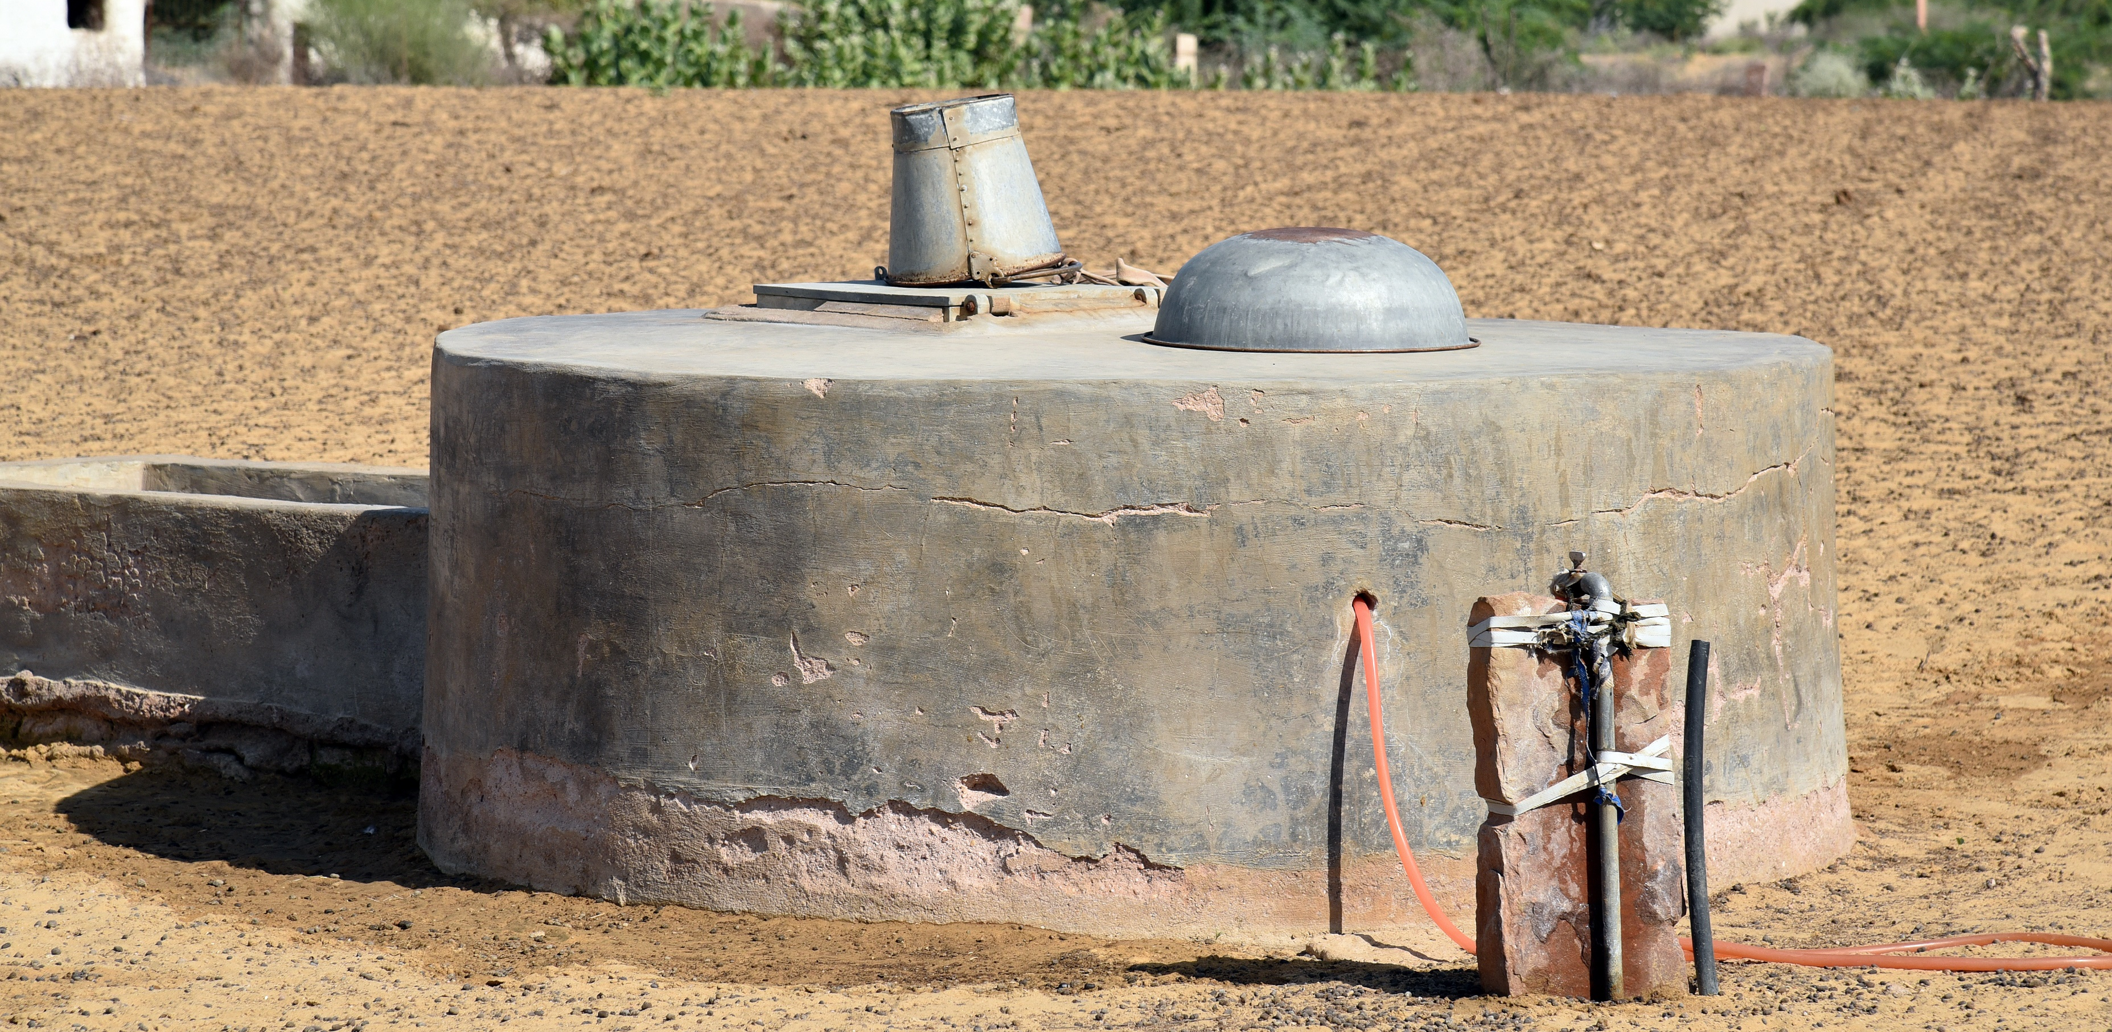
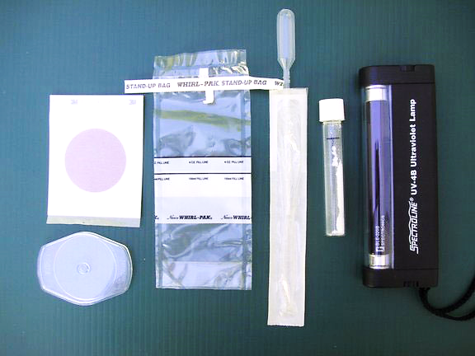
How should you assess water quality?
1
4
Conduct fecal indicator bacteria testing
To understand level of bacteriological contamination and whether control measures (e.g., source protection or water treatment) are working!
Sanitary inspection forms
To address risks at water source.
2
Review regulatory data
To understand water quality over time and corrective actions, if any, taken.
3
Check chlorine residual-regularly (daily-weekly)
To ensure appropriate residual and adjust dosing as needed.
Credit: Shutterstock
Notes:
There are 4 suggested ways of assessing and managing water quality risks. These are use of sanitary inspections to address risks at the source, reviewing regulatory data to understand water quality over time, regularly checking and measuring levels of residual chlorine (and note that this is a very cost-effective option) and finally conducting fecal indicator testing which verifies the effectiveness of water control measures and regulatory compliance. Portable water quality test kits typically include these tests.
Strict adherence to sampling protocols, testing procedures, and data analysis will make results more reliable, help guide risk assessments and determine the most appropriate interventions. Whichever way water quality is assessed, addressing hazards promptly is crucial.

Slide 17
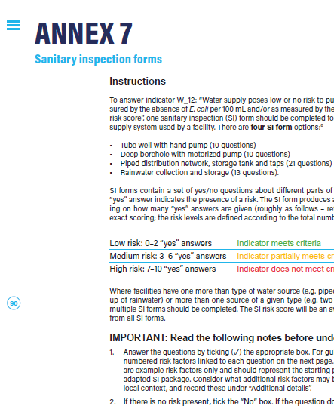
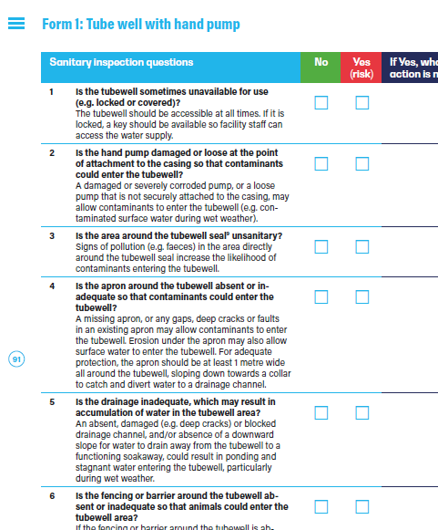
Sanitary inspection (SI) forms
An on-site evaluation of all conditions, components and practices in the water supply system that pose an actual or potential risk to public health.
WASH FIT SI forms:
1
3
Tube well with hand pump.
Piped distribution network, storage tanks and taps.
2
Borehole with motorized pump.
4
Rainwater collection and storage.
Notes:
We will look at the first of these options now, sanitary Inspection forms. These are an on-site evaluation of all conditions, components and practices in the water supply system that pose an actual or potential risk to public health.
WASH FIT includes a set of 4 SI forms specially adapted for use in healthcare settings which help pinpoint sources of contamination and guide you through ways to mitigate these risks. The 4 forms are for tube wells, boreholes, piped distribution networks and rainwater harvesting.
The forms contain a set of yes/no questions to identify the presence or absence of risk and produce an SI score to quantify overall risk levels. Using the results, facilities should start by focusing on critical risks, implementing low or no-cost measures to enhance water safety and supply reliability. These measures should be included in the improvement plan developed in step 4 of the WASH FIT cycle.

Slide 18
Sanitary inspection (SI) forms
An on-site evaluation of all conditions, components and practices in the water supply system that pose an actual or potential risk to public health.
WASH FIT SI forms:
1
3
Tube well with hand pump.
Piped distribution network, storage tanks and taps.
2
Borehole with motorized pump.
4
Rainwater collection and storage.
Notes:
We will look at the first of these options now, sanitary Inspection forms. These are an on-site evaluation of all conditions, components and practices in the water supply system that pose an actual or potential risk to public health.
WASH FIT includes a set of 4 SI forms specially adapted for use in healthcare settings which help pinpoint sources of contamination and guide you through ways to mitigate these risks. The 4 forms are for tube wells, boreholes, piped distribution networks and rainwater harvesting.
The forms contain a set of yes/no questions to identify the presence or absence of risk and produce an SI score to quantify overall risk levels. Using the results, facilities should start by focusing on critical risks, implementing low or no-cost measures to enhance water safety and supply reliability. These measures should be included in the improvement plan developed in step 4 of the WASH FIT cycle.

Slide 19
What should be considered in selecting water treatment options?
WHO Scheme to Evaluate Household Water Treatment Performance
Water treatment technologies should meet WHO’s performance standards and remove the main types of waterborne pathogens that cause disease (viruses, bacteria, protozoa).
High quality membrane filters, UV disinfectants & flocculant-disinfectants, effective chlorination, solar disinfection.
It is important when choosing a method to understand existing water quality (e.g., ask the utility or water regulator).
Notes:
Effective treatment methods must safeguard against all pathogen classes and be able to cope with changing water quality due to climate change or other factors.
To help you select which water treatment technology to use, WHO evaluates various technologies under the Household Water Treatment Scheme. This international initiative assesses the microbial performance of on-site water treatment technologies against WHO health-based criteria. ​
Based on WHO testing, higher performing technologies include high quality membrane filters, UV disinfectants and flocculant-disinfectants, effective chlorination and solar disinfection. You will need to understand existing water quality and review manufacture test data to make an informed decision about which technology to use. Where a technology provides limited protection, you will need to adjust chlorine dosing or employ additional technologies for multi-barrier protection. ​
Most important though is to choose wisely. 8 out of 50 technologies tested did not meet WHO performance criteria. More details can be found in the reference page provided with this module.

Slide 20
What should be considered in selecting water treatment options?
WHO Scheme to Evaluate Household Water Treatment Performance
Water treatment technologies should meet WHO’s performance standards and remove the main types of waterborne pathogens that cause disease (viruses, bacteria, protozoa).
Choose wisely! In the latest list of evaluated water treatment technologies (Mar 2024)
8 out of 50 technologies do not meet WHO performance criteria.
High quality membrane filters, UV disinfectants & flocculant-disinfectants, effective chlorination, solar disinfection.
It is important when choosing a method to understand existing water quality (e.g., ask the utility or water regulator).
Chlorination is a commonly used method, but requires care in appropriate dosing and monitoring; will not protect against protozoa (e.g., Cryptosporidium).
Notes:
Effective treatment methods must safeguard against all pathogen classes and be able to cope with changing water quality due to climate change or other factors.
To help you select which water treatment technology to use, WHO evaluates various technologies under the Household Water Treatment Scheme. This international initiative assesses the microbial performance of on-site water treatment technologies against WHO health-based criteria. ​
Based on WHO testing, higher performing technologies include high quality membrane filters, UV disinfectants and flocculant-disinfectants, effective chlorination and solar disinfection. You will need to understand existing water quality and review manufacture test data to make an informed decision about which technology to use. Where a technology provides limited protection, you will need to adjust chlorine dosing or employ additional technologies for multi-barrier protection. ​
Most important though is to choose wisely. 8 out of 50 technologies tested did not meet WHO performance criteria. More details can be found in the reference page provided with this module.

Slide 21
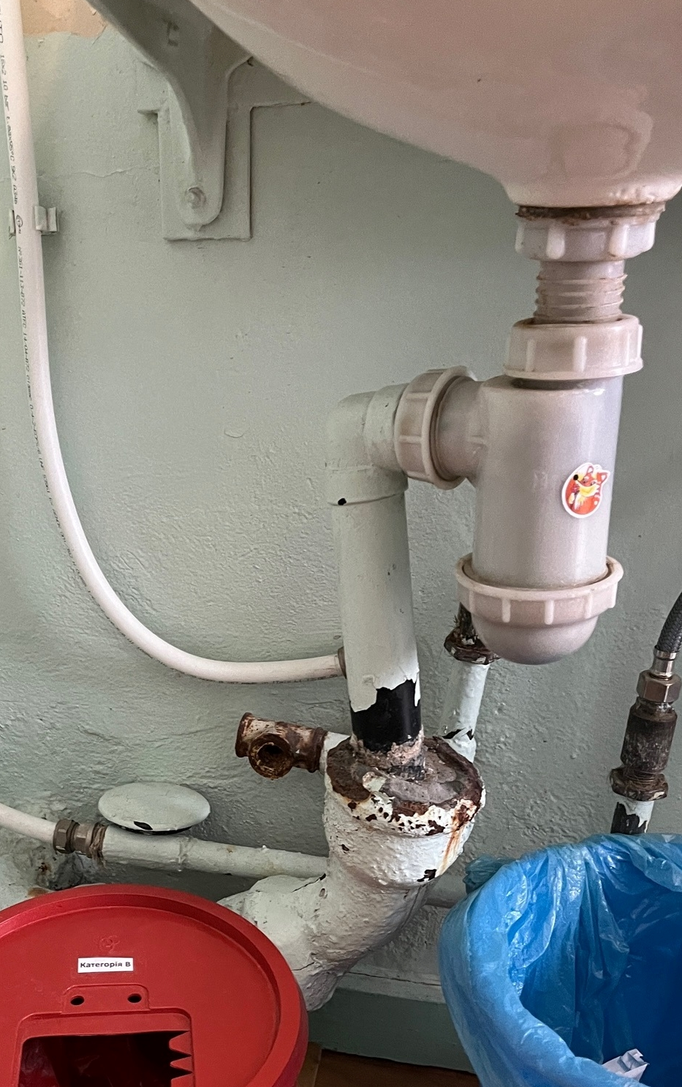
Common plumbing problems
Faulty/leaking pipework & taps → Wastes water & increases costs to facility (higher utility payments and/or pumping and energy costs).
Pooling of water on floors
→ Spreads pathogens and increases risk of infections.
Failing drainage/septic system → Stagnant water (presence of mosquitoes), risk of flooding, water contamination.
Corroded pipes → Galvanised steel corrosion or chemical contamination (e.g., lead).
Blocked hand basins, sinks and toilets → Spreads pathogens and increases risk of infections for staff, patients and carers.
Credit: WHO/Maggie Montgomery
Notes:
We will now look at plumbing practices, consider common issues and cost-effective measures to improve the safety of water supplies. Look at this photo. What problems can you see? The most obvious problem is a corroded pipe which has been poorly fixed with plastic parts.
Faulty or leaking pipes and taps waste water and can increase costs to the facility as a result of higher utility payments and energy costs. Corroded pipes lead to poor water quality, chemical contamination, or stagnation due to dead legs. Blocked sinks and toilets spread pathogens which pose an infection risk. Water pooling on floors and inadequate drainage systems create stagnant water which provide easy access for mosquitoes to breed and further disease transmission. Gutters and drainage areas must be cleaned to stop vectors from breeding.
Toilet side spray valves, which are popular in many cultures are also a potential source of cross-contamination due to backflow. They require regular cleaning and checking to ensure they are operating properly.

Slide 22
Common plumbing problems
Faulty/leaking pipework & taps → Wastes water & increases costs to facility (higher utility payments and/or pumping and energy costs).
Pooling of water on floors
→ Spreads pathogens and increases risk of infections.
Failing drainage/septic system → Stagnant water (presence of mosquitoes), risk of flooding, water contamination.
Corroded pipes → Galvanised steel corrosion or chemical contamination (e.g., lead).
Blocked hand basins, sinks and toilets → Spreads pathogens and increases risk of infections for staff, patients and carers.
Toilet side spray valves → Cross-contamination and backflow requires regular cleaning.
Credit: WHO/Maggie Montgomery
Notes:
We will now look at plumbing practices, consider common issues and cost-effective measures to improve the safety of water supplies. Look at this photo. What problems can you see? The most obvious problem is a corroded pipe which has been poorly fixed with plastic parts.
Faulty or leaking pipes and taps waste water and can increase costs to the facility as a result of higher utility payments and energy costs. Corroded pipes lead to poor water quality, chemical contamination, or stagnation due to dead legs. Blocked sinks and toilets spread pathogens which pose an infection risk. Water pooling on floors and inadequate drainage systems create stagnant water which provide easy access for mosquitoes to breed and further disease transmission. Gutters and drainage areas must be cleaned to stop vectors from breeding.
Toilet side spray valves, which are popular in many cultures are also a potential source of cross-contamination due to backflow. They require regular cleaning and checking to ensure they are operating properly.

Slide 23
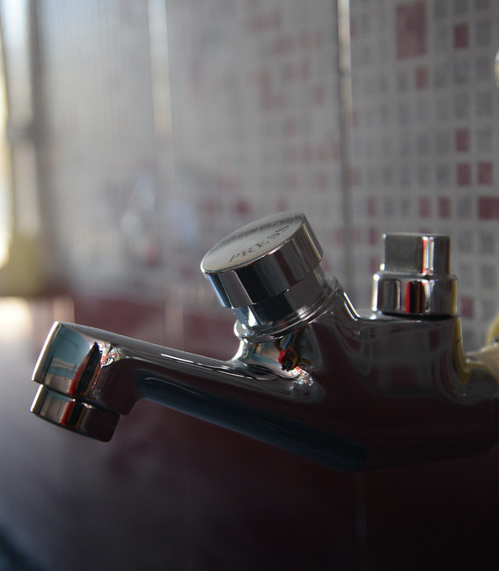
Plumbing/water quality improvements
Regularly inspect and repair leaks in piping connections.
Upgrade to PVC pipes from corroded or lead ones.
Position drinking water pipes above wastewater to prevent contamination.
Install backflow protectors on showers and sprayers.
Monitor water quality (turbidity, E. coli, chlorine levels).
Implement on-site water treatment if standards are not met.
Credit: Shutterstock
Notes:
Healthcare facilities can implement simple, low-cost plumbing measures to address these problems. Here are a few examples:
Regularly inspect and promptly repair any leaks in piping connections. Upgrade corroded or lead pipes to PVC ones. Position drinking water pipes above wastewater to prevent cross-contamination between safe water and wastewater systems. Install backflow protectors on bathroom fixtures to prevent the reverse flow of contaminated water.
As previously discussed, regular water quality inspections, including visual indicators and testing for chlorine residual, turbidity, and fecal indicator bacteria, are essential. Implement on-site water treatment if standards are not met.
Clean and disinfect water storage tanks regularly, and all sinks and taps must be kept functional to prevent disruptions in water supply and access. For rainwater collection, cleaning gutters and roofs monthly and utilizing first flush devices and filters help remove contaminants.
If water quality is compromised, for example by flooding or other source of contamination, flushing the system and implementing appropriate water treatment methods can restore water quality. Skilled, trained plumbers with access to high-quality plumbing materials locally are needed for installation and maintenance. You may wish to enlist a plumber to join the WASH FIT team. Consult local plumbing codes and standards, along with guidance and resources from the World Plumbing Council.

Slide 24
Plumbing/water quality improvements
Regularly inspect and repair leaks in piping connections.
Upgrade to PVC pipes from corroded or lead ones.
Position drinking water pipes above wastewater to prevent contamination.
Install backflow protectors on showers and sprayers.
Monitor water quality (turbidity, E. coli, chlorine levels).
Implement on-site water treatment if standards are not met.
Clean and disinfect water storage tanks.
Use skilled plumbers with access to sustainable, internationally certified replacement products.
Credit: Shutterstock
Notes:
Healthcare facilities can implement simple, low-cost plumbing measures to address these problems. Here are a few examples:
Regularly inspect and promptly repair any leaks in piping connections. Upgrade corroded or lead pipes to PVC ones. Position drinking water pipes above wastewater to prevent cross-contamination between safe water and wastewater systems. Install backflow protectors on bathroom fixtures to prevent the reverse flow of contaminated water.
As previously discussed, regular water quality inspections, including visual indicators and testing for chlorine residual, turbidity, and fecal indicator bacteria, are essential. Implement on-site water treatment if standards are not met.
Clean and disinfect water storage tanks regularly, and all sinks and taps must be kept functional to prevent disruptions in water supply and access. For rainwater collection, cleaning gutters and roofs monthly and utilizing first flush devices and filters help remove contaminants.
If water quality is compromised, for example by flooding or other source of contamination, flushing the system and implementing appropriate water treatment methods can restore water quality. Skilled, trained plumbers with access to high-quality plumbing materials locally are needed for installation and maintenance. You may wish to enlist a plumber to join the WASH FIT team. Consult local plumbing codes and standards, along with guidance and resources from the World Plumbing Council.

Slide 25
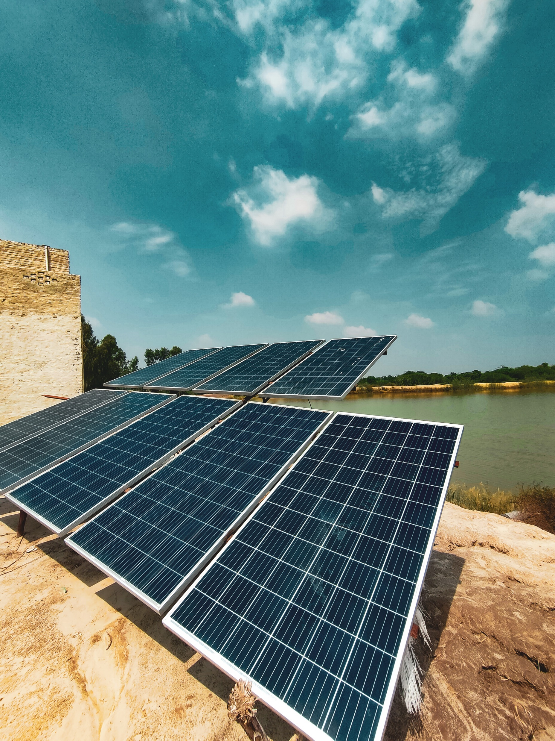
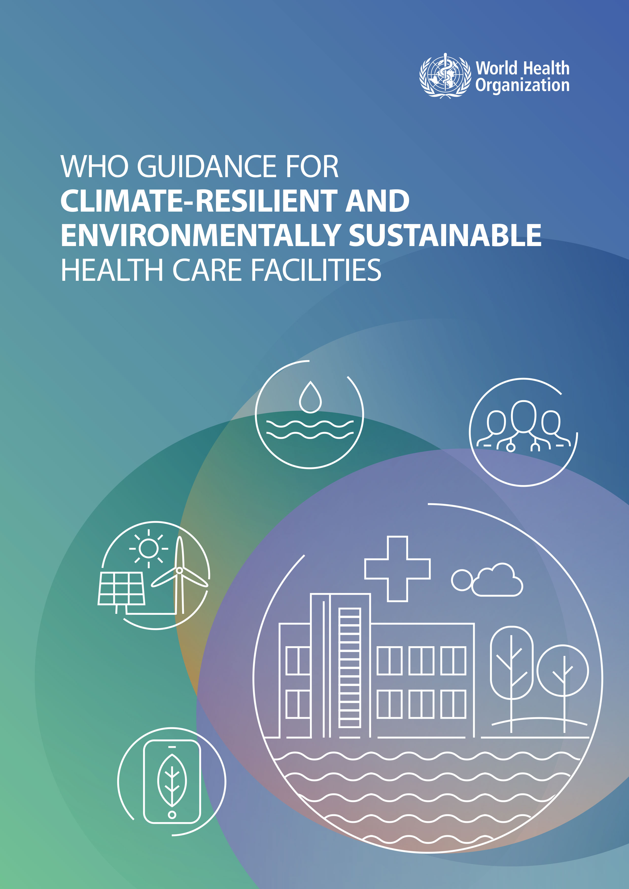
Strengthening climate-resilient water supplies in health care facilities
Increase efficiency, water storage capacity; reduce chemical contamination and carbon emissions.
Install back-up water supplies.
Use rainwater catchment systems where possible.
Credit: Shutterstock
Notes:
Coming to our last slide, we look at how we can strengthen the climate resiliency of water supplies. As the climate changes, many countries and their health care facilities face greater periods of water instability. Adaptations are needed to promote efficient use of resources, reduce chemical contaminants and pollution from carbon emissions and in doing so, help cut overall costs.
The first step should be to increase water storage capacity and install back-up water supplies which will be needed in the event of drought, flooding, fires, strong winds and power outages. One example is rainwater catchment systems which can be used where the climate, rainfall patterns and available catchment and roof space allow. First flush devices and filter boxes will improve water quality.
Raising water storage tanks can reduce risks of contamination during floods and chances of structural damage. Raising tanks allows for water to flow by gravity through a piped system, thus conserving and reducing energy costs. These systems will all need regular cleaning and maintenance.
Backup water supplies should be treated and additional treatment supplies should be stocked.
Reducing water use by repairing leaks, turning off taps during handwashing, using high-efficiency taps and low-flow toilets will also help. During and after extreme weather events, prioritize water for essential services and identify priority users.
Refer to WHO Guidance on climate resilient and sustainable health care facilities for more information.

Slide 26
Strengthening climate-resilient water supplies in health care facilities
Increase efficiency, water storage capacity; reduce chemical contamination and carbon emissions.
Install back-up water supplies.
Use rainwater catchment systems where possible.
Raise water storage tanks (reducing risk of contamination or structural damage from flooding).
Credit: Shutterstock
Stock and treat backup water supplies.
Reduce water use by repairing leaks, turning off taps during handwashing, installing high efficiency taps and low-flow toilets and prioritizing water for essential needs.
Notes:
Coming to our last slide, we look at how we can strengthen the climate resiliency of water supplies. As the climate changes, many countries and their health care facilities face greater periods of water instability. Adaptations are needed to promote efficient use of resources, reduce chemical contaminants and pollution from carbon emissions and in doing so, help cut overall costs.
The first step should be to increase water storage capacity and install back-up water supplies which will be needed in the event of drought, flooding, fires, strong winds and power outages. One example is rainwater catchment systems which can be used where the climate, rainfall patterns and available catchment and roof space allow. First flush devices and filter boxes will improve water quality.
Raising water storage tanks can reduce risks of contamination during floods and chances of structural damage. Raising tanks allows for water to flow by gravity through a piped system, thus conserving and reducing energy costs. These systems will all need regular cleaning and maintenance.
Backup water supplies should be treated and additional treatment supplies should be stocked.
Reducing water use by repairing leaks, turning off taps during handwashing, using high-efficiency taps and low-flow toilets will also help. During and after extreme weather events, prioritize water for essential services and identify priority users.
Refer to WHO Guidance on climate resilient and sustainable health care facilities for more information.

Slide 27
Key points
Water is fundamental for providing safe and clean care and for respecting the dignity and rights of staff, patients and caregivers.
Water quantity and quality needs depend on the types of health services provided and number of patients and their caregivers.
Treating water is vital: many effective methods available.
Managing water systems effectively can prevent concerns such as Legionella, which is increasingly problematic.
Climate-resilient water systems need back-up supplies, storage, extra treatment and infrastructure capable of withstanding floods, droughts and extreme weather events.
Credit: WHO/Mark Nieuwenhof
Notes:
Thank you for completing this module. The key points to remember are:
Water is fundamental for providing safe, clean care and for respecting the dignity and rights of staff, patients, and caregivers.
Water quantity and quality needs depend on the types of health services provided and number of patients and their caregivers.
Treating water is vital, with many effective methods available.
Managing water systems effectively can prevent concerns such as Legionella, which is increasingly problematic.
Developing climate-resilient water systems involves planning for back-up supplies, storage, extra treatment, and infrastructure capable of withstanding floods, droughts, and extreme weather events.
Please review the reference section of this module to access links to all the mentioned resources.

