Slide 1
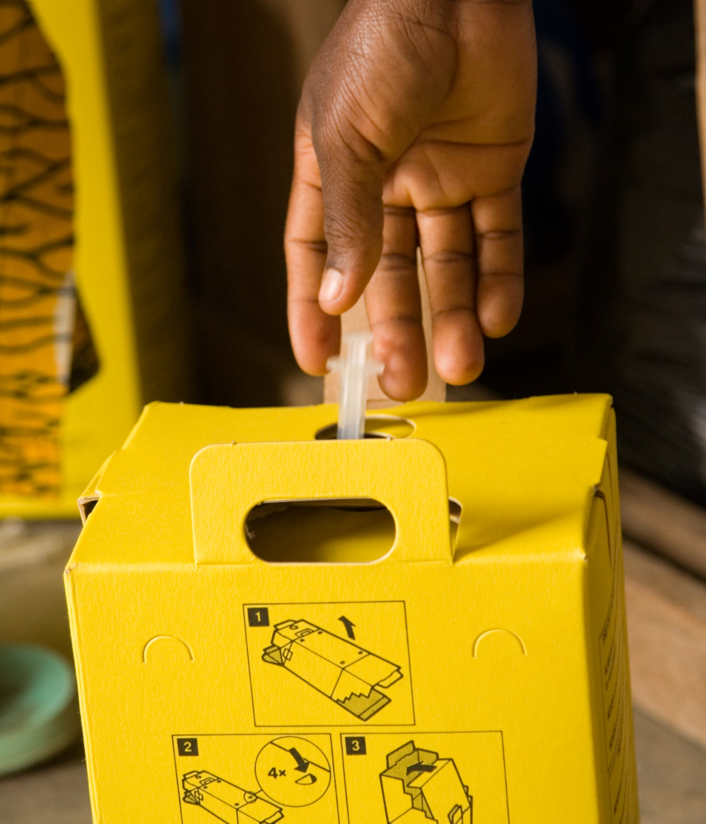
Module 9
Safe and environmentally friendly health care waste management
Credit: WHO/Oliver Asselin
Notes:
Audio: Hello again. This is Akosua Kwakye from Ghana. Welcome to Module 9: Safe and environmentally friendly health care waste management.

Slide 2
Learning objectives
By the end of this module, you will:
Understand risks from unsafe health care waste management.
Learn health care waste management from generation to disposal.
Identify ecologically-friendly waste treatment and climate mitigation options.
Understand how to improve waste management gradually when resources are limited.
Credit: WHO/Oliver Asselin
Notes:
Audio: By the end of this module, you'll understand the risks of unsafe healthcare waste management. We'll then cover ways to improve waste generation, treatment, and disposal, and how to meet guidelines for effective waste management. We’ll also explore eco-friendly waste treatment options and sustainability measures. Lastly, we'll introduce steps to improve waste management gradually when resources may be limited.

Slide 3
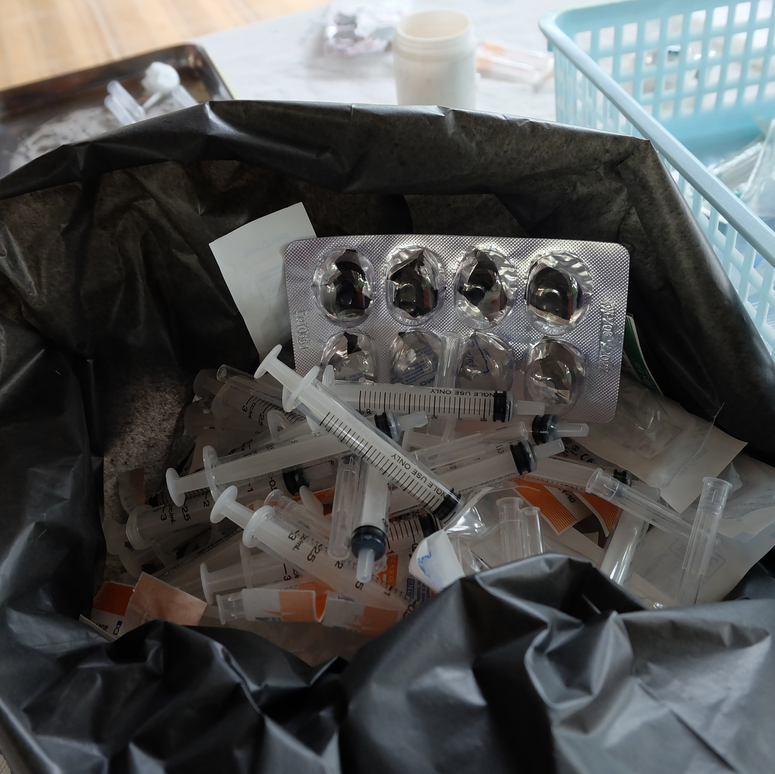
Health impacts of improper waste management
Needle-stick injuries to health care workers (Hepatitis B and C).
Transmission of infectious disease (e.g., antimicrobial resistant infections).
Environmental contamination and pollution.
Credit: Shutterstock
Notes:
Audio: Effective waste management strategies safeguard healthcare workers, patients, and communities. Improper healthcare waste management poses grave health risks, including needle-stick injuries to health workers, transmission of diseases and antimicrobial-resistant organisms and environmental pollution. All of these endanger public health.
Uncontrolled incineration releases dioxins and furans, which may be carcinogenic and contribute to other adverse health outcomes upon inhalation. Chemical exposure from mercury-containing medical devices, leads to neurological damage. Contaminated injections have caused millions of Hepatitis B and C infections and HIV transmissions worldwide.

Slide 4
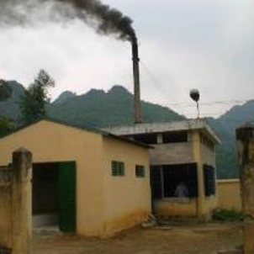
Health impacts of improper waste management
Inhalation of pollutants (dioxins and furans).
Exposure to chemicals, including heavy metals such as mercury.
Contaminated injections lead to Hepatitis B and C, HIV.
Credit: Ute Pieper
Notes:
Audio: Effective waste management strategies safeguard healthcare workers, patients, and communities. Improper healthcare waste management poses grave health risks, including needle-stick injuries to health workers, transmission of diseases and antimicrobial-resistant organisms and environmental pollution. All of these endanger public health.
Uncontrolled incineration releases dioxins and furans, which may be carcinogenic and contribute to other adverse health outcomes upon inhalation. Chemical exposure from mercury-containing medical devices, leads to neurological damage. Contaminated injections have caused millions of Hepatitis B and C infections and HIV transmissions worldwide.

Slide 5
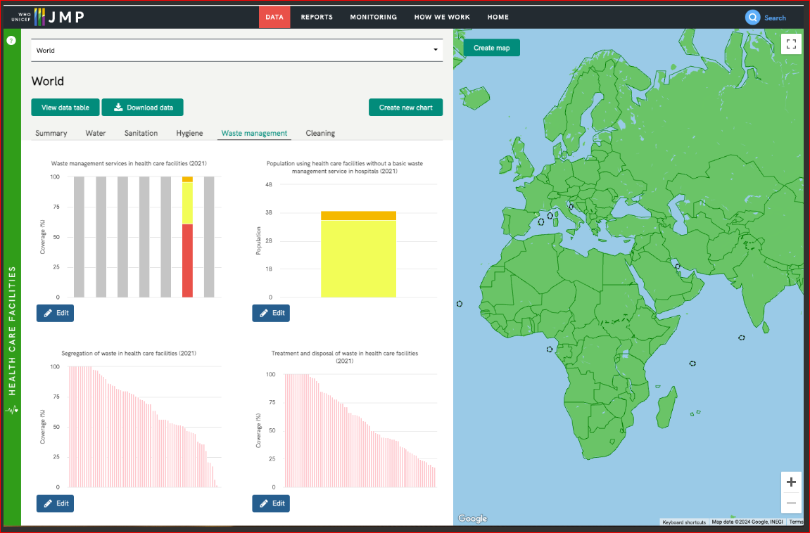
Did you know?
7 out of 10 facilities lack basic waste management in least developed countries.
Credit: WHO and UNICEF
Notes:
Audio: Shockingly, 70% of facilities in least developed countries lack basic waste management systems, meaning they don’t practice safe segregation and sharps and infectious waste are not treated and disposed of safely, for example by autoclaving or incineration. Visit the WHO/UNICEF Joint Monitoring Programme data portal to look at the latest data on waste management by region and country.
Did you know that the bulk of waste from healthcare facilities—up to 90%—is non-hazardous, akin to household waste?
Non-hazardous waste mainly comprises paper, cardboard, and plastics, resembling municipal solid waste. Only 10-25% is hazardous and requires special handling and treatment.
Approximately 10% of infectious waste includes biohazardous materials like sharp objects and pathological waste.

Slide 6
Did you know?
75% - 90% of waste produced is similar to domestic waste
‘Non-hazardous’ or ‘general waste’.
No biological, chemical, radioactive or physical hazard.
Notes:
Audio: Shockingly, 70% of facilities in least developed countries lack basic waste management systems, meaning they don’t practice safe segregation and sharps and infectious waste are not treated and disposed of safely, for example by autoclaving or incineration. Visit the WHO/UNICEF Joint Monitoring Programme data portal to look at the latest data on waste management by region and country.
Did you know that the bulk of waste from healthcare facilities—up to 90%—is non-hazardous, akin to household waste? Non-hazardous waste mainly comprises paper, cardboard, and plastics, resembling municipal solid waste. Only 10-25% is hazardous and requires special handling and treatment.
Approximately 10% of infectious waste includes biohazardous materials like sharp objects and pathological waste.

Slide 7
Did you know?
10% - 25% of health care waste is ‘hazardous’
Requires special handling and treatment.
May pose a variety of environmental and health risks.
Notes:
Audio: Shockingly, 70% of facilities in least developed countries lack basic waste management systems, meaning they don’t practice safe segregation and sharps and infectious waste are not treated and disposed of safely, for example by autoclaving or incineration. Visit the WHO/UNICEF Joint Monitoring Programme data portal to look at the latest data on waste management by region and country.
Did you know that the bulk of waste from healthcare facilities—up to 90%—is non-hazardous, akin to household waste? Non-hazardous waste mainly comprises paper, cardboard, and plastics, resembling municipal solid waste. Only 10-25% is hazardous and requires special handling and treatment.
Approximately 10% of infectious waste includes biohazardous materials like sharp objects and pathological waste.

Slide 8
Did you know?
10% of infectious waste includes biohazardous materials like sharps and pathological waste.
Notes:
Audio: Shockingly, 70% of facilities in least developed countries lack basic waste management systems, meaning they don’t practice safe segregation and sharps and infectious waste are not treated and disposed of safely, for example by autoclaving or incineration. Visit the WHO/UNICEF Joint Monitoring Programme data portal to look at the latest data on waste management by region and country.
Did you know that the bulk of waste from healthcare facilities—up to 90%—is non-hazardous, akin to household waste? Non-hazardous waste mainly comprises paper, cardboard, and plastics, resembling municipal solid waste. Only 10-25% is hazardous and requires special handling and treatment.
Approximately 10% of infectious waste includes biohazardous materials like sharp objects and pathological waste.

Slide 9
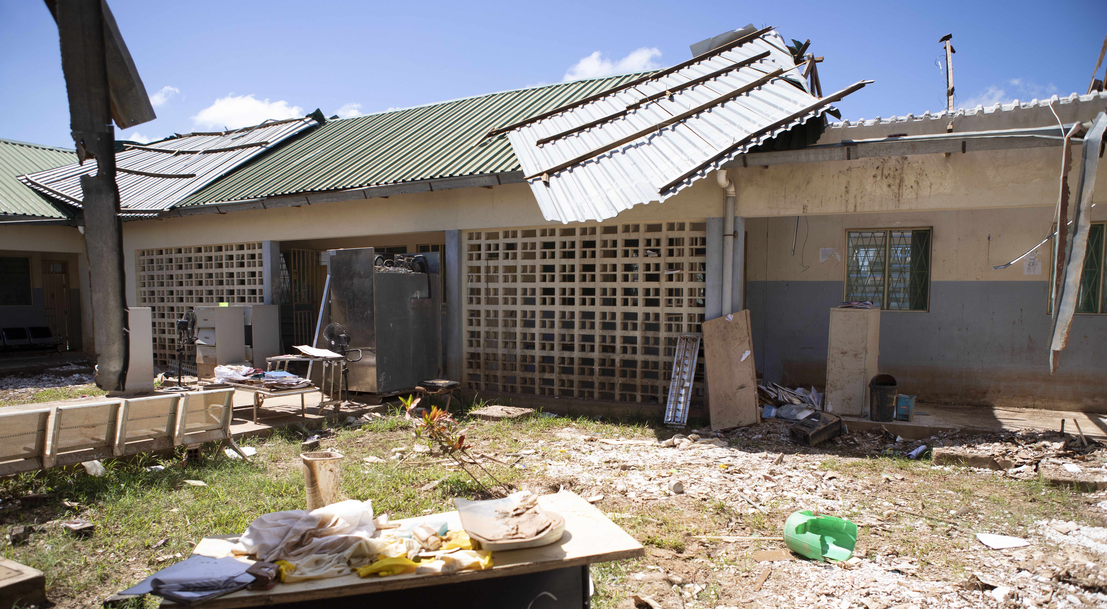
Climate change and waste
Medical packaging and health commodities (PPE, vaccines, diagnostics, medicines) end up as waste → large contributor to carbon emissions from the health sector.
Incineration (e.g., furans) and use of landfills leads to emission of greenhouse gases (e.g., methane).
Increased rainfall and flooding affect waste containers, spreads contaminants and disrupts waste management chain.
Credit: WHO/Mark Nieuwenhof
Notes:
Audio: Healthcare waste management and climate change are closely linked. Waste management negatively impacts the environment, and climate change also poses challenges for waste management. The shipping and packaging of health commodities—including personal protective equipment, vaccines, diagnostics, and medicines—contribute substantially to carbon emissions and generate waste that impacts the environment.
Incineration and disposal of waste to landfills emits greenhouse gases such as carbon dioxide, methane, and nitrous oxide. Methane is significantly more potent than carbon dioxide in terms of its global warming potential.
Climate change can also compromise waste containment, with increased rainfall and flooding posing risks to waste containers, leading to the spread of contaminants and disrupting the waste management chain.

Slide 10
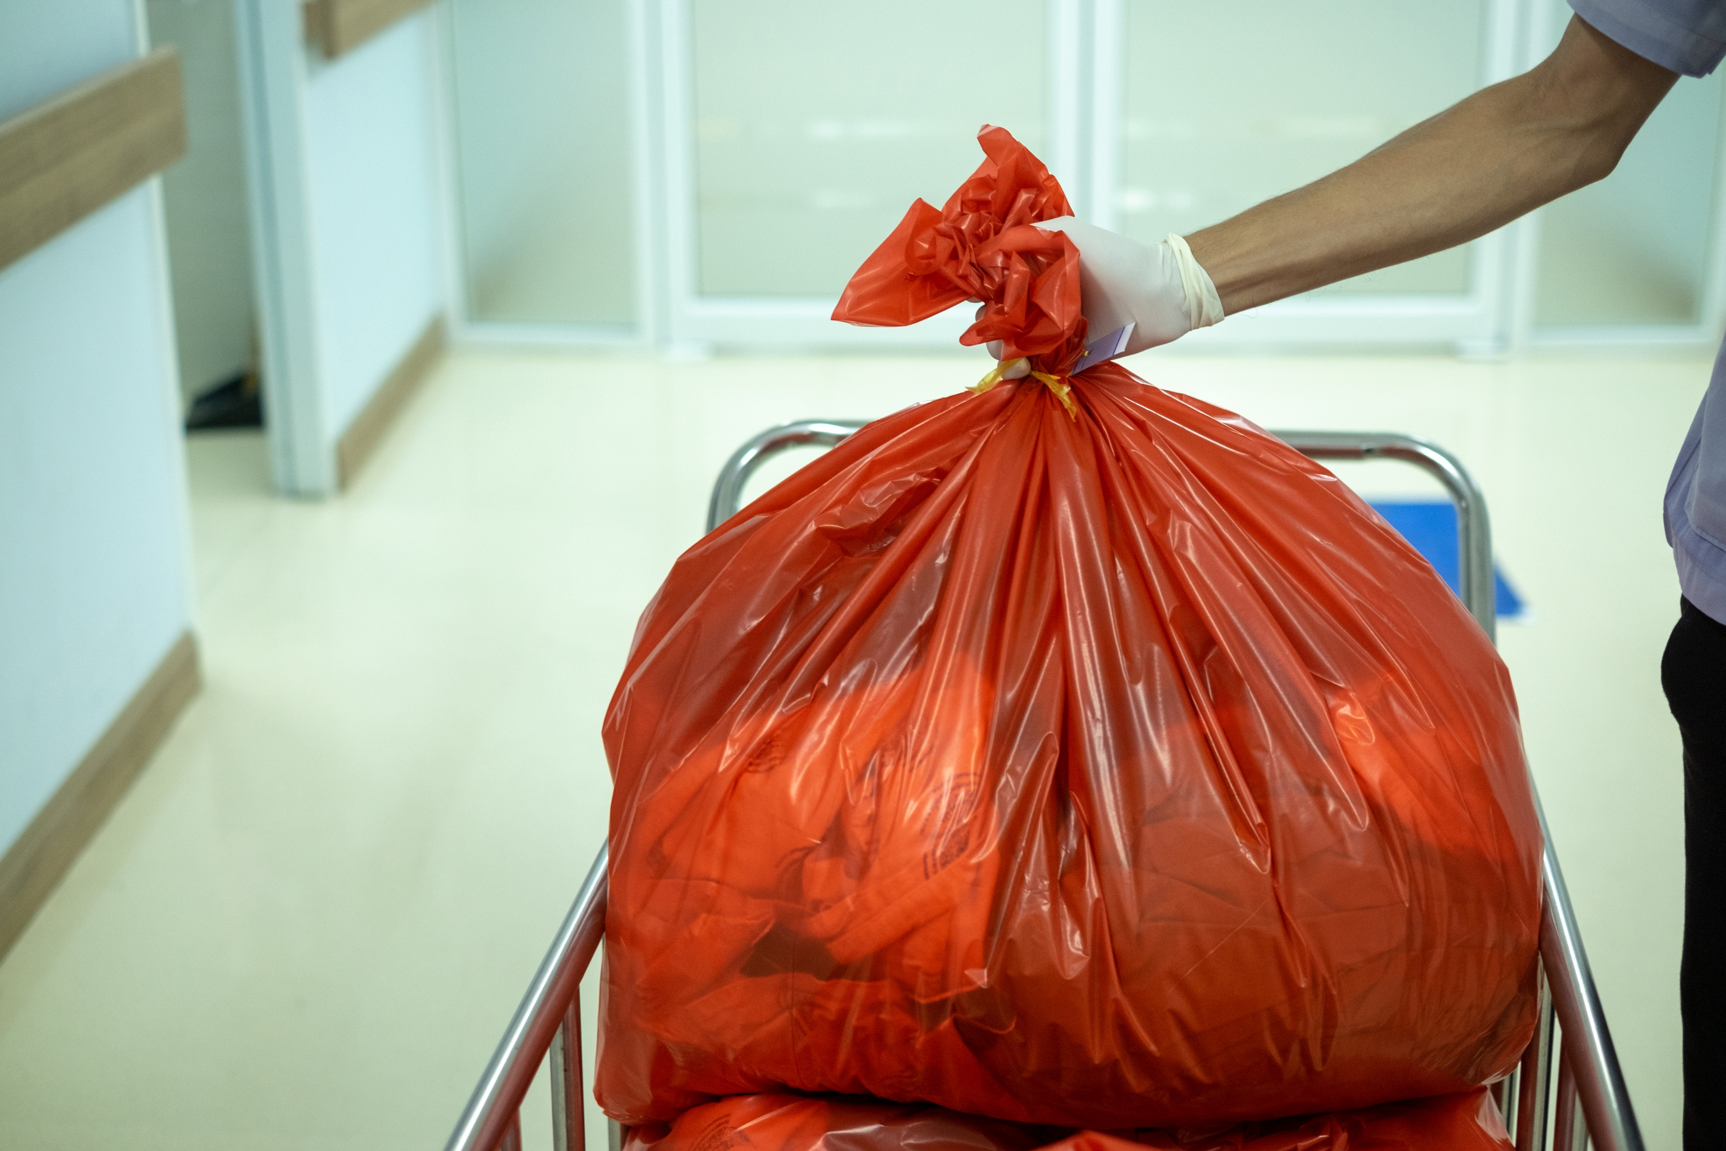
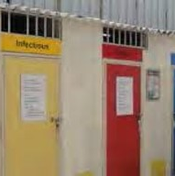
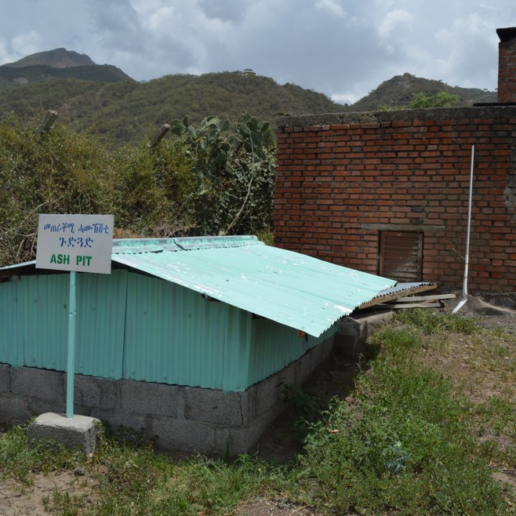
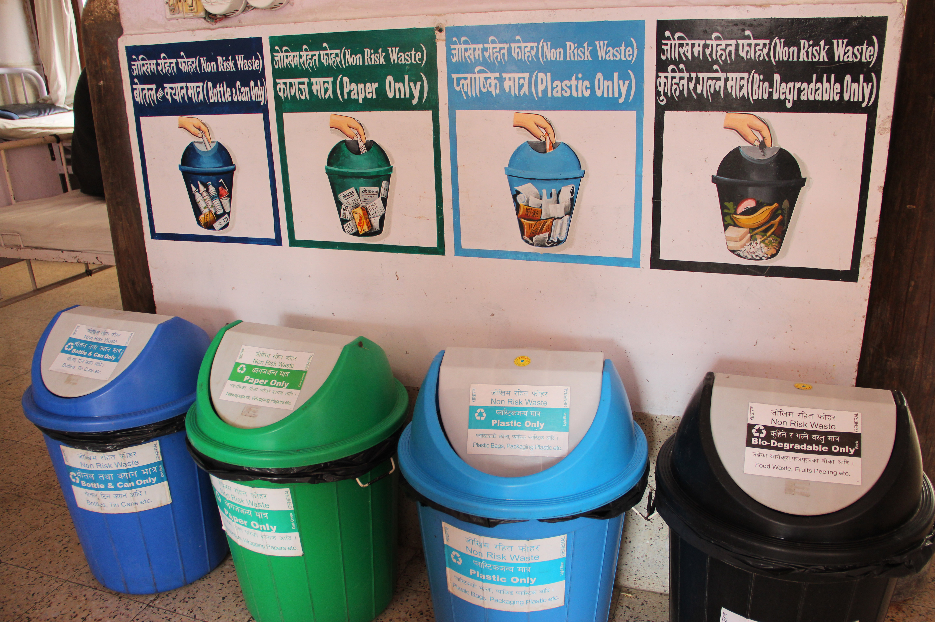
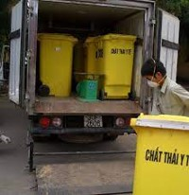
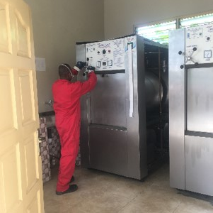
The waste management chain
Generation/
Minimization
Final disposal
Segregation
Collection
Transport
Storage
Treatment
Credits (from left): WHO/Vismita Gupta-Smith; Shutterstock; WHO/Ute Pieper; WHO/Ute Pieper; WHO/Arabella Hayter; WHO/Arabella Hayter
Notes:
Audio: This arrow shows an ideal waste management chain from waste generation all the way through to final disposal. We will go through each of these steps in order. To read about these in depth, refer to WHO's 2014 publication, Safe management of wastes from health-care activities which you can find in the Resources section.
The process starts with waste generation and minimization at the source or point of care.
Many different tactics help reduce waste. Some of these are to minimize unnecessary glove usage (and encourage hand hygiene in the process), opt for eco-friendly and less packaging, and adopt a "just in time" procurement approach (where goods are received from suppliers only as they are needed).
These strategies also lead to cost savings, using fewer consumables, less fuel for powering waste management technologies and putting less strain on infrastructure. Segregation can effectively and significantly decrease the volume of hazardous waste and has a huge impact on the ability of waste management systems to cope.

Slide 11
The waste management chain
Generation/
Minimization
Final disposal
Segregation
Segregation
Collection
Transport
Storage
Treatment
Credits (from left): WHO/Vismita Gupta-Smith; Shutterstock; WHO/Ute Pieper; WHO/Ute Pieper; WHO/Arabella Hayter; WHO/Arabella Hayter
Notes:
Audio: This arrow shows an ideal waste management chain from waste generation all the way through to final disposal. We will go through each of these steps in order. To read about these in depth, refer to WHO's 2014 publication, Safe management of wastes from health-care activities which you can find in the Resources section.
The process starts with waste generation and minimization at the source or point of care.
Many different tactics help reduce waste. Some of these are to minimize unnecessary glove usage (and encourage hand hygiene in the process), opt for eco-friendly and less packaging, and adopt a "just in time" procurement approach (where goods are received from suppliers only as they are needed).
These strategies also lead to cost savings, using fewer consumables, less fuel for powering waste management technologies and putting less strain on infrastructure. Segregation can effectively and significantly decrease the volume of hazardous waste and has a huge impact on the ability of waste management systems to cope.

Slide 12
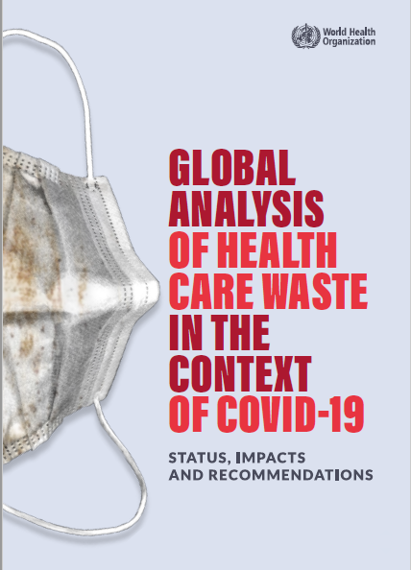
Learning from COVID-19; almost ½ of volume of waste items were “non-essential”
38,000 tonnes
Non-essential: hair and shoe covers, some gloves (not needed for many COVID-19 interactions).
Non-essential Personal protective equipment
Essential Personal protective equipment
Essential: medical masks, gowns, apron protection, some gloves.
49,000 tonnes
Notes:
Audio: In 2021, WHO conducted a global analysis of health care waste generated during COVID-19, using data on items shipped through the UN procurement system and found that nearly 50%, of the waste (or 38,000 tonnes) were items deemed non-essential for COVID-19 care.
This resulted in significant increases in health care waste volumes - in some facilities, ten times as much - which overwhelmed already understaffed and under resourced facilities. As well as needing to dispose of this waste, there were also huge economic and environmental costs to purchasing, shipping and storing all these materials. This could have been avoided by only procuring what was needed.

Slide 13
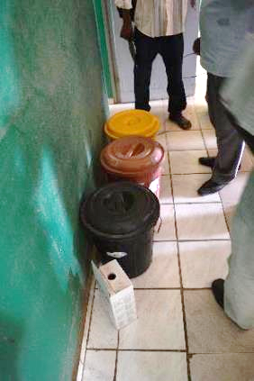
Segregation
Generation/
Minimization
Final disposal
Segregation
Collection
Transport
Storage
Treatment
Can significantly reduce the amount of waste that requires treatment.
Segregate at source, where waste is generated.
Credit: WHO/Arabella Hayter
Notes:
Audio: Without proper segregation, hazardous waste can contaminate non-hazardous waste, effectively increasing volume of waste that is considered hazardous and thus needs to be treated. Effective segregation allows non-hazardous waste to be recycled, reducing environmental impact and in some cases, generating revenue.
To segregate correctly, waste bins must meet specific requirements. They should be properly labelled, with leak-proof liners, covers and pedals Bins must be available by all care points and regular monitored to check they are not overflowing. In addition, visual aids, such as posters strategically placed at points of care, serve as reminders for good practices. Campaigns and regular training refreshers are often needed for staff to practice consistent and correct segregation

Slide 14
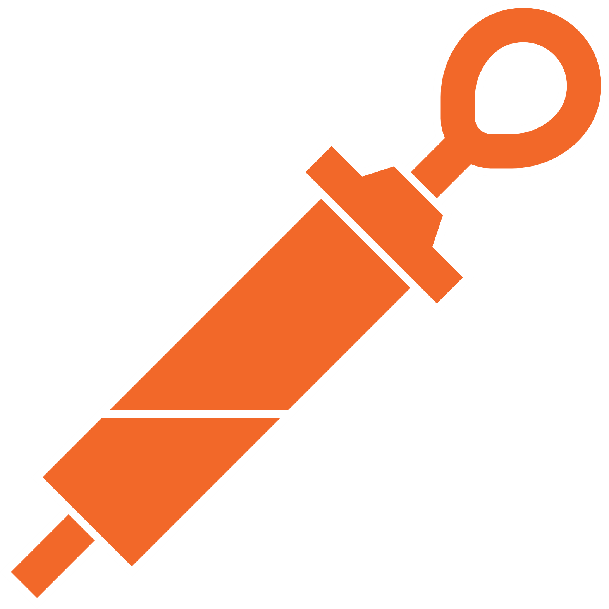
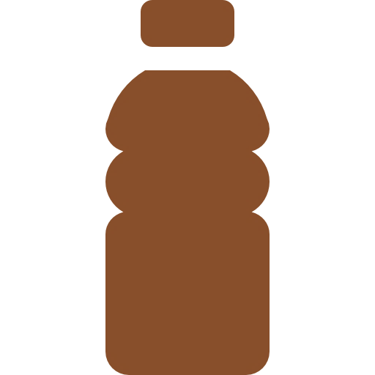
Segregation
Generation/
Minimization
Final disposal
Segregation
Collection
Transport
Storage
Treatment
Yellow container (lined)
3-bin standard system:
General (+ recycling)
Infectious
Sharps
Black container (lined)
Sharps box/Needle cutter
+ additional bins for recycling of general waste | Plastic | Paper | Glass
Notes:
Audio: Without proper segregation, hazardous waste can contaminate non-hazardous waste, effectively increasing volume of waste that is considered hazardous and thus needs to be treated. Effective segregation allows non-hazardous waste to be recycled, reducing environmental impact and in some cases, generating revenue.
To segregate correctly, waste bins must meet specific requirements. They should be properly labelled, with leak-proof liners, covers and pedals Bins must be available by all care points and regular monitored to check they are not overflowing. In addition, visual aids, such as posters strategically placed at points of care, serve as reminders for good practices. Campaigns and regular training refreshers are often needed for staff to practice consistent and correct segregation

Slide 15
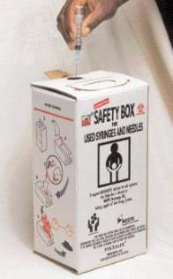
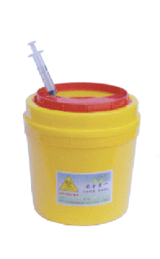
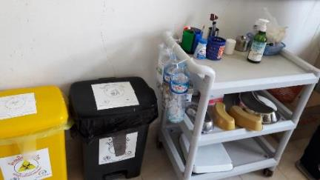
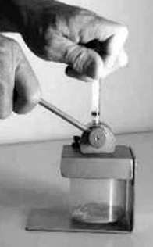
Segregating infectious and sharp waste
Generation/
Minimization
Final disposal
Segregation
Collection
Transport
Storage
Treatment
Credit: WHO/Ute Pieper
Credit: WHO/Ute Pieper
Credit: WHO/Ute Pieper
Cardboard sharps box Plastic sharps container
Low resource option
Plastic bottles replace sharps container.
Needle cutter
Needle is cut from syringe body, sharps container can be used for longer.
Notes:
Audio: Here you can see some examples of commonly used waste containers. The gold standard is to have a cardboard or hard plastic sharps container, as seen on the left. In low-resource settings, budget solutions may be required where plastic bottles are used instead. This can be attached to the trolly which moves around the ward, closer to the point of waste generation. Finally, needle cutters may be used which removes the needle from the syringe, meaning the sharps container takes longer to fill before it must be replaced.

Slide 16
Common non-hazardous waste
Generation/
Minimization
Final disposal
Segregation
Collection
Transport
Storage
Treatment
Packaging materials (paper, cardboard, plastic).
Plastic bottles & cans.
Food containers and organic food remains.
Broken/old equipment or furniture (e.g., tables, chairs).
How do you dispose of this type of waste?
Local landfills.
Municipal waste disposal sites.
Facility waste pit.
Recycling.
Composting.
Example of non-hazardous waste in Nepal.
Example of non-hazardous waste in Nepal.
Credit: WHO/Vismita Gupta
Notes:
Audio: What types of non-hazardous waste are most common? Packaging, plastic bottles, food containers, and outdated equipment make up the bulk.
Disposal methods for this type of waste include landfill, municipal waste sites, facility waste pits, recycling, and composting.

Slide 17
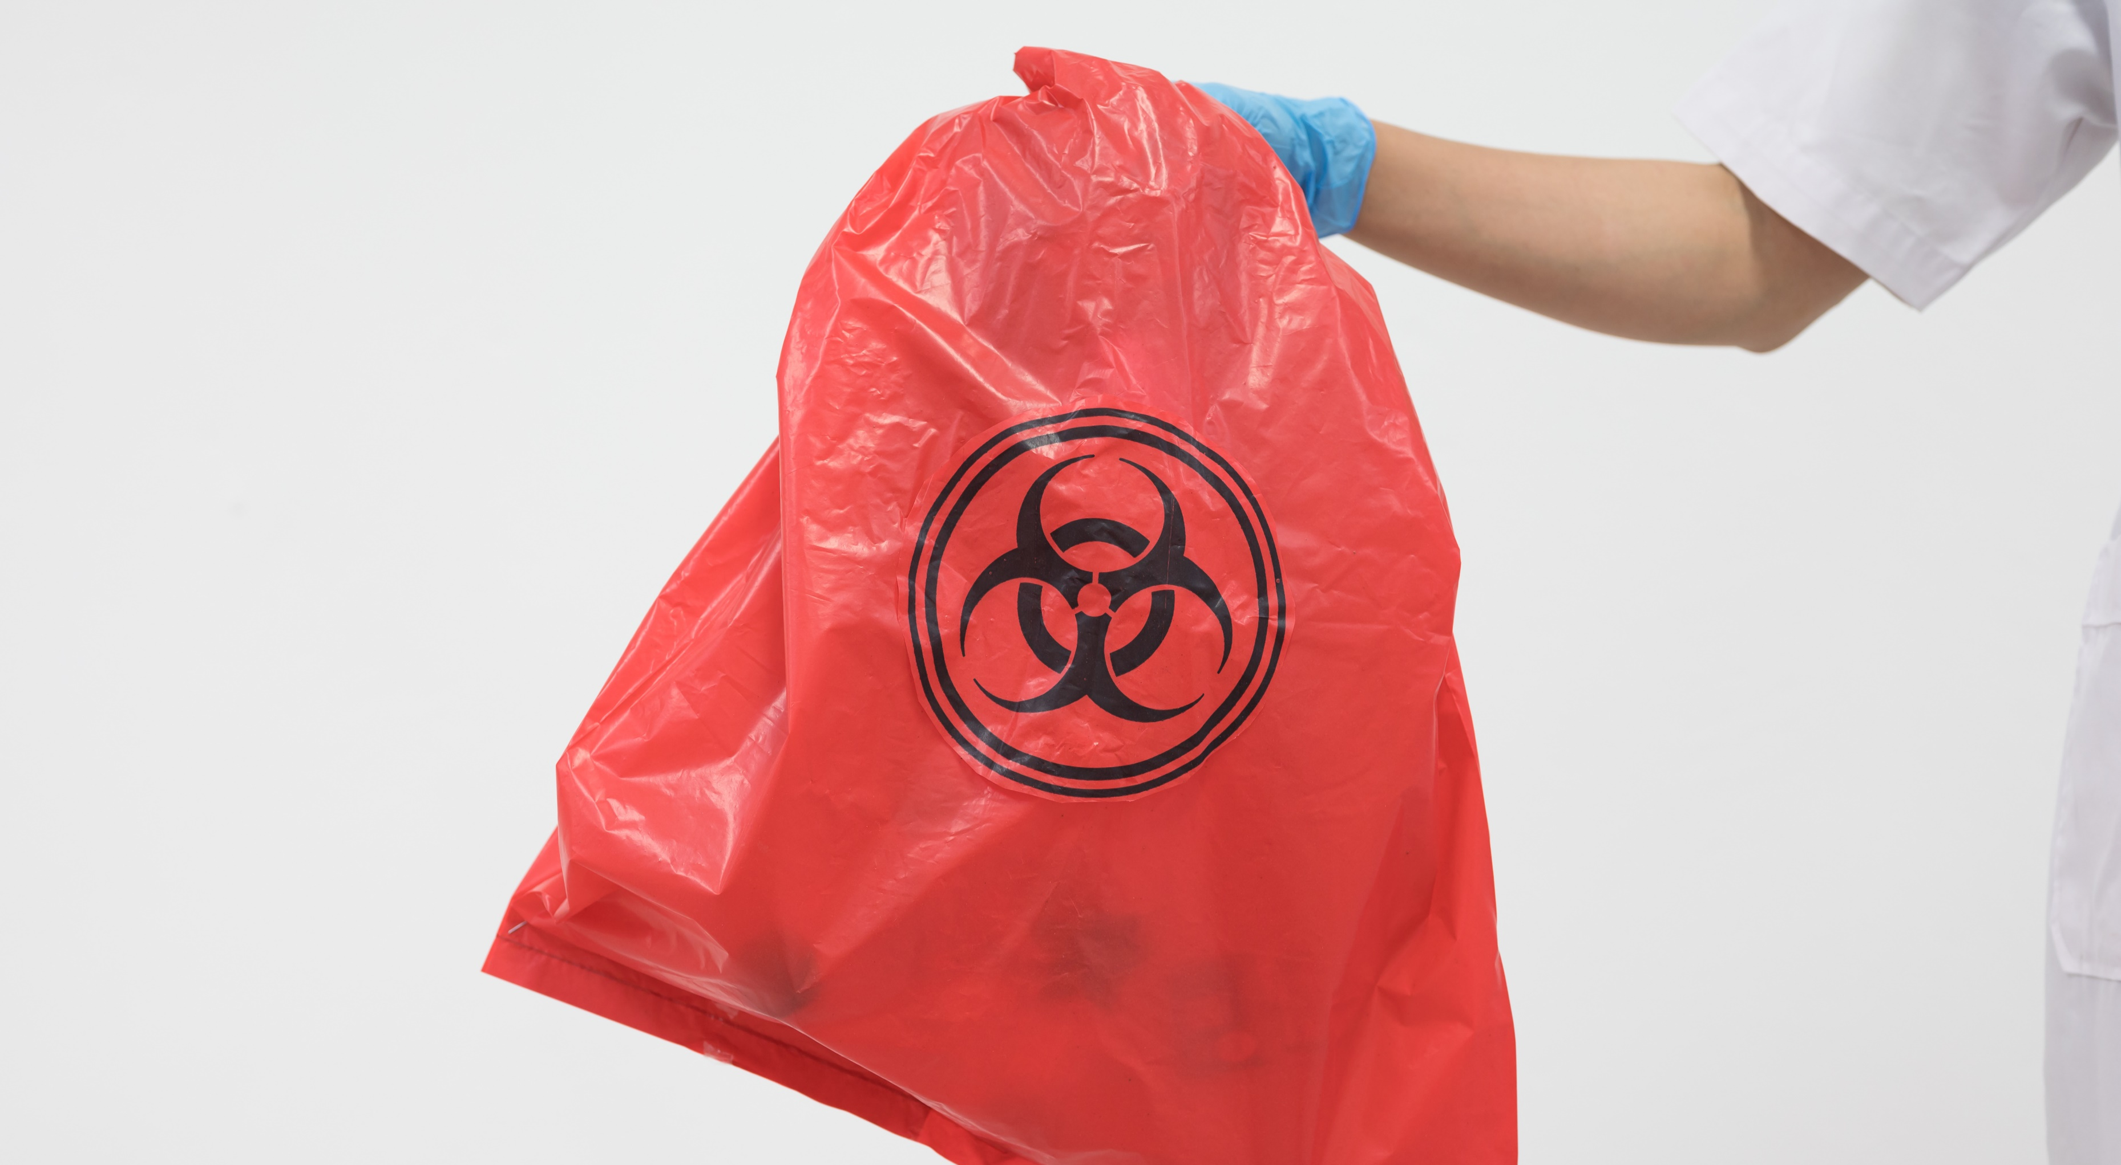
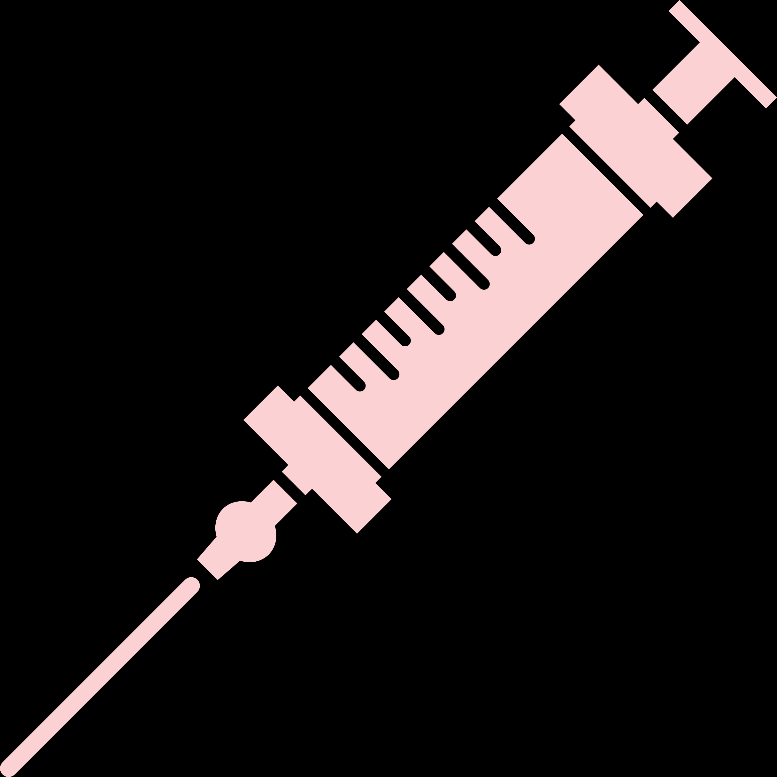
Collection & transport
Generation/
Minimization
Final disposal
Segregation
Collection
Transport
Storage
Treatment
Tie bags securely and replace after removing.
Collect according to schedule or when ¾ full.
Use appropriate personal protection equipment (PPE) for waste handlers.
Use covered trolley, wheelbarrow, wheeled bin or cart (exclusively used for waste).
Practice hand hygiene after handling waste.
Clean and disinfect transport equipment at the end of each working day.
Transport hazardous and non-hazardous waste separately.
¾ Full
Notes:
Audio: Regular collection and transport of waste to designated treatment or disposal facilities is important and should be done according to strict protocols, and in a timely manner with designated equipment such as a covered trolley, wheelbarrow, wheeled bin or cart.
Bins used for waste collection should be disinfected, for example, with a 0.2% chlorine solution to minimize the risk of contamination and spread of infections, and hand hygiene performed after handling waste.
Additionally, facilities must provide washing and disinfection areas for waste handlers and those responsible for transporting the waste.

Slide 18
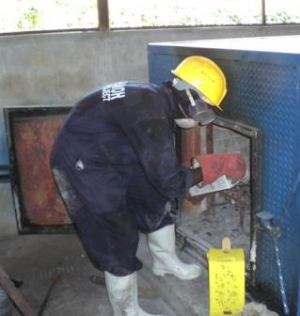
PPE for waste handlers
Generation/
Minimization
Final disposal
Segregation
Collection
Transport
Storage
Treatment
Heavy duty gloves.
Mask/goggles or face shield.
Long-sleeved gown/apron.
Closed shoes.
Depending on the task, a hard hat may be recommended.
REMEMBER!
Perform hand hygiene immediately after removing personal protective equipment.
Health care waste worker wearing PPE, Kenya.
Credit: WHO/Ute Pieper
Notes:
Audio: Handling and transporting waste is intrinsically dangerous, so waste handlers need adequate protection. This includes wearing appropriate Personal Protective Equipment, such as gloves, masks, and goggles, and preventing spillage or exposure. Thorough hand hygiene before and after handling waste is crucial to prevent infections.
Waste should not be re-sorted to avoid exposure to hazards. Handlers should avoid carrying waste against the body and use waste transportation equipment for heavy loads to prevent injuries.

Slide 19
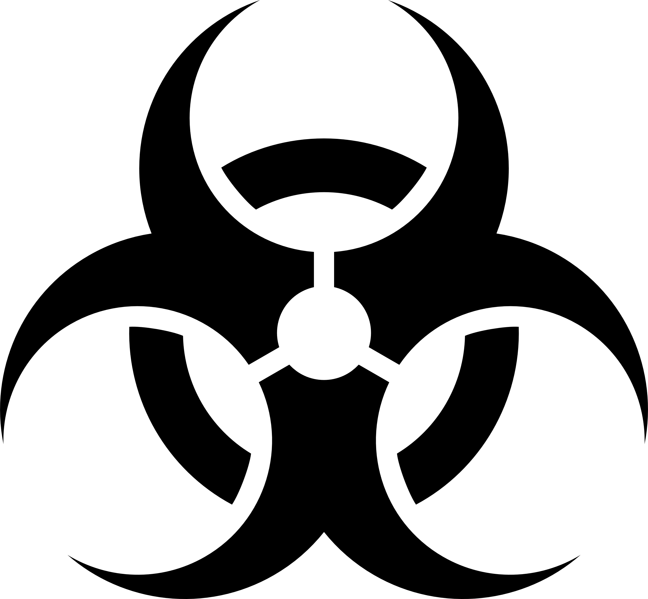
Storage of infectious & sharp waste
Generation/
Minimization
Final disposal
Segregation
Collection
Transport
Storage
Treatment
Temperate climate: Winter = 72 hours/Summer = 48 hours
Warm climate: Cool season = 48 hours/Hot season = 24 hours
Inaccessible to unauthorized persons/children, animals, insects and birds.
Labelled with biohazard symbol.
Floor and walls are sealed or tiled to allow easy disinfection.
Well ventilated & protected from rain.
Storage does not exceed maximum time limit.
Sharps require attention: containers replaced when 3/4th full.
Notes:
Audio: Proper storage of infectious and sharp waste in healthcare facilities is crucial for meeting health and safety standards.
The storage area must have sealed or tiled floors and walls for easy disinfection,
alongside adequate ventilation to prevent hazardous gas buildup and protection from rain.
There are strict time limits for storage based on climate, in hotter climates waste must not wait as long before being treated.
Sharps waste requires special attention - containers must be replaced when three-quarters full.

Slide 20
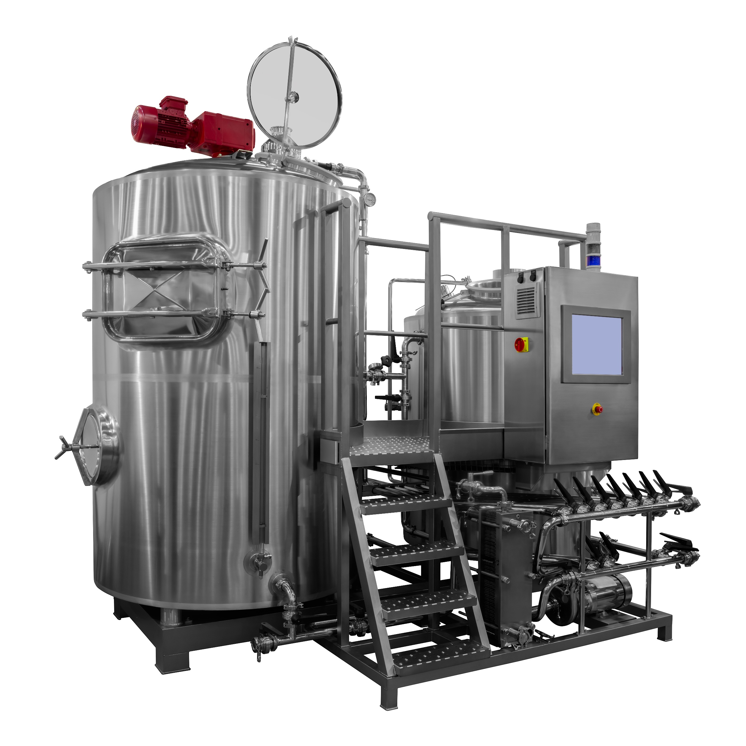
Non-burn treatment options are the most environmentally friendly
Generation/
Minimization
Final disposal
Segregation
Collection
Transport
Storage
Treatment
Technologies in accordance with international conventions
Treatment by steam ~121°C - ~134°C.
Only for infectious/sharp waste.
No hazardous emissions or ash.
Renders waste non-hazardous, some may be recycled.
Typical size ranges from 35-200 liters treatment capacity.
Some technologies need continuous water and power supply.
Credit: Shutterstock
Low-heat based and chemical based processes
Dual chamber incineration with flue gas treatment
Notes:
Audio: Non-burn treatment methods, like autoclaves, are evolving to be more accessible and eco-friendly, featuring newer models that are more cost-effective and resource-efficient. Some autoclaves require as little as 3 liters of water per cycle, a significant reduction from older models. Operating with steam, autoclaves sterilize waste without emitting hazardous substances or ash.
This process renders waste non-hazardous, with potential for recycling, thus lessening the environmental impact.
Autoclaves vary in size, accommodating different waste volumes, but require a steady water and power supply for optimal operation, which is not possible in all settings.

Slide 21
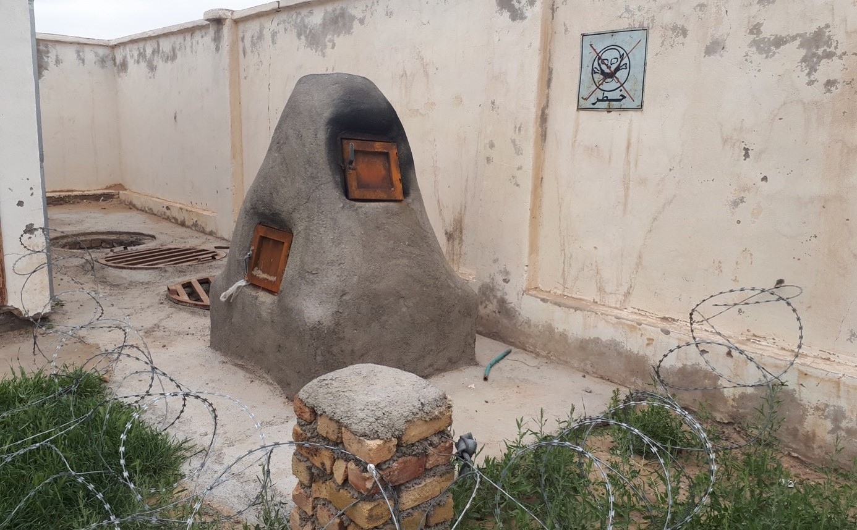
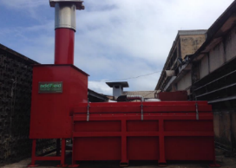
Incineration
Aim to comply with Stockholm Convention.
High temperature to prevent release of toxic particulates (dioxins & furans).
2 chambers: 850°C & 1100°C
Credit: UNICEF
Locally constructed incinerators as interim option in low resource settings.
Credit: WHO/Arabella Hayter
Notes:
Audio: Incineration, particularly in low-resource settings, is often favored for its affordability and ease of setup compared to non-burn technologies. However, it carries significant environmental and health risks from emissions like dioxins and furans, a type of Persistent Organic Pollutants. Many types of waste are also not suitable for incineration.
These substances are highly hazardous to health and the environment, affecting different bodily systems and increasing the risk of cancer. The Stockholm Convention has set a goal to limit the emissions of dioxins and furans, aiming for minimal presence in the air. This is a worldwide effort to lessen the damage caused by these pollutants. Meeting this standard requires using the best techniques and practices available.

Slide 22
Pressurized gas containers.
Sealed ampoules or vials (explode in the chamber).
Halogenated materials (e.g., PVC plastics).
Waste containing mercury, cadmium and other heavy metals.
Radioactive waste.
Chemical waste (e.g., reactive chemicals, aldehydes), unless by licensed incinerators with adequate flue gas treatment.
What should NOT be incinerated?
Notes:
Audio: Incineration, particularly in low-resource settings, is often favored for its affordability and ease of setup compared to non-burn technologies. However, it carries significant environmental and health risks from emissions like dioxins and furans, a type of Persistent Organic Pollutants. Many types of waste are also not suitable for incineration.
These substances are highly hazardous to health and the environment, affecting different bodily systems and increasing the risk of cancer. The Stockholm Convention has set a goal to limit the emissions of dioxins and furans, aiming for minimal presence in the air. This is a worldwide effort to lessen the damage caused by these pollutants. Meeting this standard requires using the best techniques and practices available.

Slide 23
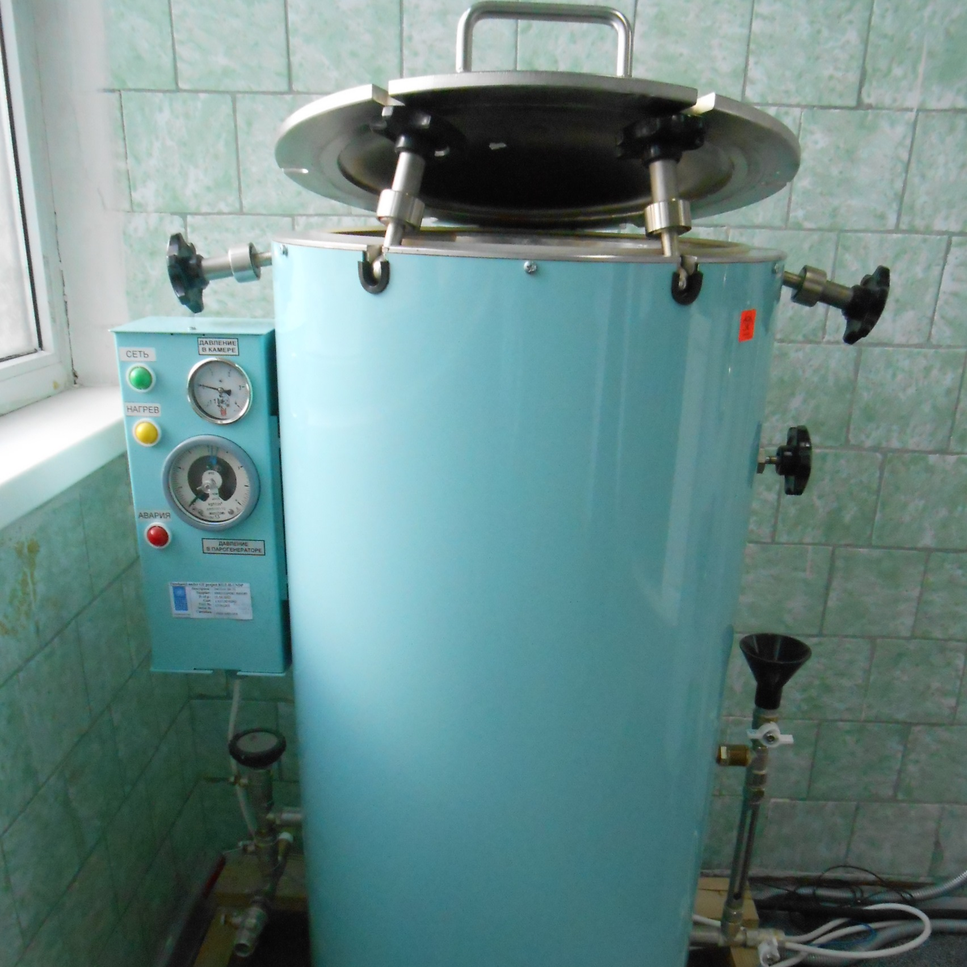
Heirarchy of waste treatment options
Generation/
Minimization
Final disposal
Segregation
Collection
Transport
Storage
Treatment
Low-heat based and chemical based processes
TECHNOLOGIES IN ACCORDANCE WITH INTERNATIONAL CONVENTIONS
Dual chamber incineration with flue gas treatment
Dual chamber incineration without flue gas treatment
INTERIM TREATMENT TECHNOLOGIES
Single chamber incineration without flue gas treatment
Automated pressure pulsing gravity autoclaving
Credits (top to bottom): WHO/Ute Pieper; WHO/Ute Pieper; Shutterstock
Notes:
Audio: Waste may be treated on or off-site. Smaller facilities are not generally expected to have their own waste treatment infrastructure and may send waste to be treated elsewhere. This is known as centralized treatment.
A number of waste treatment options exist and are classified here into a hierarchy. At the top are "green" options, which are the most preferable. These include non-burn technologies like autoclaves that produce minimal to no emissions, or incinerators that operate at high temperatures that align with International Conventions.
Moving down the hierarchy, "yellow" options are interim solutions. While these may not fully meet international standards, they are a step towards the end goal.
At the bottom are "red" options, considered last resorts. These are used in extremely low resource settings, in emergencies or as temporary measures. However, they often have significant environmental and health impacts, as we have already discussed.
WHO provides a comparative analyses of technologies, taking into account compliance with international standards, cost, energy requirements (such as electricity, water and fuel), waste volumes and importantly, environmentally sustainability. You can find a link to the document in the resources section at the end of the module.

Slide 24
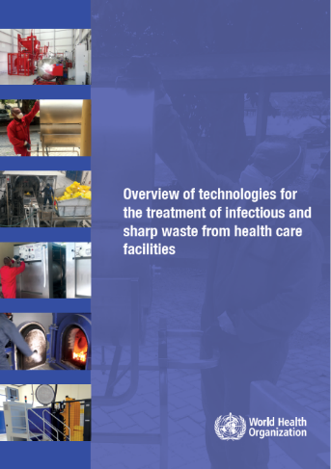
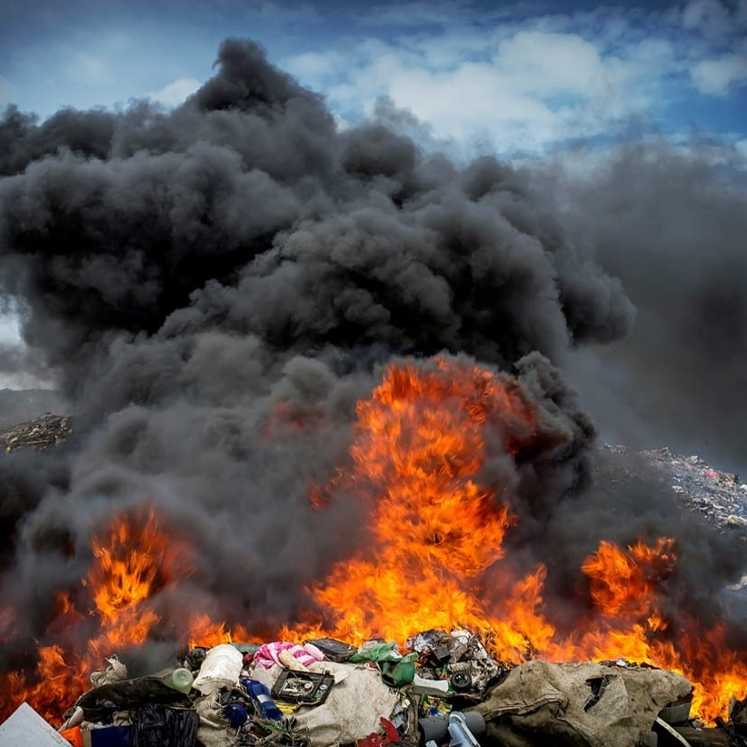
Heirarchy of waste treatment options
Generation/
Minimization
Final disposal
Segregation
Collection
Transport
Storage
Treatment
Low-heat based and chemical based processes
TECHNOLOGIES IN ACCORDANCE WITH INTERNATIONAL CONVENTIONS
Dual chamber incineration with flue gas treatment
Dual chamber incineration without flue gas treatment
INTERIM TREATMENT TECHNOLOGIES
Single chamber incineration without flue gas treatment
Automated pressure pulsing gravity autoclaving
Burning in a pit
UNCONTROLLED WASTE COMBUSTION
Open burning
Credits (top to bottom): WHO/Ute Pieper; WHO/Ute Pieper; Shutterstock
Notes:
Audio: Waste may be treated on or off-site. Smaller facilities are not generally expected to have their own waste treatment infrastructure and may send waste to be treated elsewhere. This is known as centralized treatment.
A number of waste treatment options exist and are classified here into a hierarchy. At the top are "green" options, which are the most preferable. These include non-burn technologies like autoclaves that produce minimal to no emissions, or incinerators that operate at high temperatures that align with International Conventions.
Moving down the hierarchy, "yellow" options are interim solutions. While these may not fully meet international standards, they are a step towards the end goal.
At the bottom are "red" options, considered last resorts. These are used in extremely low resource settings, in emergencies or as temporary measures. However, they often have significant environmental and health impacts, as we have already discussed.
WHO provides a comparative analyses of technologies, taking into account compliance with international standards, cost, energy requirements (such as electricity, water and fuel), waste volumes and importantly, environmentally sustainability. You can find a link to the document in the resources section at the end of the module.

Slide 25
Type of technology | Range of capacities (kg/h) | Environmental impact | Capital costs | Operating costs
Vacuum autoclave | 1 – 3000 | x | x | x
Hybrid autoclave | 5 – 3000 | x | xx | xx
Batch microwave | 30 – 210 | x | x | xx
Continuous microwave | 100 – 300 | x | xx | xx
Frictional heat treatment | 10 – 500 | x | xx | xx
Sodium hypochlorite | 600 – 3000 | xx | xxx | xx
Incineration including flue gas treatment | 10 – 3000+ | xxx | xxxx | xxxx
x = low, xx =medium, xxx = high, xxxx = very high
Notes:
Audio: This table provides a comparison of the technologies commonly available on the market which comply with the Stockholm and Basel Conventions.
Of these, vacuum autoclaves have the lowest environmental impact, capital and operating costs.
When selecting waste technologies, consider national & international regulations, budget availability for investment and maintenance, infrastructure including space, availability of energy likeelectricity, water or fuel, and the types & quantity of waste generated. Finally, look at what options exist for final disposal, such as recycling or landfills nearby?

Slide 26
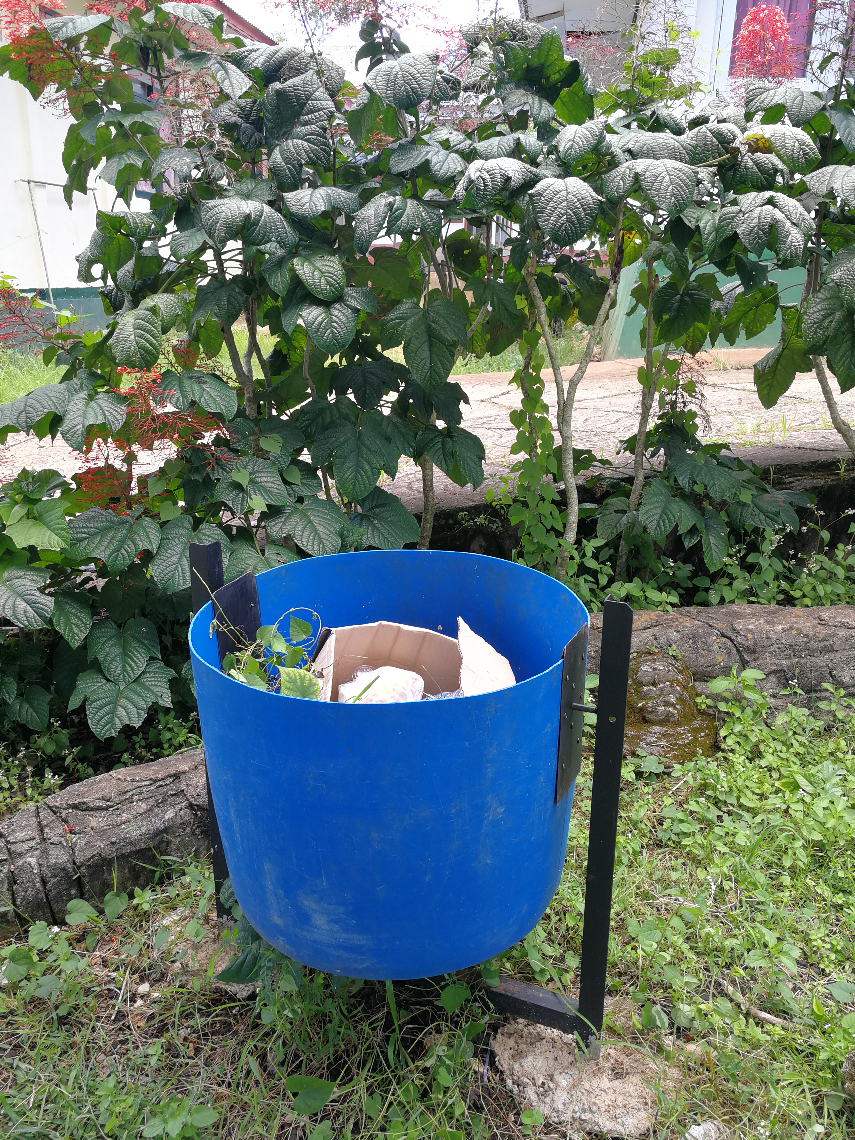
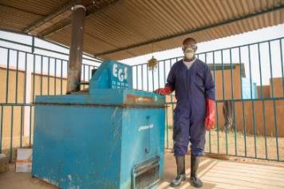
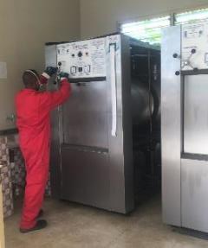
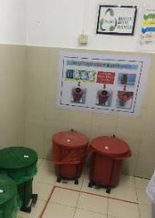
Making incremental improvements
Immediate improvements, minimal cost
Long term, most expensive
Medium term
Credits: WHO/Arabella Hayter
Notes:
Audio: Remember the diagram on the last slide. We aim to progress through the WASH FIT hierarchy incrementally, making small, cost-effective improvements. Remember, every step taken enhances climate resilience.
Initially, efforts should focus on minimizing waste through staff training in waste segregation and optimizing PPE use, supported by reminders across the facility.
In the medium term, investing in infrastructure, like secure waste storage or cost-effective incinerators for facilities which are currently using open burning, becomes essential.
Long-term strategies include creating a reverse logistics system for eco-friendly waste treatment at centralized facilities, emphasizing sustainable practices.
Nationally, establishing standards and legal frameworks, alongside allocating regular budgets for infrastructure, maintenance, energy, and training, is crucial for standardized, sustainable waste management.

Slide 27
Making incremental improvements
Immediate improvements, minimal cost
Long term, most expensive
Medium term
Waste minimization.
Training on waste segregation & rationale use of PPE.
Regular cleaning of outside grounds and waste bins.
Reminders at points of care.
Credits: WHO/Arabella Hayter
Notes:
Audio: Remember the diagram on the last slide. We aim to progress through the WASH FIT hierarchy incrementally, making small, cost-effective improvements. Remember, every step taken enhances climate resilience.
Initially, efforts should focus on minimizing waste through staff training in waste segregation and optimizing PPE use, supported by reminders across the facility.
In the medium term, investing in infrastructure, like secure waste storage or cost-effective incinerators for facilities which are currently using open burning, becomes essential.
Long-term strategies include creating a reverse logistics system for eco-friendly waste treatment at centralized facilities, emphasizing sustainable practices.
Nationally, establishing standards and legal frameworks, alongside allocating regular budgets for infrastructure, maintenance, energy, and training, is crucial for standardized, sustainable waste management.

Slide 28
Making incremental improvements
Immediate improvements, minimal cost
Long term, most expensive
Medium term
Build lockable, covered storage areas.
Build low-cost incinerator as interim solution.
Credits: WHO/Arabella Hayter
Notes:
Audio: Remember the diagram on the last slide. We aim to progress through the WASH FIT hierarchy incrementally, making small, cost-effective improvements. Remember, every step taken enhances climate resilience.
Initially, efforts should focus on minimizing waste through staff training in waste segregation and optimizing PPE use, supported by reminders across the facility.
In the medium term, investing in infrastructure, like secure waste storage or cost-effective incinerators for facilities which are currently using open burning, becomes essential.
Long-term strategies include creating a reverse logistics system for eco-friendly waste treatment at centralized facilities, emphasizing sustainable practices.
Nationally, establishing standards and legal frameworks, alongside allocating regular budgets for infrastructure, maintenance, energy, and training, is crucial for standardized, sustainable waste management.

Slide 29
Making incremental improvements
Immediate improvements, minimal cost
Long term, most expensive
Medium term
Reverse logistics system.
Waste is regularly & safely transported to centralized plant.
Non-burn technologies.
Solar power.
Credits: WHO/Arabella Hayter
Notes:
Audio: Remember the diagram on the last slide. We aim to progress through the WASH FIT hierarchy incrementally, making small, cost-effective improvements. Remember, every step taken enhances climate resilience.
Initially, efforts should focus on minimizing waste through staff training in waste segregation and optimizing PPE use, supported by reminders across the facility.
In the medium term, investing in infrastructure, like secure waste storage or cost-effective incinerators for facilities which are currently using open burning, becomes essential.
Long-term strategies include creating a reverse logistics system for eco-friendly waste treatment at centralized facilities, emphasizing sustainable practices.
Nationally, establishing standards and legal frameworks, alongside allocating regular budgets for infrastructure, maintenance, energy, and training, is crucial for standardized, sustainable waste management.

Slide 30
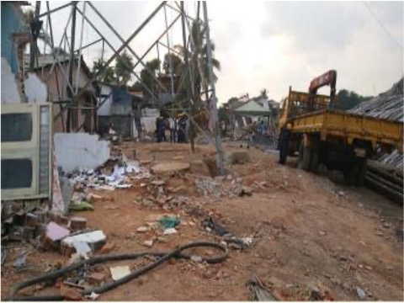
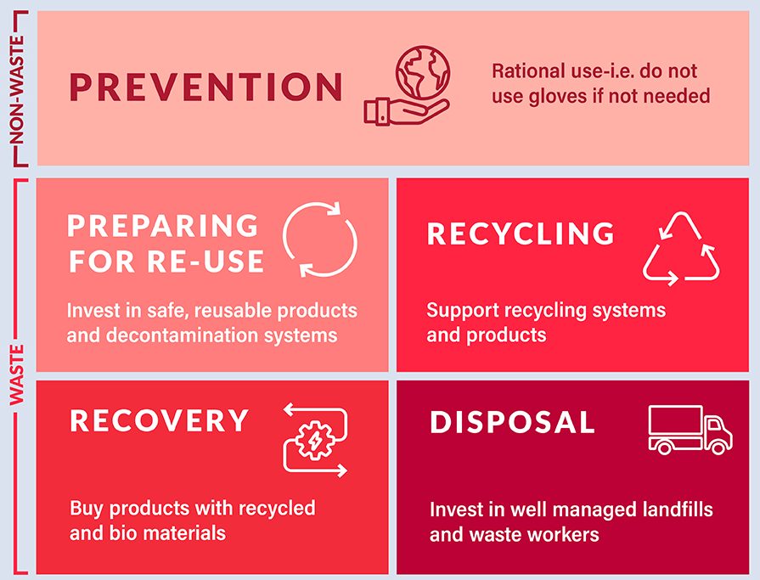
Strategies to mitigate and improve climate resilience of waste management
Waste prevention and reduction.
Waste recycling.
Sufficient waste containers & frequent emptying.
Safe storage capacity.
Repairing a dumpsite after its collapse from heavy rains in Sri Lanka.
Credit: WHO
Notes:
Audio: Finally, we will touch on some good practices to mitigate climate impact and enhance resilience. Strategies to prevent and reduce waste minimize the quantity generated. Recycling of non-hazardous materials conserves resources and decreases landfill use. Ensuring sufficient waste containers are available and planning for frequent emptying are vital, particularly when demands on health care facilities increase. Preparing for emergencies by improving storage capacity for additional waste generated during climate events is also necessary. Transitioning to safer waste treatment options, such as autoclaves that disinfect and neutralize waste without burning, is part of this initiative. Additionally, to combat the risks from floods, waste treatment areas and pits should be elevated, and ash pits made watertight and kept from overfilling to prevent contamination. These measures not only mitigate the impact of climate change but also bolster resilience to its effect.

Slide 31
Strategies to mitigate and improve climate resilience of waste management
Safe storage capacity.
Phase out incineration and implement non-burn technologies.
Elevate waste treatment areas and pits in flood prone areas.
Repairing a dumpsite after its collapse from heavy rains in Sri Lanka.
Credit: WHO
Notes:
Audio: Finally, we will touch on some good practices to mitigate climate impact and enhance resilience. Strategies to prevent and reduce waste minimize the quantity generated. Recycling of non-hazardous materials conserves resources and decreases landfill use. Ensuring sufficient waste containers are available and planning for frequent emptying are vital, particularly when demands on health care facilities increase. Preparing for emergencies by improving storage capacity for additional waste generated during climate events is also necessary. Transitioning to safer waste treatment options, such as autoclaves that disinfect and neutralize waste without burning, is part of this initiative. Additionally, to combat the risks from floods, waste treatment areas and pits should be elevated, and ash pits made watertight and kept from overfilling to prevent contamination. These measures not only mitigate the impact of climate change but also bolster resilience to its effect.

Slide 32
Key points
Aim for gradual (incremental) waste system improvements.
All facilities should prioritize waste reduction.
Segregate hazardous from non-hazardous waste at the source.
Utilize sharps boxes; avoid recapping or reusing needles.
Where possible, choose environmentally-friendly technologies like autoclaving for infectious/sharps waste treatment.
Implement national standards, regulations and budgets for safe waste management.
Credit: WHO/Oliver Asselin
Notes:
Audio: Thank you for completing this module. Key points to remember are:
Aim for gradual improvements in waste management systems.
Prioritize reducing waste generation across all facilities to save costs and protect the environment.
Ensure segregation of hazardous from non-hazardous waste right at the source.
Utilize sharp boxes to avoid needle recapping or reuse and keep infectious and sharp waste away from patients and the public.
Treat infectious and sharp waste before disposal, ideally using environmentally friendly technologies such as autoclaving.
Implementation of national standards, regulations, and budgets is crucial for the safe management of healthcare waste.
Please explore the reference section of this module for links to all mentioned resources.

