Slide 1
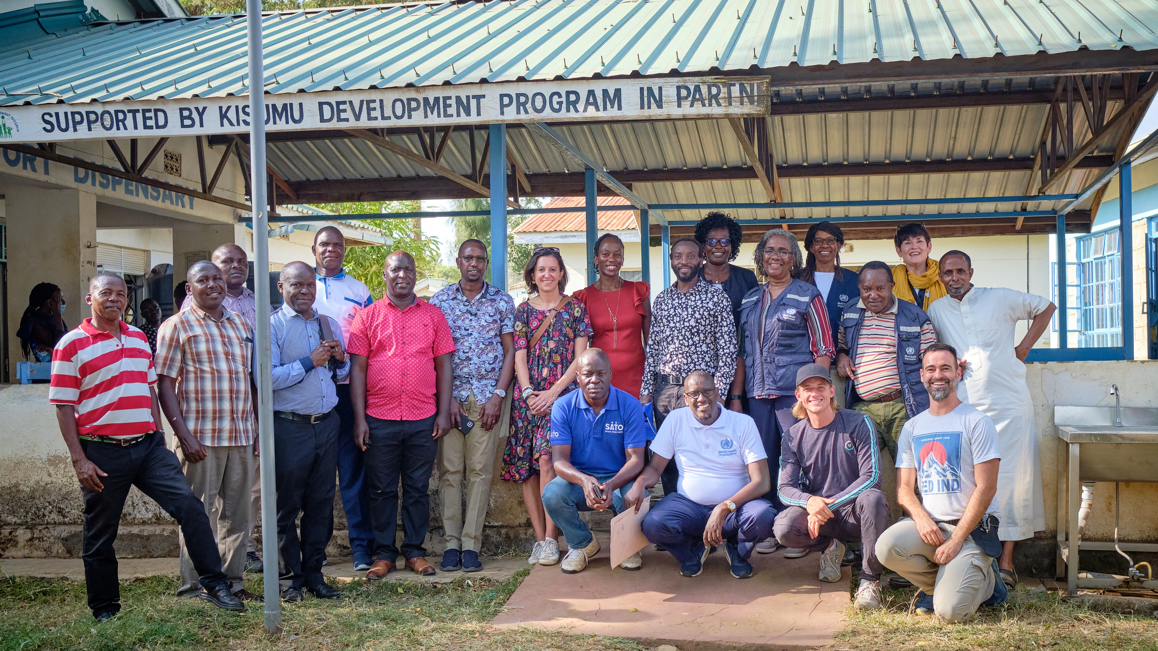
Module 2
The WASH FIT Improvement Cycle: Establish and train the team and document decisions (Step 1)
Credit: WHO/JacsSpoor
Notes:
Audio: Hello. This is Arabella Hayter again. Welcome to Module 2 on the WASH FIT Improvement Cycle: Establish and Train the Team and Document Decisions.​​

Slide 2
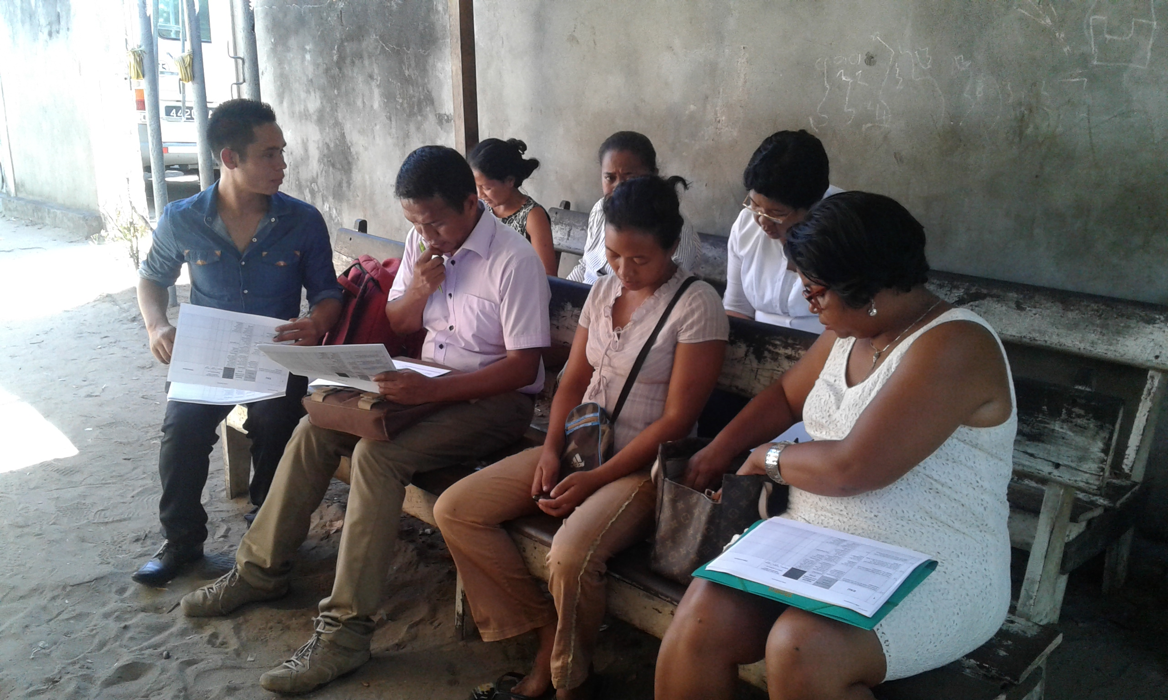
Learning objectives
By the end of this module, you will:
Establish and coordinate a proficient WASH FIT team tailored to your facility's needs.
Understand what makes a team successful, including the role of leadership.
Recognize and mitigate challenges like limited technical capacity and high workload.
Credit: WHO
Notes:
Audio: By the end of this module, you will know how to establish and coordinate a proficient WASH FIT team which is tailored to your facility’s needs. You will understand what makes a team successful, including the role of leadership and you recognize and mitigate challenges like limited technical capacity, stakeholder engagement and high workload.

Slide 3
WASH FIT improvement cycle
Step 1
Establish and train the team and document decisions
Step 5
Step 2
Monitor, review, adapt, improve
Undertake an assessment of the facility
Step 4
Step 3
Develop an incremental improvement plan and take action
Conduct a risk assessment to identify and prioritize areas for improvement
Notes:
Audio: Before moving forward, let's take a look at the WASH FIT improvement cycle, which consists of five phases that are undertaken at the facility. Through this module, and the four to follow, we will take you through each step one-by-one. The steps are:​
Step 1: Establish and train the team and document decisions​
Step 2: Undertake an assessment of the facility ​
Step 3: Conduct a risk assessment to identify and prioritize areas for improvement​
Step 4: Develop an incremental improvement plan and take action ​
Step 5: Monitor, review, adapt and improve

Slide 4
WASH FIT improvement cycle
Step 1
Establish and train the team and document decisions
Step 2
Step 5
Step 2
Step 5
Monitor, review, adapt, improve
Monitor, review, adapt, improve
Undertake an assessment of the facility
Undertake an assessment of the facility
Step 4
Step 4
Step 3
Step 3
Conduct a risk assessment to identify and prioritize areas for improvement
Develop an incremental improvement plan and take action
Conduct a risk assessment to identify and prioritize areas for improvement
Develop an incremental improvement plan and take action
Notes:
Audio: This module will focus on step one: establishing and training the team and documenting decisions.​

Slide 5
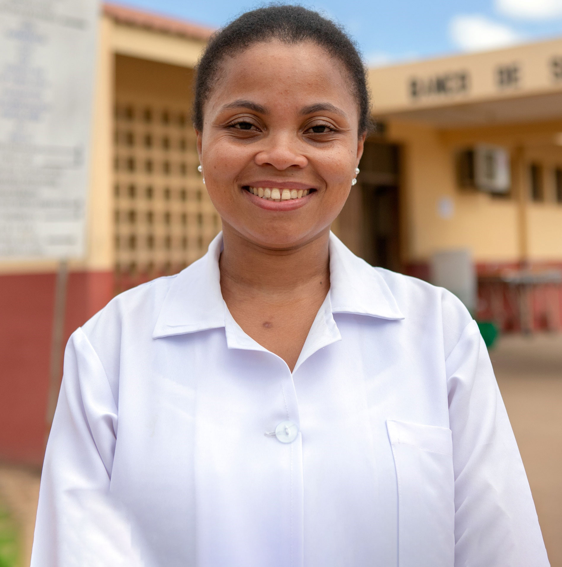
Step 1: Establish and train the team and document decisions
Credit: WHO/Mark Nieuwenhof
Train
Build your team with staff and community members.
Train, mentor and support.
Conduct annual refresher courses.
Hold regular meetings.
Supporting tools
Official training package.
Simple form to record roles & responsibilities of team members.
Record of team meetings.
Notes:
Audio: Establishing and Training Your Team is the starting point for WASH FIT. Building your team involves selecting staff and community members with the necessary expertise and empowering them through training, mentoring and support. You can use the official WASH FIT training package or locally adapted materials to ensure each member fully understands their role. You may need to conduct annual refresher courses or as needed when staff turnover. Regular meetings are crucial for sustaining momentum, evaluating progress and strategizing for continued improvement. Documentation of decisions taken in each of the subsequent steps is vital, using forms to detail roles and responsibilities and team meetings. We will also look at data visualization and sharing in the next module. Keeping a record of team meetings and decisions taken will help you to look back and see what progress has been made over time, guide your work, and be useful when it comes to sharing data. These records may also be useful for other facilities to learn from.

Slide 6
Step 1: Establish and train the team and document decisions
Credit: WHO/Mark Nieuwenhof
Train
Build your team with staff and community members.
Train, mentor and support.
Conduct annual refresher courses.
Hold regular meetings.
Supporting tools
Official training package.
Simple form to record roles & responsibilities of team members.
Record of team meetings.
Document
Document decisions taken (written reports, photos and videos).
Record and share data.
Look back at records to monitor progress.
Share records and progress with other facilities.
Notes:
Audio: Establishing and Training Your Team is the starting point for WASH FIT. Building your team involves selecting staff and community members with the necessary expertise and empowering them through training, mentoring and support. You can use the official WASH FIT training package or locally adapted materials to ensure each member fully understands their role. You may need to conduct annual refresher courses or as needed when staff turnover. Regular meetings are crucial for sustaining momentum, evaluating progress and strategizing for continued improvement. Documentation of decisions taken in each of the subsequent steps is vital, using forms to detail roles and responsibilities and team meetings. We will also look at data visualization and sharing in the next module. Keeping a record of team meetings and decisions taken will help you to look back and see what progress has been made over time, guide your work, and be useful when it comes to sharing data. These records may also be useful for other facilities to learn from.

Slide 7
Key principles
All team members have specific roles and responsibilities that are clearly defined and endorsed by senior management.
A leader is appointed to drive the process with full support from senior management.
Team has diversity and gender balance and involves clinical and non-clinical or auxiliary staff.
Community, facility users, and local government representatives are involved and provide broader community context.
Notes:
Audio: Let's explore the key principles that make a WASH FIT team effective.
​
Firstly, all team members must have specific roles and responsibilities, that are clearly defined and endorsed by senior management, to increase accountability. A leader, either part of senior management or with full support from them, is appointed to drive the process. The team should have diversity and gender balance and should involve a mix of clinical and non-clinical (or auxiliary) staff. Members of the community, facility users, and local government representatives.

Slide 8
Making the team more friendly for Gender Equality, Disability and Social Inclusion (GEDSI)
The team reflects the diversity of the community & users with specific WASH requirements or constraints:
Members of disabled people’s organisations (DPOs).
Women’s groups and human rights activists.
Civil society to speak up for marginalised and indigenous groups.
Respect all members of the team regardless of gender, ethnicity, age or whether they are in a clinical or non-clinical role.
Notes:
Audio: The team should reflect the diversity of the local community and users, especially those with specific WASH requirements or disabilities. This will help to uphold the principles of gender equality, disability and social inclusion, a topic which we will come back to throughout this course. To do this, the team should include members of disabled people’s organizations, women’s group and human rights activists, and representatives from civil society who can speak up for marginalized and indigenous groups.
All members of the team should be respected, and their voices heard regardless of gender, ethnicity, age or whether they are in a clinical or non-clinical role.

Slide 9
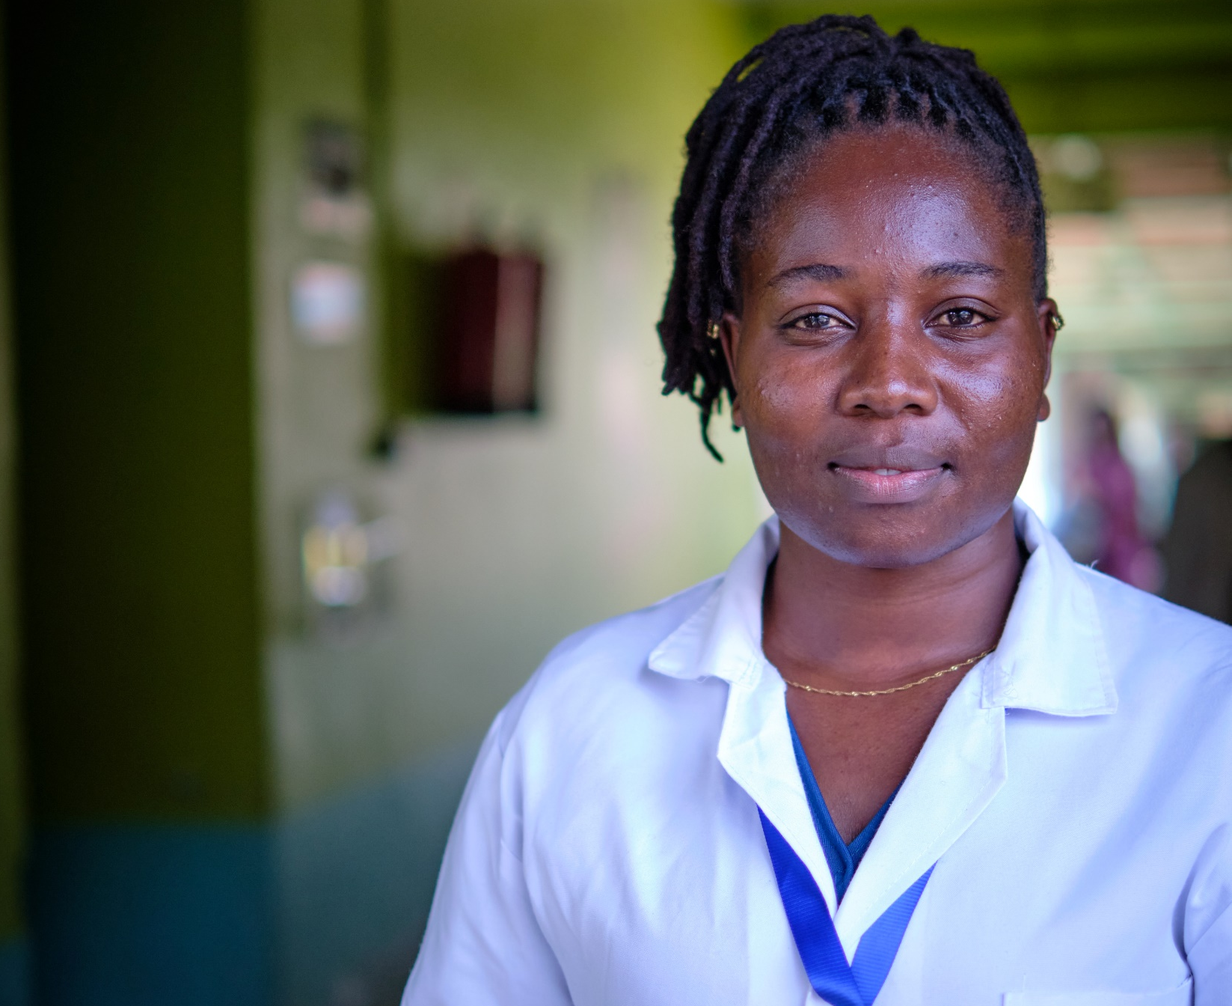
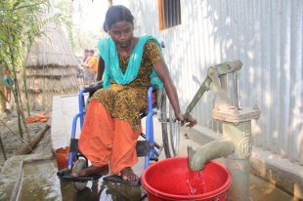
Forming the appropriate WASH FIT team
What, How, and Who should be in the WASH FIT team?
How might the team differ between a small rural facility and a district/national hospital?
What external expertise could be needed?
Credit: WHO/Fanjan Combrink
Credit: WHO/Nazik Armenakyan
Credit: CDD/Shumon Ahmed
WASH FIT team members in Georgia, Nepal and Madagascar
Notes:
Audio: Team composition will vary according to the size of healthcare facility's size and the type of services offered. Take a moment to pause the video and consider who should be in a WASH FIT team? How might the team differ between a small rural clinic and a larger district or national hospital. What external expertise could be needed?

Slide 10
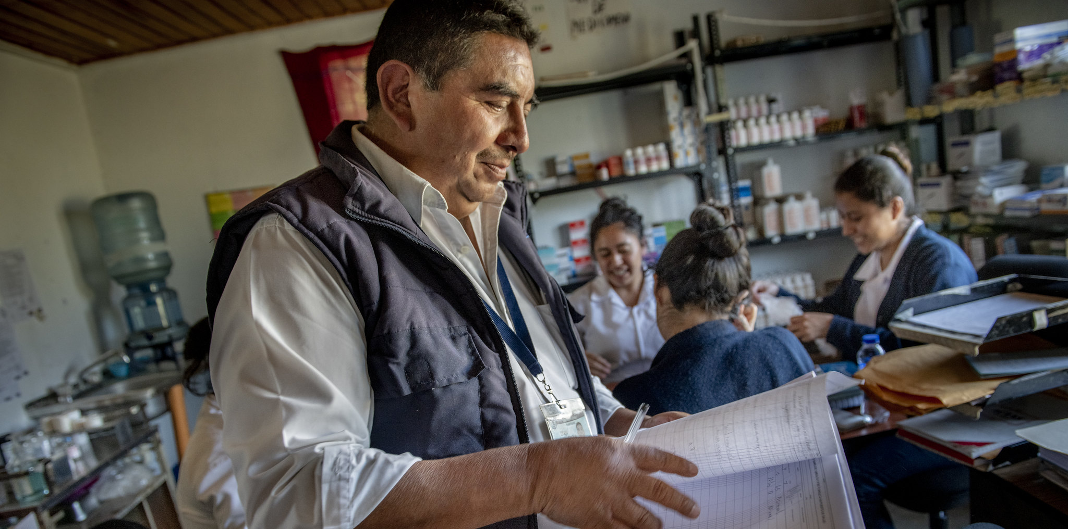
Team membership
Primary health care facility
Community engineer/ technician
District health authority representative
Facility manager, doctor or clinician
Nurse/health assistant
Community leader
Credit: MCSP/Karen Kausmaski
Notes:
Audio: In primary health care facilities, the team typically includes a facility manager, doctors or clinicians, nurses or health assistants, community engineers or technicians, community leaders and district health authorities.

Slide 11
Team membership
District/ national hospital
IPC or IPC/WASH focal point
Additional clinicians
Community representatives
Engineers
Health care waste technician/ cleaner
Senior management
Quality lead
External experts
Credit: MCSP/Karen Kausmaski
Notes:
Audio: Larger facilities, such as district or national hospitals, might expand their teams to include additional clinicians, members of senior management, IPC or WASH focal points, quality leads, engineers, healthcare waste technicians, cleaners and representatives from community or patient groups. External experts from local government units, water quality management committees, NGOs and professional organizations offer diverse perspectives and specialized knowledge. Local WASH experts, engineers and representatives from water districts and regulators provide technical and regulatory insights, who can bring their skills and knowledge to enhance compliance with local standards and help identify problems in the facility. Whether in a small clinic or a large hospital, the WASH FIT team should bring together a range of skills and expertise, who can collectively make a significant impact.

Slide 12
Team membership
District/ national hospital
IPC or IPC/WASH focal point
Additional clinicians
Community representatives
Engineers
Health care waste technician/ cleaner
Senior management
Quality lead
External experts
Credit: MCSP/Karen Kausmaski
Notes:
Audio: Larger facilities, such as district or national hospitals, might expand their teams to include additional clinicians, members of senior management, IPC or WASH focal points, quality leads, engineers, healthcare waste technicians, cleaners and representatives from community or patient groups. External experts from local government units, water quality management committees, NGOs and professional organizations offer diverse perspectives and specialized knowledge. Local WASH experts, engineers and representatives from water districts and regulators provide technical and regulatory insights, who can bring their skills and knowledge to enhance compliance with local standards and help identify problems in the facility. Whether in a small clinic or a large hospital, the WASH FIT team should bring together a range of skills and expertise, who can collectively make a significant impact.

Slide 13
What challenges might the WASH FIT team face?
Technical capacity
Engagement of stakeholders & senior management
High workload – limited time for WASH FIT activities
Staff turnover – need for retraining
Communication between team members
Limited funds
Difficult to sustain momentum
Credit: WHO/Nazik Armenakyan
Notes:
Audio: Navigating through the WASH FIT process, it’s important to anticipate and prepare for potential challenges that the team might face. These challenges include limited technical capacity among team members, limited engagement of stakeholders and senior management, high workloads of staff meaning there is limited time for WASH FIT activities, high staff turnover and the need to retrain existing and upskill new team members. Ensuring effective communication between team members can also be difficult. Limited funds can also have an impact on team morale as well as the ability to make improvements. Sometimes it may seem difficult to sustain momentum in the face of these other challenges.
Reflect on these challenges and consider any additional barriers specific to your context. Take a moment to think about steps you would take to overcome these challenges. This might be improving communication methods to hear from all team members, allocating dedicated time for WASH FIT activities and additional resources where available, or engaging stakeholders more effectively.

Slide 14
What challenges might the WASH FIT team face?
Technical capacity
Engagement of stakeholders & senior management
High workload – limited time for WASH FIT activities
Staff turnover – need for retraining
Communication between team members
Limited funds
Difficult to sustain momentum
Credit: WHO/Nazik Armenakyan
Notes:
Audio: Navigating through the WASH FIT process, it’s important to anticipate and prepare for potential challenges that the team might face. These challenges include limited technical capacity among team members, limited engagement of stakeholders and senior management, high workloads of staff meaning there is limited time for WASH FIT activities, high staff turnover and the need to retrain existing and upskill new team members. Ensuring effective communication between team members can also be difficult. Limited funds can also have an impact on team morale as well as the ability to make improvements. Sometimes it may seem difficult to sustain momentum in the face of these other challenges.
Reflect on these challenges and consider any additional barriers specific to your context. Take a moment to think about steps you would take to overcome these challenges. This might be improving communication methods to hear from all team members, allocating dedicated time for WASH FIT activities and additional resources where available, or engaging stakeholders more effectively.

Slide 15
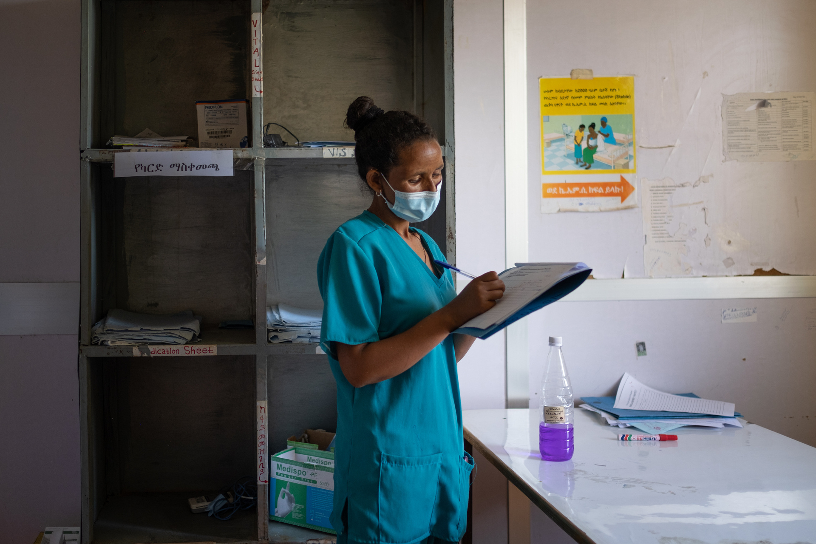
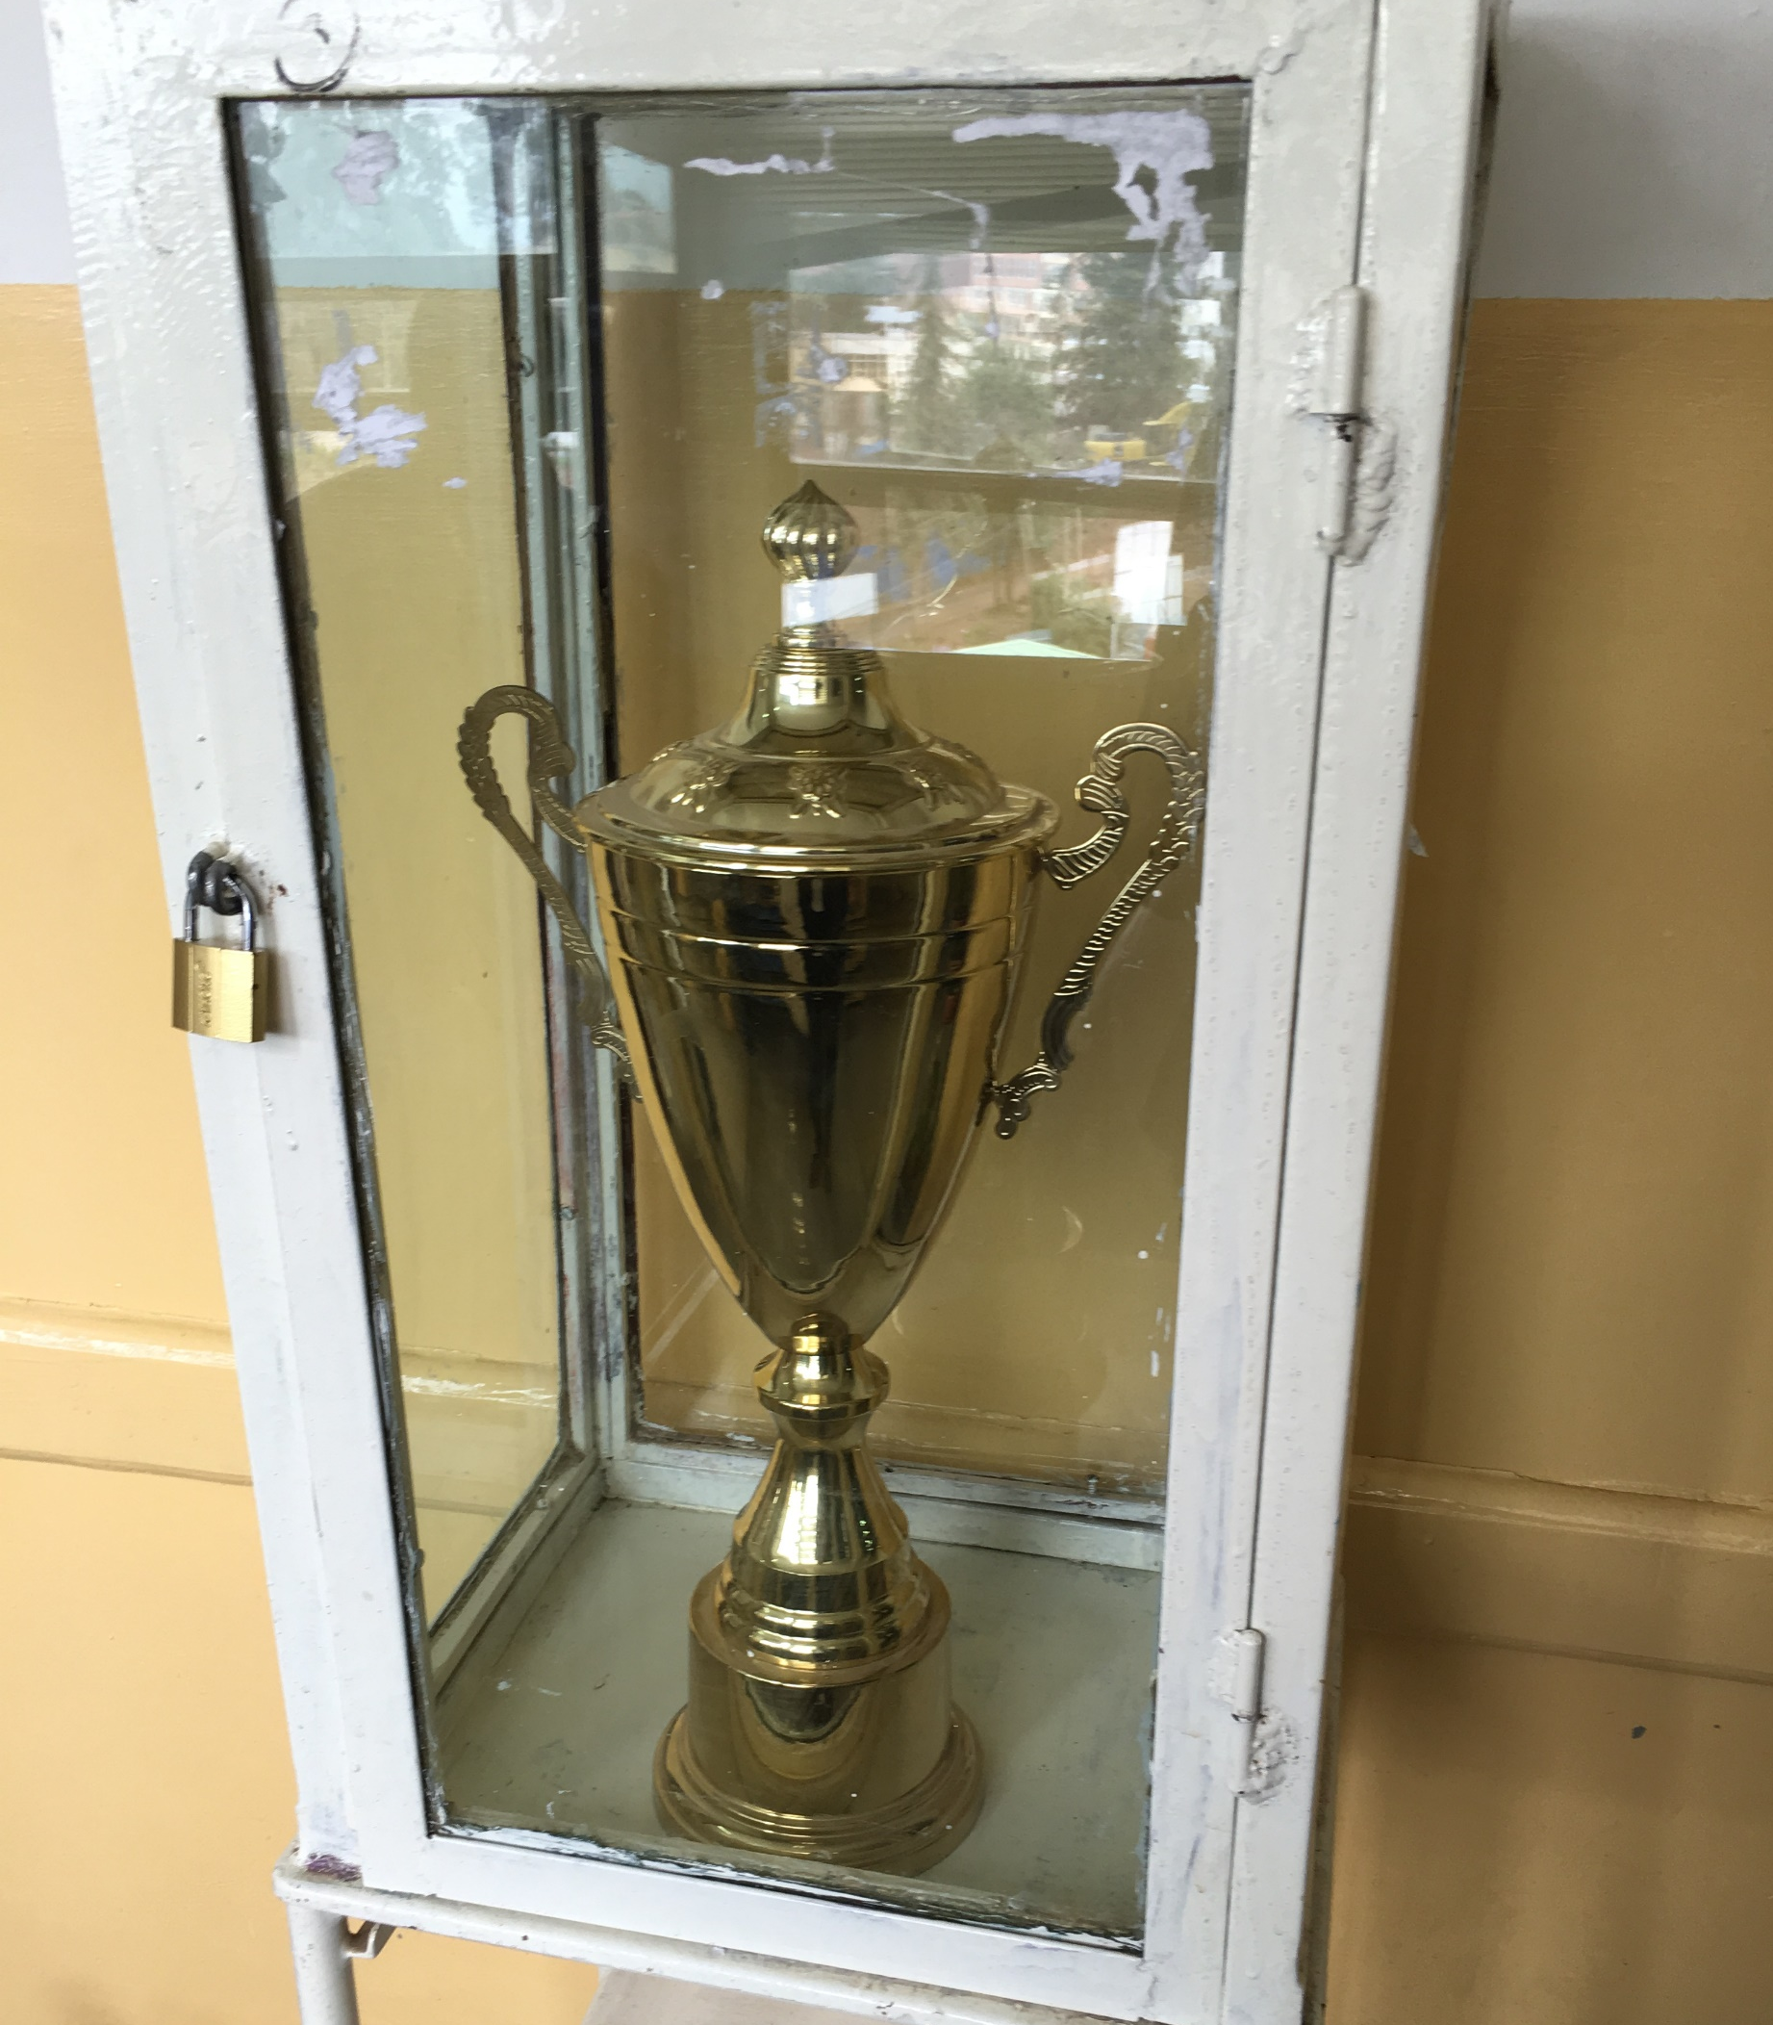
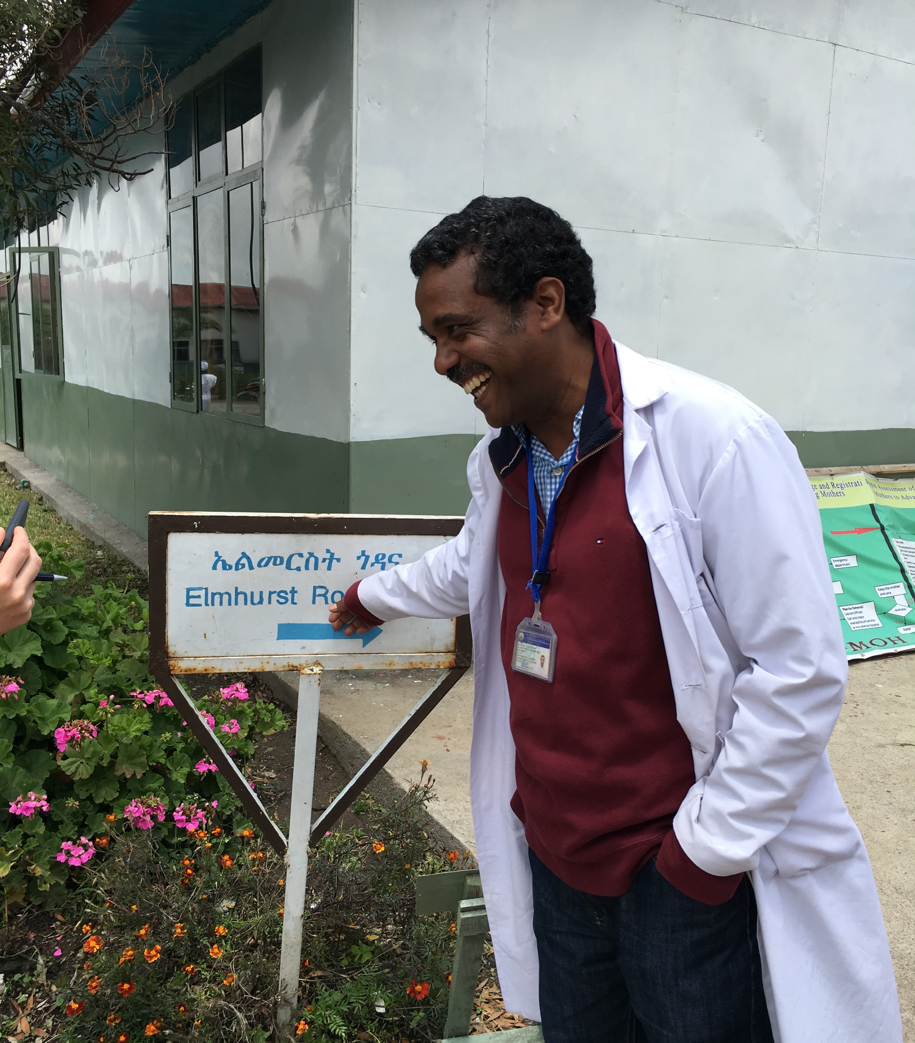
Role of leadership in supporting WASH FIT teams in Ethiopia
Committed leader created a culture of quality improvement.
Credit : WHO/Blink Media - Hilina Abebe
Credit: WHO/Arabella Hayter
A formally recognized quality management system includes WASH.
Staff incentivized with awards for good performance.
Credit: WHO/Arabella Hayter
Notes:
Audio: Let’s take a look at a case study of a team in Ethiopia, from a large district hospital participating in the CASH initiative. CASH stands for Clean and Safe Hospitals, a national program aimed at improving quality of care through WASH and IPC which built on the WASH FIT methodology. The CASH teams, guided by strong strong leadership and a culture valuing WASH, where staff were incentivized with awards for good performance were critical for driving behavior change.

Slide 16
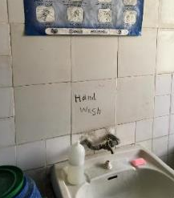
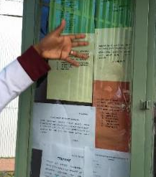
Role of leadership in supporting WASH FIT teams in Ethiopia
Wards ranked according to WASH FIT score & shown at facility entrance.
Credit: WHO/Arabella Hayter
Credit: WHO/Arabella Hayter
Regular audits of WASH & IPC.
Regular hand hygiene activities.
Credit: WHO/Arabella Hayter
Notes:
Audio: Combined with regular audits, ranking of wards according to the WASH FIT score and regular hand hygiene activities helped improve WASH indicators. Some of these strategies will be further explored in the hand hygiene module and technical factsheet on multimodal strategies. Prior to starting Module 9 on hand hygiene, consider reviewing the hand hygiene factsheet in the reference section of that module.

Slide 17
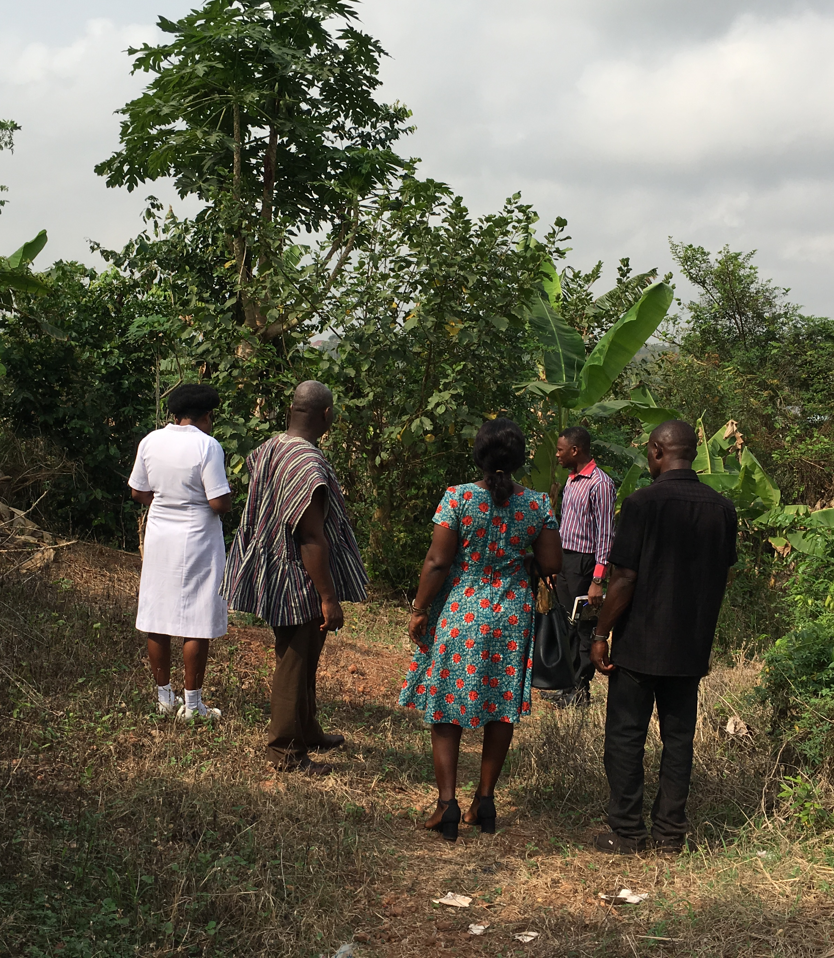
Role of community engagement to support WASH FIT teams in Ghana
Community score cards provide means to rank WASH needs and improvements alongside other key needs.
Members of the community committee inspect the waste pit with the IPC focal point to plan improvements.
Credit: WHO/Arabella Hayter
Notes:
Audio: In Ghana, community engagement is crucial for improving rural primary healthcare, including Water, Sanitation, and Hygiene through a community scorecard managed by the Ghana Health Service. Communities contribute feedback and solutions for quality care enhancements.

Slide 18
Role of community engagement to support WASH FIT teams in Ghana
Specific community actions included:
Organized cleaning campaigns.
Hired a local engineer to fix plumbing and build a facility fence to keep animals out.
Appeared on local radio to solicit community feedback and ideas for the health care facility.
Members of the community committee inspect the waste pit with the IPC focal point to plan improvements.
Credit: WHO/Arabella Hayter
Notes:
Audio: Specific community actions included organizing cleaning campaigns to remove health care waste from common areas and gardens, hiring a local engineer who could make quick fixes to plumbing problems such as leaking taps and build a fence around the facility to keep animals out. Community members also appeared on local radio to solicit feedback and ideas from the community to improve the facility. In this picture, community committee members and the Infection Prevention and Control (IPC) focal point inspect waste management facilities to plan further improvements. These sorts of activities can be integrated into the WASH FIT cycle and need not cost a lot of money.

Slide 19
Key points
A team responsible for WASH FIT and quality improvement is established and trained.
Team meets regularly and documents decision making.
Team is the driving force behind all WASH FIT activities.
Size and makeup of team will vary according to the size of facility – external expertise may be sought.
Training and regular mentoring of the team is important.
Credit: WHO/JacsSpoor
Notes:
Audio: Key points from this module include the following: ​
A team responsible for WASH FIT and quality improvement is established and trained. ​
The team should meet regularly and document decision making. ​
The team is the driving force behind all WASH FIT activities. ​
The size and makeup of the team will vary according to the ’size of the facility and external expertise may be needed. ​
Ongoing training and regular mentoring of the team is important for ongoing success.
Thank you for completing this module.

