Slide 1
Time to Act
Findings and implications from the Global Progress Report on WASH, Waste and electricity services in health care facilities
Global Launch Webinar
7 Oct 2025

Slide 2
Objectives and agenda
Objectives
Present key findings of global progress report
Share insights from countries and partners
Energize collective and strategic action
Agenda
Moderators: Dr Rola Al-Eman and Bruce Gordon, WHO
Summary of report findings: Dr Maggie Montgomery, WHO/Lindsay Denny, UNICEF
Reflections from Jordan: Dr Ayman Bani Mousa, MoH
Reflections from Zambia: Dr Florence Kabinga, MoH
Partner perspectives: Jessy Samuyachi, World Vision/Achille Lokssou-Dah-Lande, IFRC/Harish Hande, Selco Foundation
Next steps and closing: Ann Thomas, UNICEF

Slide 3
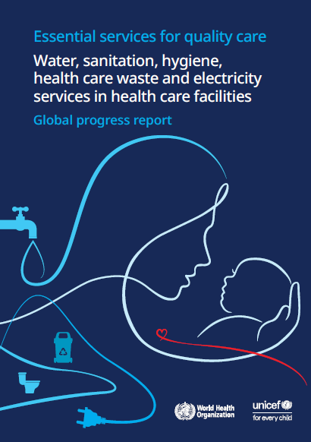
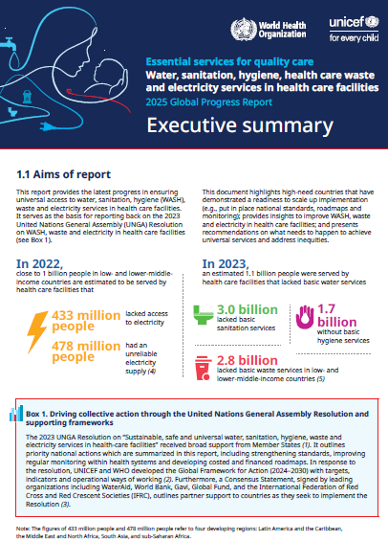
New Global Progress Report on WASH, waste and electricity in health care facilities
Launched 24 September at high level event hosted by Hungary and Philippines at UN General Assembly
Aim: provide status of progress towards universal access and report against agreed targets in UN resolution (2023) and WHA resolution (2019)
Content: Data from 101 countries on national actions, summary of service level data, case studies on integration, costed roadmaps, equity, climate, etc
Data validation: Country tracker scores given using 4-point scale, validating with country evidence + MoH review
Time scale: Report presents data for all 3 years collected (2020, 2022, 2025)

Slide 4
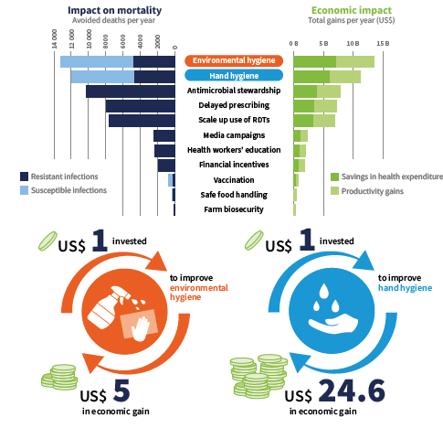
The health and economic case for better WASH, waste and electricity services
Safe, climate resilient and environmentally sustainable health care facilities
Foundation for quality and primary health care
Addressing preventable maternal and newborn deaths
Core element of Global Action Plan on IPC
Fundamental to Global AMR commitments and action plans
Critical to vaccine efforts to improve safe and sustainable health care waste management
Enables health security and supports health emergency preparedness and response

Slide 5
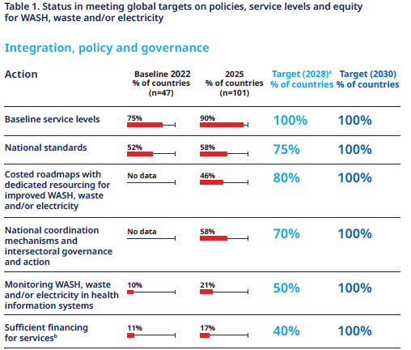
Progress against global targets

Slide 6
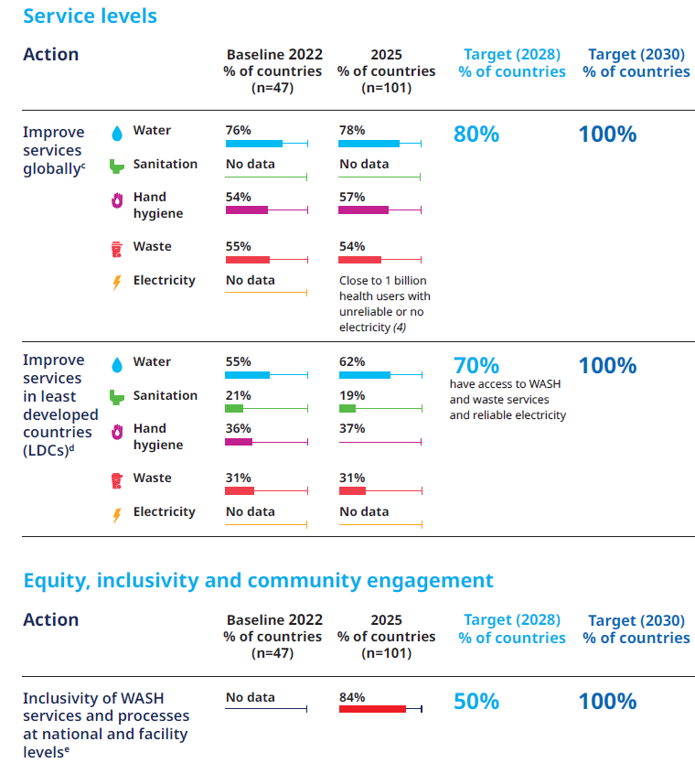
Progress against global targets, continued

Slide 7
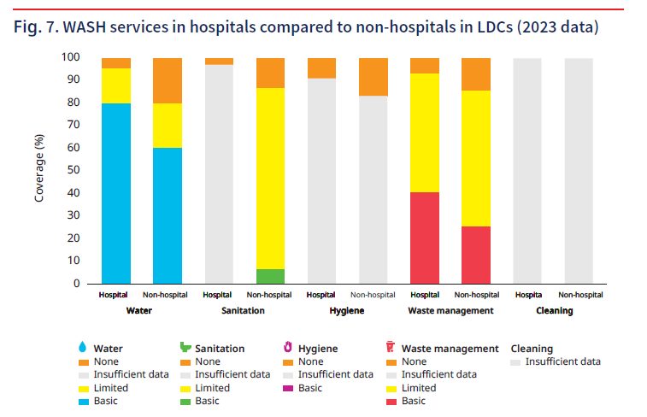
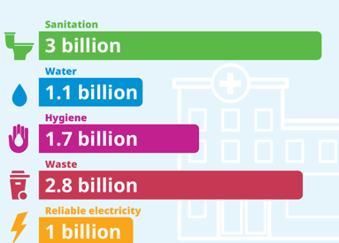
Gaps in services also indicate large inequities
Globally, billons of health users lack basic services at health care facilities

Slide 8
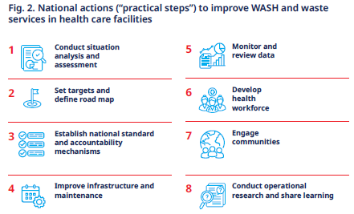
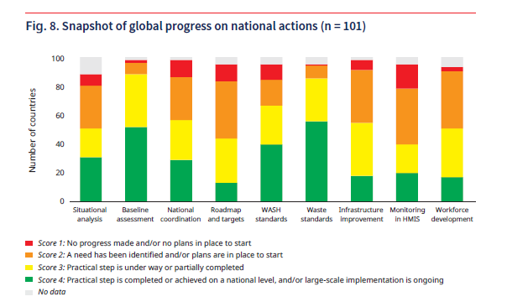
Countries taking action, investments needed
All 101 responding countries taking action at national level
82% have fully implemented at least one national action – including LDCs
17% of countries have substantially advanced/completed all national actions
Most implemented: Baseline assessments (53%) and WASH (42%) and Waste (58%) standards
Least implemented: Costed roadmaps (14%), infrastructure improvements (18%) and workforce (17%)

Slide 9
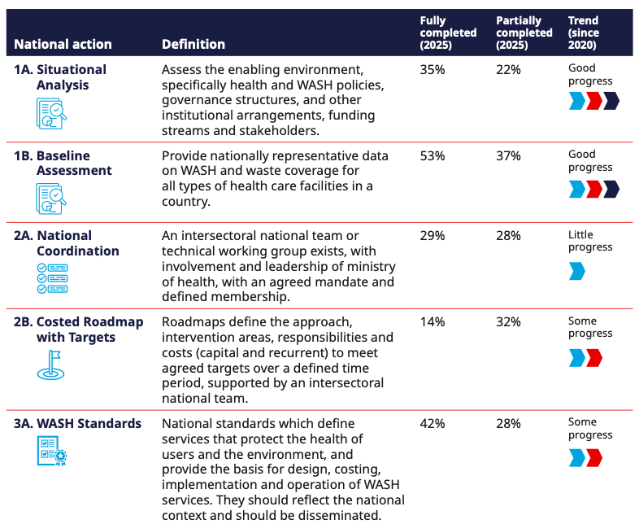
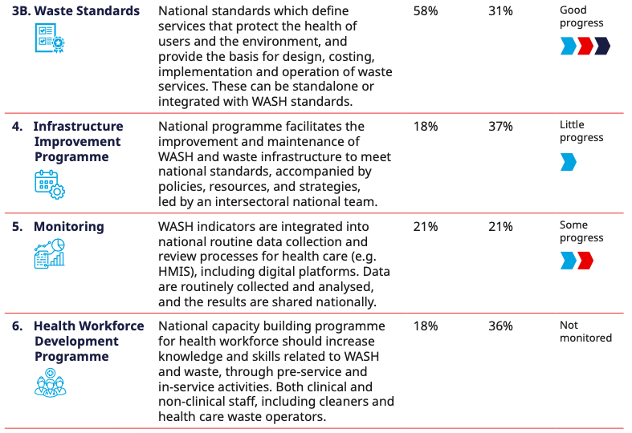
Progress greatest on baselines, standards; least on coordination and at-scale infrastructure improvements

Slide 10
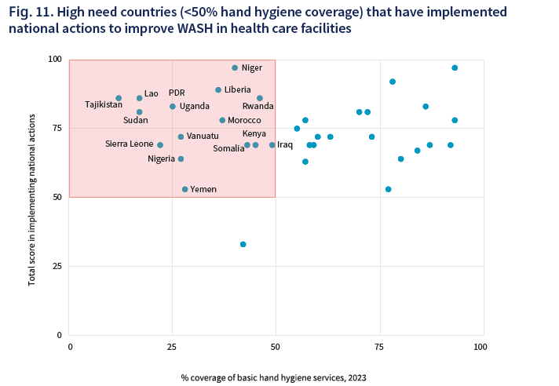
Quick win opportunities to invest in high need countries demonstrating a readiness to implement

Slide 11
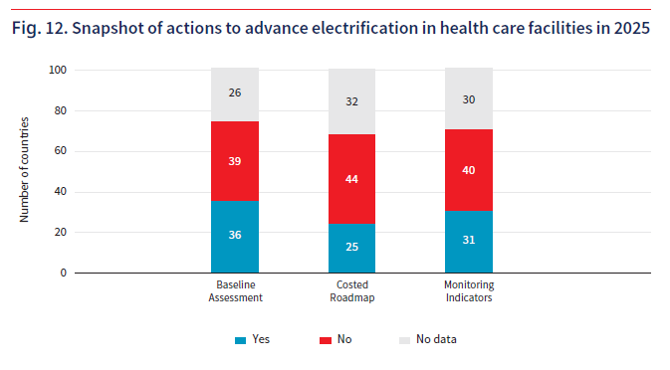
Electrification efforts advancing; need for greater integration

Slide 12
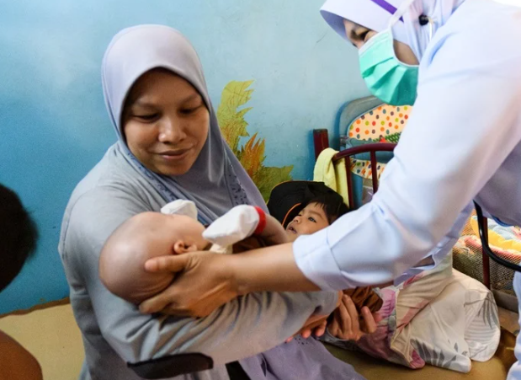
Countries are solving roadblocks, one roadmap at a time
Ethiopia: Roadmap 2025–2035
Aligns with the national Health Sector Transformation Plan, with a strong focus on climate resilience.
Cost over 10 years is US$ 652 million, with the greatest proportion (27%) needed for climate resilient, reliable and safe water supplies.
Half of the needed financing will be leveraged from federal and regional governments, with the remainder coming from development partners (20%) and local government/communities (30%).
Indonesia: Roadmap 2021-2030
Focused on primary health care facilities, addressing seven pillars across system strengthening, capacity building and infrastructure improvement.
Addresses gender and equity through inclusive policy, facility design, and monitoring.
Estimated $500M is needed for targets set out in this Road Map, with 75% of the funding to be leveraged from national, district and provincial government.
See full documents at https://www.washinhcf.org/country-progress-tracker/

Slide 13
Recommendations
Integrate safe and sustainable WASH, waste and electricity into health system programming, financing and implementation
-Finance domestic priorities aligned with country planning and budgets
-Engage in joint advocacy, leadership and planning
-Develop and implement costed and financed roadmaps
2. Regularly monitor and review progress and strengthen accountability
-include indicators in HMIS, review and disseminate data
-regularly report on WASH budgets and expenditures
Develop and empower the health workforce
-support pre and in-service training for clinical and non-clinical staff
-provide clear job descriptions, compensation and safe work environment

Slide 14
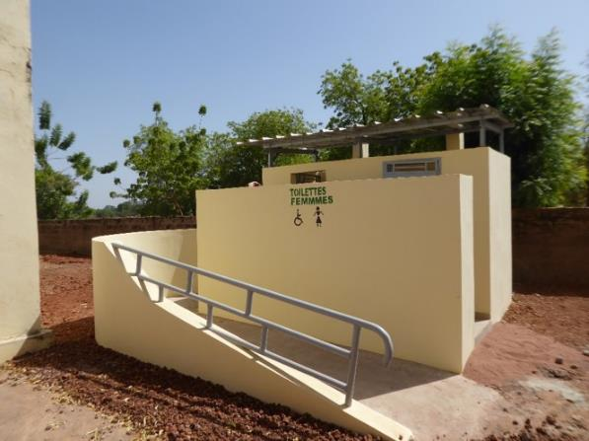
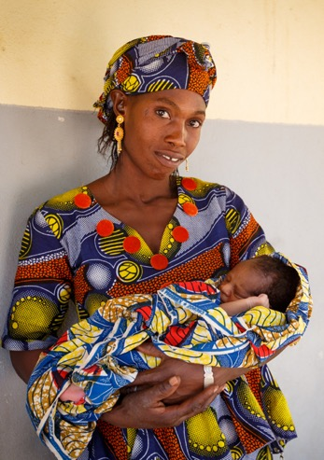
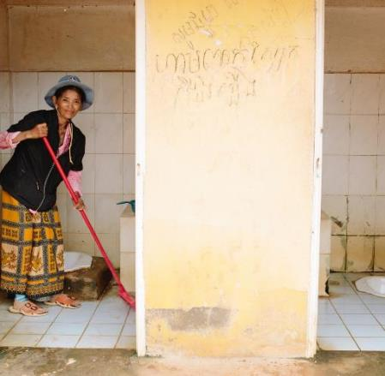
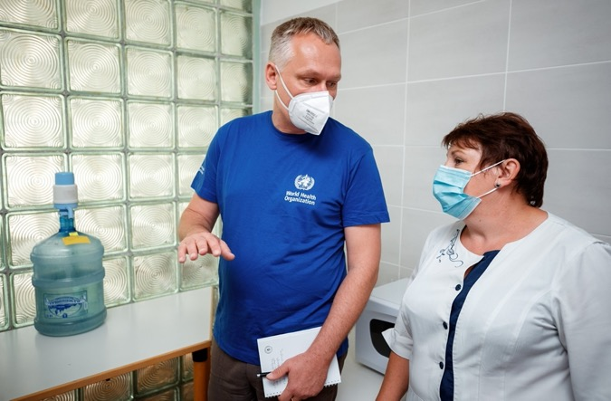
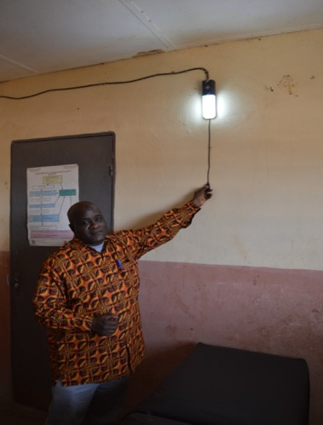
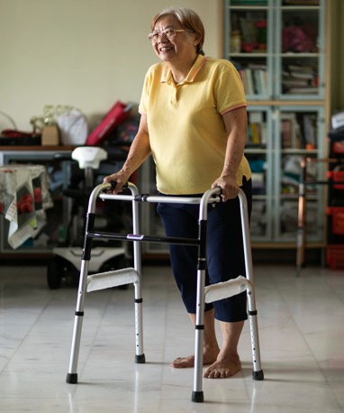

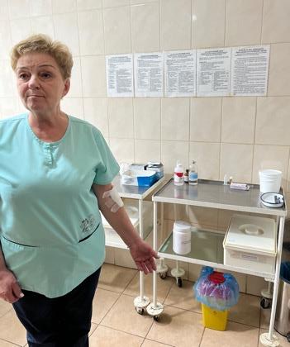
Thank you
WHO/UNICEF knowledge portal:
www.washinhcf.org
WHO/UNICEF Joint Monitoring Programme:
www.washdata.org

Slide 15

Jordan’s Journey: Advancing WASH in Health Care Facilities

Slide 16
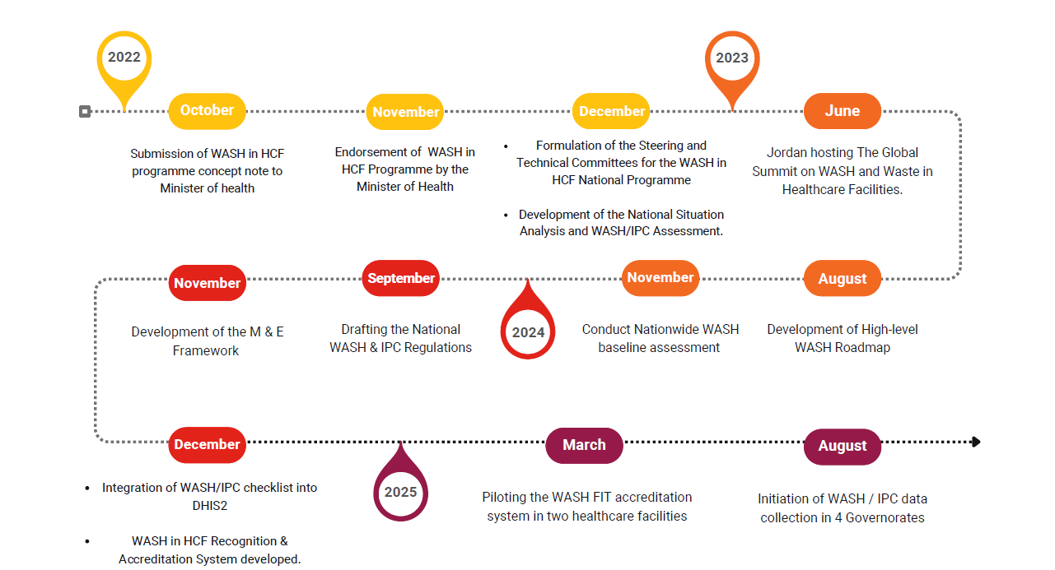

Slide 17
Lessons Learned
Government ownership is critical – Strong MoH leadership, aligned with national priorities , anchored in Steering & Technical Committees, ensures national ownership, sustained financing, and long-term institutionalization.
Partnerships add value – Collaboration & Coordination within MOH and between MOH and stakeholders ensured technical depth, credibility and program legitimacy.
Use of existing systems – Integrating WASH FIT and IPC indicators into DHIS2 provided a single national platform, eliminating parallel reporting and enabling routine monitoring, accountability, and sustainability.
Accreditation as an incentive – Linking WASH/IPC standards to the HCF accreditation system motivated facilities while institutionalizing improvements.
Capacity building matters – Continuous training and coaching of frontline workers and management on WASH, IPC, WASH FIT, Risk Communication and Community Engagement (RCCE) built ownership, equity, and safeguarding into daily practice.
Scaling requires piloting – Piloting WASH FIT–based accreditation in two facilities allows refinement and adaptation, ensuring readiness for national scale-up.

Slide 18

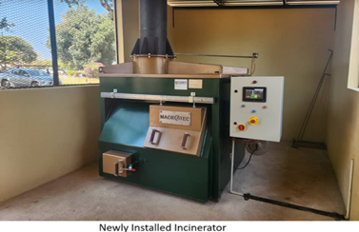
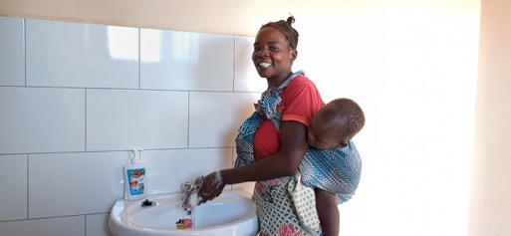
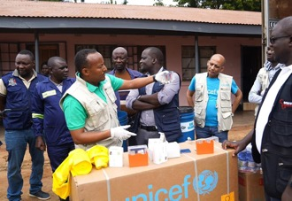
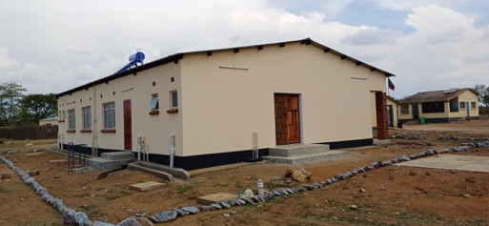
MINISTRY OF HEALTH
Zambia’s Journey Toward Universal WASH in Health Care Facilities
Presenter: Florence Kabinga, Chief Environmental Health Officer

Slide 19

























ZAMBIA’s WASH IN HCFs – 2025 SNAPSHOT
72%
of health care facilities have basic water services
39%
of health care facilities have basic sanitation services
19%
of health care facilities have hand hygiene services at points of care
CURRENT STATUS IN ZAMBIA (2025)*
*These data sets are based on the validated data estimates from the MoH/UNICEF National WASH in HCFs National Workshop held in Kabwe in May 2025 with partners.
42%
of health care facilities have basic health care waste management services
16%
of health care facilities have basic environmental cleaning services
85%
of health care facilities have some form of energy services
BASIC WASH SERVICE ACROSS ALL 5 SERVICE LEVELS
Nationally,
1.02%
Meaning as of 2025, only 32 out of 3134 facilities (including 320 facilities with insufficient data) have access to Basic WASH Services. This is far below the National Target of 70% of HCFs having access to Basic WASH Services by 2026.
of health care facilities have basic WASH services across all service levels
14% of health care facilities failed to achieve basic WASH Services, despite having basic status in water, sanitation, and health care waste management. This is due to their limited or no service status in hygiene and/or environmental cleaning services.
Nationally,
87%
Meaning as of 2025, only 2,782 out of 3,134 facilities (including 320 facilities with insufficient data) have access to Limited WASH Services.
of health care facilities have Limited WASH services across all service levels
In collaboration with WASH in HCFs Partners
NGO
WASH
FORUM
Ministry of Water Development and Sanitation

Slide 20

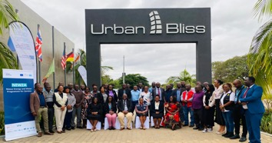
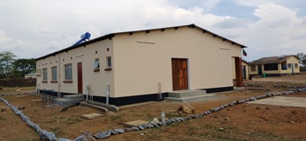

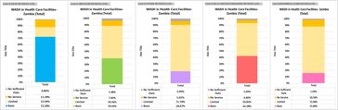
DRIVING CHANGE THROUGH THE 8 PRACTICAL STEPS
Contextualised Standards & Guidelines
National Coordination
Infrastructure Improvements and Capacity Building
Baseline Assessment/ Data
Situational Analysis, Roadmap & Targets
Following the WHA Resolution, Zambia decided to start with the development of contextualized Standards to guide Service levels.
Reactivated the National WASH in HCFs TWG to engage Partners, coordinate efforts and track progress
Government Commitment to improve the WASH infrastructure to meet National Standards.
Government-led assessment data to inform priority setting & resource mobilization.
Currently working on the SitAn and Costed Roadmap to inform Advocacy, investment, and resource needs.
WASH and Waste Standards in HCFs 2021
Minimum standards for WASH/IPC in HCFs 2018
WASH/IPC Guidelines & SOPs 2018
WASH and Waste Standards in HCFs 2021
Laboratory Waste Management Guidelines 2024
TWG meets regularly, Q3 is on the 8th of October 2025
Annual WASH in HCFs Workshop/ Learning Event is done
Partner Mapping completed to guide coordinated action
Presidential Directive in place
Inclusive Designs available for the different levels of HCFs
Institutionalization of WASHFIT to determine required improvement (527 facilities trained)
District Level Mentorship
Using Existing Health Structures at Sub Sub-National Level, Conducted a Nationwide Data Assessment
Integration of WASH in HCFs Indicators into DHIS2 for monitoring HMIS on a quarterly basis (pending pilot)
Engaged a Consultant to Support with the development of the SitAn and Costed Roadmap for WASH in HCFs
In collaboration with WASH in HCFs Partners
NGO
WASH
FORUM
Ministry of Water Development and Sanitation

Slide 21

Next Steps- Accelerating Zambia’s WASH Agenda
Costed Roadmap
Finalise and Launch Roadmap
Integrate Emergency Preparedness & Response
Evidence-based advocacy for WASH in HCFs financing
Data
Finalise and Publish Baseline Report
Pilot Indicators in DHIS2 to create Dashboard in HMIS
Adapt WASH FIT across all Facilities
Coordination & Improvements
Coordinated action among implementing and funding partners targeting the 87% of HCFs with Limited Services (Especially non-infrastructure investments)
In collaboration with WASH in HCFs Partners
NGO
WASH
FORUM
Ministry of Water Development and Sanitation

Slide 22
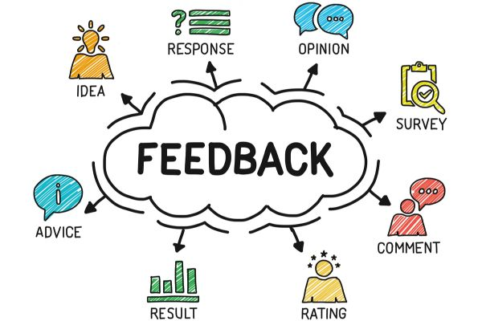

Slide 23

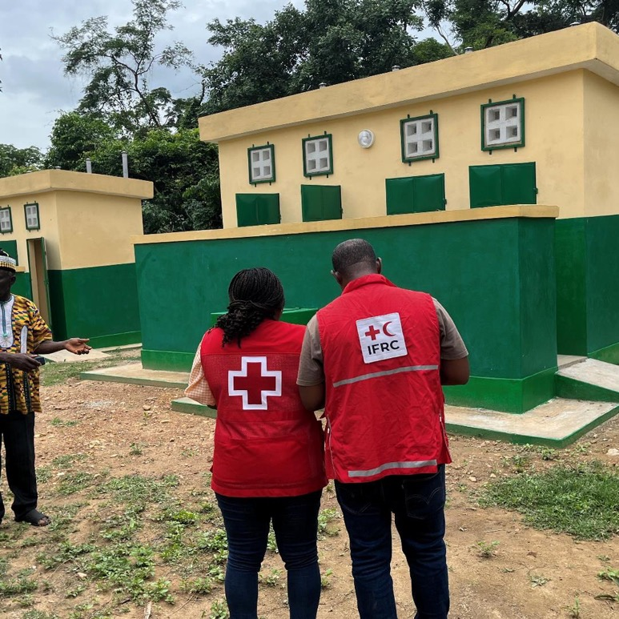
Sanitation work in health and care facilities:
TRC/IFRC
WASH-IsDB Project Togo

Slide 24
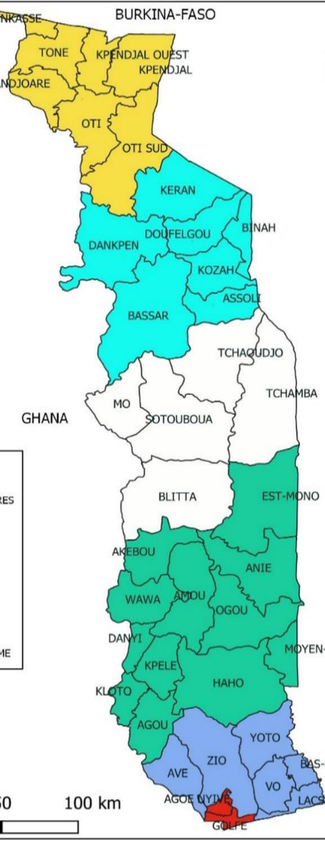
Context
Access to WASH services remains limited in Togo
  19.6% access to drinking water: (urban 36.8%, rural 6.6%)
  9.1% access to household sanitation services (Urban12,3%; Rural 6,7% ) (2020)
  45% practised open defecation
  Infant mortality rate 64,4 ‰ in 2023
TRC placed an emphasis on WASH activities, especially in HCF (strategic plan 2022-2026)
In 2023, the Government of Togo secured a USD 14 million loan from the IsDB for WASH.
  Of this, USD 4 million was allocated through IFRC as a grant to the TRC to implement sanitation-related activities over three years

Slide 25
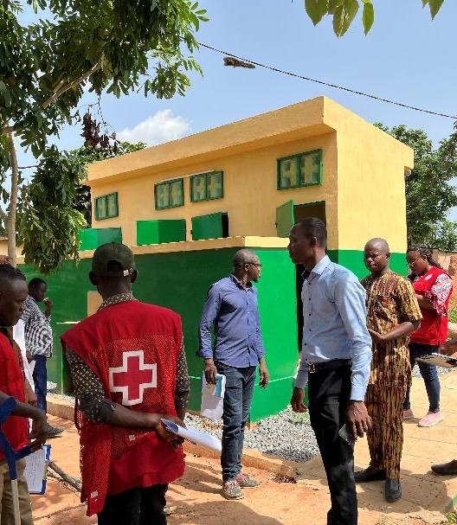
Current Approach
Objective: Improve sanitation infrastructure in health and care facilities in 4 districts
Direct beneficiaries: 49’000 people
Main project activities:
  Construction of standardized and inclusive latrine blocks adapted to facility needs
  Needs assessment in 47 health facilities
  Development of technical designs & cost estimates
  Strong multi-stakeholder coordination (MoH, Ministry of Water, IFRC, CRT)
  Partnership with 7 selected construction firms

Slide 26
What we have done so far
Infrastructure Development
42 blocks 4-cabin inclusive completed and handed over (56 planned)
14 blocks currently under construction
project implementation
Deployment of TRC project team support by IFRC staff
Quality Assurance
Continuous technical supervision (MoH engineers + project staff)
Joint monitoring missions (MoH, Ministry of Water, IFRC, CRT)
High-level field visits (IFRC Cluster Abuja, CRT leadership)
Capacity building for 314 local volunteers on CLTS-PHAST approach and CEA
Hygiene promotion activities with 36,627 people reach at date
4 incinerators built (Montfort-type )
with Swiss CR (2022-2025)
Real-time monitoring through digital tools
4 autonomous water station with solar system
With IsDB project (2024-2027)

Slide 27
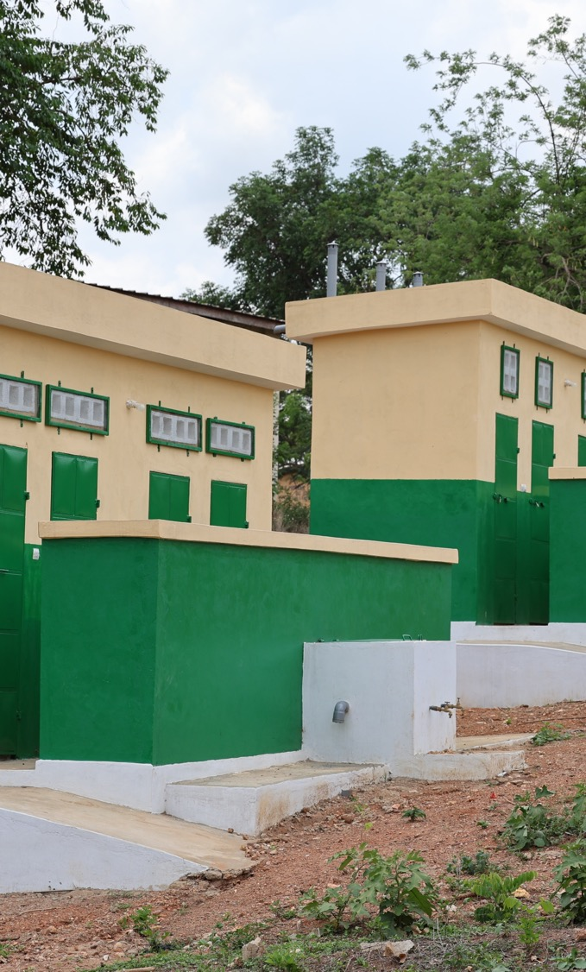
Our Future Plans
Completion of Works:
  Deliver remaining 14 latrine blocks
  Ensure proper handover & functionality
Sustainability:
  Set up operation and maintenance systems with facility staff
  Continue hygiene promotion activities
Scaling Up:
  Advocate for more latrines in underserved facilities
  Integrate innovations (inclusive designs, handwashing stations)
Monitoring, Evaluation and Learning:
  Document best practices
  Plan joint monitoring missions
  Share lessons-learnt at national/regional level

Slide 28
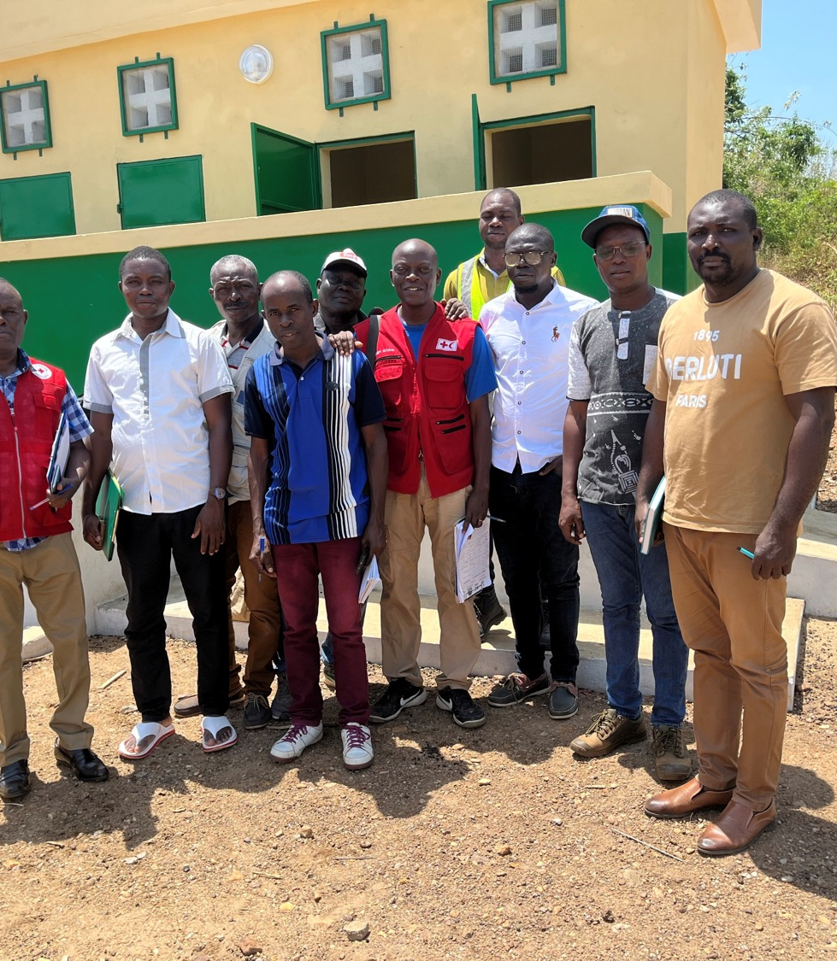
Conclusion
75% of targets already achieved
Strong coordination between partners (Togolese government, IFRC & TRC)
Focus on sustainability, inclusivity & scale up of interventions
Commitment to safer and healthier health facilities

Slide 29
Thank you
Merci

Slide 30
Key moments and upcoming opportunities
Global Strategic Network
  Next meeting November 2025 focus on partnerships and implementation
  Investing in sub-set of “champion countries” ready to implement
Ongoing WASH FIT and waste implementation
  WHO academy course, WASH FIT drop-in sessions on water quality, digitization, waste
  New advanced course on health care waste management
Streamline and amplify in key health, WASH, energy and climate efforts
  UN Water Meetings in Senegal (Dec 2025) and beyond
  UHC (Japan Nov 2025)
  COP 30 (Brazil Nov 2025)

Slide 31
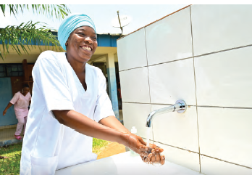
What you can do!
Read the report, share and influence others
  Full report, executive summary, social media tiles
Get in engaged
  Subscribe to newsletter, participate in online events, complete WASH FIT course
Support scaling-up and collaborative actions on WASH, waste and electricity
  Use data to guide understanding and actions
  Take action to integrate with health, energy, climate at country level
Download the report: https://iris.who.int/handle/10665/382860
Service level data portal (JMP): www.washdata.org
Global knowledge portal: www.washinhcf.org

